Slide 1
Welcome

Slide 2
HELLO!
I am Jayalakshmi
I am here to explain about Testing

Slide 3

TESTING

Slide 4
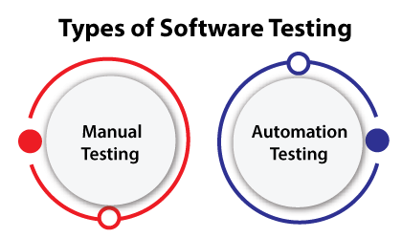
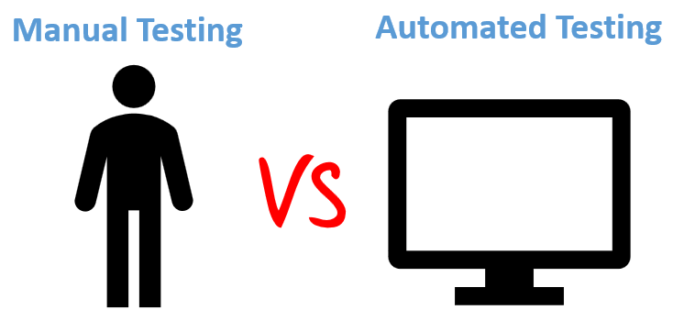

Slide 5
Manual Testing
Manual testing is the process of identifying bugs and defects in software without the help of software testing automation tools. In this procedure, QA manual testers execute test cases manually while considering the end user’s perspective.

Slide 6
Why we need manual testing
Whenever an application comes into the market, and it is unstable or having a bug or issues or creating a problem while end-users are using it.
If we don't want to face these kinds of problems, we need to perform one round of testing to make the application bug free and stable and deliver a quality product to the client, because if the application is bug free, the end-user will use the application more conveniently.
If the test engineer does manual testing, he/she can test the application as an end-user
perspective and get more familiar with the product, which helps them to write the correct
test cases of the application and give the quick feedback of the application.

Slide 7
Advantages of Manual Testing
It is excellent for accurate user interface testing.
Software testers don’t need to rewrite the entire to resolve quick fixes in the application.
Manual testing is less extensive and has a smaller immediate cost when compared to automated testing.
Manual testing can help us replicate the accurate user experience both mobile and apps.
It is easier to resolve extremely complex test cases by manual testing rather than automated testing.

Slide 8
Disadvantages of Manual Testing
Manual Testing is time-consuming mainly while doing regression testing.
Manual testing is less reliable compared to automation testing because it is conducted by humans. So there will always be prone to errors and mistakes.
Expensive over automation testing in the long run.

Slide 9
Automation Testing
Automation testing is a process of changing any manual test case into the test scripts by using automation testing tools, and scripting or programming language is called automation.
Automation testing is used to increase the efficiency, effectiveness, and coverage of Software testing.
Automation test engineer uses automation testing tools to automate the manual design test cases without any human interference.
And these testing tools can control the execution of tests, access the test data, and compares the actual result against the expected result.

Slide 10
Advantages of Automation Testing
Automated testing provides round the clock coverage as automated tests can be run all time in 24*7 environment.
Automated testing takes far less resources in execution as compared to manual testing.
It helps to train the test engineers to increase their knowledge by producing a repository of different tests.
Automated testing has less chances of error hence more reliable.
As with automated testing test engineers have free time and can focus on other creative tasks.

Slide 11
Disadvantages of Automation Testing
Automated testing is very much expensive than the manual testing.
It also becomes inconvenient and burdensome as to decide who would automate and who would train.
It has limited to some organisations as many organisations not prefer test automation.
Automated testing only removes the mechanical execution of testing process, but creation of test cases still required testing professionals.

Slide 12
Types of Testing
There are many different types of testing.
Many of these types of testing can be done manually — or they can be automated.

Slide 13
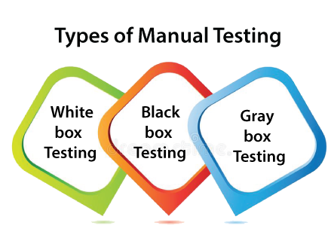

Slide 14
White-box testing:-
The white box testing is done by Developer, where they check every line of a code before giving it to the Test Engineer. Since the code is visible for the Developer during the testing, that's why it is also known as White box testing.
Black box testing:-
The black box testing is done by the Test Engineer, where they can check the functionality of an application or the software according to the customer /client's needs. In this, the code is not visible while performing the testing; that's why it is known as black-box testing.
Gray Box testing:-
Gray box testing is a combination of white box and Black box testing. It can be performed by a person who knew both coding and testing. And if the single person performs white box, as well as black-box testing for the application, is known as Gray box testing.

Slide 15
Manual vs Automated Testing
Manual Testing | Automated Testing
Manual testing is not accurate at all times due to human error, hence it is less reliable. | Automated testing is more reliable, as it is performed by tools and/or scripts.
Manual testing is time-consuming, taking up human resources. | Automated testing is executed by software tools, so it is significantly faster than a manual approach.
Investment is required for human resources. | Investment is required for testing tools.
Manual testing is only practical when the test cases are run once or twice, and frequent repetition is not required. | Automated testing is a practical option when the test cases are run repeatedly over a long time period.
Manual testing allows for human observation, which may be more useful if the goal is user-friendliness or improved customer experience. | Automated testing does not entail human observation and cannot guarantee user-friendliness or positive customer experience.

Slide 16
THANKYOU!

