Slide 1

IBM Project Presentation on “Develop an application to facilitate IPR filing for the grassroots community. ”
By
Group ID: G43
Under the guidance of
Institute of Computer Technology, Ganpat University
Date: 08 April 2023
Name | Enrolment Number
Rishabh Patel (CS) | 19162171034
Patel Sahil (CS) | 20162172007
Patel Smit Ramanlal (BDA) | 19162121031

Slide 2
Problem Statement
Industrial properties include patents or inventions, trademarks, trade names, biodiversity, plant breeding rights and other commercial interests.
Scope
The scope of IP rights is broad; two classification modes are used to determine whether IP is copyright or Industrial Property. Industrial properties include patents or inventions, trademarks, trade names, biodiversity, plant breeding rights and other commercial interests. A patent gives its holder the exclusive right to use the Intellectual Property for the purposes of making money from the invention.

Slide 3
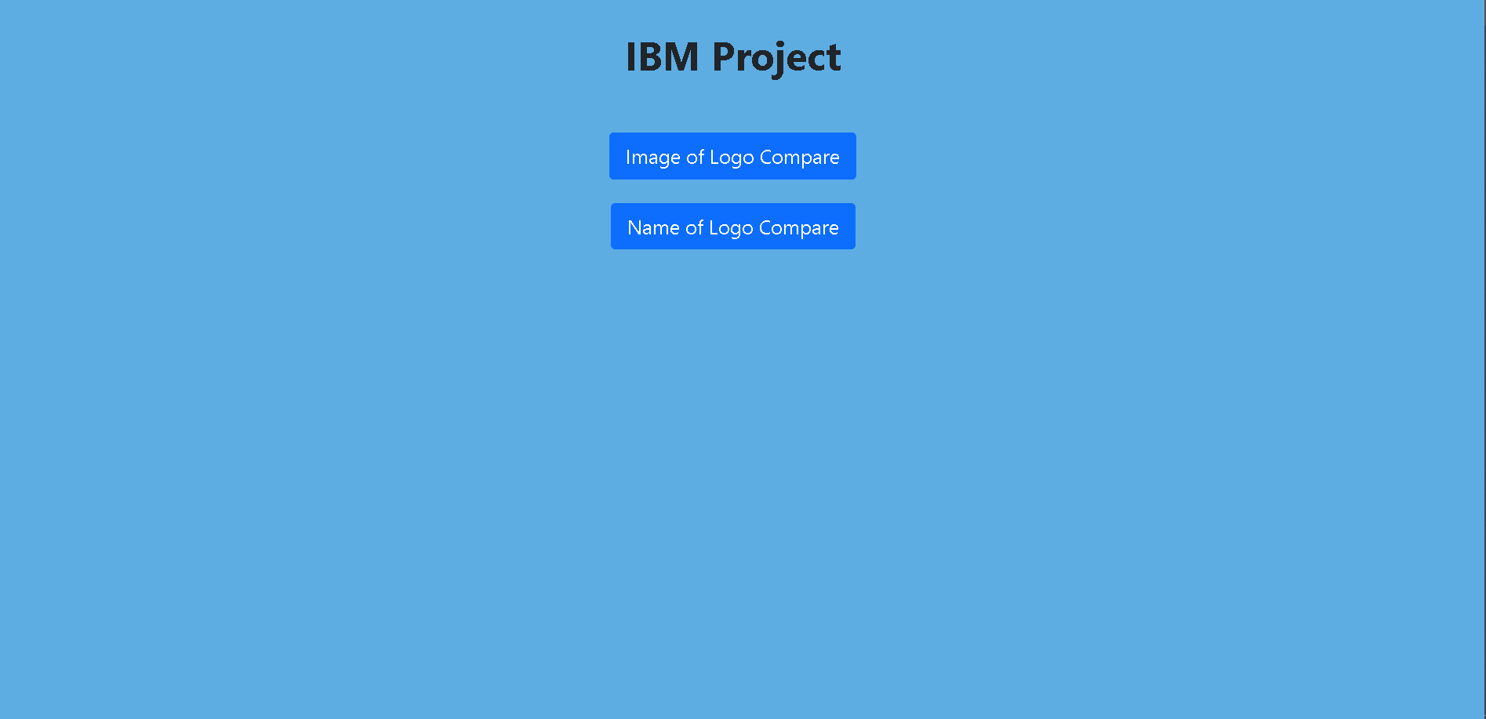

Slide 4
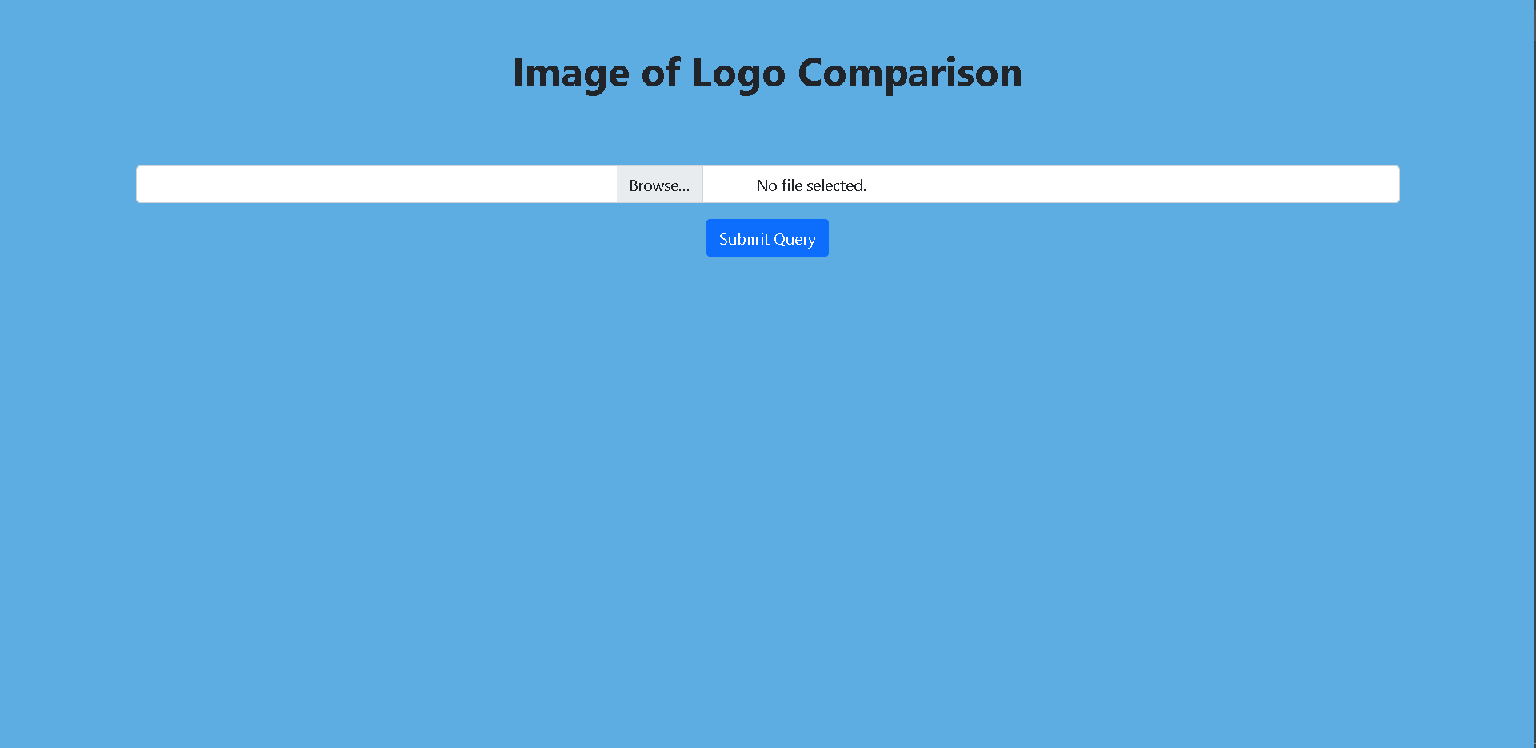
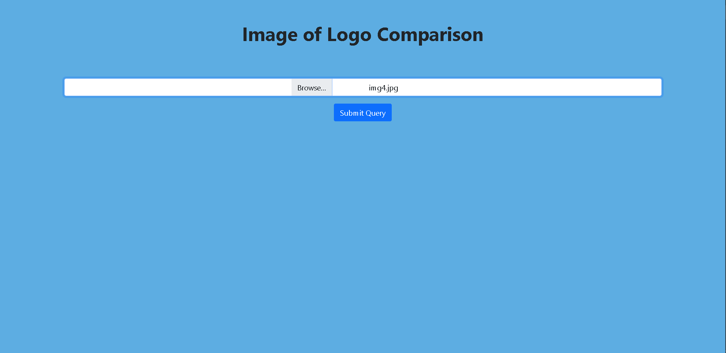

Slide 5

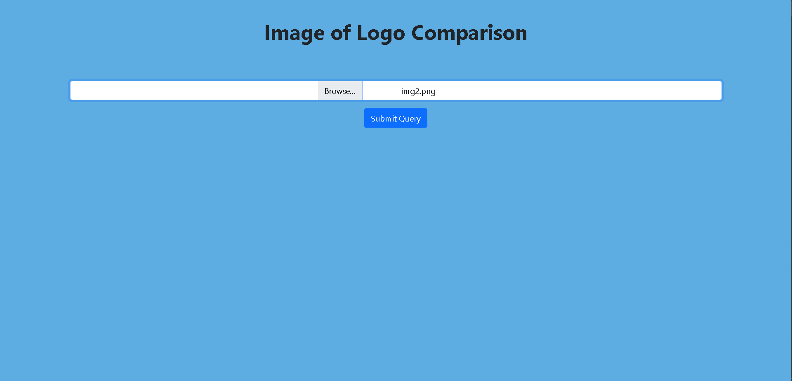

Slide 6
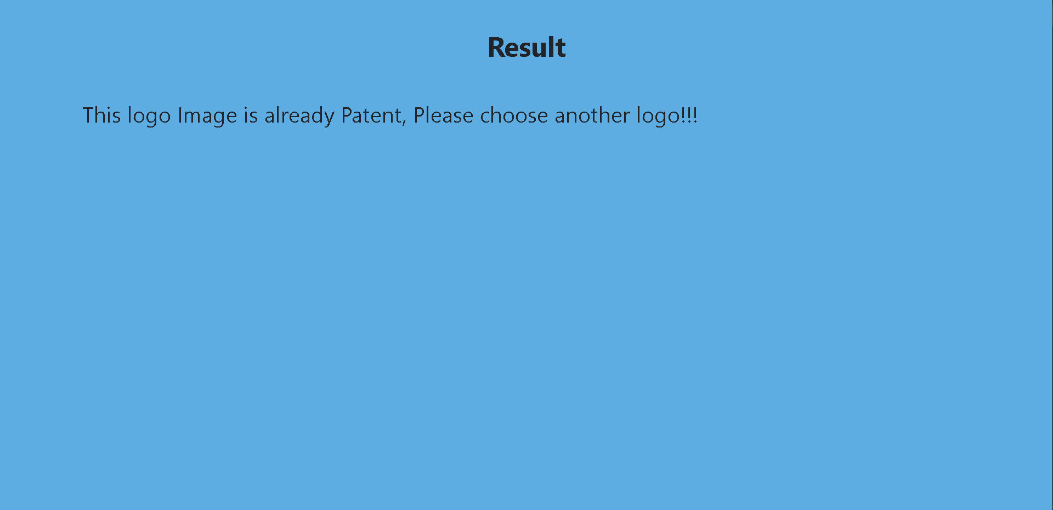
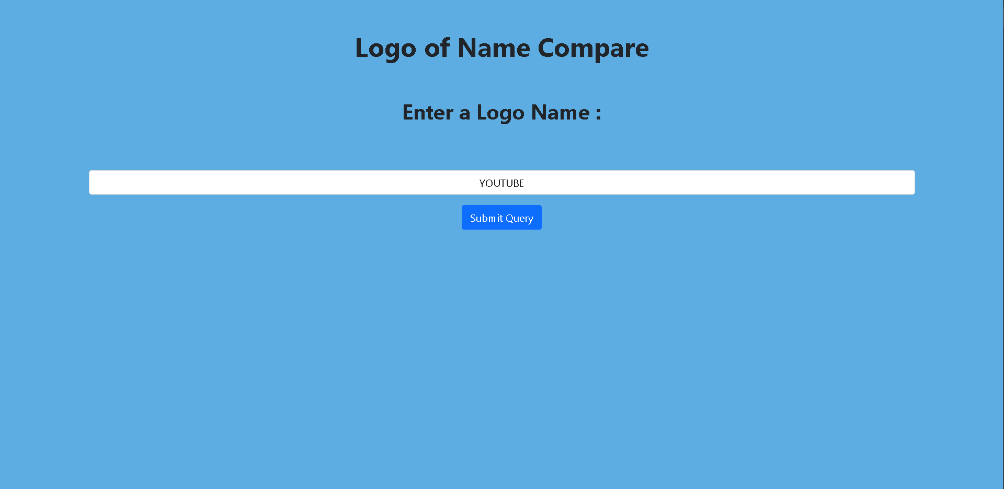

Slide 7
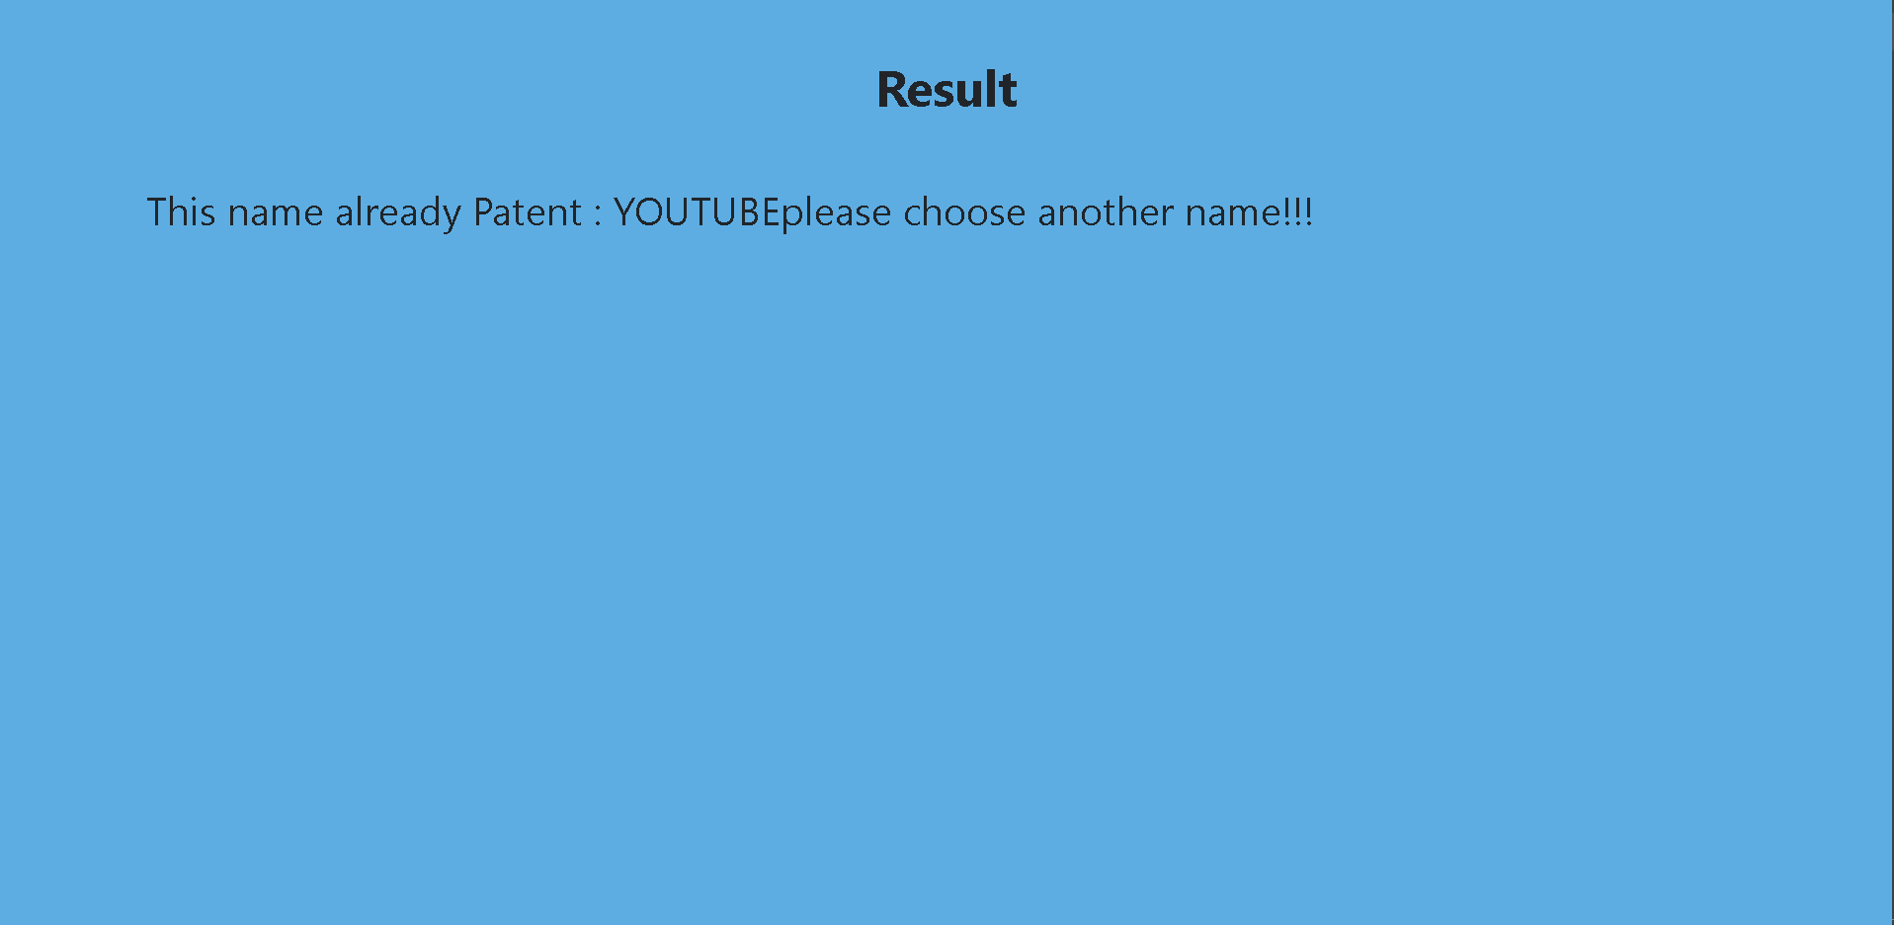
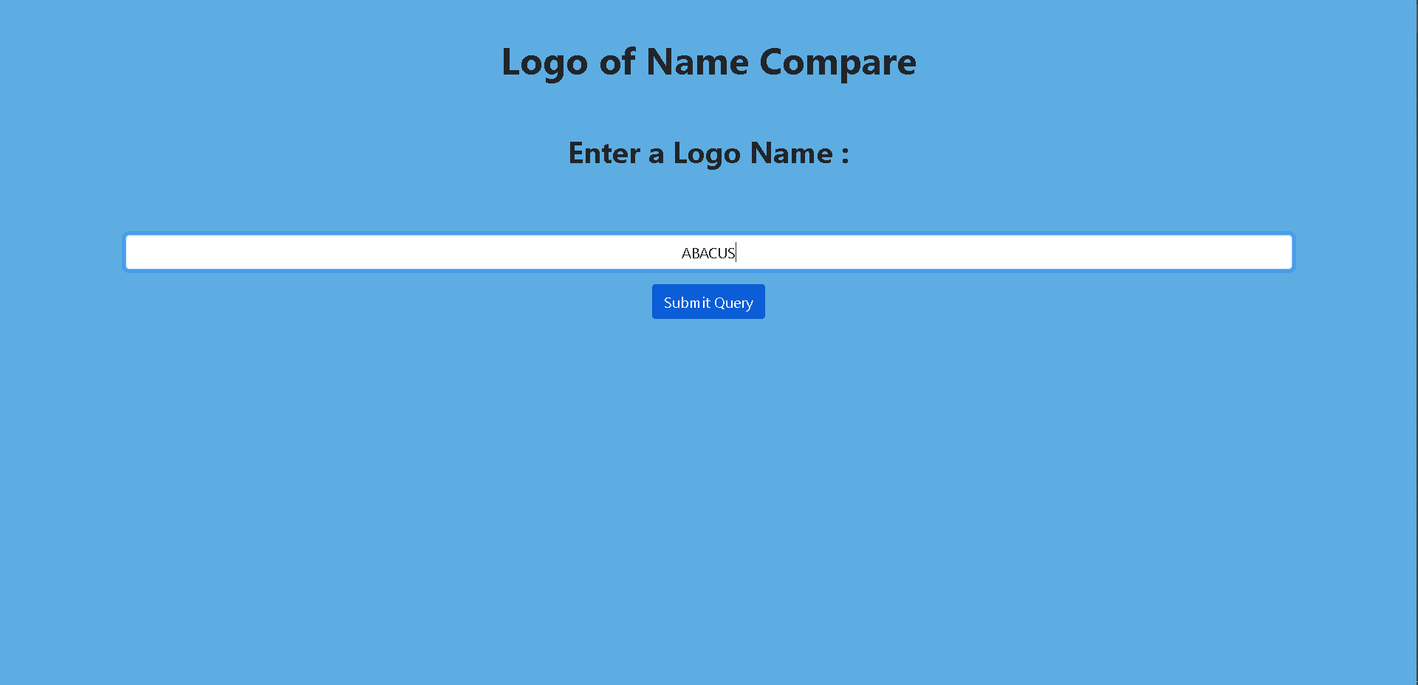

Slide 8
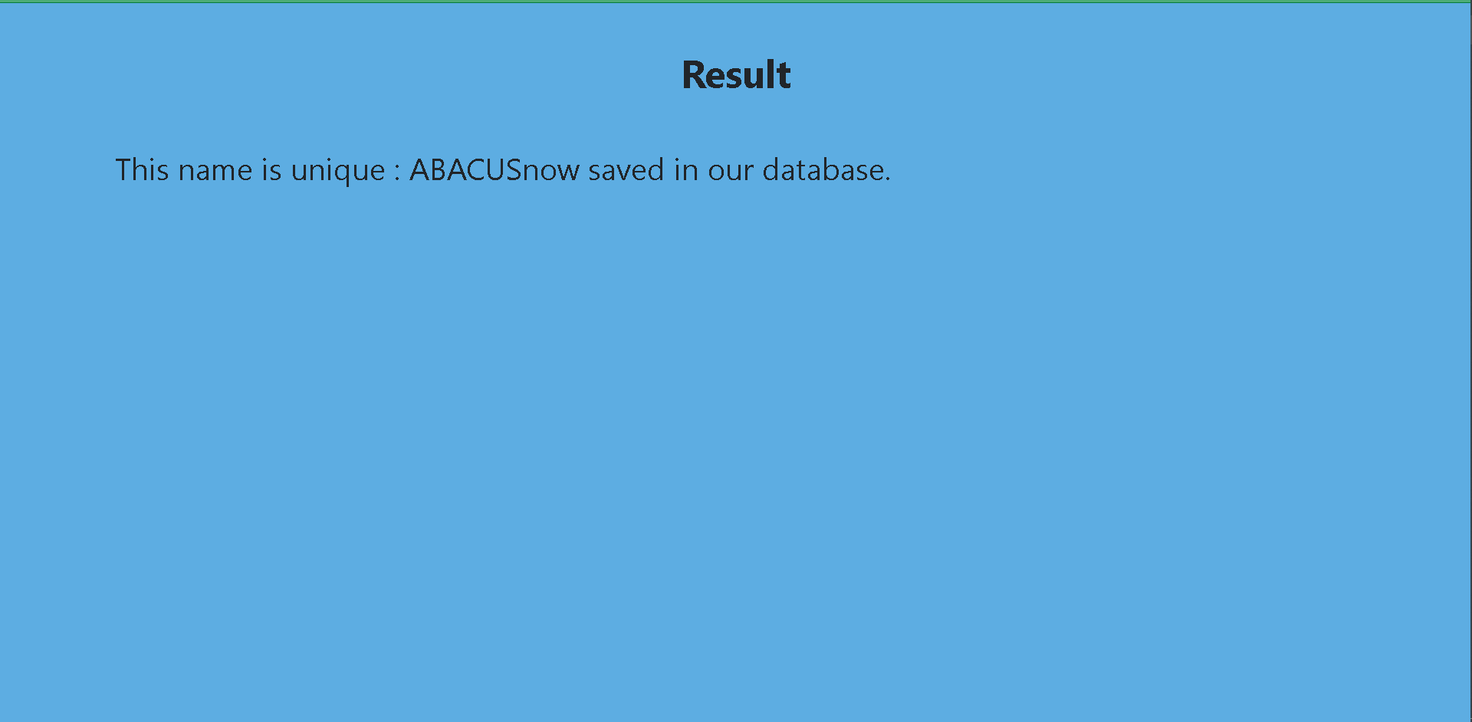

Slide 9
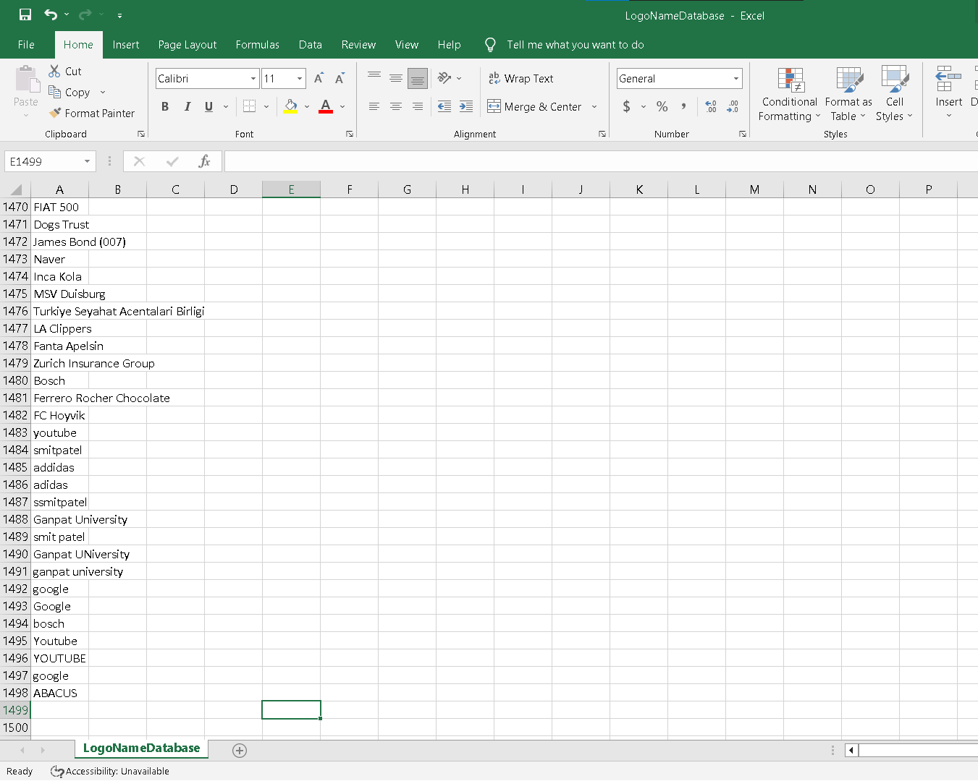

Slide 10
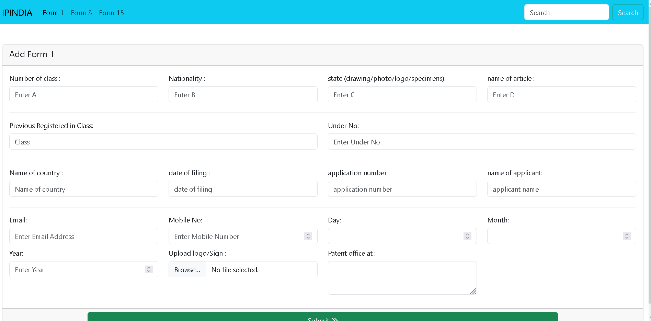

Slide 11
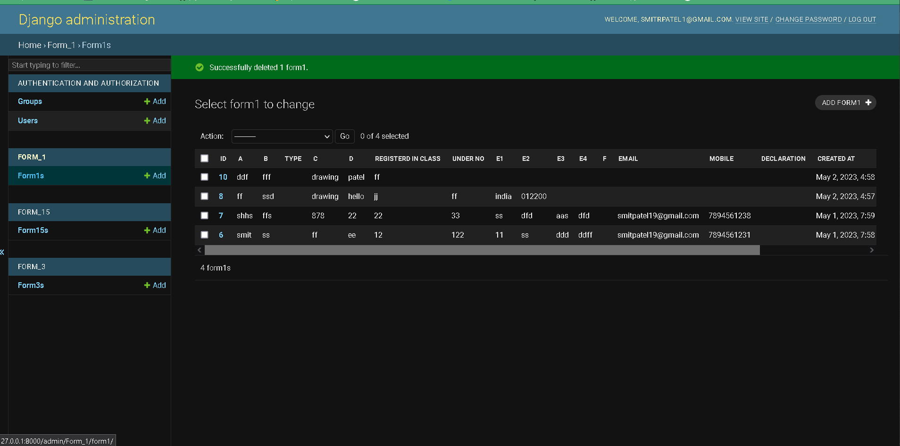

Slide 12
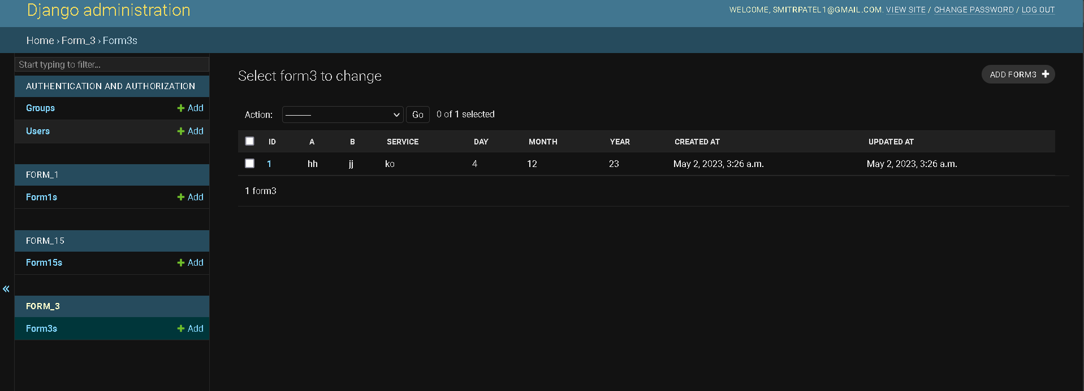

Slide 13
For Creating a webpage using django
Install Django: You can install Django using pip, the package manager for Python. Open a terminal and enter the following command: pip install Django
Create a Django project: Use the following command to create a new Django project: django-admin startproject projectname
Create a Django app: Django projects are made up of one or more apps. To create an app, use the following command:python manage.py startapp appname
Define URL patterns: In the app directory, create a file named urls.py and define URL patterns for the app.
Define views: In the app directory, create a file named views.py and define views for the app.
Create templates: In the app directory, create a directory named templates and create HTML templates for the app.
Configure settings: In the project directory, open the file settings.py and configure the project settings, including the installed apps, database settings, and static and media file locations.
Run the development server: Use the following command to run the development server:python manage.py runserver
Access the webpage: Open a web browser and go to http://localhost:8000/ to view the webpage.

Slide 14
What is Wazuh
Wazuh is an open-source security platform that provides threat detection, visibility, and compliance management capabilities for organizations. It is based on the ELK stack (Elasticsearch, Logstash, and Kibana) and incorporates the powerful security capabilities of the OSSEC Host-based Intrusion Detection System.
Wazuh provides a centralized platform for security monitoring and incident response, with features such as log analysis, file integrity monitoring, vulnerability detection, and threat detection. It can collect and analyze data from multiple sources, including network traffic, system logs, and endpoint agents.
Wazuh also provides real-time alerting and notification capabilities, enabling security teams to respond quickly to potential threats. In addition, Wazuh includes a set of compliance management tools to help organizations meet regulatory requirements such as PCI DSS, HIPAA, and GDPR.

Slide 15
Created Login page for backed side
After login CA admin panel can be seen
We will get 3 different types of form
CA admin will have groups , user functionality
Forms can be filled from frontend
After admin access forms details can be changed

Slide 16
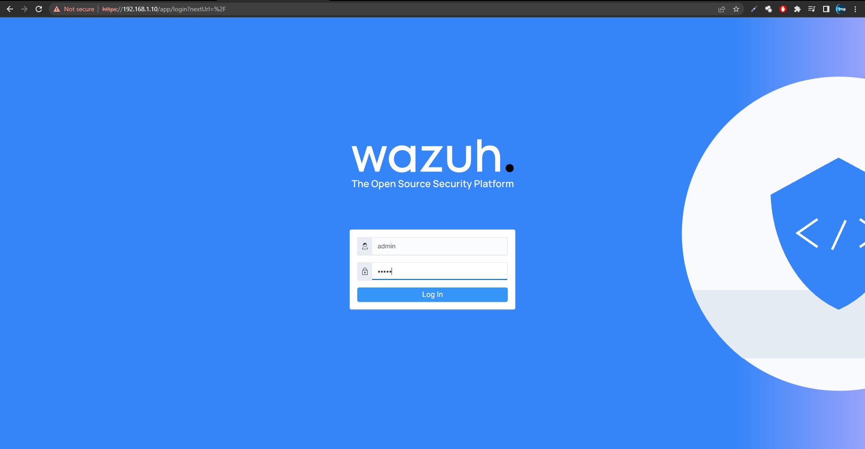

Slide 17
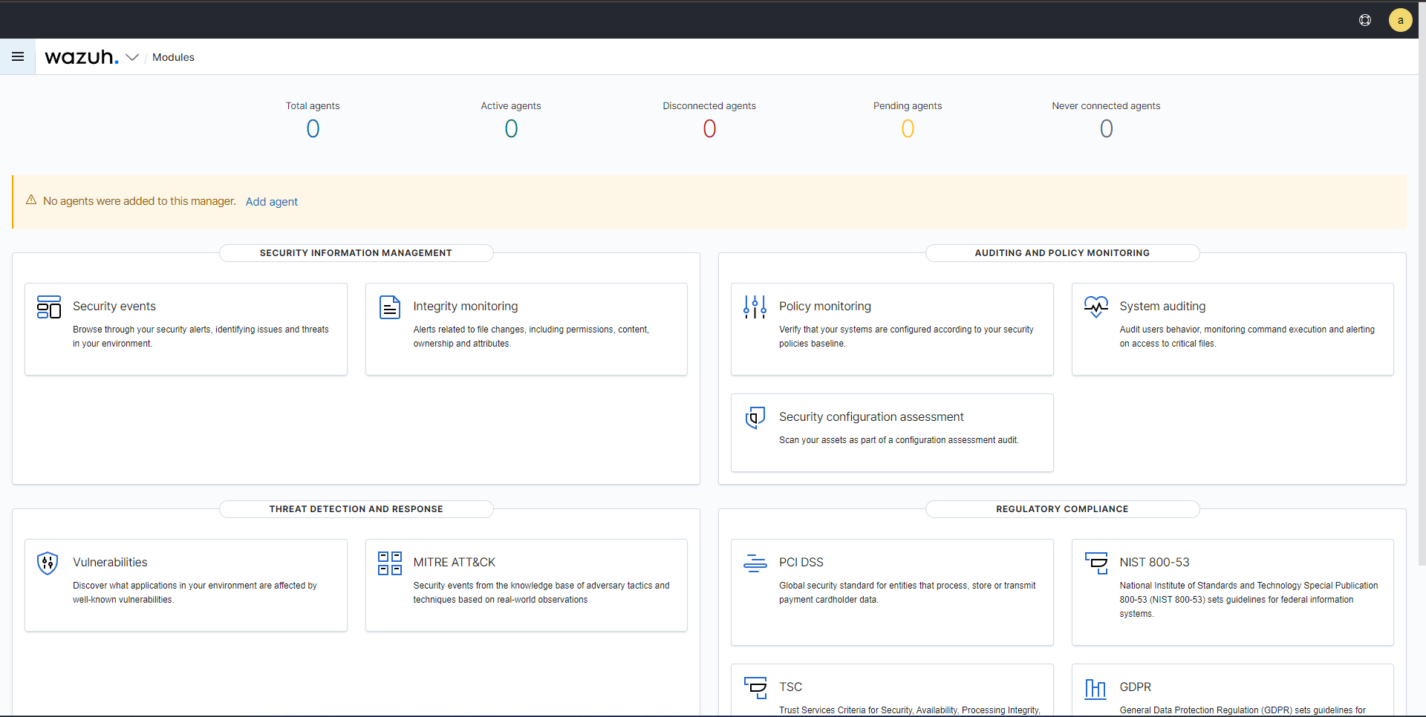

Slide 18
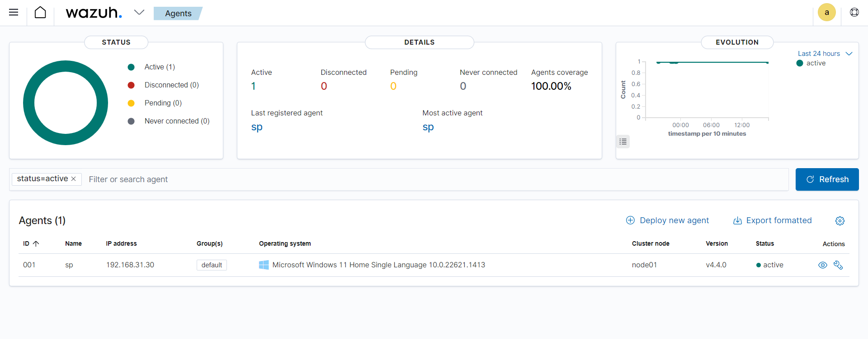

Slide 19
Recommended Tools & Technologies
Database: MySql
Backend: Python-Django+Flask
SIEM tool: Wazuh
Frontend: Python-Django

Slide 20
References
https://www.ipindia.gov.in/
https://www.ncbi.nlm.nih.gov/pmc/articles/PMC3217699/
https://www.ies.gov.in/pdfs/why-India-needs-to-urgently-invest-in-its-IPR-ecosystem-16th-Aug-2022.pdf
http://www.sric.iitkgp.ac.in/docss/iitkgpipguide.pdf

Slide 21
Thank You !!

