Slide 1

Insert Video Here
(mandirsync-logo.mp4)
MandirSync
Integrated Temple Management Software
Simplifying Seva, Accounting & Administration
"Sacred workflows, simplified."

Slide 2
Insert Video Here
(mandirsync-logo.mp4)
MandirSync
Integrated Temple Management Software
Simplifying Seva, Accounting & Administration
"Sacred workflows, simplified."

Slide 3
MandirSync
What is MandirSync?
Purpose-built temple management software for Indian temples of all sizes.
Integrates Donations, Sevas, Accounting, Inventory, Assets & Panchang in one system.
Designed for transparency, audit-readiness, and operational efficiency.
Available as SaaS (cloud) or Standalone (on-premise) deployment.

Slide 4
MandirSync
Challenges in Temple Administration
Fragmented records: Manual ledgers, Excel sheets, loose parchis.
Lack of audit trail for donations, sevas, inventory, and assets.
Difficulty reconciling donation counters, UPI collections, and bank.
No integrated view of seva bookings, CWIP, assets, and depreciation.
Time-consuming preparation of reports for trustees, donors, auditors.
Bottom line: MandirSync converts all of this into a single, reliable system.

Slide 5
MandirSync
MandirSync – Major Modules
Devotees & Donations (Mobile-first entry)
Sevas & Token Sevas (Pre-printed tokens, reconciliation)
Accounting & Reports (Double-entry, Auditors view)
Inventory Management (Store wise, consumption)
Asset Management & Depreciation (CWIP, Gold, Land)
Panchang (Optional)

Slide 6
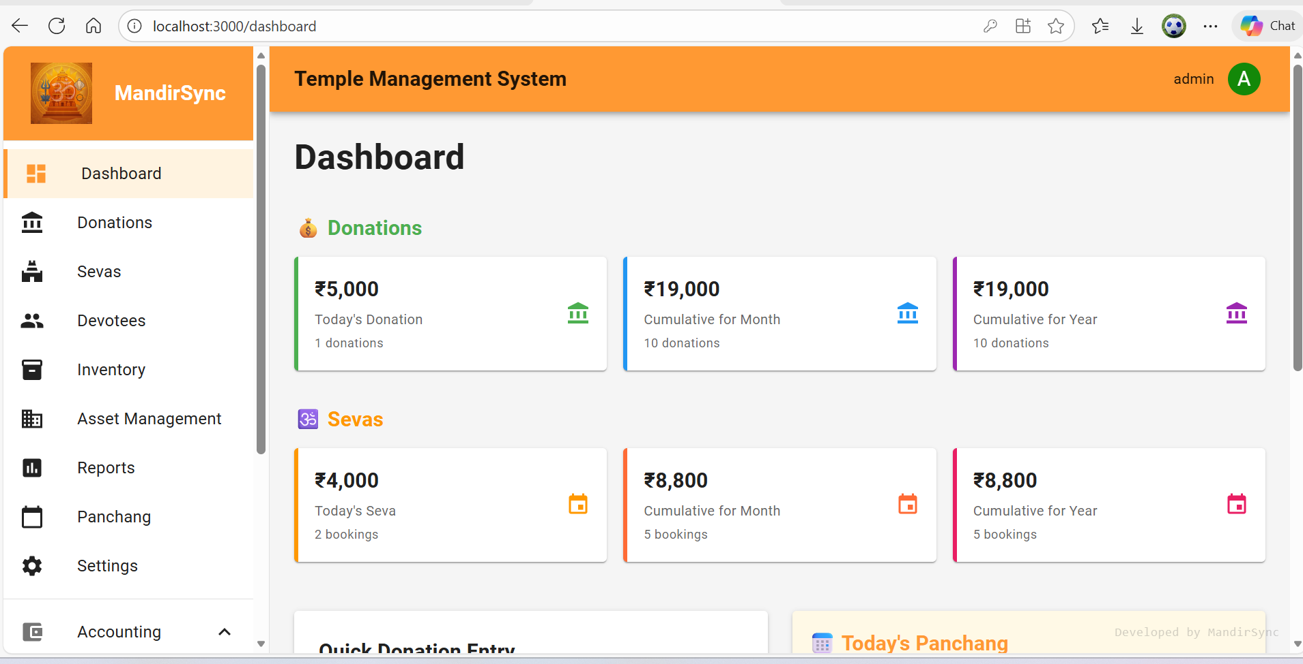
MandirSync
MandirSync – Major Modules

Slide 7
MandirSync
Devotee & Donation Management
Devotee master with mobile-first search and auto-fill.
Fast Quick Donation Entry from dashboard.
Auto-fill address from PIN code (city, state, country).
Consolidated accounting: 4100 – Donation Income (Main).
Multiple modes: cash, UPI, bank, with clear tracking.
Highlight: Reduces counter time and improves data quality.

Slide 8
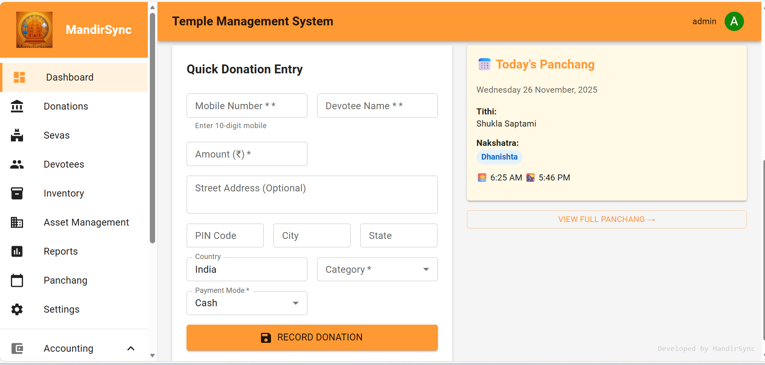
MandirSync
MandirSync – Major Modules
Category pf donation is Configurable as per the temples requirement. Once the donation is recorded, accounting entry automatically passed.

Slide 9
MandirSync
Seva Management & Token Sevas
Seva master: timings, capacity, approvals, priests, pricing.
Seva booking with mobile-based devotee lookup & PIN code auto-fill.
Token Seva system: Color-coded pre-printed tokens for small-value sevas.
Controlled serial numbers and reconciliation.
Accounting consolidation: 4200 – Sevas – Main.
Emphasize internal control and audit-friendliness.

Slide 10
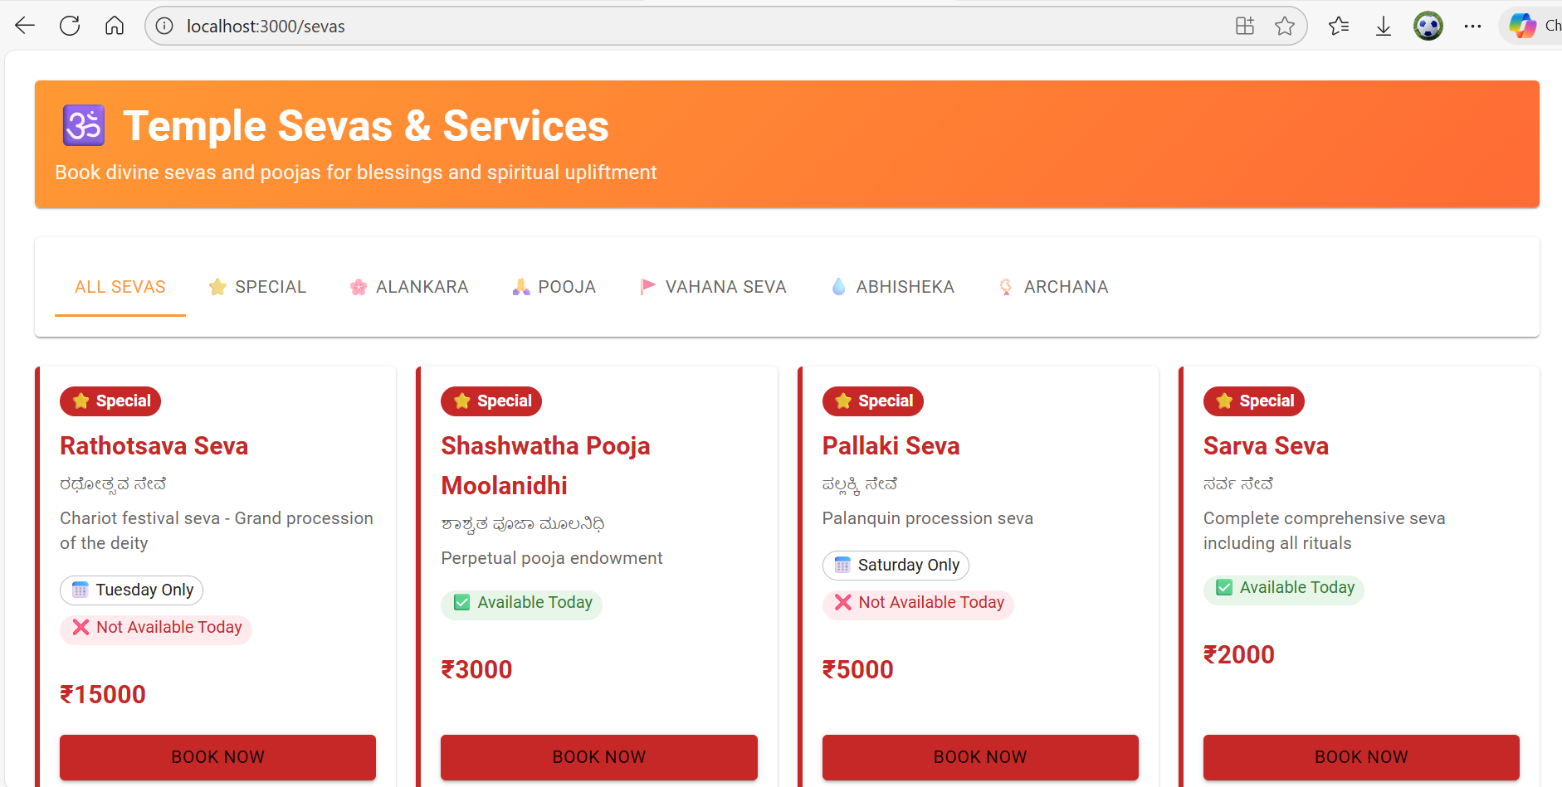
MandirSync
Seva Management & Token Sevas
Configurable as per the temples requirement. Once the seva is recorded, accounting entry is
Entry is automatically passed.

Slide 11
MandirSync
Integrated Accounting Engine
Full double-entry bookkeeping with Chart of Accounts.
Automatic journal entries for Donations, Sevas, Inventory, Assets.
Handling of CWIP capitalization, depreciation, revaluation.
Trial Balance shows short list of main accounts with drill-down.
Designed with auditors in mind – traceable, consistent, exportable.

Slide 12
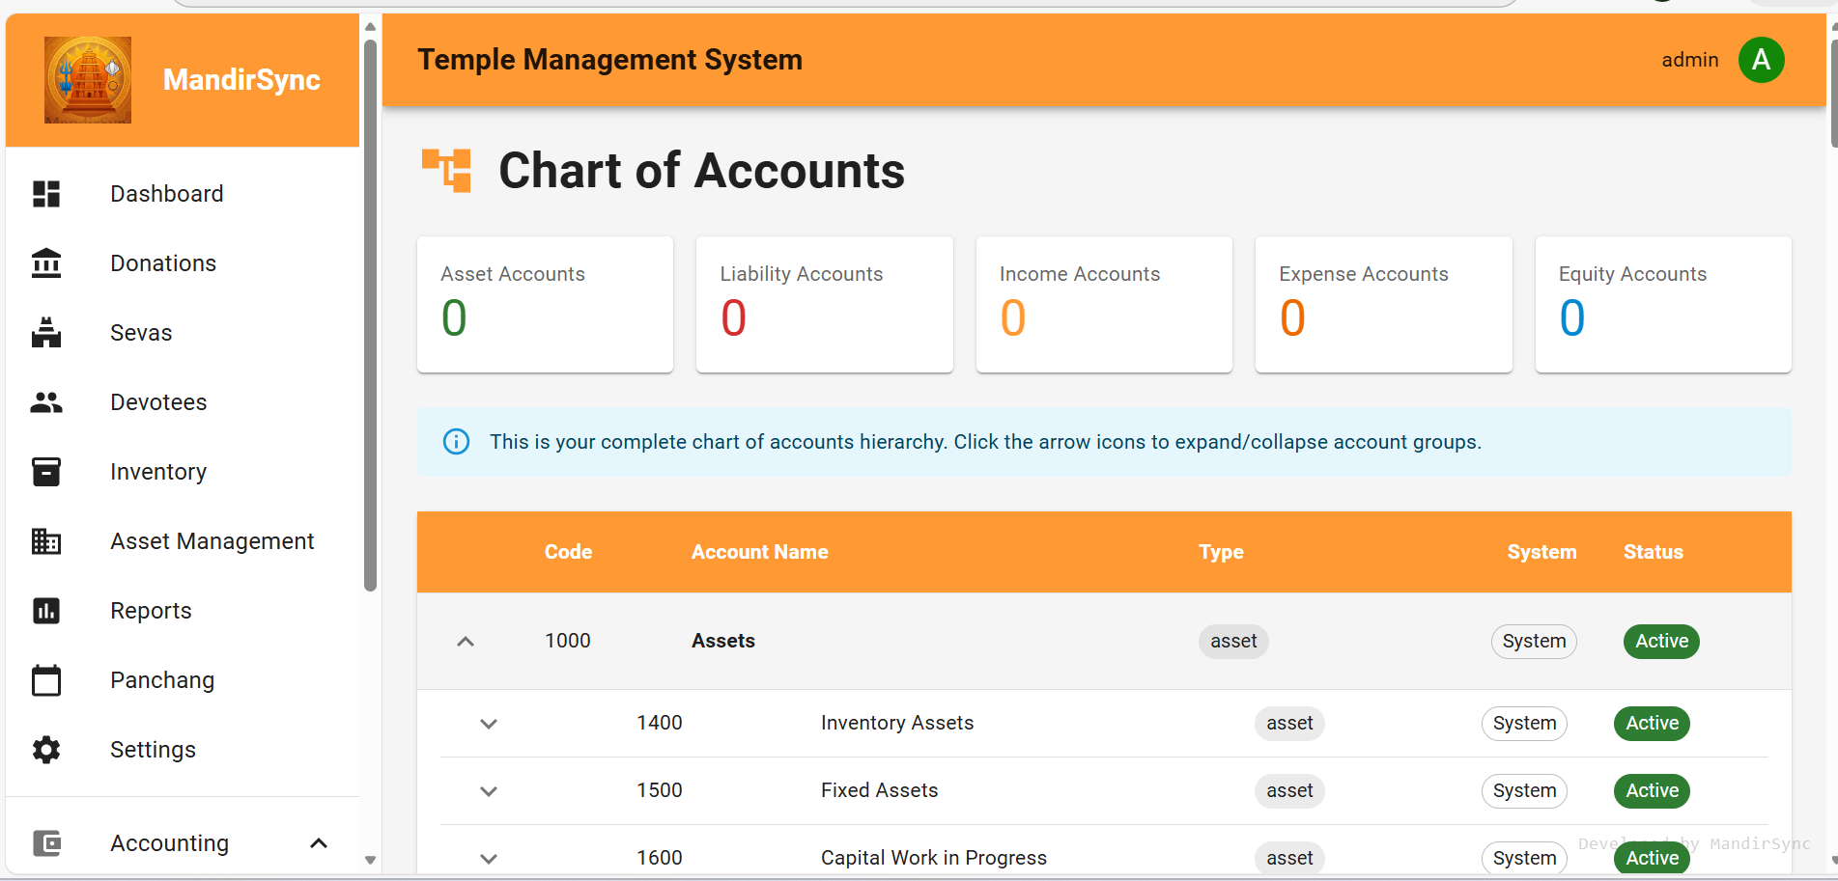
MandirSync
Integrated Accounting Engine
We have created more than 70+ head of accounts in Chart of accounts and is customisable
As per temples requirement

Slide 13
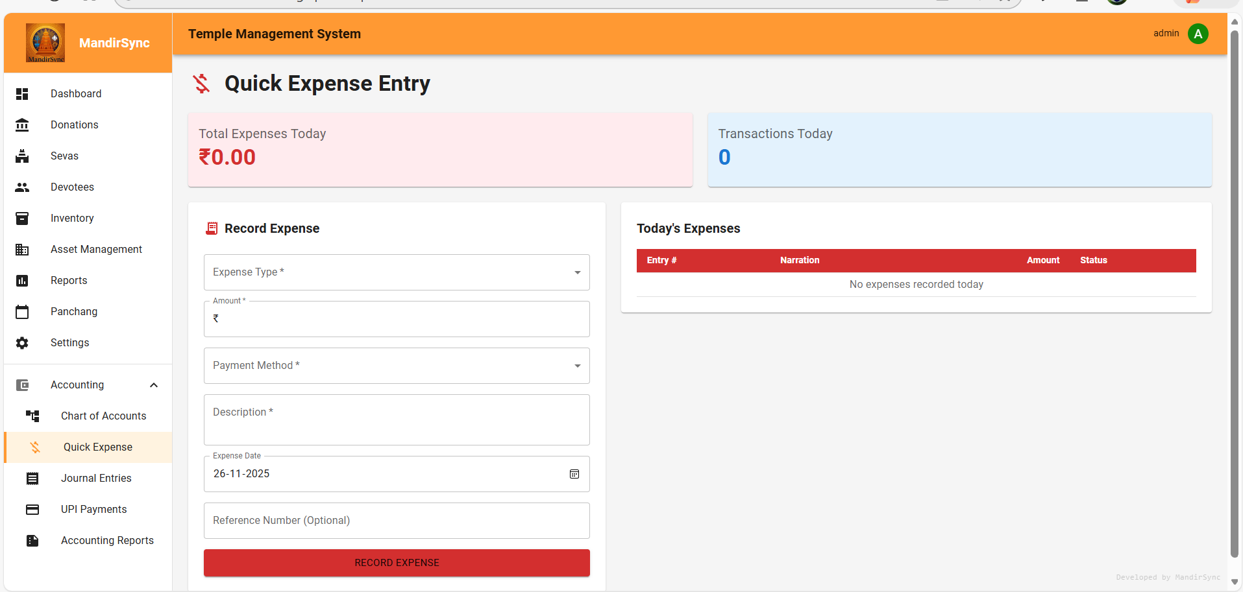
MandirSync
Integrated Accounting Engine
The Quick expense entry modules enables recording of expenses by payment mode - either
Cash or through Bank

Slide 14
MandirSync
Inventory & Store Management
Item Master (Pooja materials, groceries, cleaning, etc.).
Store Master (Main store, kitchen, pooja room, etc.).
Purchase Entry: Dr Inventory / Cr Cash/Bank.
Issue Entry: Dr Expense / Cr Inventory (consumption).
Stock Report: item/store-wise quantities, values, low-stock.

Slide 15
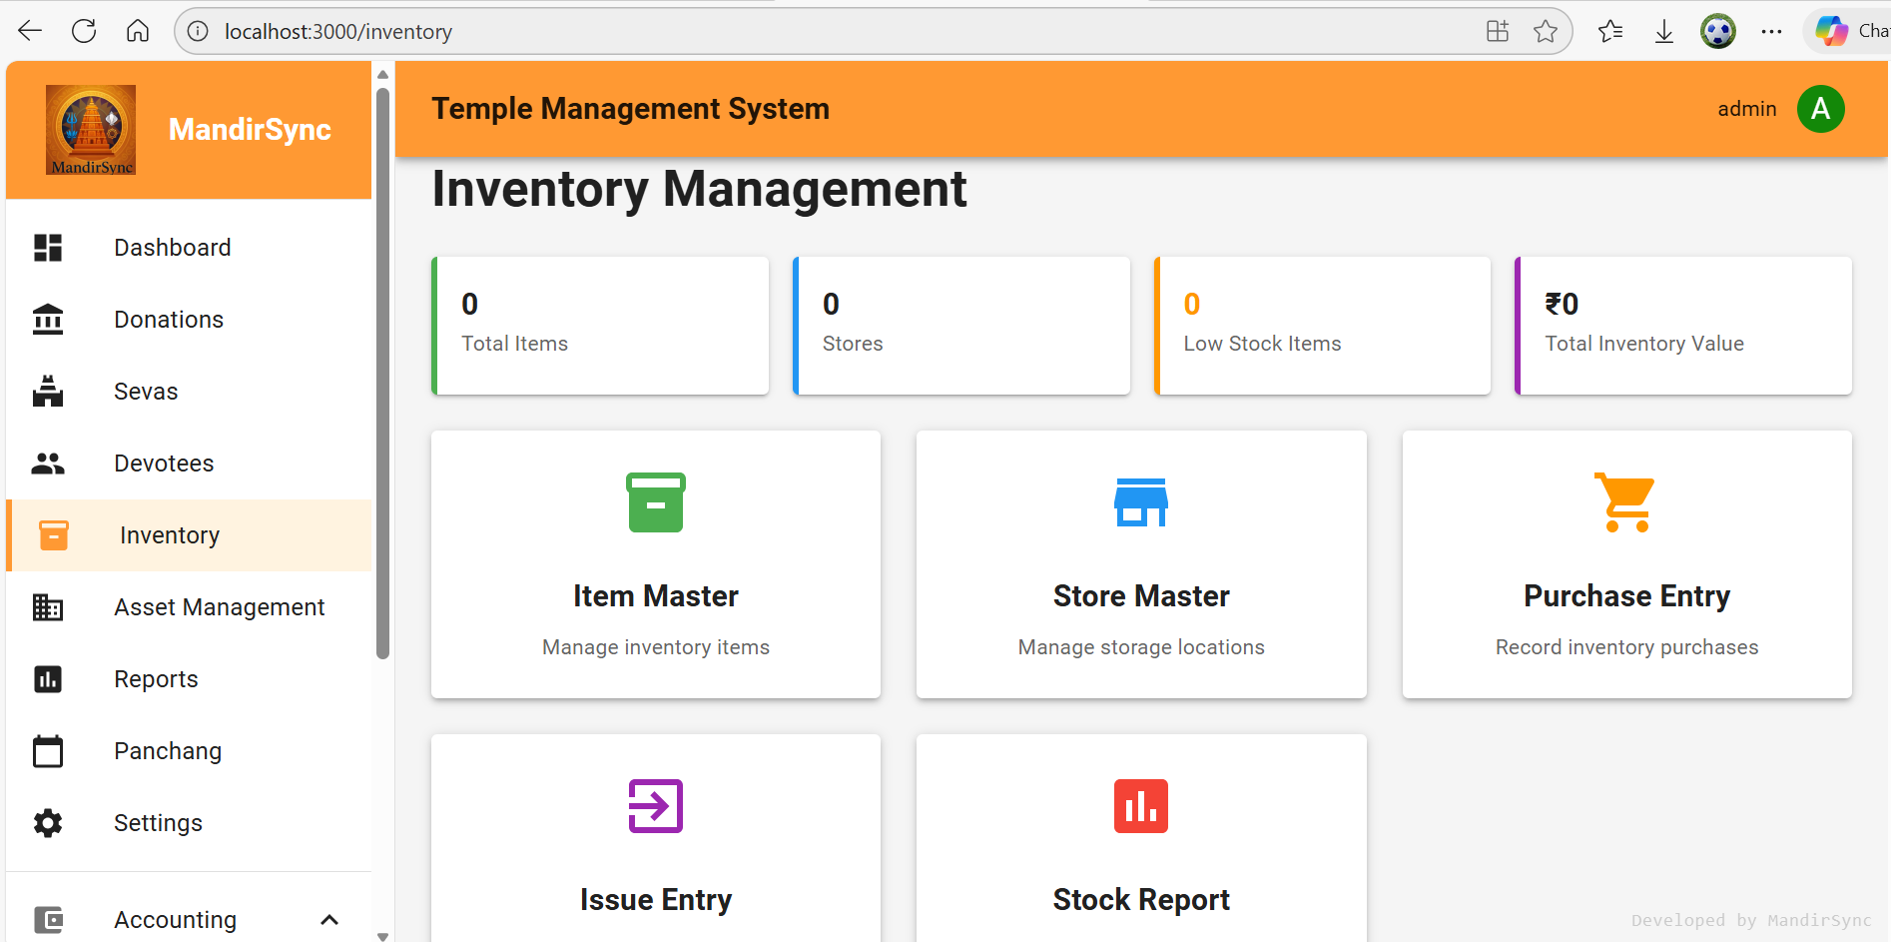
MandirSync
Inventory & Store Management
A comprehensive Inventory module is available where all inventory like Purchase, utilisation
including shrinkage wastage can be accounted. Stock report is available. A dash board is
Available for quick view and to take necessary action

Slide 16
MandirSync
Asset Management – Foundations
Asset Master: land, buildings, vehicles, equipment, gold/silver.
Asset categorization with account mapping (1500–1999 series).
Tracks original cost, book value, accumulated depreciation.
Handles Fixed Assets, Precious Assets and CWIP.
Built specifically for temple asset realities (land, gold, silver).

Slide 17
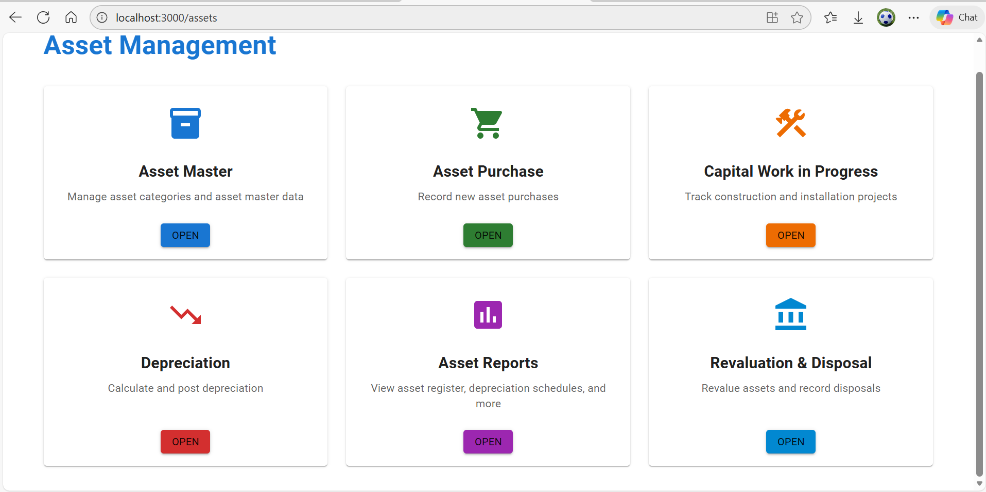
MandirSync
Asset Management – Foundations
A detailed process driven , audit ready asset management is in place,
Built specifically for temple asset realities (land, gold, silver).

Slide 18
MandirSync
CWIP & Procurement
CWIP projects for construction, renovation, infrastructure.
Record all project expenses – Materials, Labour, Overheads.
Accounting: Dr CWIP account, Cr Cash/Bank/Payables.
Capitalize to Fixed Asset: Dr Asset, Cr CWIP (automatic entry).
Optional tender process designed for large temples.
This module is built for specifically as there is lot of construction work is carried out in temples like Jeernodhara, new Building or Hall etc. Some times these expenses overlaps the financial Year, hence to proper accounting, we created this module and is audit ready

Slide 19
MandirSync
Flexible Depreciation – 8 Methods
Supports all major methods: Straight-Line, WDV, etc.
Temple admin selects method in consultation with auditor.
Automated schedules and journal entries.
Dr Depreciation Expense, Cr Accumulated Depreciation.
Compliant with standard accounting practices (AS/Ind AS).

Slide 20
MandirSync
Revaluation & Disposal of Assets
Revaluation for land, buildings, gold, silver.
Handles upward and downward revaluations with Reserve.
Disposal types: sale, scrap, donation, loss, theft.
Automatic gain/loss calculation and posting.
Example: Dr Asset, Cr Revaluation Reserve.
Keeps temple balance sheet realistic and audit-ready.

Slide 21
MandirSync
Daily Panchang
Daily Panchang integrated with temple location.
Configurable display settings.
Only enabled on demand for users who need it.
ℹ️ 100% Accurate - Cross-verified with Swiss Ephemeris with Lahiri Ayanamsa.

Slide 22
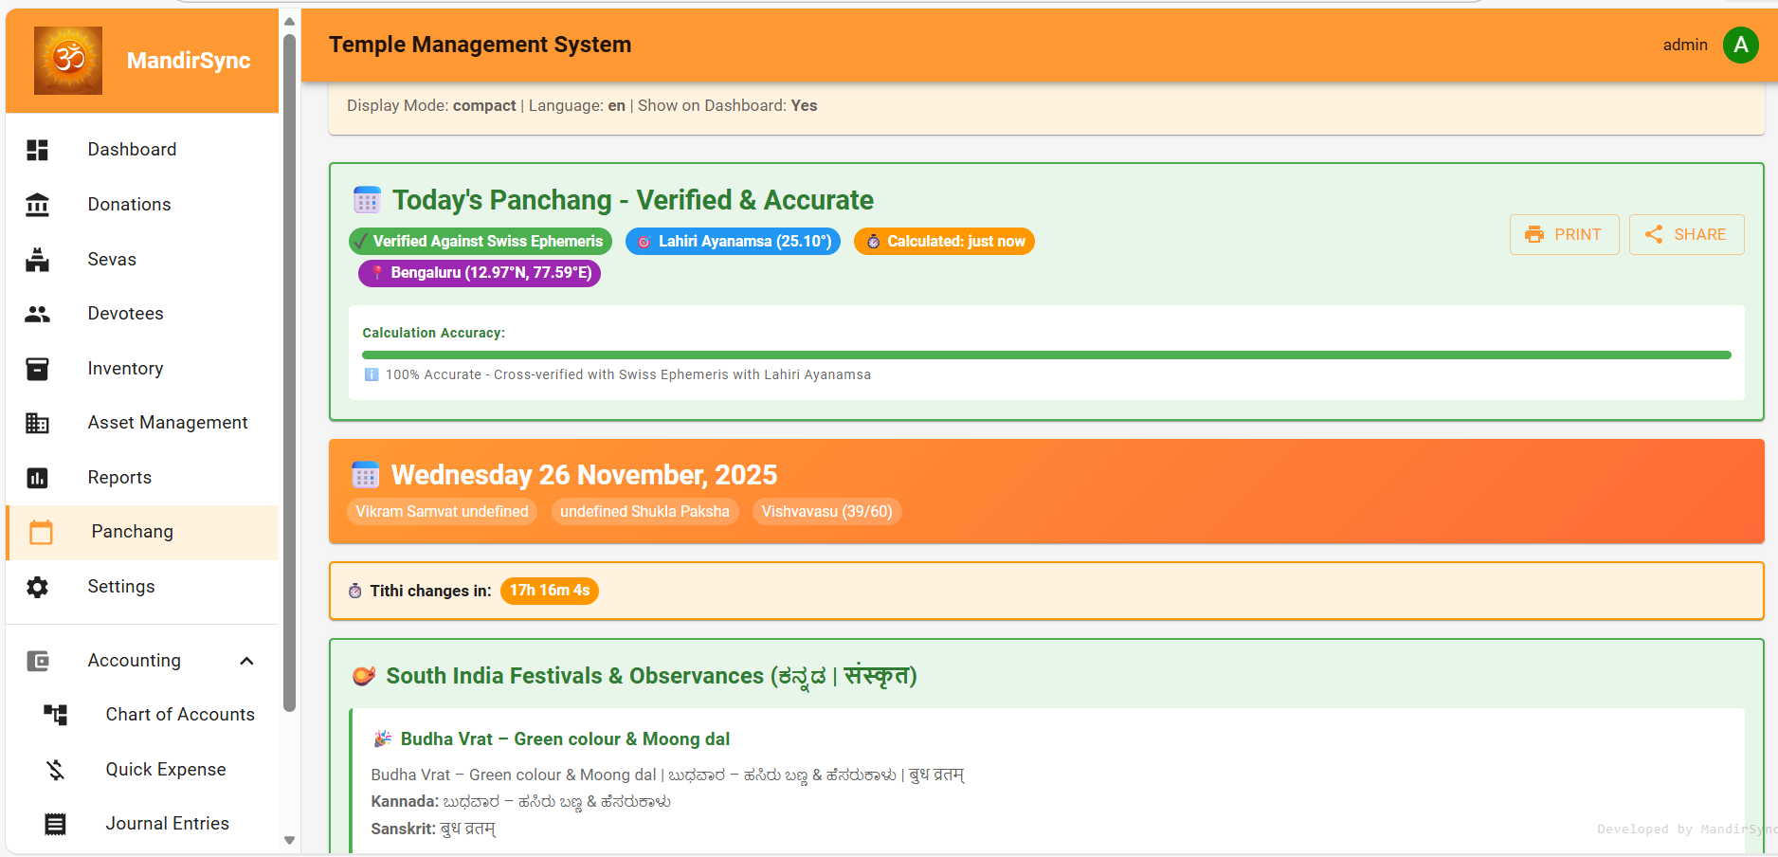
MandirSync
Daily Panchang

Slide 23
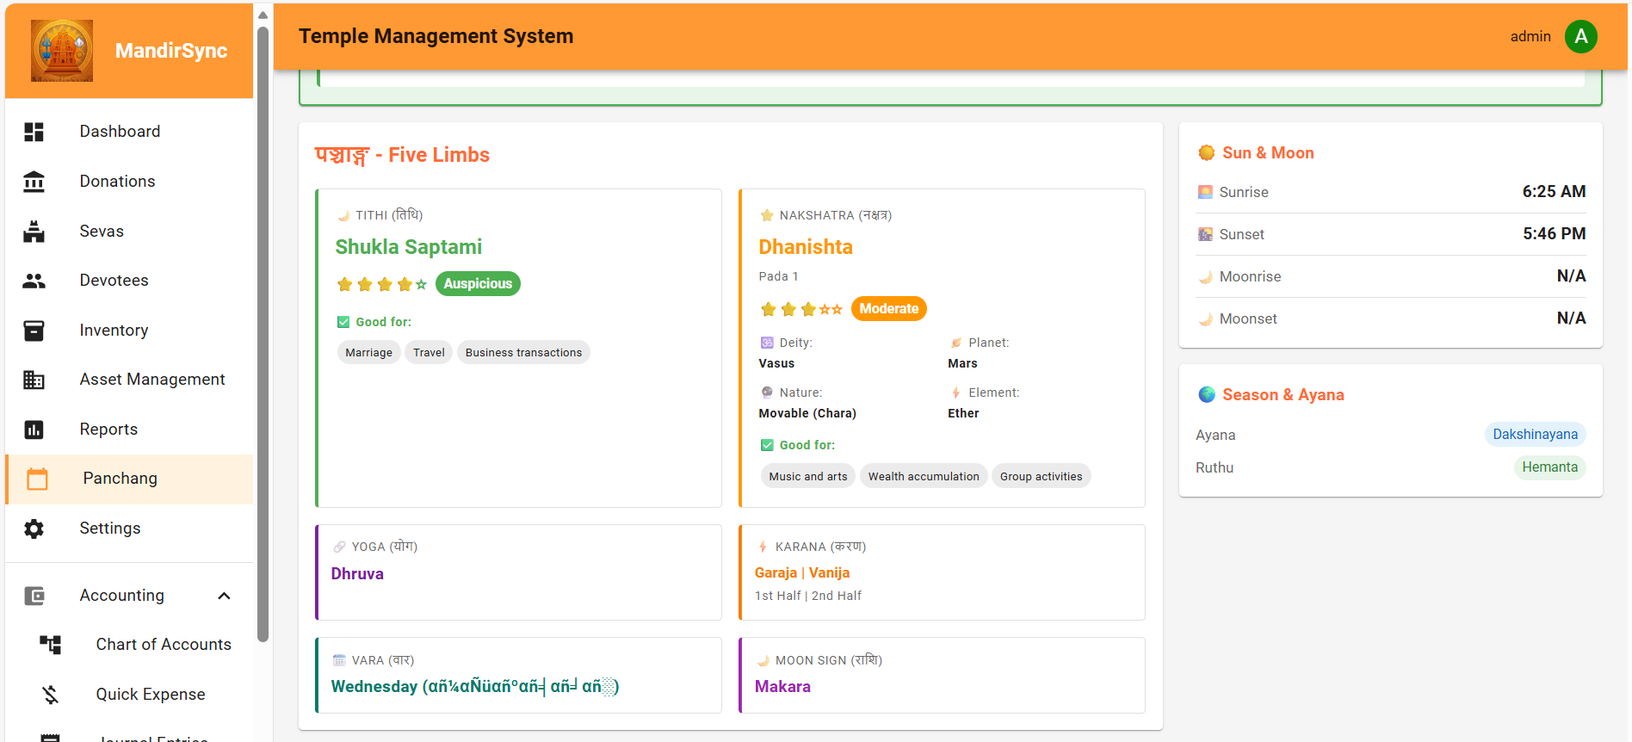
MandirSync
Daily Panchang

Slide 24
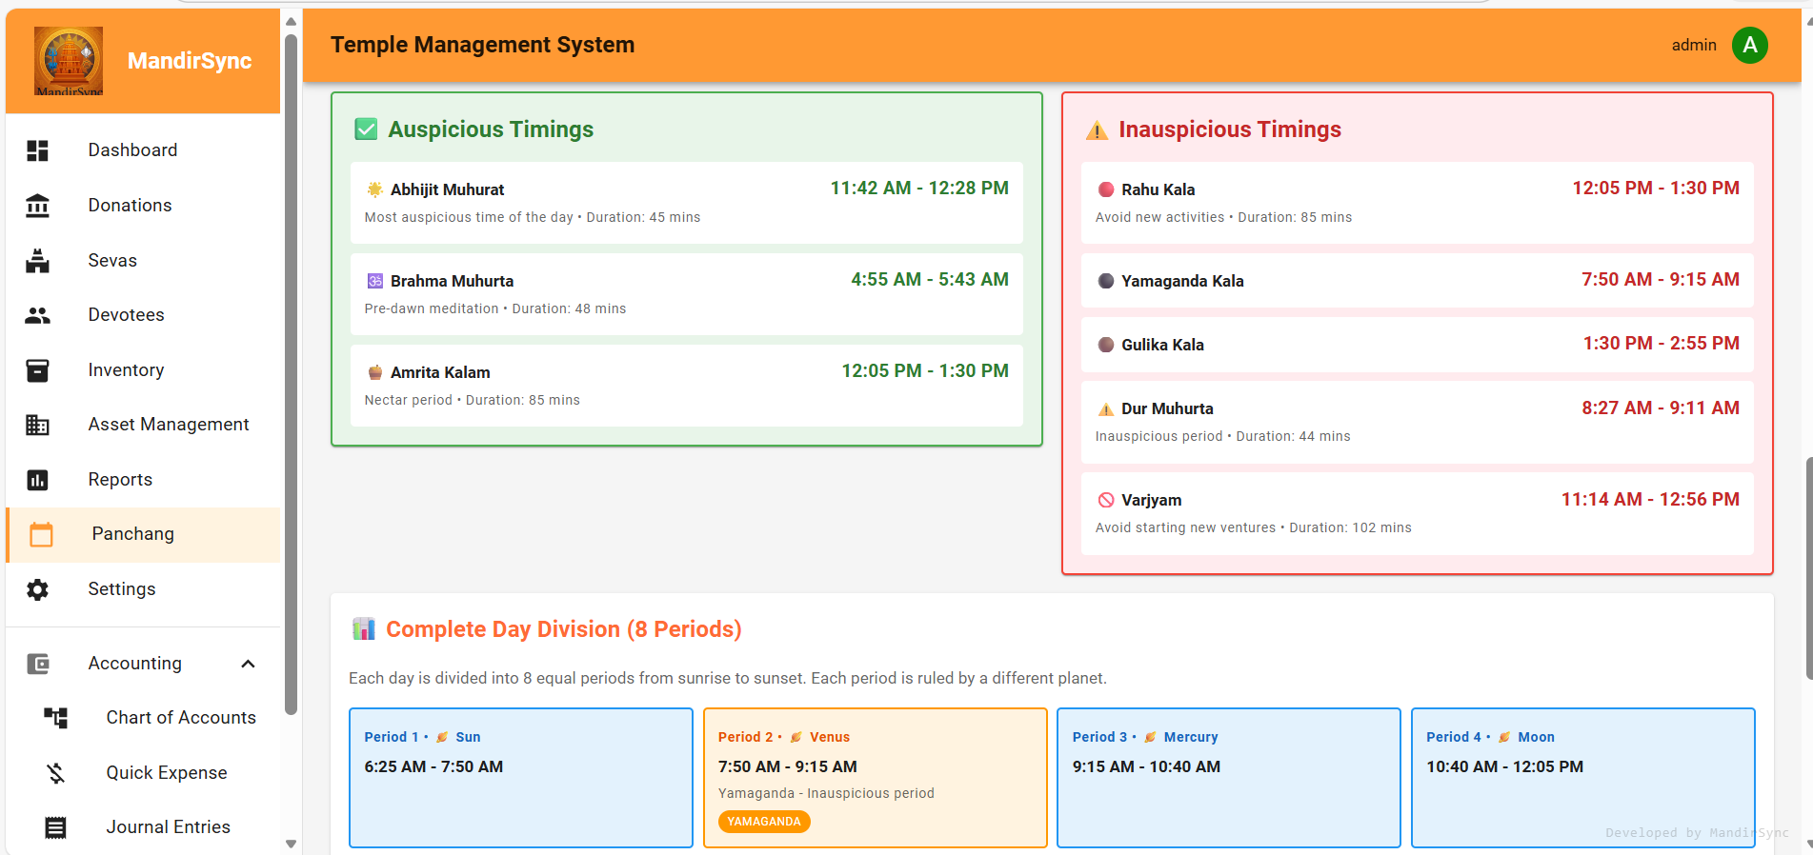
MandirSync
Daily Panchang

Slide 25
Deployment Options
SaaS (Cloud)
Standalone (On-Premise)
Accessible from anywhere.
Automatic backups & updates.
Lower upfront hardware cost.
Best for reliable internet.
Runs on temple’s own server.
Data stays locally.
Temple controls backups.
Can upgrade to SaaS later.

Slide 26
MandirSync
Technical Overview
Frontend: React + Material-UI with responsive design.
Backend: FastAPI (Python), RESTful APIs.
Database: PostgreSQL with migrations and scripts.
Clean separation of Models, APIs, and Accounting engine.
Robust logging and schema management.

Slide 27
MandirSync
Security & Controls
User login & role-based access (admin, accountant, counter).
Controlled token seva (for low value seva which is < ₹ 50/- or as decided by the temple aythority) inventory and reconciliation.
Every transaction linked to journal entries where applicable.
Exportable reports for auditors and trustees.
Logs and database migrations to avoid schema drift.

Slide 28
MandirSync
Key Benefits to Your Temple
Single source of truth for donations, sevas, inventory, and assets.
Faster counter operations with mobile-first and PIN code auto-fill.
Stronger financial discipline and easier audits.
Better transparency for devotees, trustees, and regulators.
Scales from small local temples to large institutions.
"Less time on administration, more time on Seva."

Slide 29
MandirSync
Final Word & Next Steps
MandirSync combines tradition + technology.
Covers: Donations > Sevas > Inventory > Assets > Accounting.
Flexible SaaS or Standalone deployment.
Next steps: Demo with sample data, Auditor review, Phased rollout.
Contact: jayamurli1954@gmail.com
Mobile: +91 9444019106
Dhanyavaad

