Slide 1
Create an Application
1. CD e:/angular/
2. now use the @angular/cli tool's ng new to create a new angular app as follows
ng new InventionsHub
3. Serve the app using ng serve -open
It will open the app at http://localhost:4200

Slide 2
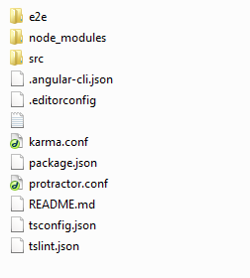
Directory Structure
Root:

Slide 3
Directory Structure
1. E2e - End-to-end (e2e) tests of the application, written in Jasmine and run by the protractor e2e test runner.
2. node_modules - The npm packages installed with the npm install command.
3. Src - Angular application files go here.
4. angular-cli.json - angular-cli.json is a file used by @angular/cli tool which is used to automate the angular workflow by automating different operations related to development and testing of angular apps. .angular-cli serves as a blueprint to the @angular/cli tool.

Slide 4
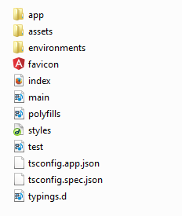
Directory Structure
src:

Slide 5
Directory Structure
1.app - app directory is where we define the building blocks of our angular project like modules , components , services etc.
2. assets - this directory contains all the static assets of our app like images etc.
3. environments - environments directory hold our environment specific settings , e.g. different configuration files for development , testing and staging etc.
4. index.html - is the landing page or the main page of our application rendered when angular app bootstraps.
5. main.ts - is the main typescript file which is used to bootstrap the angular module.
6. Styles.css - Global styles for the application.

Slide 6
Modules
What is an Angular Module?
- A module is a mechanism to group components, directives, pipes and services that are related.
- A module can export or hide components, directives, pipes and services. The exported elements are meant to be used by other modules, while the ones that are not exported (hidden) are just used inside the module itself and cannot be directly accessed by other modules of our application.

Slide 7
Modules
Definition:
import { NgModule } from '@angular/core';
import { BrowserModule } from '@angular/platform-browser';
import { AppComponent } from './app.component';
@NgModule({
declarations: [ AppComponent ],
imports: [ BrowserModule ],
providers: [],
bootstrap: [AppComponent],
exports:[…]
})
export class AppModule { }
- To be able to define modules we have to use the decorator NgModule. we have turned the class AppModule into an Angular module just by using the NgModule decorator. The NgModule decorator requires at least three properties: imports, declarations and bootstrap.

Slide 8
Modules
Decorator: takes a metadata object and describes a class to Angular.
Below are the properties of NgModule decorator.
Imports - imports other modules with the components, directives, and pipes that components in the current module need.
Declarations - Declares which components, directives, and pipes belong to the module.
Bootstrap – Defines the components that should be bootstrapped when this module is bootstrapped.
Exports - Specifies a list of directives/pipes/modules that can be used by other modules
Providers - are to make services and values known to DI. They are added to the root scope and they are injected to other services or directives that have them as dependency.

Slide 9
Components
What is a Component?
- Components are basically classes that interact with the .html file of the component, which gets displayed on the browser.
- A module can have any no. of components.
Component Dependent files:
- app.component.css – style file for created component
- app.component.html – html file for rendering the UI elements
- app.component.spec.ts - this can be used for unit testing.
- app.component.ts – component class file.

Slide 10
Components
app.component.ts:
import { Component } from '@angular/core';
@Component({
selector: 'app-root',
templateUrl: './app.component.html',
styleUrls: ['./app.component.css']
})
export class AppComponent {
title = 'app';
}
\AngularSession\InventionsHub\src\index.html:
<body>
<app-root></app-root>
</body>
The content from app.component.html will be rendered inside <app-root></app-root> & displayed in browser.

Slide 11
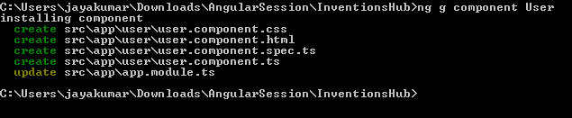
Components
Create a Component:
Syntax:
ng generate component comp-name [--flat ]
comp-name – component name
--flat – if you don’t want to create seperate folder for this component

Slide 12
Components
app.component.ts:
import { Component } from '@angular/core';
@Component({
selector: 'app-root',
templateUrl: './app.component.html',
styleUrls: ['./app.component.css']
})
export class AppComponent {
title = 'app';
}
\AngularSession\InventionsHub\src\index.html:
<body>
<app-root></app-root>
</body>
The content from app.component.html will be rendered inside <app-root></app-root> & displayed in browser.

Slide 13
Forms
Types of Forms in Angular:
- Two ways of working with forms – 1. template driven form 2. model driven forms.
1. template driven form:
- most of the work is done in the template
- lets create a login form now
Steps:
1. import { FormsModule } from '@angular/forms'; in module.
2.Add FormsModule in imports array in module.
3. Create a HTML form like below

Slide 14
Forms
<form #userlogin = "ngForm" (ngSubmit) = "onClickSubmit(userlogin.value)" >
<input type = "text" name = "emailid" placeholder = "emailid" ngModel>
<br/>
<input type = "password" name = "passwd" placeholder = "passwd" ngModel>
<br/>
<input type = "submit" value = "submit">
</form>
- In template driven forms, we need to create the model form controls by adding the ngModel directive and the name attribute.
- we have also added the ngForm to the #userlogin. The ngForm directive needs to be added to the form template that we have created. We have also added function onClickSubmit and assigned userlogin.value to it.

Slide 15
Forms
Component.ts:
import { Component } from '@angular/core'
@Component(
{
'selector':'template-form',
'templateUrl':`./template1.html`
}
)
export class AppComponent {
onSubmit(value: any){
console.log(value);
}
}

Slide 16
Forms
1. Model driven form:
- most of the work is done in the component class.
- lets create a login form now
Steps:
1. import { ReactiveFormsModule } from '@angular/forms'; in module.
2.Add ReactiveFormsModule in imports array in module.
3. Create a HTML form like below

Slide 17
Forms
<div>
<form [formGroup]="formdata" (ngSubmit) = "onClickSubmit(formdata.value)" >
<input type="text" class="fortextbox" name="emailid" placeholder="emailid" formControlName="emailid">
<input type="password" class="fortextbox" name="passwd" placeholder="passwd" formControlName="passwd">
<input type="submit" class="forsubmit" value="Log In">
</form>
</div>
<p> Email entered is : {{emailid}} </p>

Slide 18
Forms
import { Component } from '@angular/core'
import { FormGroup,FormControl,Validators } from '@angular/forms'
@Component(
{
selector:'modeldriven-form',
templateUrl:`./template2.html`,
}
)

Slide 19
export class AppComponent{
userForm = new FormGroup(
{
name:new FormControl('brandon’),
passwd :new FormControl('brandon’)
}
);
onSubmit(){
console.log(this.userForm.value);
} }

