Slide 1
From Weak to Strong: Harnessing the XGBoost Advantage
By JAYANA Sarma

Slide 2
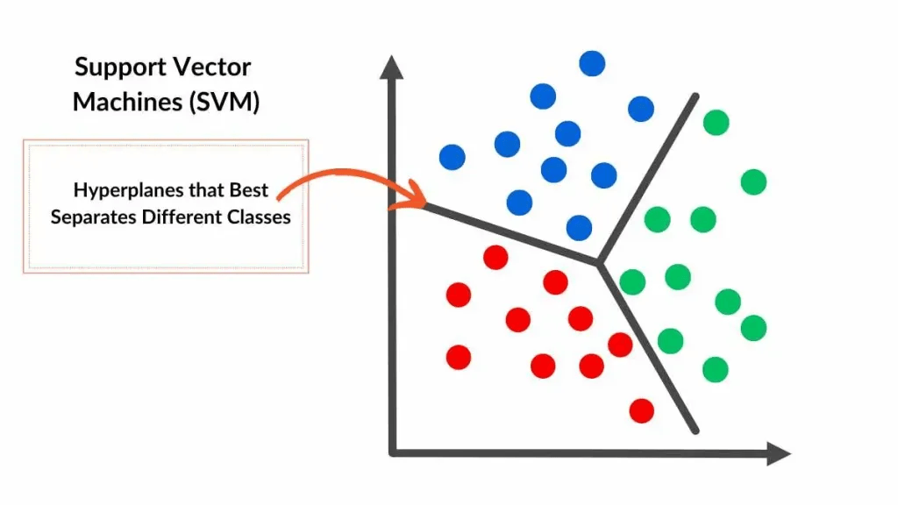
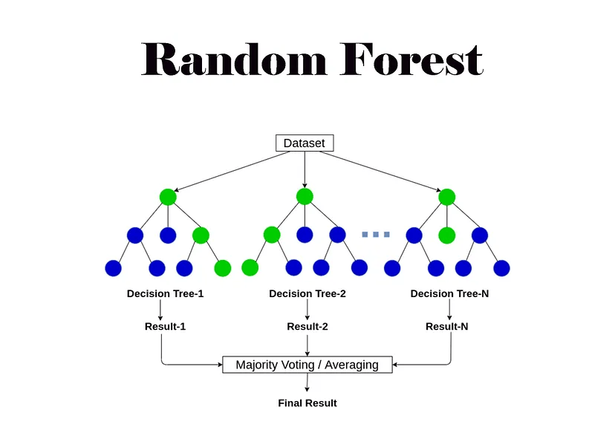
SVM V/S RANDOM FOREST
A support vector machine (SVM) is a supervised machine learning algorithm that classifies data by finding an optimal line or hyperplane that maximizes the distance between each class in an N-dimensional space.
Effective in high-dimensional spaces but sensitive to parameter tuning.
A Random Forest is a machine learning algorithm that combines multiple decision trees to make predictions, essentially "voting" on the final result, making it robust and accurate for both classification and regression tasks.
Robust, avoids overfitting, and works well with large datasets.

Slide 3
XGBoost, at a Glance!
Scalable Gradient Boosting Algorithm: Improved version of gradient boosting.
Focus Areas: Efficacy, computational speed, and model performance.
Open-Source Library: Part of the Distributed Machine Learning Community.
Optimized Design: Leverages both software and hardware capabilities.
Key Strengths: Enhances boosting techniques for high accuracy in minimal time.

Slide 4
A Quick Flashback to Boosting
Boosting generally means increasing performance. In ML, Boosting is a sequential ensemble learning technique to convert a weak hypothesis or weak learners into strong learners to increase the accuracy of the model.
For example,
Imagine a class of students learning math:
1. The teacher starts with a simple concept(weak learner)
2. Reviews mistakes and teaches a slightly advanced lesson to address those errors.
3. Repeats this process until most students understand (strong learner).
Similarly, boosting sequentially improves the model's "understanding" of data.

Slide 5
ENSEMBLE LEARNING
Ensemble Learning combines decisions from multiple machine learning models to improve accuracy compared to using a single model.
It reduces error by leveraging the strengths of multiple models.
Maximum voting technique is commonly used for classification tasks, where the majority of votes determine the final prediction.

Slide 6
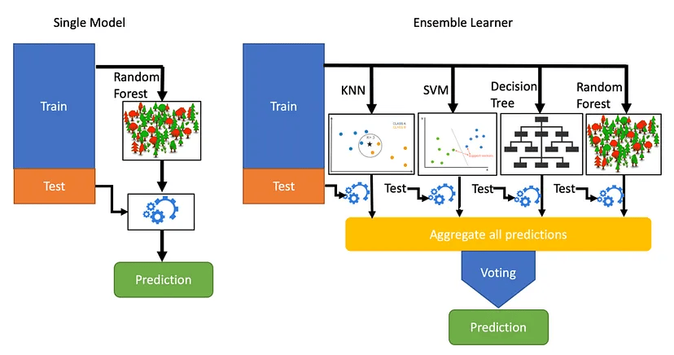
This image shows a clear distinction of a single ML model with respect to Ensemble Learner:

Slide 7
Working of boosting algorithm:
Boosting Algorithm Overview:
Combines multiple weak learners (models) to improve performance.
Each new model is trained to correct the errors of the previous model.
Learning Process:
Misclassified samples receive higher weights, while correctly classified ones have lower weights.
The final model places more emphasis on the stronger learners (models that perform better).
Greedy Nature:
Boosting is greedy because it focuses on correcting mistakes sequentially, without revisiting previous models.
Overfitting Prevention:
It’s recommended to set a stopping criterion (e.g., early stopping or model performance) to avoid overfitting.

Slide 8

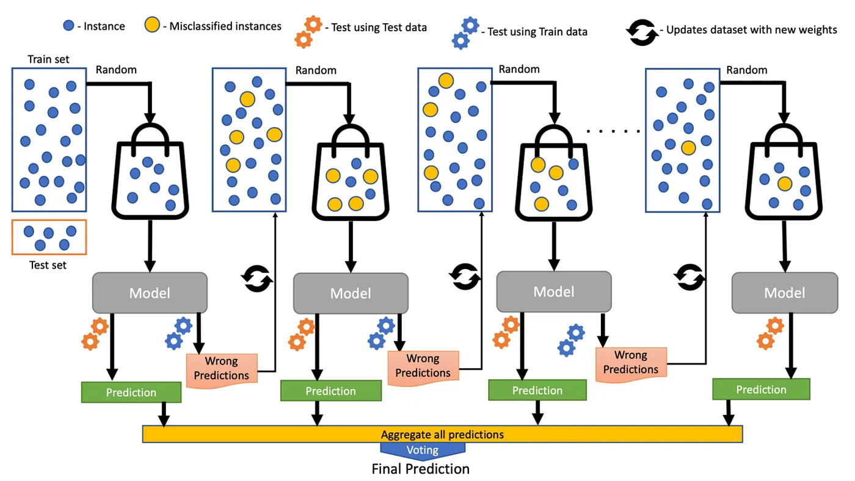
Mathematical Notion Capital F(i) is current model, F(i-1) is previous model and small f(i) represents a weak model
Internal working of boosting algorithm

Slide 9
Gradient Boosting:
Gradient Boosting Overview:
Special case of boosting that minimizes errors using the gradient descent algorithm.
Produces models composed of weak prediction learners (e.g., decision trees).
Key Difference from Boosting:
Gradient Boosting updates weights using gradients of the loss function via gradient descent, optimizing errors iteratively.
Loss represents the difference between predicted and actual values.
Loss Functions:
Regression problems: Use Mean Squared Error (MSE) as the loss function.
Classification problems: Use Logarithmic Loss as the evaluation metric.
Gradient Boosting Process:
Additive Modeling:
Builds the model by sequentially adding new decision trees to minimize loss.
Existing trees are left unchanged to reduce overfitting.
Stops when the loss falls below a specified threshold or a maximum number of trees is reached.

Slide 10
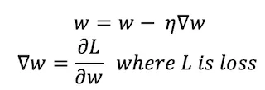
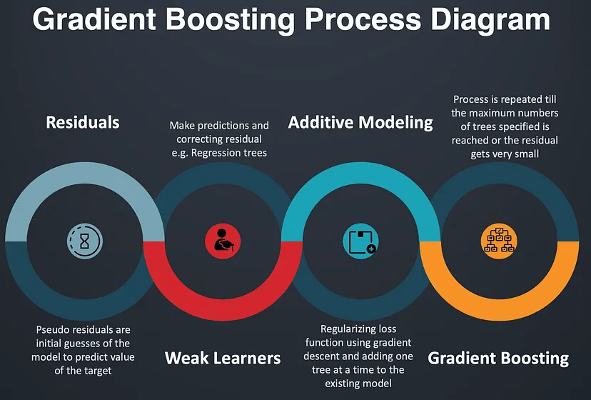
w represents the weight vector, eta is the learning rate
Process flow of Gradient Boosting

Slide 11
XGBOOST in action
Algorithm Enhancements:
Tree Pruning:
Reduces tree size to avoid overfitting.
Uses techniques like Cost Complexity or Weakest Link Pruning with MSE, k-fold cross-validation, and learning rate.
Prunes backward after reaching the specified max depth, keeping splits if the total loss remains positive.
Sparsity-Aware Split Finding:
Handles missing or sparse data by assigning a default direction in trees.
Optimizes for sparse data by visiting only missing values, making it much faster (up to 50x).
System Enhancements:
Parallelization:
Speeds up tree learning by sorting data in compressed blocks and using all CPU cores/threads.
Efficient for handling frequent node creation.
Cache Awareness:
Stores gradient statistics in thread-specific buffers, reducing time for read/write operations.
Optimized block sizes (generally 2¹⁶) minimize cache misses.

Slide 12
Flexibility in XGBoost:
Customized Objective Function — An objective function intends to maximize or minimize something. In ML, we try to minimize the objective function which is a combination of the loss function and regularization term. Optimizing the loss function encourages predictive models whereas optimizing regularization leads to smaller variance and makes prediction stable.
Examples: reg: linear(Regression)
Binary: logistic(binary classification)
Multi : softmax(multiclass classification)
Customized Evaluation Metric — This is a metric used to monitor the model’s accuracy on validation data. ● rmse — Root mean squared error (Regression) ● mae — Mean absolute error (Regression) ● error — Binary classification error (Classification) ● logloss — Negative log-likelihood (Classification) ● auc — Area under the curve (Classification)

Slide 13
Resources:
https://medium.com/sfu-cspmp/xgboost-a-deep-dive-into-boosting-f06c9c41349
https://xgboost.readthedocs.io/en/stable/
https://medium.com/@jyotsna.a.choudhary/mastering-xgboost-a-technical-guide-for-intermediate-machine-learning-practitioners-f7ad167c6865

Slide 14
Thank You

