Slide 1
CMAD Design Review
Jayant/Anuj – June 7th 2019

Slide 2
Agenda
Architecture
Server Design
UI Design
List of REST APIs
UI Mockup Screen

Slide 3
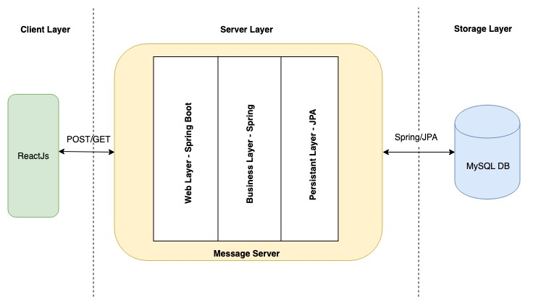
Application Architecture

Slide 4
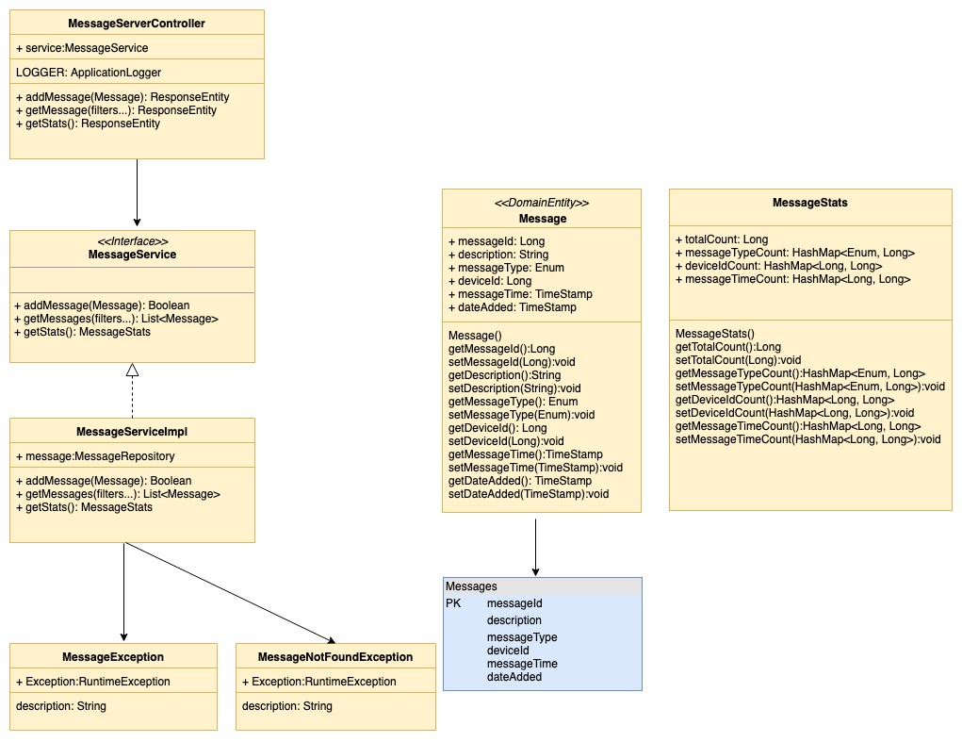
Server Design

Slide 5
List of REST APIs
addMessage - POST - <host>/message
getMessage - GET - <host>/message/search
Response JSON Structure
{ messages: [
{ messageId: 1, description: "M1", messageType: "ERROR", deviceId: 100,
messageTime: "01-01-2019", dataAdded: "01-01-2019" }
]
}
getStats - GET - <host>/message/stats
Response JSON Structure
{ totalCount: 1500,
messageTypeCount: {"ERROR": 200, "INFO": 1300},
deviceIdCount: {"100": 850, "101": 650},
messageTimeCount: {"01-01-2019": 1000, "02-01-2019": 500}
}
Header Response Codes
code = 200, message = "Successfully retrieved messages"
code = 404, message = "Message not found with given filters"
code = 500, message = "Some error occurred while performing operation"

Slide 6
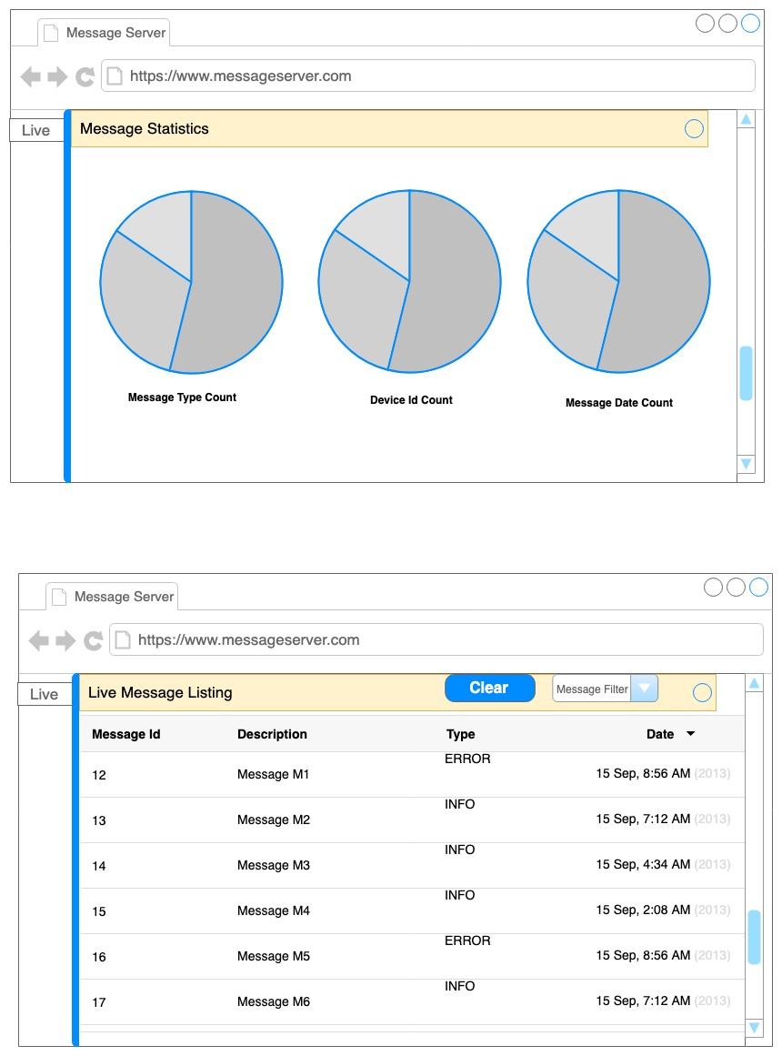
UI Mockup Screens

Slide 7
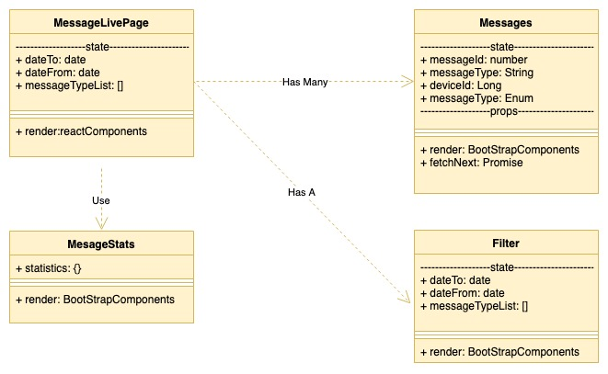
UI Design

