Slide 1
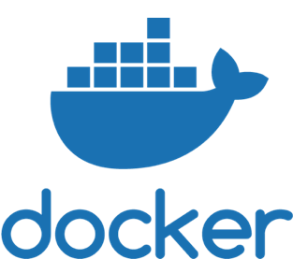
Docker for Beginners

Slide 2
Takeaways
Docker concepts, terminologies and architecture

Slide 3
Takeaways
Docker concepts, terminologies and architecture
Useful Docker commands

Slide 4
Takeaways
Docker concepts, terminologies and architecture
Useful Docker commands
Develop small POCs using docker

Slide 5
Takeaways
Docker concepts, terminologies and architecture
Useful Docker commands
Develop small POCs using docker
Start thinking about containerisation

Slide 6
Pre-requisites
Basic understanding of Linux and Virtualisation concepts

Slide 7
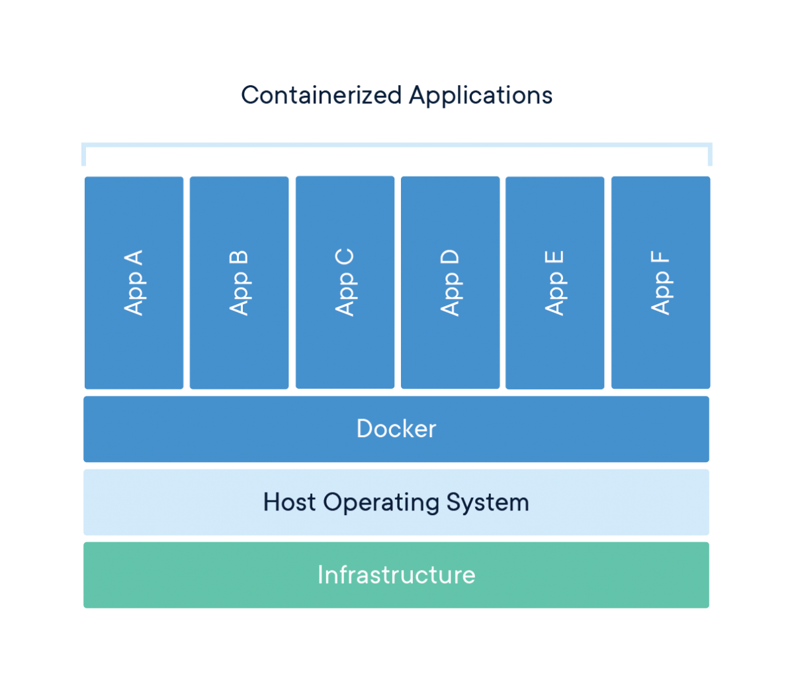
What is Container
A standardised unit of software
Standard
Lightweight
Secured
No server bound
Source : https://docker.com

Slide 8
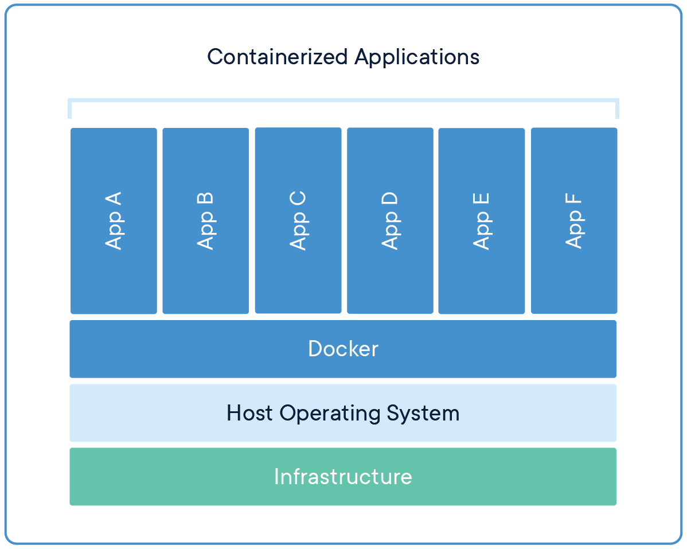
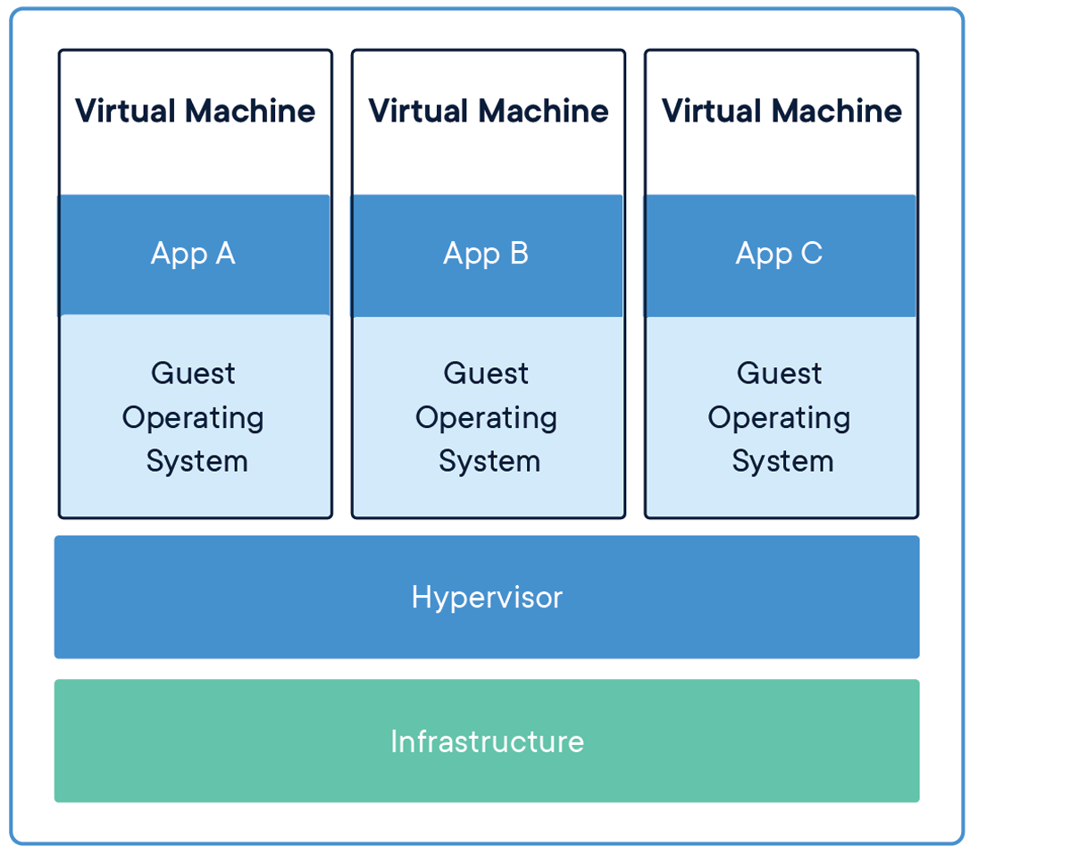
Containers vs VMs
Source : https://docker.com

Slide 9
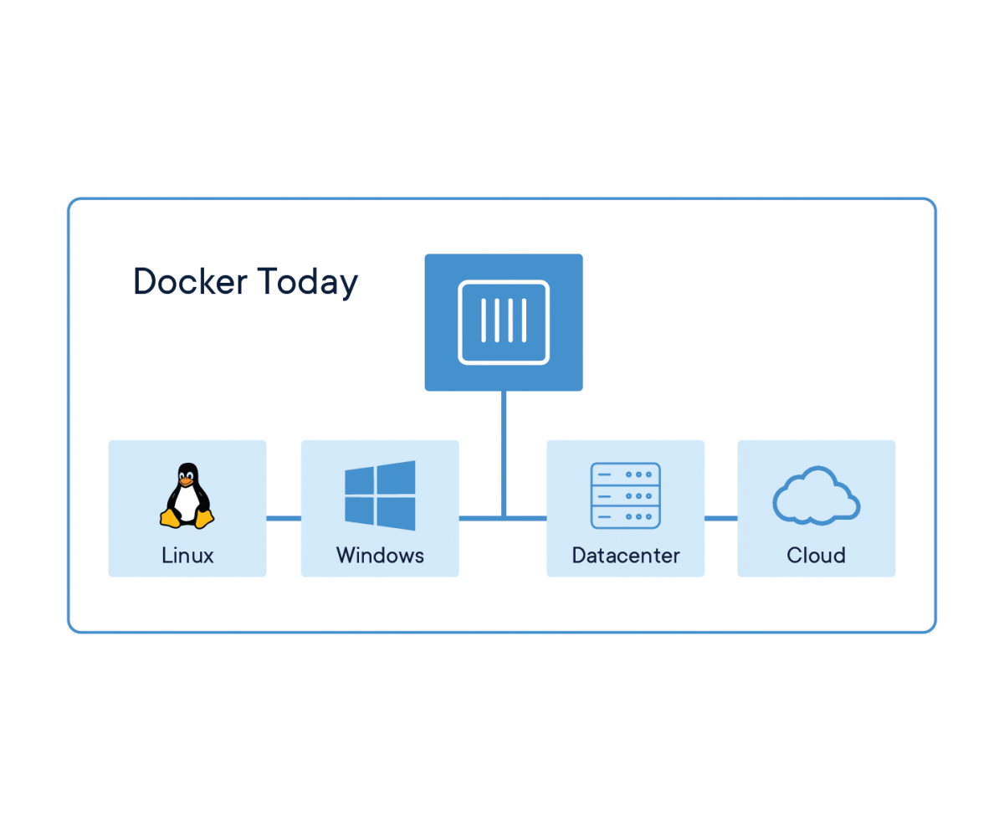
Docker Today
Works for me, will work for you.
Source : https://docker.com

Slide 10
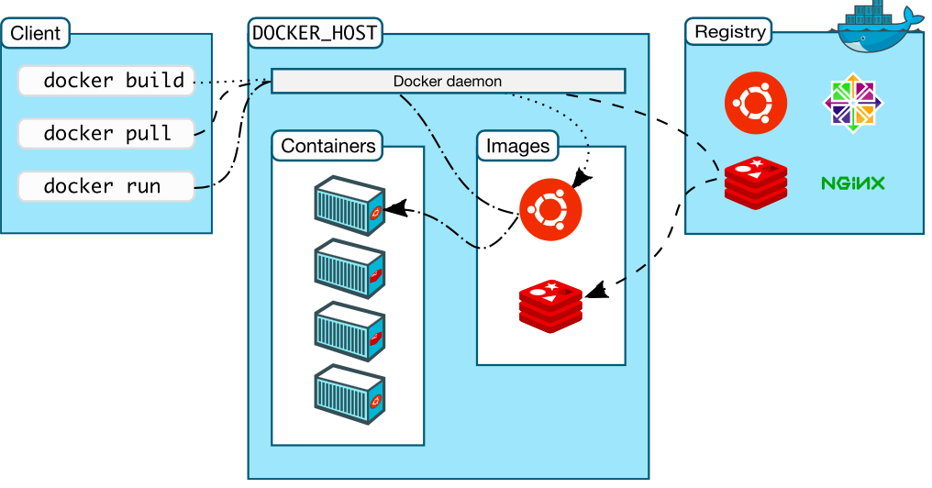
Architecture
Source : https://docs.docker.com/engine/docker-overview/

Slide 11
How to Start
Signup : https://hub.docker.com/signup
Verify email-id
Login : https://labs.play-with-docker.com/
Add a docker instance
Linux based OSs - go ahead

Slide 12
Hands-On
Run Your Container
Build a container
Run a container
Check docker processes
Stop the container
Remove a container
Dockerize a simple shell script

Slide 13
Dockerfile
FROM
FROM <image>

Slide 14
Dockerfile
FROM
FROM <image>
ARG
ARG VAR=val

Slide 15
Dockerfile
FROM
FROM <image>
ARG
ARG VAR=val
RUN
RUN <command>

Slide 16
Dockerfile
FROM
FROM <image>
ARG
ARG VAR=val
RUN
RUN <command>
LABEL
LABEL <key>=<val>

Slide 17
Dockerfile
FROM
FROM <image>
ARG
ARG VAR=val
RUN
RUN <command>
LABEL
LABEL <key>=<val>
EXPOSE
EXPOSE <portno>

Slide 18
Dockerfile
FROM
FROM <image>
ARG
ARG VAR=val
RUN
RUN <command>
LABEL
LABEL <key>=<val>
EXPOSE
EXPOSE <portno>
CMD
CMD <command>

Slide 19
Dockerfile
FROM
FROM <image>
ARG
ARG VAR=val
RUN
RUN <command>
LABEL
LABEL <key>=<val>
EXPOSE
EXPOSE <portno>
CMD
CMD <command>
ENV
ENV <key>=<val>

Slide 20
Dockerfile
FROM
FROM <image>
ARG
ARG VAR=val
RUN
RUN <command>
LABEL
LABEL <key>=<val>
EXPOSE
EXPOSE <portno>
CMD
CMD <command>
ENV
ENV <key>=<val>
ADD
ADD <command>

Slide 21
Dockerfile
FROM
FROM <image>
ARG
ARG VAR=val
RUN
RUN <command>
LABEL
LABEL <key>=<val>
EXPOSE
EXPOSE <portno>
CMD
CMD <command>
ENV
ENV <key>=<val>
ADD
ADD <command>
ENTRYPOINT
ENTRYPOINT <command>

Slide 22
Hands On Contd.
Adding CI/CD with Docker Images
Create a simple Flask app
Create and build Docker image
Run the Docker image
Push to a registry
Deploy some change

Slide 23
Some Commands
docker images
docker run
docker pull
docker push
docker build
docker ps
docker stop
docker rm
docker rmi

Slide 24
Use Case
Quote Generator
Trader Dashboard
Portfolio Service
Audit Service
Migration DB

Slide 25


What’s Next
Docker Deep Dive
Kubernetes for Beginners
Helm for Beginners
Logo Source : https://kubernetes.io https://helm.sh

