Slide 1
Hack to Hire 2024
Use Case Solution
Jayant Mathur

Slide 2
Content
Introduction
Literature Survey
Dataset
Methodology
Results
Conclusion

Slide 3
Introduction
Problem Statement
Develop a state-of-the-art question-answering model leveraging the Quora Question Answer Dataset.
The objective is to create an AI system capable of understanding and generating accurate responses to a variety of user queries, mimicking a human-like interaction.
Data set
https://huggingface.co/datasets/toughdata/quora-question-answer-dataset

Slide 4
Literature Survey
Overview of Existing Solutions:
Traditional Rule-Based Systems: Explore the foundational approach where predefined rules govern language processing. Discuss their limitations in handling diverse and complex language patterns.
Sequence-to-Sequence Models: Outline the development of Seq2Seq models, noting their ability to generate outputs based on sequences of inputs. Highlight their improvements over rule-based methods.
Transformer-Based Models: Introduce modern transformer architectures like BERT, GPT-2, and T5. Explain how these models surpass earlier methods by leveraging self-attention mechanisms for improved contextual understanding and response accuracy.
Key Insights:
Revolutionizing NLP: Detail how transformer models have significantly advanced natural language processing, enabling more nuanced understanding of context and generating more coherent and contextually appropriate responses.

Slide 5
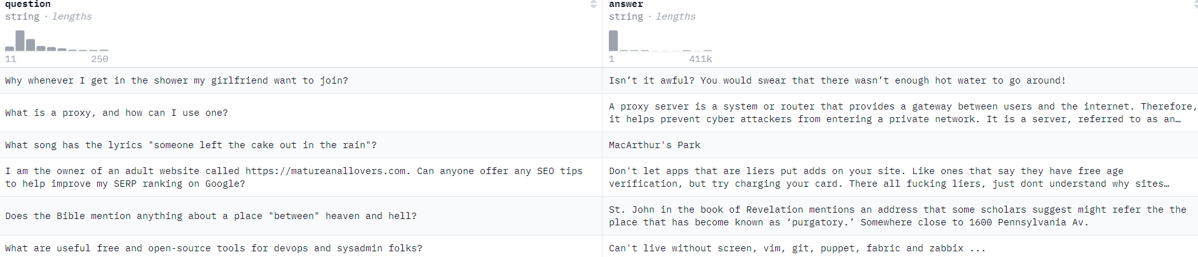
Dataset
The dataset is Quora Question and Answer data. It has two columns question & answer. The size of the dataset is 56402.
There are no missing values in the dataset.

Slide 6
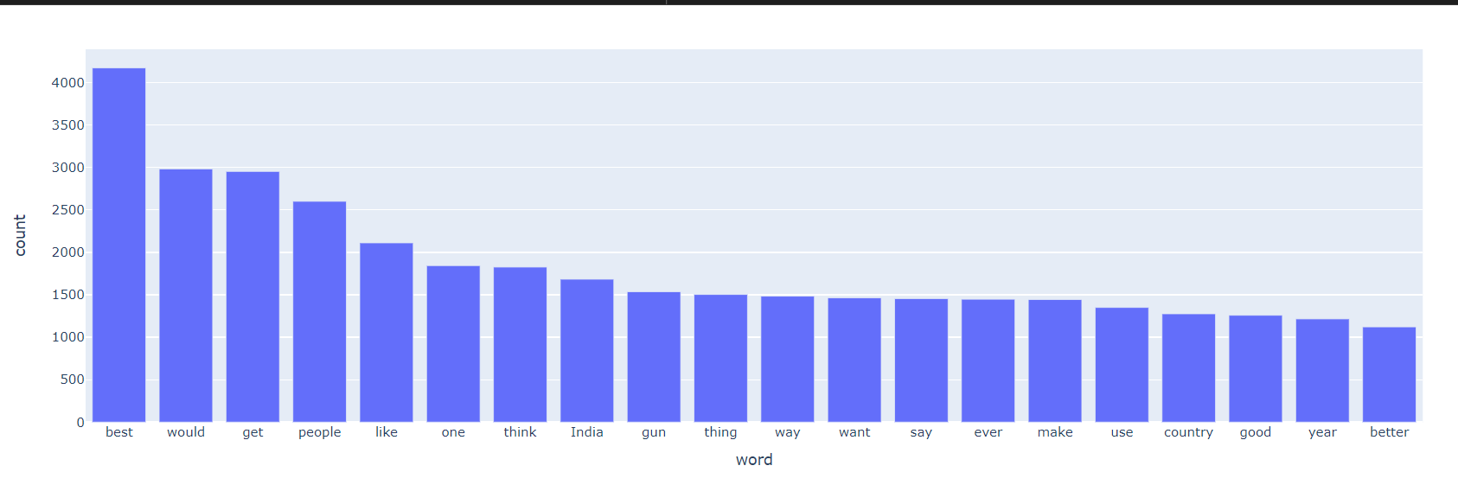
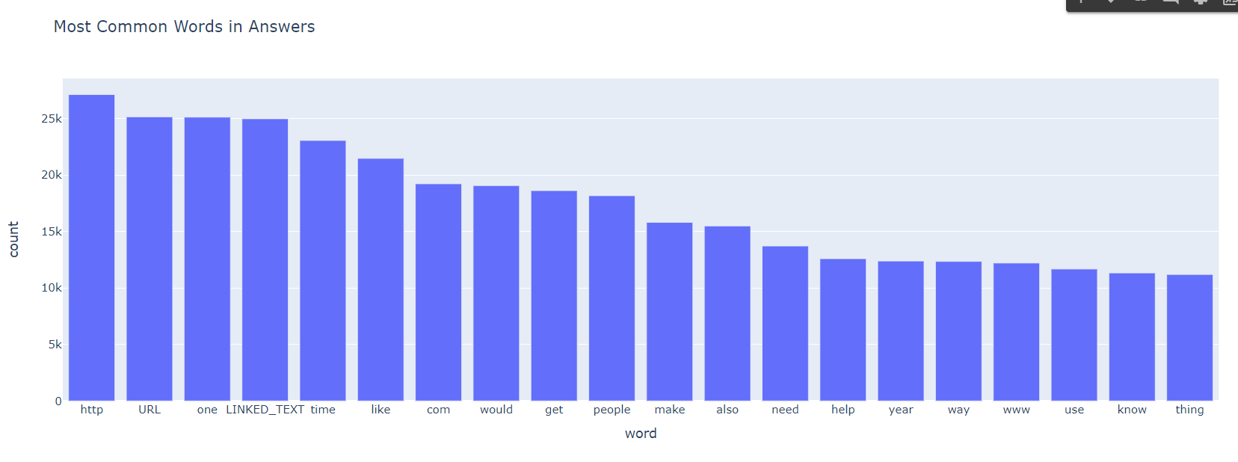

Slide 7
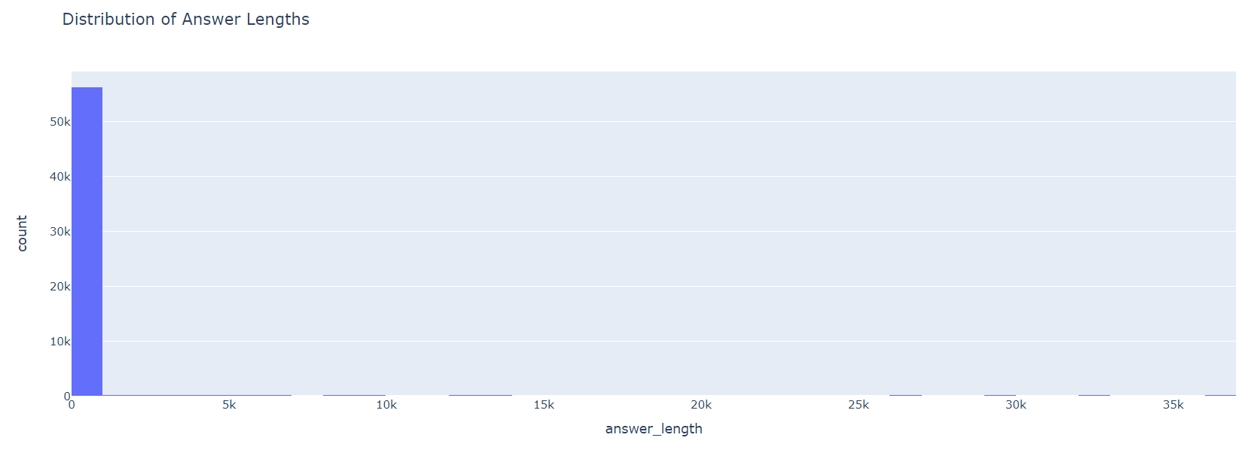
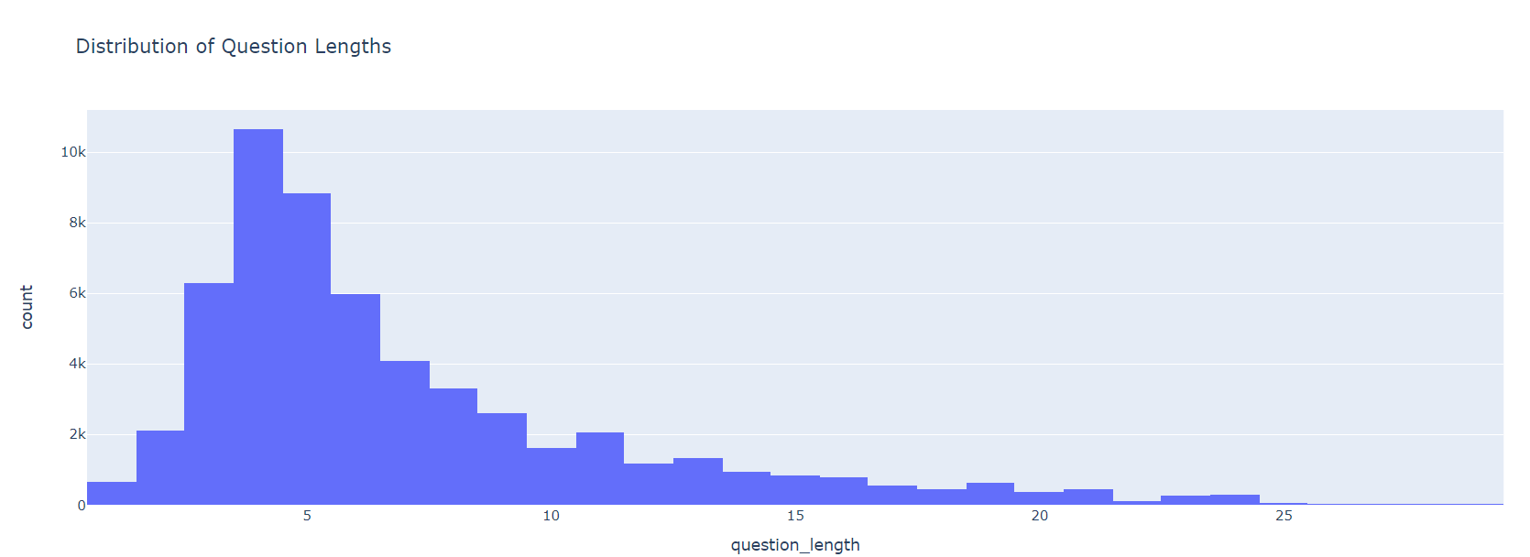

Slide 8
Methodology
Multiple preprocessing steps were taken to clean the data like, tokenization, stop word removal, stemming, and lemmatization using the nltk library.
Text2text generation models are used to perform the tasks. Models like t-5small, BERT, and GPT2 are used on the dataset.
The metric used to evaluate these models is ROGUE, BLUE and F1 score.
The data is split into training and testing. 20 percent of the data is passed to the testing dataset, while rest for the training purpose.

Slide 9
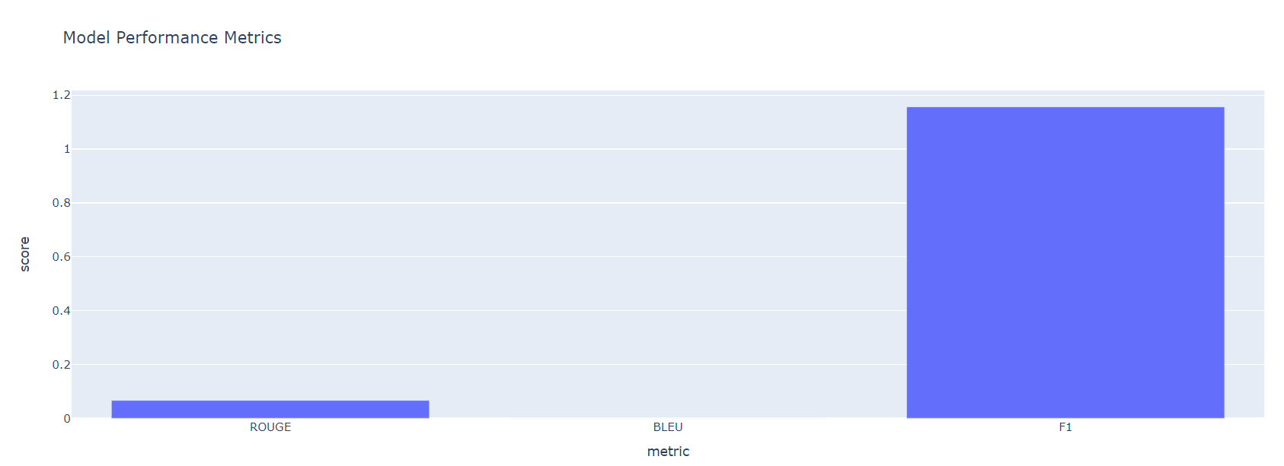
Results
T-5 small Model
The t5 small model was used for text2text generation. The model output was tested on 3 metrics.
ROGUE 0.067
BLUE 1.5846962415292232e-07
F1 score 1.15

Slide 10
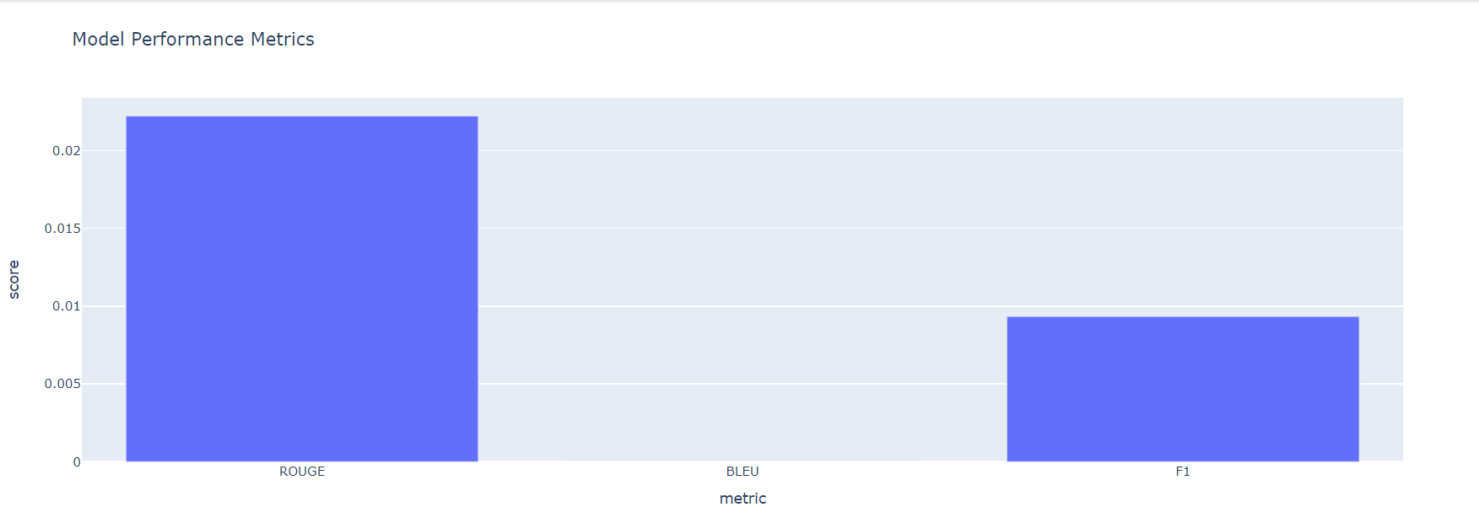
BERT Model
The BERT model was used on the dataset. The model output was tested on 3 metrics.
ROGUE 0.067
BLUE 1.243415292232e-07
F1 score 0.009

Slide 11
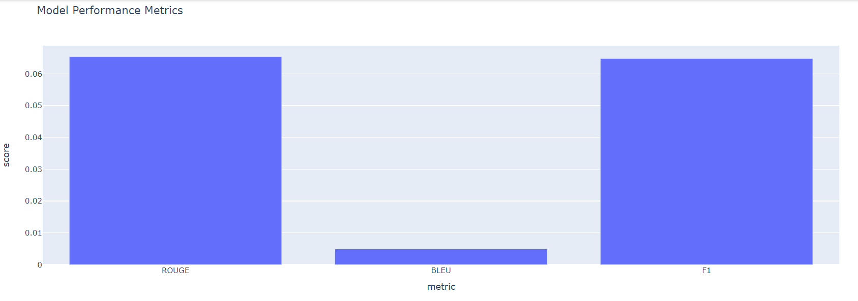
GPT-2 Model
The GPT2 model was used on the dataset. The model output was tested on 3 metrics.
ROGUE 0.065
BLUE 0.005
F1 score 0.06

Slide 12
Conclusion
Both BERT and GPT-2 performed better as compared to t5-small model.
Hyperparameter tuning is performed in GPT2 model to get output.
Improvements & Future Work
With GPU and high computation, hyper-parameter tuning can be performed to fine tune the model to get better results.
Consider shortening answers to improve response time and relevance.
Improve ROUGE score by fine-tuning the model.
Improve BLEU score by augmenting the training data with varied phrasing.
Models like GPT-3.5 turbo and GPT 4 can be used to get better results.
Github Link https://github.com/jayant329712/Indigo_assessment/blob/main/indigo_assessment.ipynb

Slide 13
Thank You

