Slide 1
.NET Dependency Agent
AI based dependency and architecture analysis for .NET projects
Presentation Goal
Show what the tool scans
Explain the generated reports
Highlight the new architecture diagram output
Simple demo deck for manager discussion

Slide 2
Why this tool is useful
Problem and solution in simple terms
Current Challenge
Our Solution
Manager Value
Difficult to understand project dependencies quickly
Manual checking takes time
Architecture is not always documented
Scan GitHub or local .csproj
Detect packages, references and call flow
Generate AI impact report and diagrams
Faster onboarding
Clear dependency visibility
Better impact analysis before code changes
DotNet Dependency Agent • Manager Demo
2

Slide 3
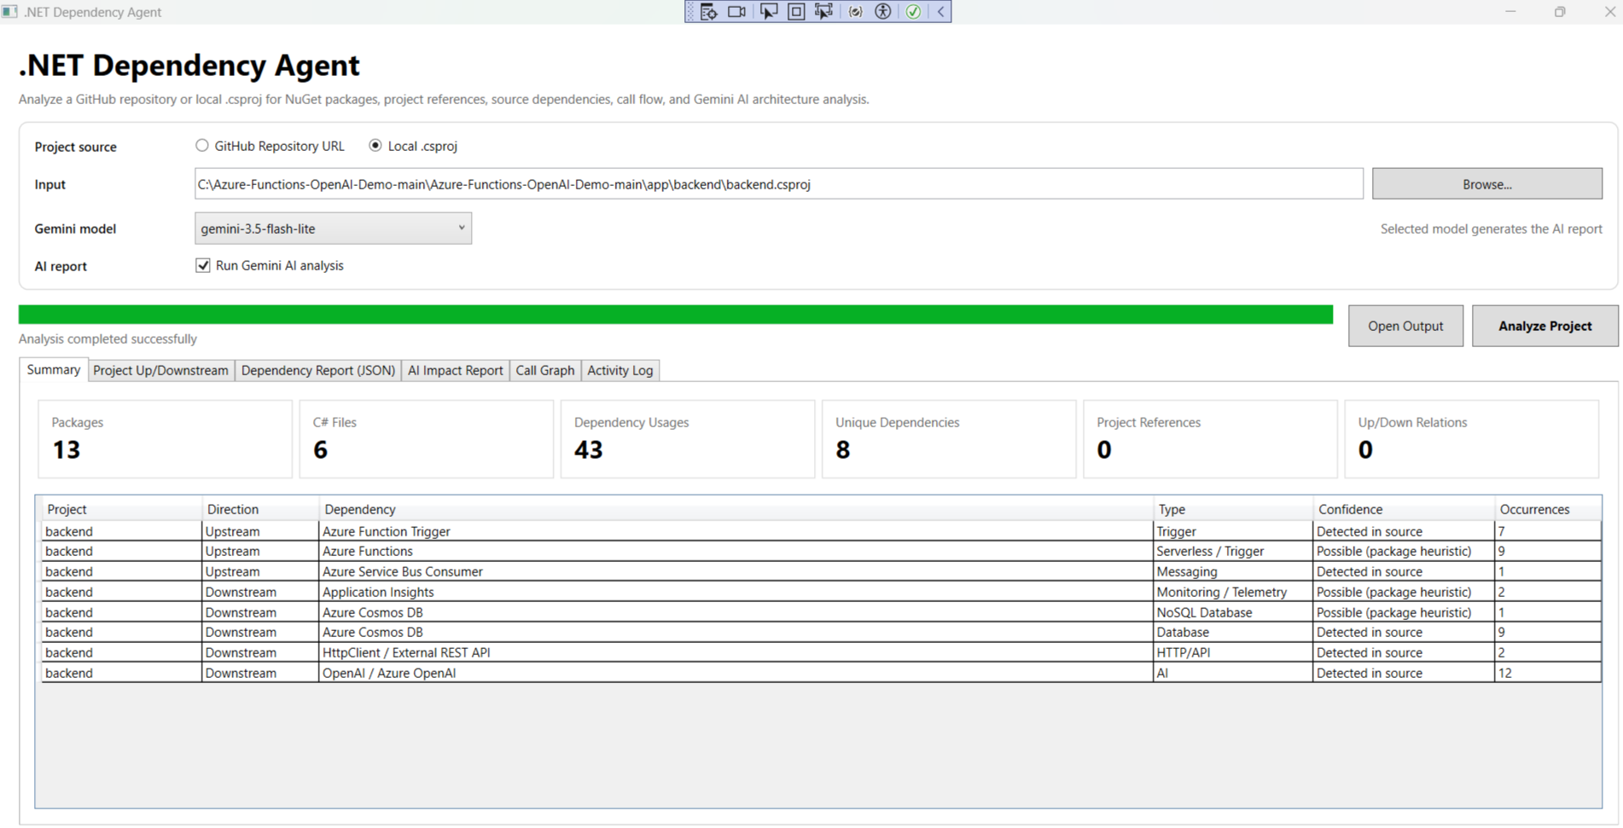
Application Overview
Main screen after successful analysis
What this screen shows
Input can be GitHub URL or local .csproj
Gemini model can be selected from dropdown
Summary tab shows counts and dependency usages
Analysis completed successfully with output folder
Demo project: Azure Functions backend
DotNet Dependency Agent • Manager Demo
3

Slide 4
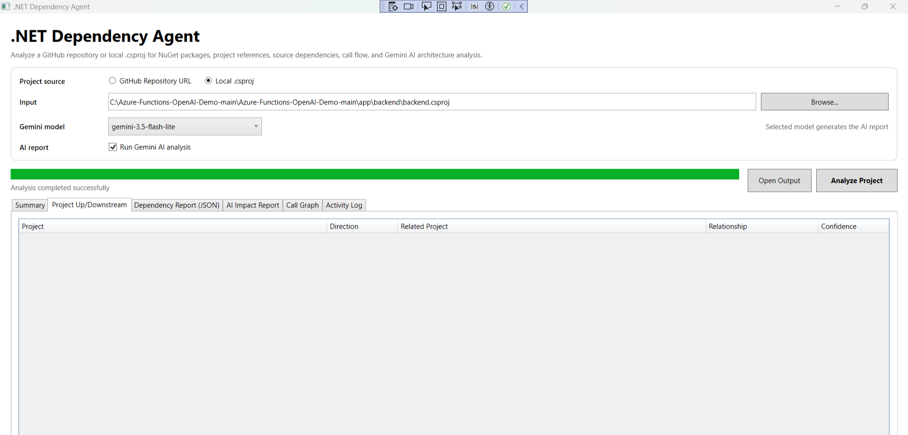
Dependency Findings
Upstream and downstream view
Key point
This tab shows project-to-project relationships.
For this sample project, there are no internal project references.
External dependencies are still detected in the Summary and AI report.
Manager speaking line
“The tool separates confirmed project relationships from external package/service dependencies.”
DotNet Dependency Agent • Manager Demo
4

Slide 5
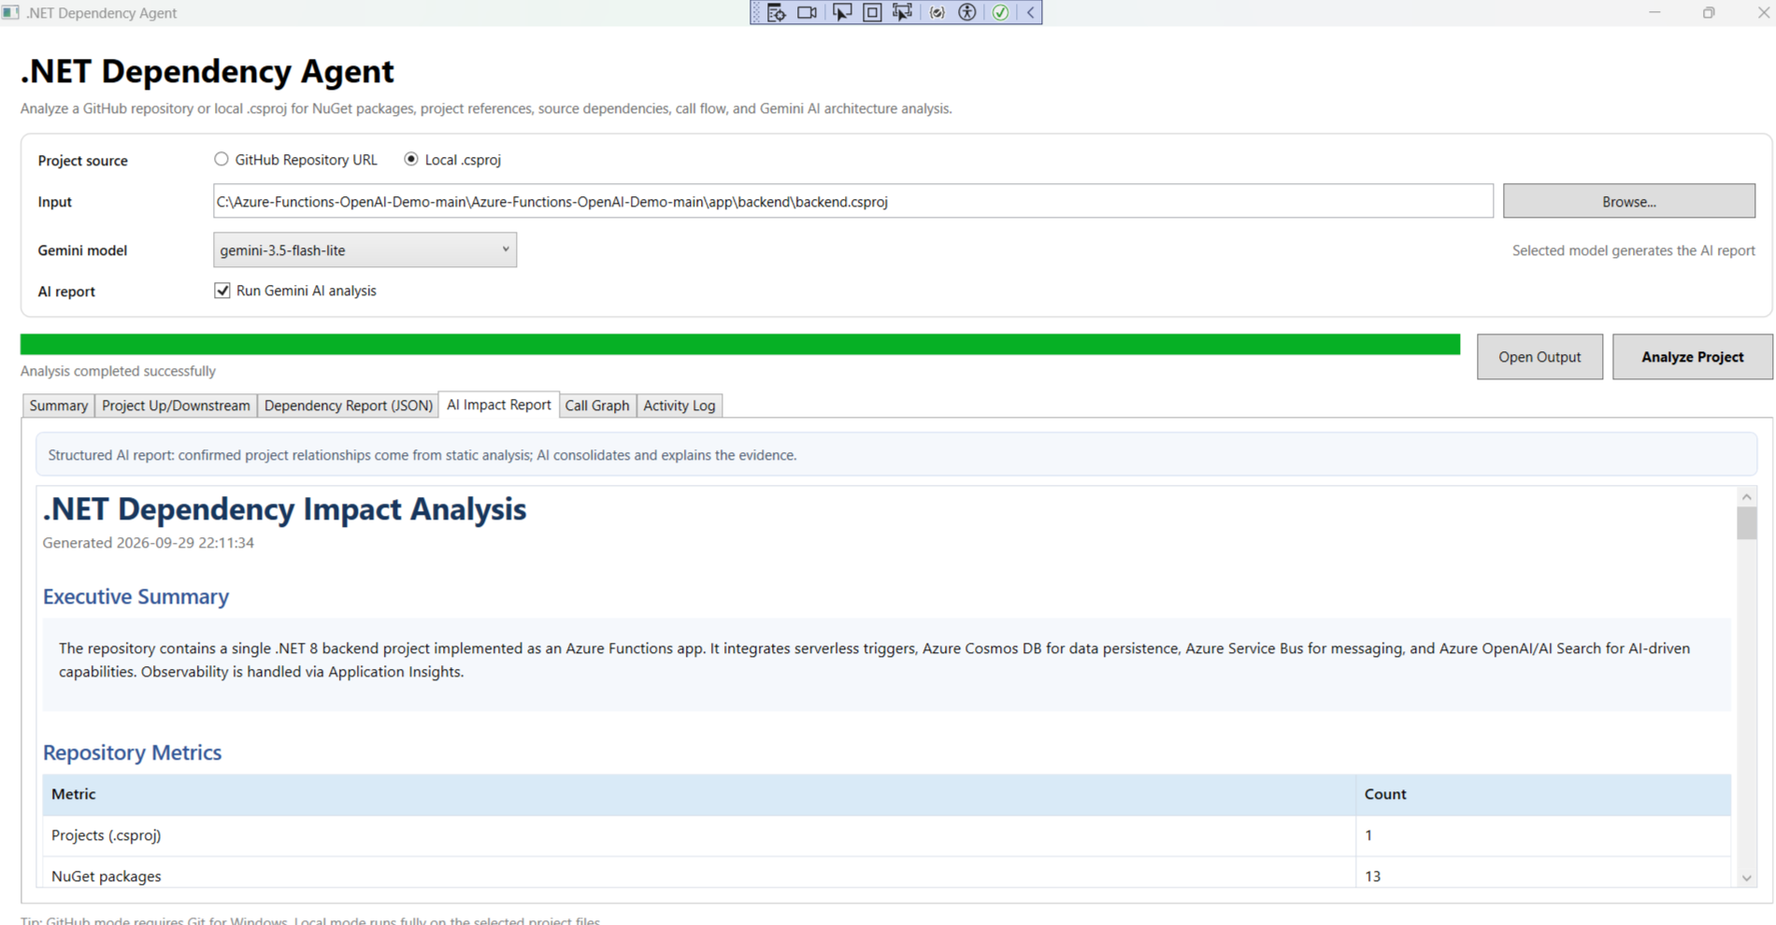
AI Impact Report
Readable explanation generated for manager and developer review
Report content
Executive summary
Repository metrics
Project architecture
Components and connections
Risks and recommendations
Simple HTML report for sharing
DotNet Dependency Agent • Manager Demo
5

Slide 6
Generated Architecture Diagram
New visual output added to the report
Azure OpenAI
Chat + Embeddings
.NET 8 Backend
Azure Functions
Diagram features
Client / API Consumer
Auto-generated from project scan
Color-coded blocks
Clear arrows with dependency direction
Separate SVG file saved in output folder
Azure Cosmos DB
Data Store
Application Insights
Telemetry
HTTP Triggers
Ask / Chat / Upload
Azure Service Bus
Queue / Message
Solid = confirmed
Dashed = possible
DotNet Dependency Agent • Manager Demo
6

Slide 7
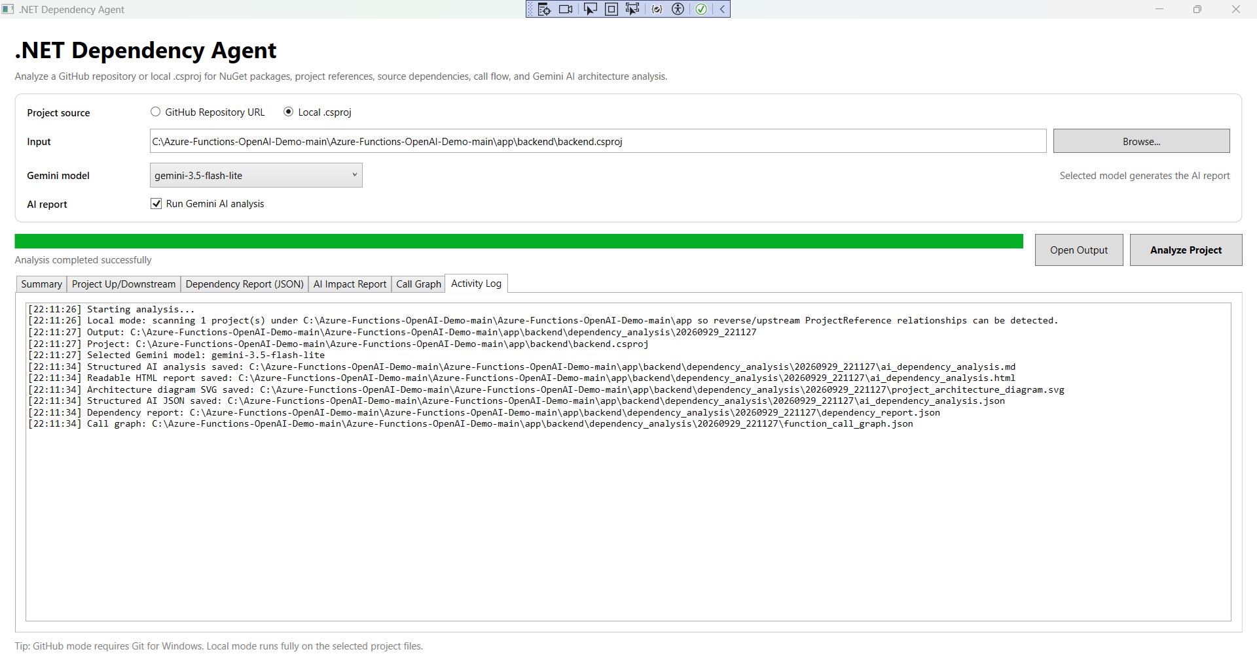
Generated Output Files
Activity log confirms report and diagram generation
Files produced
ai_dependency_analysis.html
ai_dependency_analysis.md
ai_dependency_analysis.json
project_architecture_diagram.svg
dependency_report.json
function_call_graph.json
This makes the result easy to share, review and store with project documentation.
DotNet Dependency Agent • Manager Demo
7

Slide 8
Next Steps
Simple plan to improve the tool further
1. Improve scanning
2. Improve reporting
3. Practical usage
More project types
Controller / service / repository mapping
Better confidence scoring
Cleaner architecture diagrams
More manager-friendly summary
Export to Word/PDF later
Use before code changes
Use during onboarding
Use in impact analysis reviews
Closing line: “This tool gives a quick and visual understanding of any .NET project dependency and architecture.”
DotNet Dependency Agent • Manager Demo
8

