Slide 1
Datadog: Monitoring and analysis + Implementation
https://medium.com/@vrushaliraut1234/datadog-monitoring-and-analysis-a302605c0bac

Slide 2
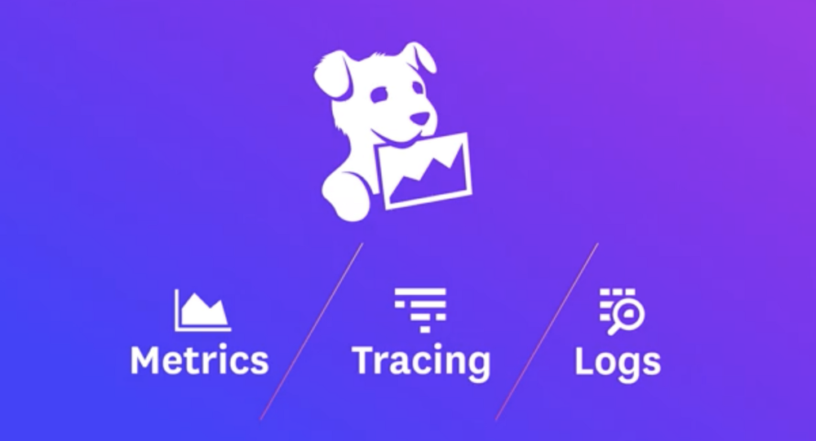
Datadog: Monitoring and analysis + Implementation

Slide 3
Table of Contents:-
What is datalog?
What types of monitoring can be done?
Dashboard introduction
How to integrate with REST OR gRPC service.

Slide 4
* Datadog:-
Datadog is a monitoring service for cloud-scale applications, providing monitoring of servers, databases, tools, and services, through a SaaS-based data analytics platform

Slide 5
What types of monitoring can be done?
Datadog is great for businesses that need…
Cloud monitoring
Server performance monitoring service
Server monitoring tools
Server usage analytics
80+ turn-key integrations for data aggregation
Alert notifications via e-mail and PagerDuty
Full API access
Overlay metrics and events across disparate sources
An easy way to compute rates, ratios, averages, or integrals
Sampling intervals of 10 seconds
Tools for team collaboration

Slide 6
A. Events:-
The Event Stream is based on the same conventions as a blog:
Every event in the stream can be commented on.
Great for distributed teams and maintaining the focus of an investigation.
You can filter by: user, source, tag, host, status, priority, incident
On the left-hand side, you can see a list of all data sources integrated.

Slide 7
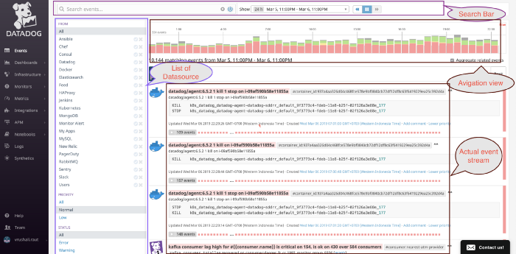

Slide 8
B. Dashboards:- There are 2 types of the dashboard you can create using Datadog
New Timeboard — For troubleshooting and correlation Time-synchronized metrics and event graph Automatic layout. Timeboards allows you to troubleshoot issues by pinpointing to the metrics and services at the same time.

Slide 9
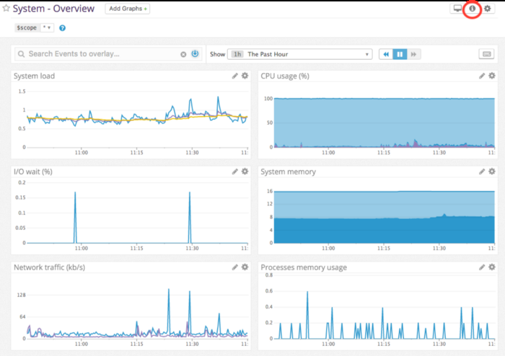

Slide 10
2. New Screenboard — For status board and sharing data. Mix widget and timeframes Custom drag-and-drop layout. Screenboards are ideal for checking the overall health and status of the services and entire architecture

Slide 11
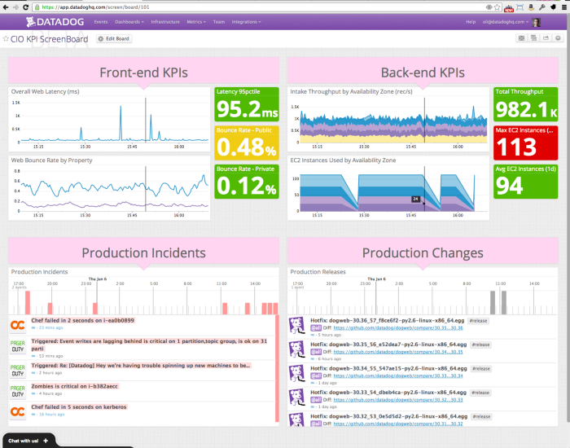

Slide 12
C. Infrastructure:-
The Infrastructure list page shows all hosts monitored by your Datadog application.

Slide 13
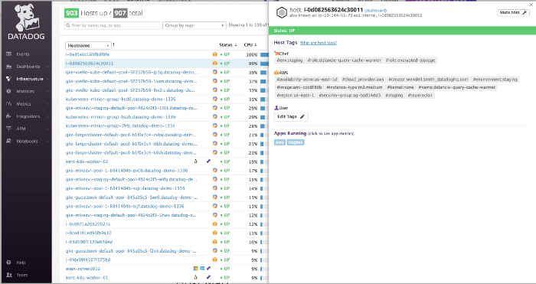
you can see the tags applied to each machine; as they’re assigned to perform certain roles, tagging allows you to indicate machines have a certain purpose.

Slide 14
D. Monitors:-
Applies to any metric you want, revenue: data center temperature.
Multi alerts (by device, host, etc.)
Set alert notification message

Slide 15
E. APM(Tracing):-
Datadog APM provides you with deep insight into your application’s performance-from automatically generated dashboards monitoring key metrics

Slide 16
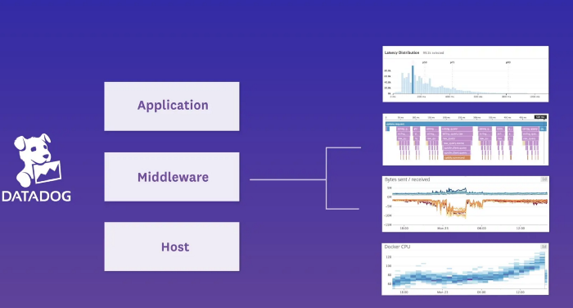

Slide 17
* How to integrate:-
More than 200 built-in integrations. you can integrate it into your project here is an interactive video to get started.

Slide 18
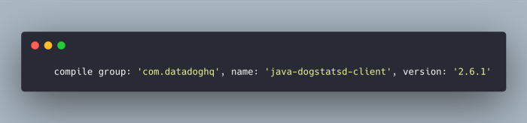
* Implement it with REST service

Slide 19
Once you add a dependency, you need to implement statsD client in your rest service like this.

Slide 20
