Slide 1
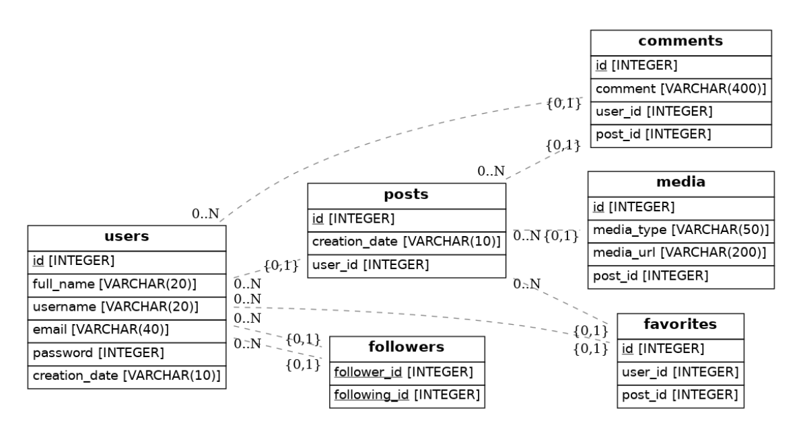
Ex1: Create tables and populate some data as per the ERD below

Slide 2
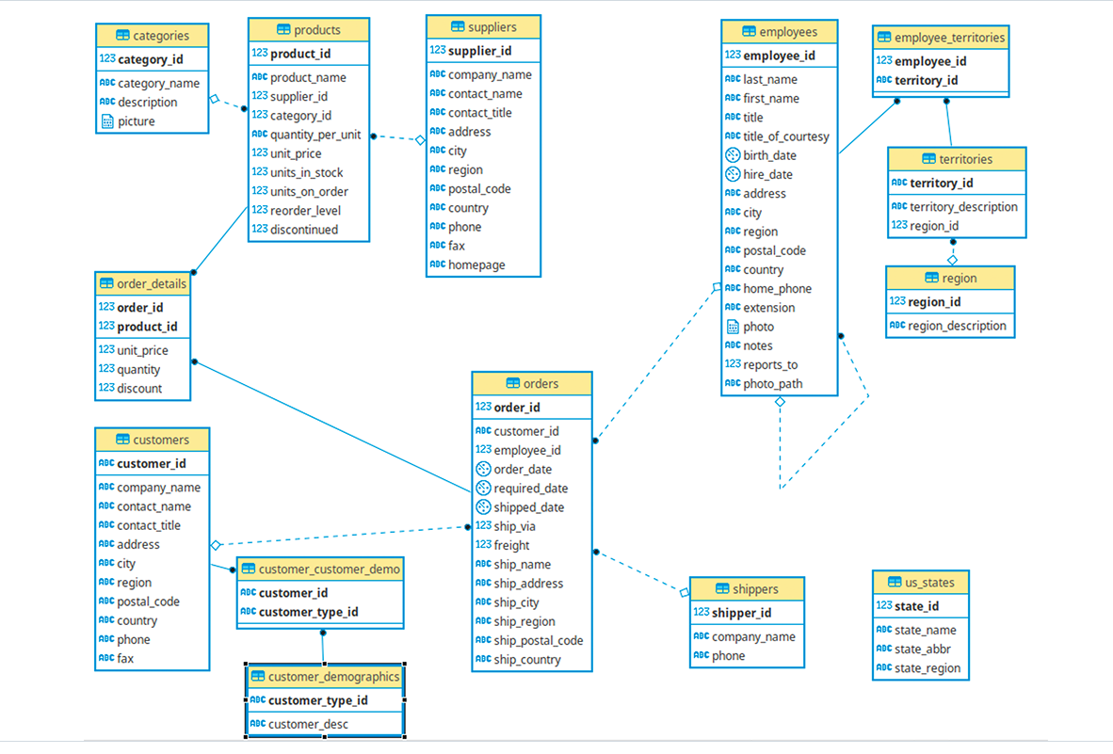

Slide 3
create schema sqlpractice;
set search_path to sqlpractice;
create table department( id serial primary key, dept_code varchar(10), dept_desc varchar(50)
)
create table employee(id serial primary key,
emp_code varchar(10),
emp_name varchar(50),
department_id int references department(id) )

Slide 4
Reference:
https://github.com/pthom/northwind_psql

