Slide 1
JDBC -> Java Database Connectivity
JPA -> Java Persistence API
Hibernate -> ORM Tool
RDBMS
Java
JDBC Driver
Postgres Driver
MySql driver
Table
View
Index
Trigger
Sequence
Function
Stored Procedure

Slide 2
Exercises
-----------------
Create a maven project use GAV :
com.capgemini.javardbmsprac ->0.1
Add postgres maven dependency
Create a db in postgress called javardbmsprac
Create a table called vehicle_master having only id -> serial , make ->varchar (20)
Write a jdbc program to insert a record in the vehicle_master ( 1,”Audi”)
Create another java class in the same project where you print and insert dynamic data in the vehicle table taking input from the user.
Update the above program to include update and delete of vehicle
Create an entity called University and using JPA and hibernate insert records in the university table. The properties will be id, university name, university state.
Same exercise as above do it using hibernate
Implement all CRUD operations on University using hibernate.
Create class Driver and License establish OneToOne uni-directional and bi directional relationship using hibernate.

Slide 3
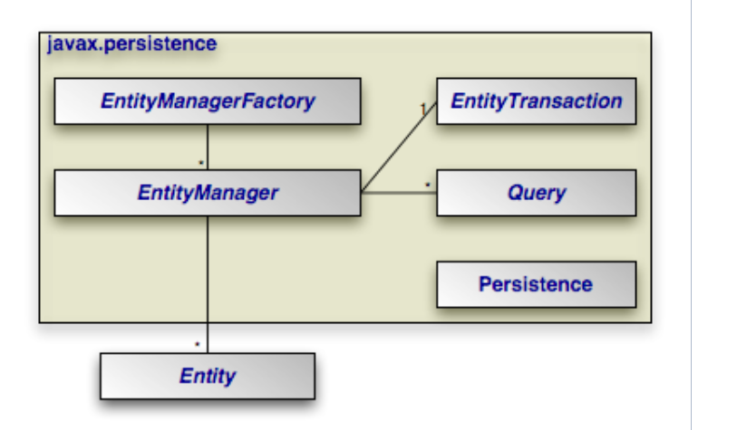
JDBC Problem:
Repetitive code
Writing native SQL queries
JPA -> Java Persistence API (Specification)
JPA is implemented by different vendors like Hibernate , EclipseLink (Oracle)/ TopLink
POJO -> Plain Old Java Object . Java class having properties /attributes , getter/setter, toString
https://openjpa.apache.org/builds/1.2.3/apache-openjpa/docs/jpa_overview_arch.html

Slide 4
JDBC Program
1
DB
Java Program
2
JPA
Hibernate
JDBC Driver
3
Hibernate

Slide 5
ORM
JPA
Hibernate
Java
ORM
Object Relational Mapping
Hibernate
DB
Movie
(Object)
movie (table)

Slide 6
Persistence.xml
hiberanate.cfg.xml
HibernateUtil.java
EntityManagerFactory
SessionFactory
EntityManager
Session
CRUD API
CRUD API

Slide 7
Person
OneToOne
Pan

Slide 8
Maven -> Build and dependency management tool
Gradle – another option
Driver -> Jar -> Java Archive
G -> Group Id (com.capgemini.ai)
A -> Artifact Id (imageproj)
V -> Version (0.1)

