Slide 1
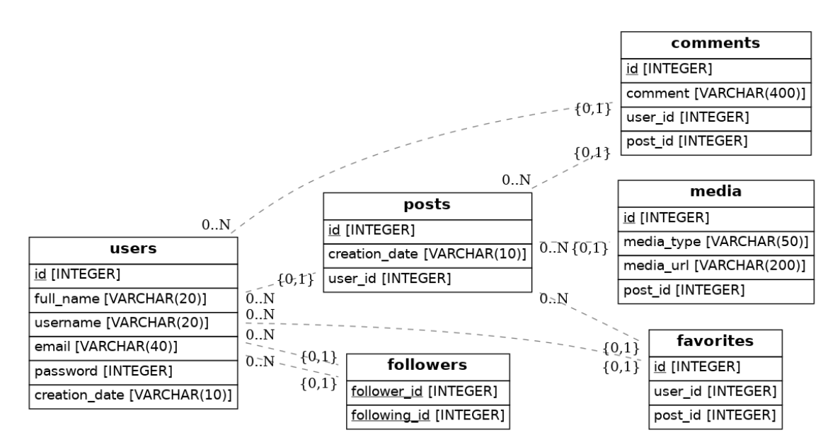
Ex1: Create tables and populate some data as per the ERD below

Slide 2
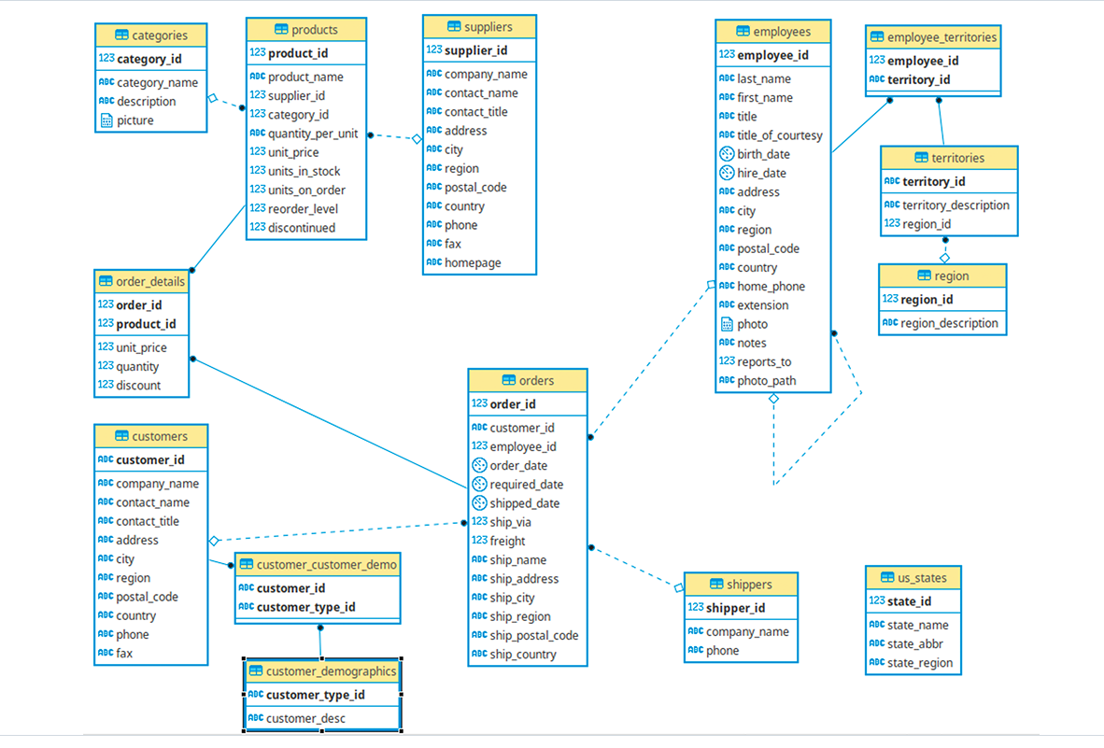

Slide 3
create schema sqlpractice;
set search_path to sqlpractice;
create table department( id serial primary key, dept_code varchar(10), dept_desc varchar(50)
)
create table employee(id serial primary key,
emp_code varchar(10),
emp_name varchar(50),
department_id int references department(id) )

Slide 4
A
B
Inner Join
A
B
A
B
Full Join
Left Join
A
B
Right Join

Slide 5
alter table employee
add column salary numeric(13,2)
create table project( id int primary key, project_code varchar(10), project_desc varchar(100) )
insert into project (id,project_code,project_desc)values(2,'LOGST01','Logistic Project’);
alter table employee add column project_id int references project(id)
select * from employeeupdate employee set project_id=1
select distinct(e.emp_name),d.dept_desc, p.project_descfrom employee e, department d, project pwhere e.department_id=d.idand e.project_id= p.id

Slide 6
Reference:
https://github.com/pthom/northwind_psql

Slide 7
Ex2: Find out the employee details who earn more than 50000
Ex3: Find out the employee details who earn in the range of 20000 to 50000 use between
Ex4. Using sum find out the total expenditure of the company as salary
Ex5: Find out the average salary earned by employees use avg
Ex6 : Print the employee details sorted by employee salary in descending order
Ex7 : Display the employees with department name.
Ex8: Display the employee name, employee code and his/her department name
Ex9 : Find out the most recently added employee code
Ex10 : Create record in employee table with department_id null , create record in department having no matching record in the employee table and then run queries using inner join, left outer join and right outer join
Ex11: Add a manager_id column in the employee table and using self join print the employee names and their manager names
Ex12 : Give me department wise employee count

Slide 8
Ex13 : Display a list : username , number of followers and how many ppl they are following
Ex14 : Display a list : username , number of comments made against the posts of users
Ex15 : Display a list : username , number of posts of users

Slide 9
Ex16: Display number of orders per customer.
Ex17. Display count of products category
wise per supplier
Ex18: Region wise employee count
Ex19: List of customers served by Eastern region employees
Ex20 : List of first three customers along with order value who placed highest orders (price)
Ex21 : First four highest sold categories (price)
Ex22: First four suppliers whose product sold maximum in terms of quantity

Slide 10
Ex 23: Name of the shipper who shipped maximum number of orders
Ex24: Name of the shipper who shipped maximum order value
Ex25 : Name of the manager whose employees have shipped maximum order value

