Slide 1
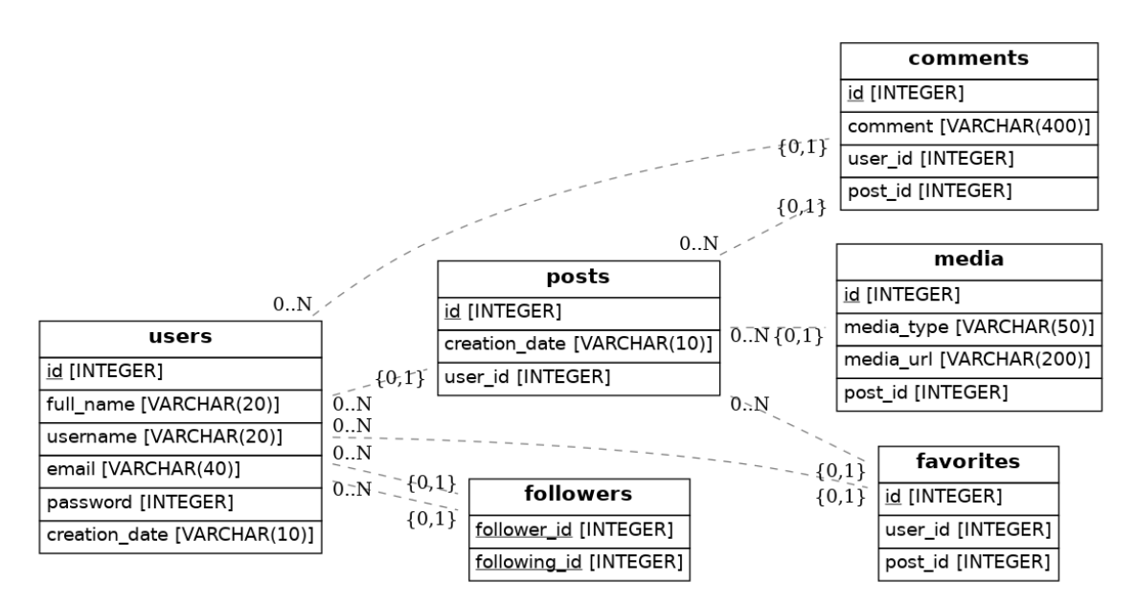
Ex1: Create tables and populate some data as per the ERD below

