Slide 1
IDMEPOTENT
Emp_name =“amit” id=1
Update emp_name=“jayanta” where id=1 -> PUT Mapping
Insert into employee (emp_name) value (‘jayanta’)
{
“id”:1,
“emName”:”Jayanta”
}
http://localhost:8080/user (GET Mapping)
JAVA
Serialization-> java object to bytestream
{
“emName”:”Amit”
}
http://localhost:8080/user (POST Mapping)
DE-Serialization-> bytestream to Java Object

Slide 2
Ex1 : In the Employee managemnet project Create a package called exception under that create a class called DataNotFoundExcption having a constructor that accepts a message String message.
In the Service layer add exceptions in deleteById, findById
Ex2: Using Spring MVC with thymeleaf as a view do a CRUD on Food Booking.
Name of the food: Pizza
Qty : 4

Slide 3
MVC - Model View Controller
Design Pattern

Slide 4
View
Model
Controller
/movies
https://terasolunaorg.github.io/guideline/1.0.1.RELEASE/en/Overview/SpringMVCOverview.html

Slide 5
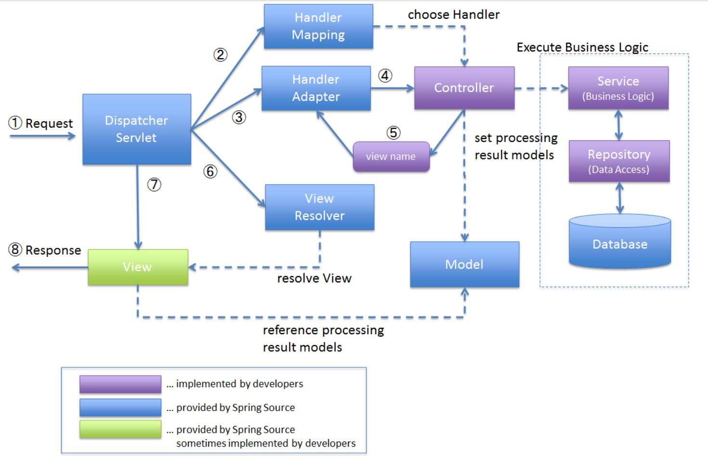

Slide 6
REACT
/movie -> GetMapping
REST
DB
ANGULAR

