Slide 1
/api/book
JWT=>Json Web Token
Algo
Type
Payload
Signature
Filter
MyApp
http request

Slide 2
Database
Front End
Back End
HTML -> UI
CSS-> Beautification
JavaScript -> Dynamicity
HTML -> Hyper Text Markup Language

Slide 3
<tag attribute=“a1”> This is a content </tag>
HTML ELEMENT=tag + attribute+ content
<input type=“text” />
<p> This is a paragraph</p>
Block level element : takes the entire space , automatically adds a new line.

Slide 4
Ex 1: Create a springboot application having an endpoint called getCurrentTime which is going to give you current data time. Secure this end point with a JT token. Create an endpoint called /login where you pass user id and password to generate the token which will be used to access the other end points.
Ex2: Create an HTML document called hello.html . Title should show hello and in body you have 50 word text.
Ex3: Print the following text on an HTML document : This is the first page of our simple web application. Please note that first page is in bold.
Ex3: Create a text box that can have only positive odd numbers.
Ex4: Create a table to display some employee information like employee name, employee id and salary. Show few data in that table, create some appropriate table column headers.
Ex5: Create a drop down to show different currencies.

Slide 5
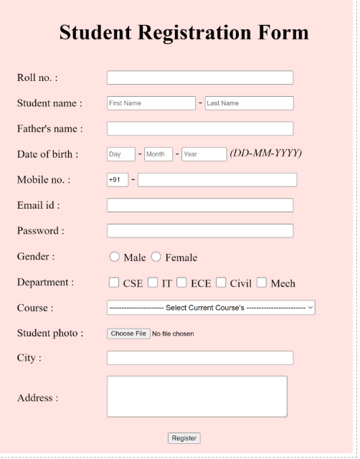
Ex6: Create the following form using HTML

Slide 6
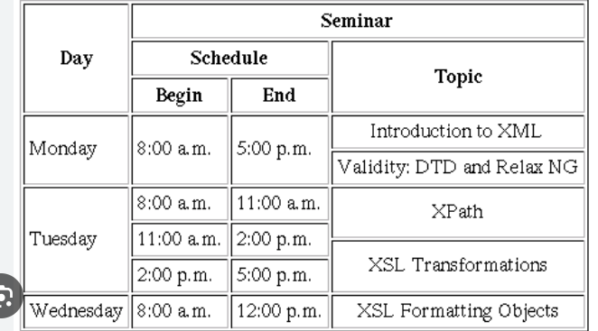
Ex7: Create the following using HTML table

Slide 7
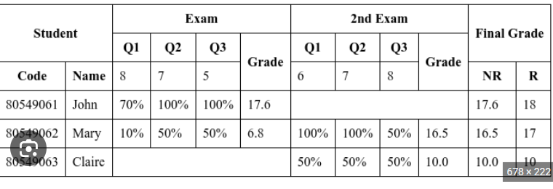
Ex8: Create the following using HTML table

Slide 8
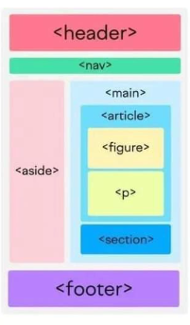
Ex9: Create the following using HTML table

Slide 9
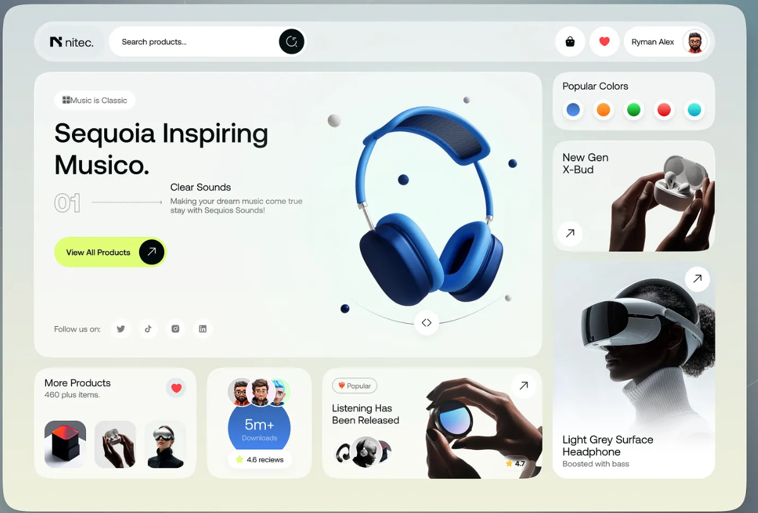
Ex10: Create the following using HTML bootstrap

Slide 10
Semantic Tag : <aside> <nav> <header> <footer> <article> <section>
Non Semantic Tag : <div> <span> -> Layout

Slide 11
Break up to 11:15 AM

