Slide 1
C1V
CV
CV
CV
CV
CV
12CV
C4V
C8V
BOOTSTRAP GRID

Slide 2
CSS -> Cascading Style Sheet
Inline
Internal
External file
Selectors
P{
}
selector { property: value }
p { color:red }
H1{color:green}

Slide 3
HTML
Head
Body
h1
h2
h3
div
div
DOM -> css1.html
Specificity

Slide 4
Margin

Slide 5
Paddding

Slide 6
Ex 1 : Create a grid layout with Bootstrap that includes:
A header section that spans the full width of the container
A main section with two columns: one for content (8 columns wide) and one for a sidebar (4 columns wide)
A footer section that spans the full width of the container
Ex2: Create a paragraph and using inline css align the text to center , color is green and font-size 40px
Ex3: Modify the above code and apply the same css using internal style.
Ex4: Modify the above code and apply the same css using external css file.
Ex5 : Create some html elements in a new html file. Using group , class, id, universal selectors apply different styles to them. Try to apply same properties and see how it is getting overridden.
Ex6: Create two div elements put them inside a container and using margin properties change their positions with respect to each other.
Ex7: Create one div element and put some text inside it and using margin change the position of the text.

Slide 7
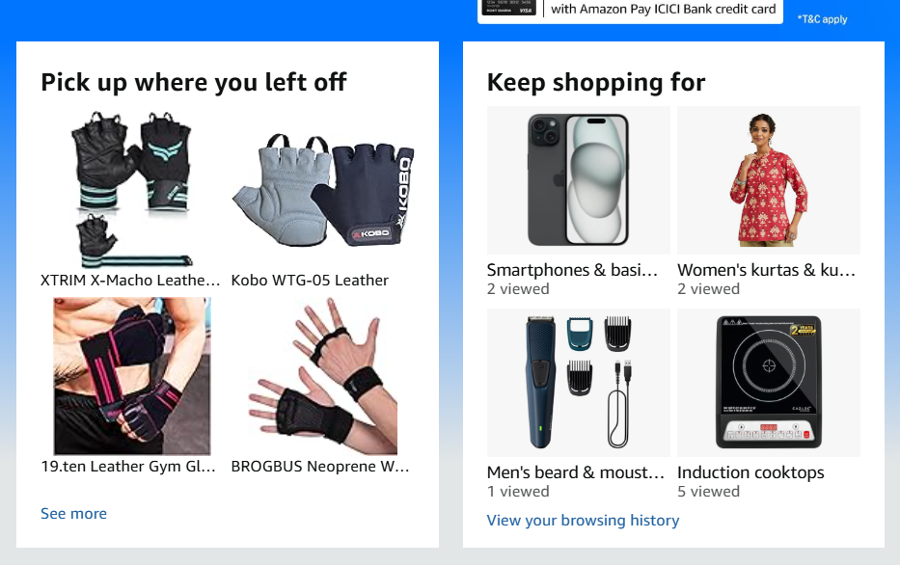
Ex 8 : Create login page with CSS and BootStrap with all standard fields and forgot password and remember me option.
Ex 9 :Create a separate html page called typography.html include bootstrap css links and use bootstrap typography features.
Ex10: Implement the following layout using flexbox

Slide 8
Ex11 :Create an HTML structure for a blog post with the following elements:
Header with navigation menu (3-4 links)
A section with a background image, title, and meta information (author, date)
Main content area with:
Introduction paragraph
2-3 sections with headings, paragraphs, and images
Call-to-action (CTA) button
Sidebar with:
About author section with image, bio, and social media links
Recent posts section with 3-4 links
Footer with copyright information and social media links
Style the layout using CSS to achieve the following:
Responsive design that works on desktop, tablet, and mobile devices
Custom typography and font sizes
Consistent spacing and margins
CTA button with a hover effect
Use CSS Grid or Flexbox to create a responsive grid layout for the main content area and sidebar.
Add media queries to adjust the layout for different screen sizes.
Design Requirements:
Use a clean and minimalistic design
Choose a maximum of 3-4 colors for the design
Use a consistent font family throughout the design
Ensure adequate contrast between text and background colors

Slide 9
Ex12 : E-commerce Website:
Create a simple online store with product pages, shopping cart, and checkout
Include pages for Home, Products, About, and Contact

Slide 10
Break up to 11:15 AM

