Slide 1
Hibernate
EclipseLink
iBatis
O -> Object
R -> Relational
M -> Mapping
JAVA
Jdbc driver
DB
JDBC
ORM
Table
Object
Translate Java Object manipulation to SQL query

Slide 2
Spring is a framework of frameworks
For Rapid application development
POJO- > Plain Old Java Objects
Properties, Getters/Setters, toString , Constructors
Beans -> pojo classes
Scope = singleton
Scope= prototype
Property based DI

Slide 3
3 types of DI
Property based
Setter based
Constructor based
context
bean
container
container
Inversion of Control -> IoC
Dependency Injection -> DI

Slide 4
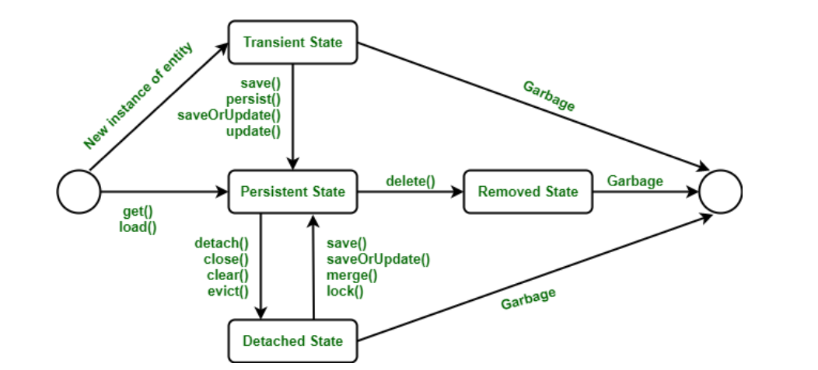

Slide 5
Ex1: Create a hibernate application to store data in the database table called PAN – id (int), panholderName(String) , panNumber(String) -> save some record in the db using hibernate.
Ex2: Create a maven project , add spring context as dependency, create class called Department with two properties deptCode like “Fin” departmentName like “Finance” . Using spring context create the beans and print it.
Ex3: Set some default values for Department bean, create a bean called college having collegeName and department. Using property based DI set a department to the College bean. In the App class get the College bean and print it.
Ex3: Modify your previous code to do a constructor based DI.
Ex4: Create a class called Display having a property called size (int) ,create a class called Mobile in that Mobile class using contstructor based DI inject Display object. Make both of these classes spring beans by using @Component and use annotation based configuration for application context.

Slide 6
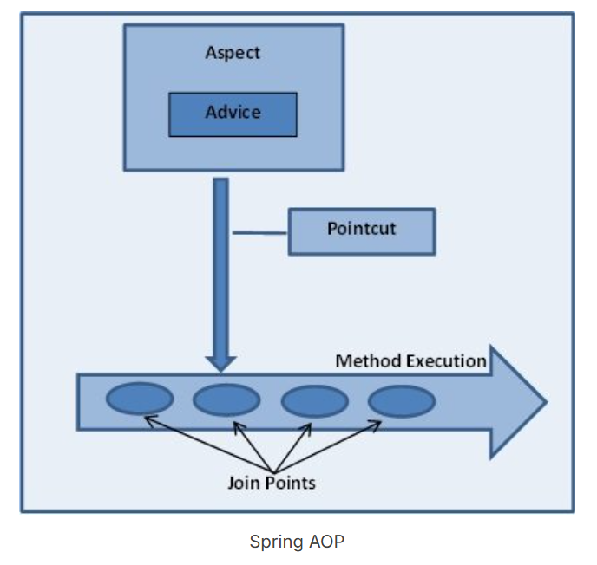
Checkin
void showBookingSlip()
void showPhotoId()
Void payment()
2. Restaurant
void collectDish()
void collectFood()
void pay()
3. Gym
void showRoomKey()
4. Swimming Pool
void takeShower()
wearMusk()
showVacCard()
bookingSlip
photoId
pay

Slide 7
BREAK UPTO 4:00 PM

