Slide 1
3 types of DI
Property based
Setter based
Constructor based
context
bean
container
container
Inversion of Control -> IoC
Dependency Injection -> DI

Slide 2
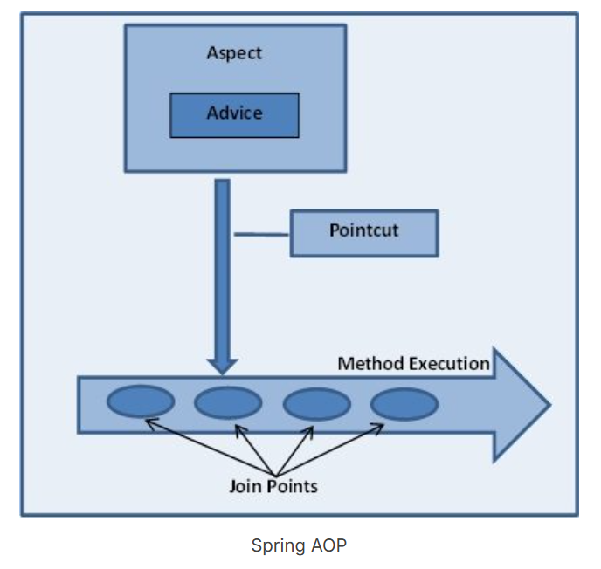
Checkin
void showBookingSlip()
void showPhotoId()
Void payment()
2. Restaurant
void collectDish()
void collectFood()
void pay()
3. Gym
void showRoomKey()
4. Swimming Pool
void takeShower()
wearMusk()
showVacCard()
bookingSlip
photoId
pay

Slide 3
Ex1: You are travelling by Air. For that you need to go through following processes inside a class called AirTravelProcess.
checkIn
collectBoardingPass
doSecurityCheck
doBoarding
Using aop you implement an advice called showPhotoId before checkIn
Another advice showBoardingPass -> before secuirity check and before boarding. Put theses two advices in a single aspect called AirTravelAspect
During checkIn process you can encounter an exception called NoSeatAvailableException and handle it through an AfterThrowing advice.
void checkIn(Boolean flag) throws NoSeatAvailableException
try
checkIn(false) -> true print check in successful if it is false throw NoSeatAvailableException
collectBoardingPass()
doSecurityCheck()
doBoarding()
}catch(Exception ex
{}

Slide 4
Ex2 : Create a spring MVC application to display a list of Car Names like Audi, Mercedes
,BMW. Use Controller->Service->Repo three layers . Create a jsp called carlist.jsp.
Controller -> CarController (“/car”)
@Gemppaing(“/list”)
Method String showCarList(Model m)
http://localhost:8080/firstdemomvc/car/list -> show the carlist.jsp
In that JSP file get the list of cars from controller and using for each display it.
Ex3:
Create a Springboot MVC application with layers (service and repo) print a list of Cities in India

Slide 5
M -> Model
V-> View
C->Controller
MVC-> Design Pattern (Solution to recurringly occurring problems)
/product
Controller
data
data
View
Model

Slide 6
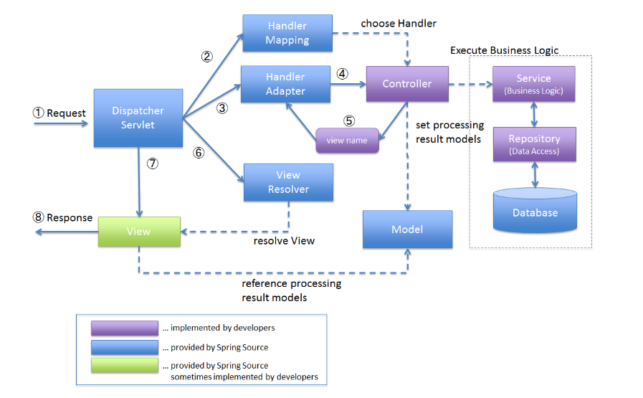

Slide 7
BREAK UPTO 2:00 PM

