Slide 1
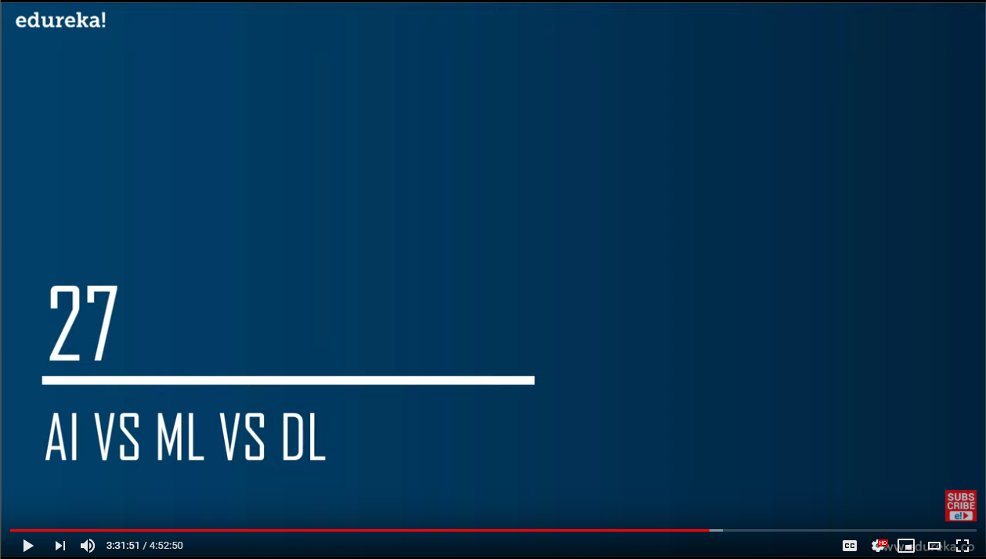

Slide 2
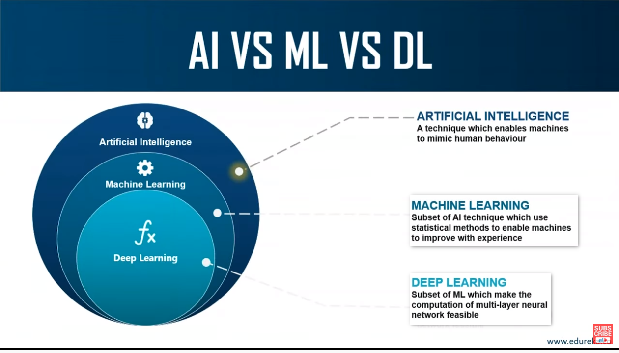

Slide 3

ML is not capable enough to handle high dimensional data.
e.g image recognition has large dimensions of data. So ML is not suitable.

Slide 4
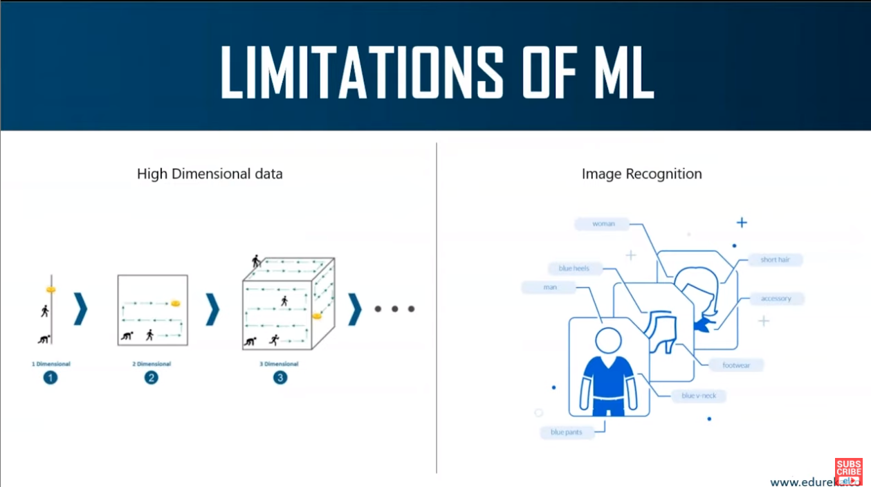

Slide 5
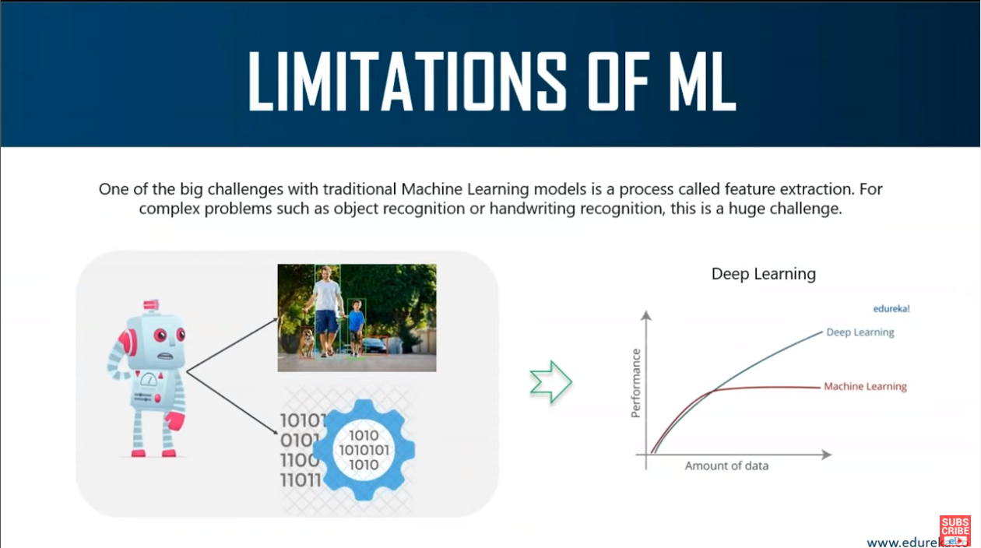
Problem: tell the computer what are the features (predictor variables) it should look for that will play an important role in predicting the outcome and getting a good accuracy.

Slide 6
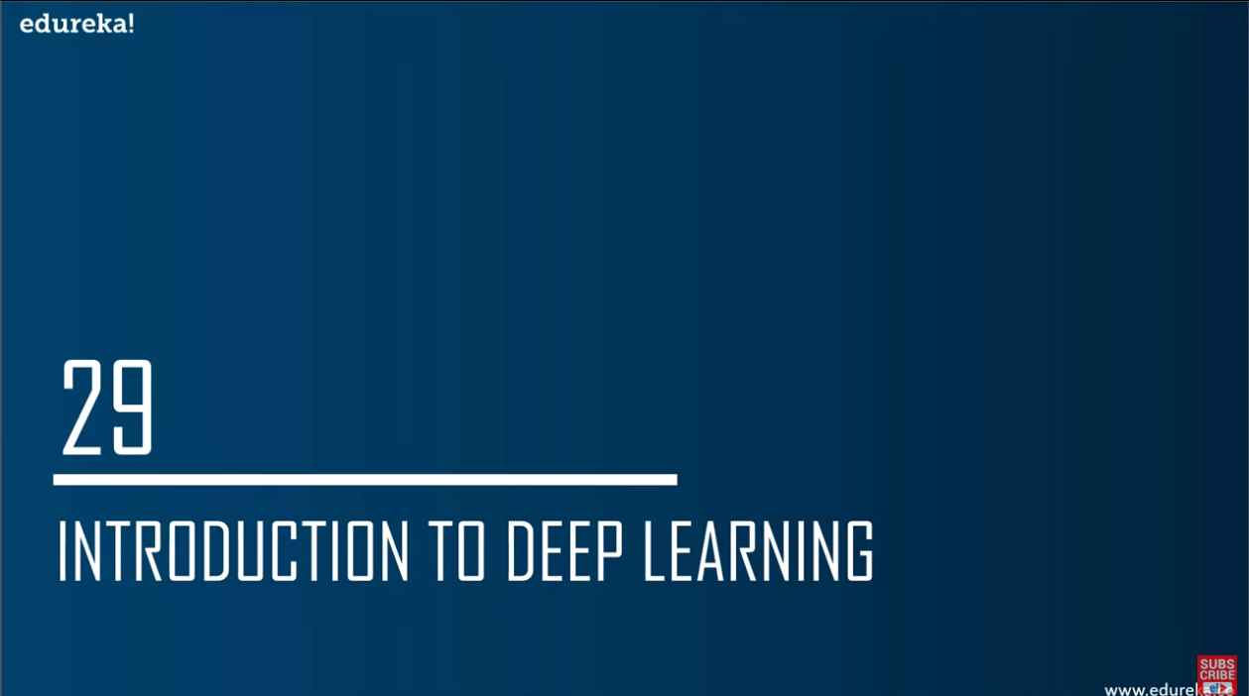
Overcome the challenges of feature extraction.
DL is capable of learning to focus on the right features by themselves.
This require very little guidance from the programmer.
It mimics the way our brain functions.

Slide 7
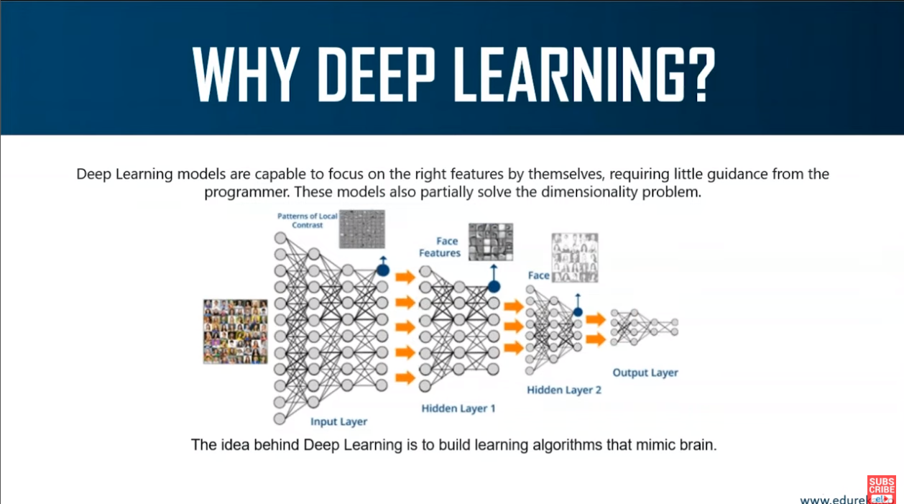
Example: recognize the face of different people in an image

Slide 8
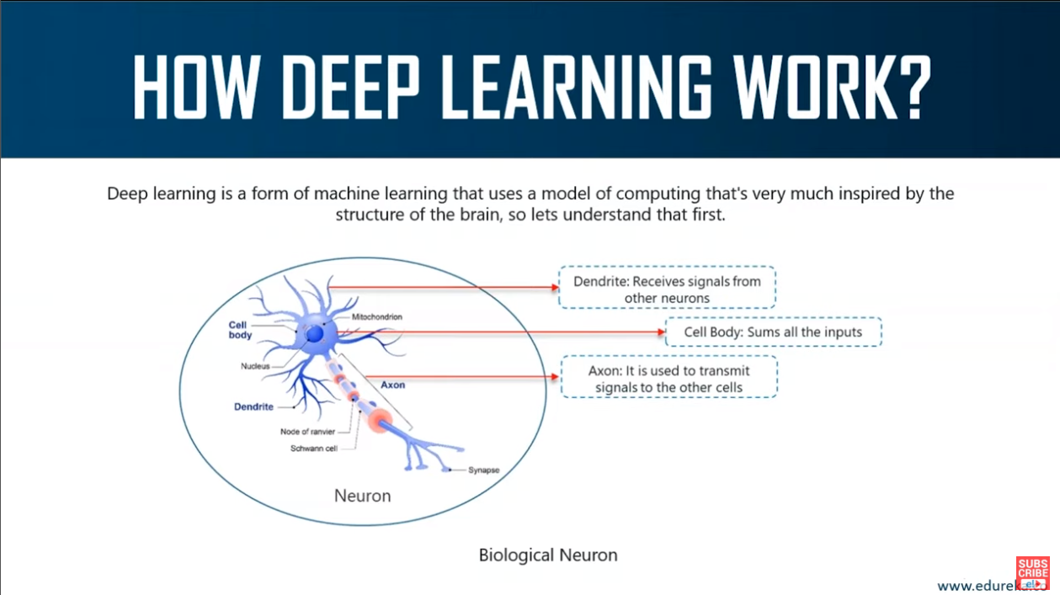
Artificial neurons are also called perceptron

Slide 9
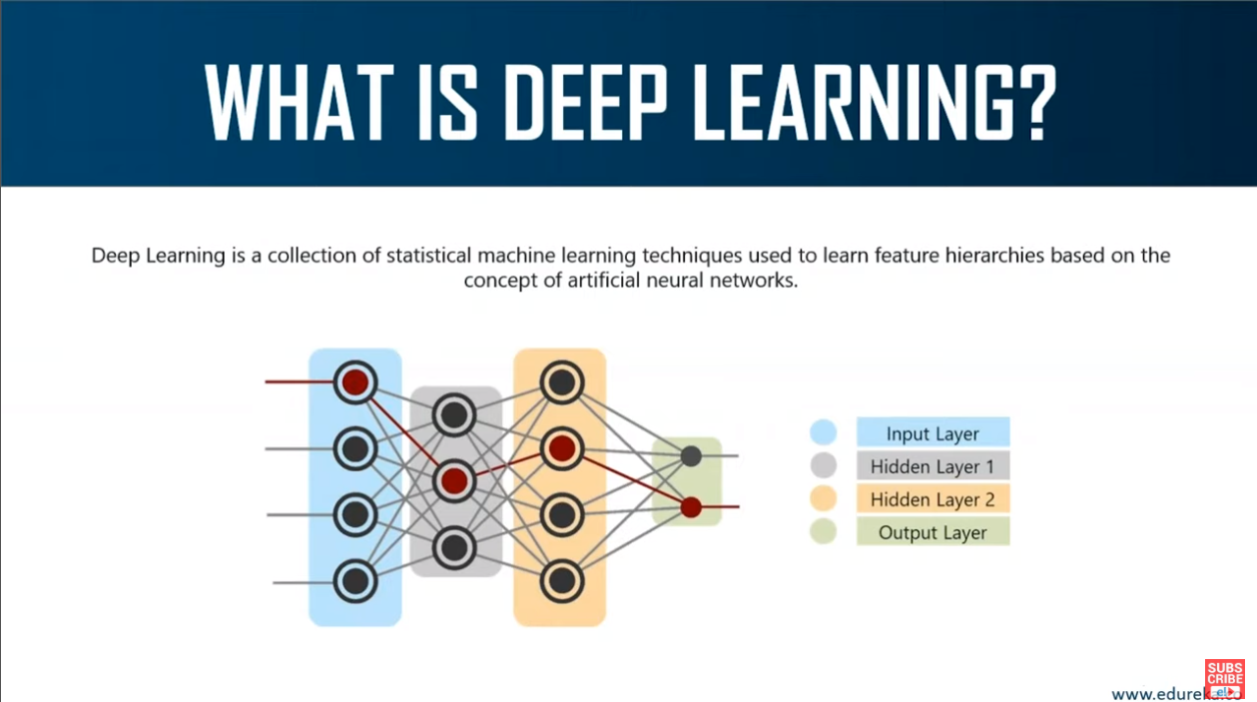
Hidden layer 1 will identify eyes, noses etc.
Hidden layer 2 will identify entire face

Slide 10
