Slide 1

Literature Seminar on
“Development of three axis cost effective CNC
PCB designing machine’’
Group Members :
Jayant Dhandale EE20006
Inshul Zade EE20008
Ulhas Munne EE20009
Prajwal Rudrakar EE20014
Vidhisha Shende EE20015
Hitesh Dudhe EE21D025
Priti Pawar EE21D026
Guided By :
Mr. Afsar Khan
(Assistant professor)

Slide 2
CONTENT
Introduction
Literature Survey
Proposed Problem / Methodology
Work Plan (month wise)
References

Slide 3
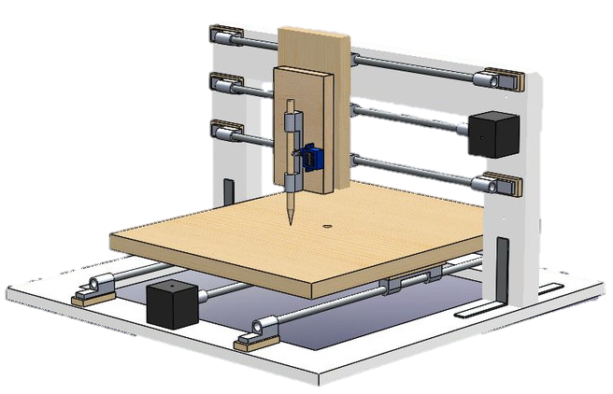
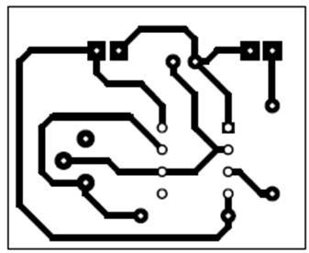
INTRODUCTION
An CNC PCB plotter is a machine designed for the automated design trace of printed circuit boards (PCBs). This project involves the construction of a compact and cost-effective PCB plotter, which can greatly simplify the PCB prototyping process for electronics enthusiasts and professionals. This offers the advantage of instant PCB creation, reducing the turnaround time for electronics prototyping.

Slide 4
LITERATURE SURVEY

Slide 5
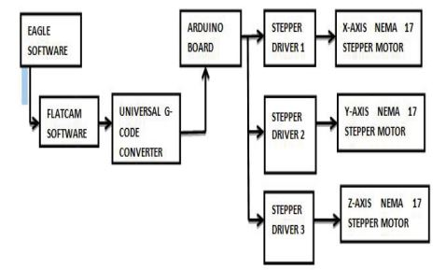
Paper No.1
Title: Design and Implementation of Three-Axis Cost Efficient CNC PCB Milling Machine
CNC, Computer Numerical Control, technology has become increasingly prominent in the manufacturing sector, To enhance accessibility and affordability, low-cost CNC machines are being developed.
Leveraging this CNC technology and the transformative wave of automation and digital electronics, the concept of a CNC-based PCB design machine is being introduced.
Block control of CNC

Slide 6
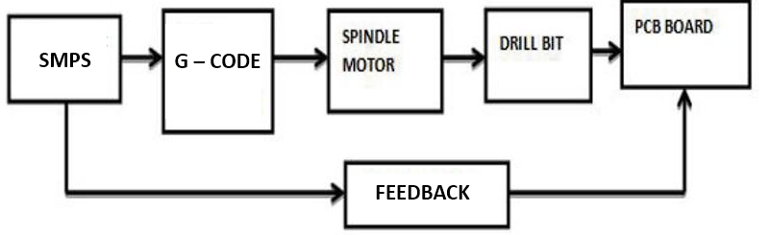
It uses two stepper motors and one servo motor as linear actuators on each X, Y & Z axis for drawing and drilling with proper synchronization of all this three axis. It uses the G-Code directly from supporting software like inkscape and laser grbl.
It has interface with PC and the Controller. This code is further passed to stepper motor by easy drivers and as per instructions the stepper motors moves and plot the circuit path and design it.
Block diagram of PCB milling machine

Slide 7
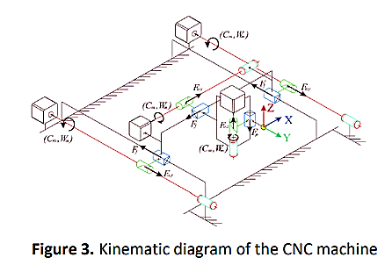
Paper No.2
Title: Mechanisms of a 3-axis CNC machine design and experiment
This paper presents the characteristic of three axis CNC machine The kinetic, dynamic, physical and electrical properties of each axis of the CNC machine are gathered , while Figure 3 shows the kinematic diagram of the x, y and z axes.
Kinematic parameters in the context of a three-axis CNC machine refer to the motion-related characteristics that define the movement of each axis. These parameters are crucial for understanding and controlling the machine's behavior.

Slide 8
Kinematic parameters, has critical process to ensure accuracy and reliability in machining operations. Calibration involves adjusting and verifying various machine parameters to match the intended specifications.
Resolution Calibration:
Verifying and, if necessary, adjusting the resolution settings to ensure that
the machine can accurately interpret and execute fine movements.
Positional Accuracy Calibration:
Calibrating the machine's feedback systems (such as encoders) to accurately
reflect the true position of each axis, compensating for any systematic errors.

Slide 9
Paper No.3
Title: A Build-Your-Own Three Axis CNC PCB Milling Machine
The paper is organized as discusses how a PCB is designed from open source software and fabricated using an inexpensive CNC milling machine. Softwares and Procedure to make a PCB layout file and how to generate the fabrication data. Issues and techniques prevalent in fabricating PCBs.
GRBL is open source software (FOSS) used to generate CNC machine G code and M code signals that will drive stepper motors using the Arduino microcontroller. G-code and M-code are programming G-code provides instruction commands for position, speed and path of the motion,. Compiled version of GRBL software code is available in the form of hex file and is burned into the Arduino.
GRBL CNC code will receive signals from Arduin serial buffer and parses it to decode the serial data into G-code.

Slide 10
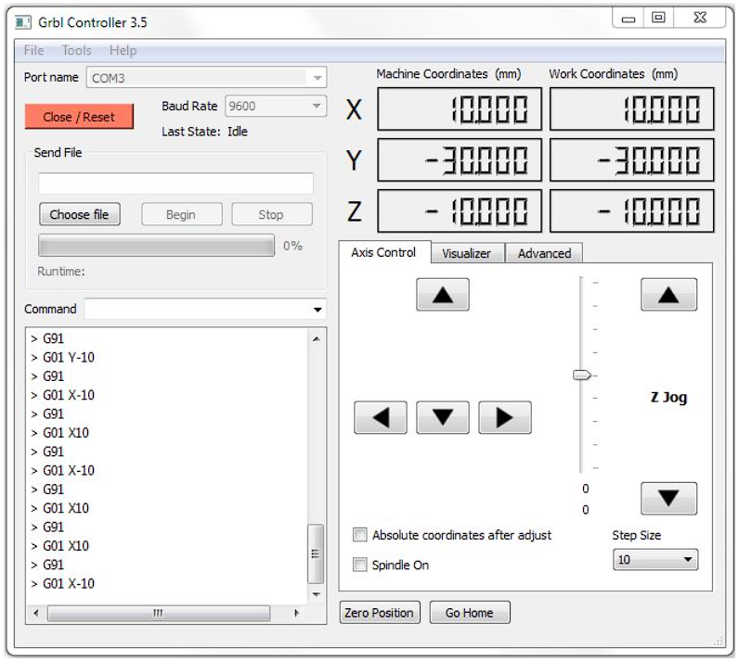
GRBL is configured through a set of parameters that can be adjusted to match the specific characteristics of the CNC machine it is controlling it map motor pulse steps in mm in graph plot.
GRBL has inbuilt calibrator software
Communication with GRBL is typically done through a serial interface (USB in the case of Arduino), allowing users to send G-code commands from a computer to the CNC machine.
Control tool

Slide 11
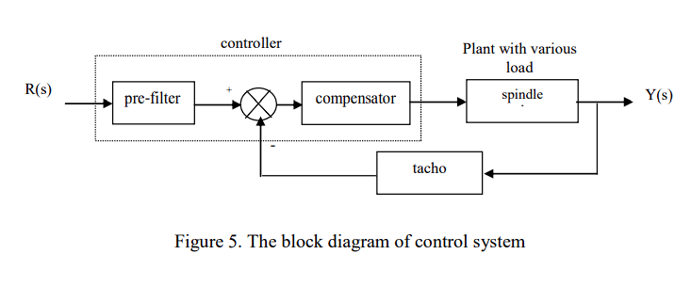
Paper No.4
Title: Quantitative feedback theory-based robust Control for a spindle of Lathe Machine
This paper presents theoretical and experimental design of a robust control based on quantitative feedback theory (QFT) approach to control deepness variations on cutting process for a x axis of CNC lath machine.
The dynamics of spindle is uncertain and varying due to deepness variation on milling process. Ref. Practical design steps are explained in which QFT based conditions are assembled to obtain a compensator and pre-filter gain to control a spindle.

Slide 12
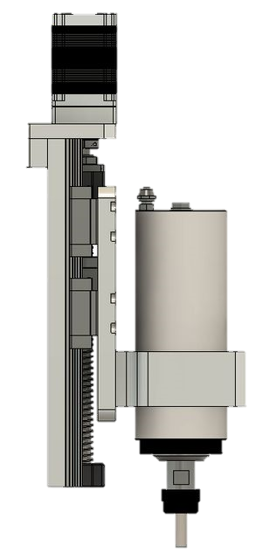
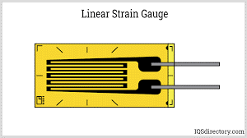
Stress analysis of the spindle is crucial for ensuring the precise installation of strain gauge sensor feedback on the Z-axis of a CNC machine. This enhances machine performance and accuracy. Effective implementation of such technology optimizes CNC machining processes.
Using a strain gauge for controlling stress on a CNC Z-axis involves integrating a feedback system that monitors the stress levels in real-time, allowing for dynamic adjustments to optimize performance and prevent overloading.
Strain guage
Z axis
Z axis control system
Z axis spindle

Slide 13
PROBLEM STATEMENT
PROBLEM STATEMENT
Prototype electronics development process relies on conventional PCB tracing, which stages of including printing circuit layouts on paper, using laser printers for toner transfer, and subsequent ironing.
The Z-axis spindle is susceptible to damage due to the absence of a loading effect feedback mechanism. The current setup lacks the ability to provide real-time feedback on the loading conditions experienced by the spindle.

Slide 14
PROPOSED METHODOLOGY
Solution
Use of CNC plotter mechanism for PCB trace designing
Portability easy control via Bluetooth
Advance feedback methodology for Z axis by strain gauge for spindle

Slide 15
WORK PLAN
Sr. No | Target | TimeLine
1 | CNC requirements | 10/10/2023
2 | Inspection and testing of parts | 10/11/2023
3 | Hardware assembling | 15/12/2023
4 | Hardware assembly testing | 10/1/2024
5 | Z axis installation | 12/2/2024
6 | Project output | Till mid of March

Slide 16
REFERRENCES
Paper 1
http://tlc.iiitdm.ac.in/wp-content/uploads/2021/01/Publications/J-1%2C%202017-18.pdf?_t=1569397912
Paper 2
https://www.researchgate.net/publication/349849620_Mechanisms_of_a_3-axis_CNC_machine_design_and_experiment
Paper 3
https://www.sciencedirect.com/science/article/abs/pii/S2214785318325318
Paper 4
https://www.researchgate.net/publication/323463754_Quantitative_feedback_theory-based_robust_control_for_a_spindle_of_lathe_machine

Slide 17
THANK YOU

