Slide 1
Problem Statement
ATM PIN SECURITY SYSTEM
IQ logic lock system

Slide 2
Title of the Solution:
Name of Team Leader: Jayant Dhandale
Name of Guide: Pankaj Thote
Department :Electrical Engineering
Institute /Organization: S B J IT M R

Slide 3
Introduction
In digital world static password are no longer sufficient to protect the sensitive data credential from cyber threats, to counter these risk an dynamic password software offers an solution for it . The methodologies mentioned in this document are based on random variables like time and self entering variable which enables to auto change the password as it enhanced security and protect from unauthorize login attempts.

Slide 4
Motivation and Literature Review/ Market status
Security
Hard decoding
Demand in market
Custom logic flexibility

Slide 5
Proposed Solutions
Using time as a random variable it can use in ATM
security of four digit passcode
Current time format of HH:MM assigned for four digit passcode
Like e.g. (12:47 am) set passcode as ‘1247’

Slide 6


Proposed Solutions
Submission of digits in hour and minute as H+H:M+M
E.g.(12:48 am) termed as [1+2:4+8] = [03:12] then passcode settled as ‘0312’
Same syntax is implemented with subtraction and multiplication operation as
per choice

Slide 7
Benefits to Society
Enhanced Security: Time-based PINs could add an extra layer of security to ATM transactions. Since the PIN changes every minute,
Reduced Fraud: Time-based PINs could decrease instances of fraud related to stolen PINs or card skimming.
This dynamic nature makes it more difficult for hackers to exploit.
Complexity: Introducing a time-based PIN system would require significant

Slide 8
Novelty
Static Passcode System:
Consistency: In a static passcode system, the passcode remains the same until the user decides to change it. This offers consistency and predictability for users.
Ease of Use: Users only need to remember one passcode, which can simplify the authentication process
Dynamic Passcode System:
Enhanced Security: Dynamic passcodes change frequently, making them more resistant to unauthorized access. Even if one passcode is compromised, it becomes useless after a short period.
Reduced Vulnerability: Dynamic passcodes are less vulnerable to common attacks like phishing or replay attacks, as they have a limited lifespan.

Slide 9
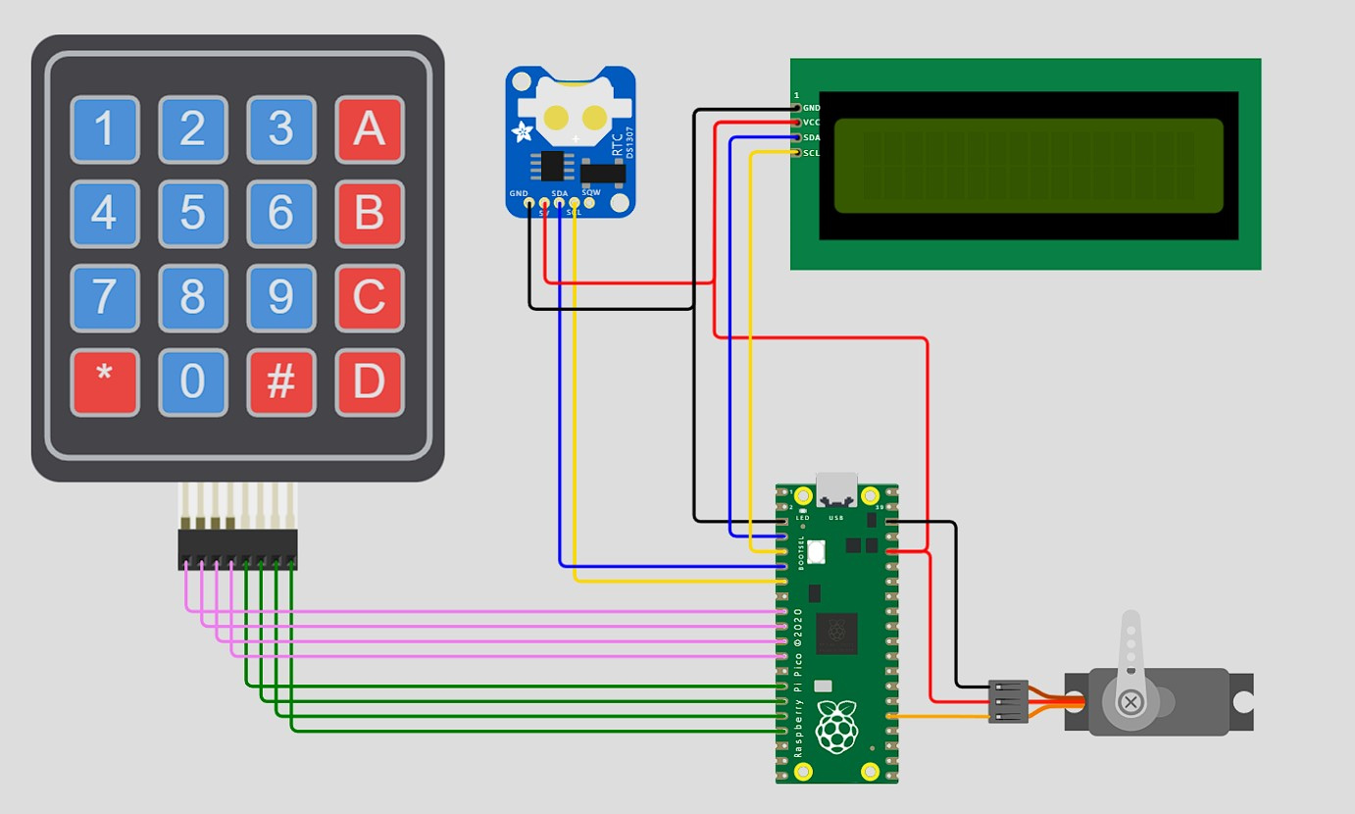
Prototype Available
Hardware prototype

Slide 10
Economics / Finance involved
Low cost
It can be done with software upgaradation
Less invest in upgradation

Slide 11
Whether Interested For Startups
Providing solution over Smart Grid Security operations
Industries inventory
Banking

