Slide 1
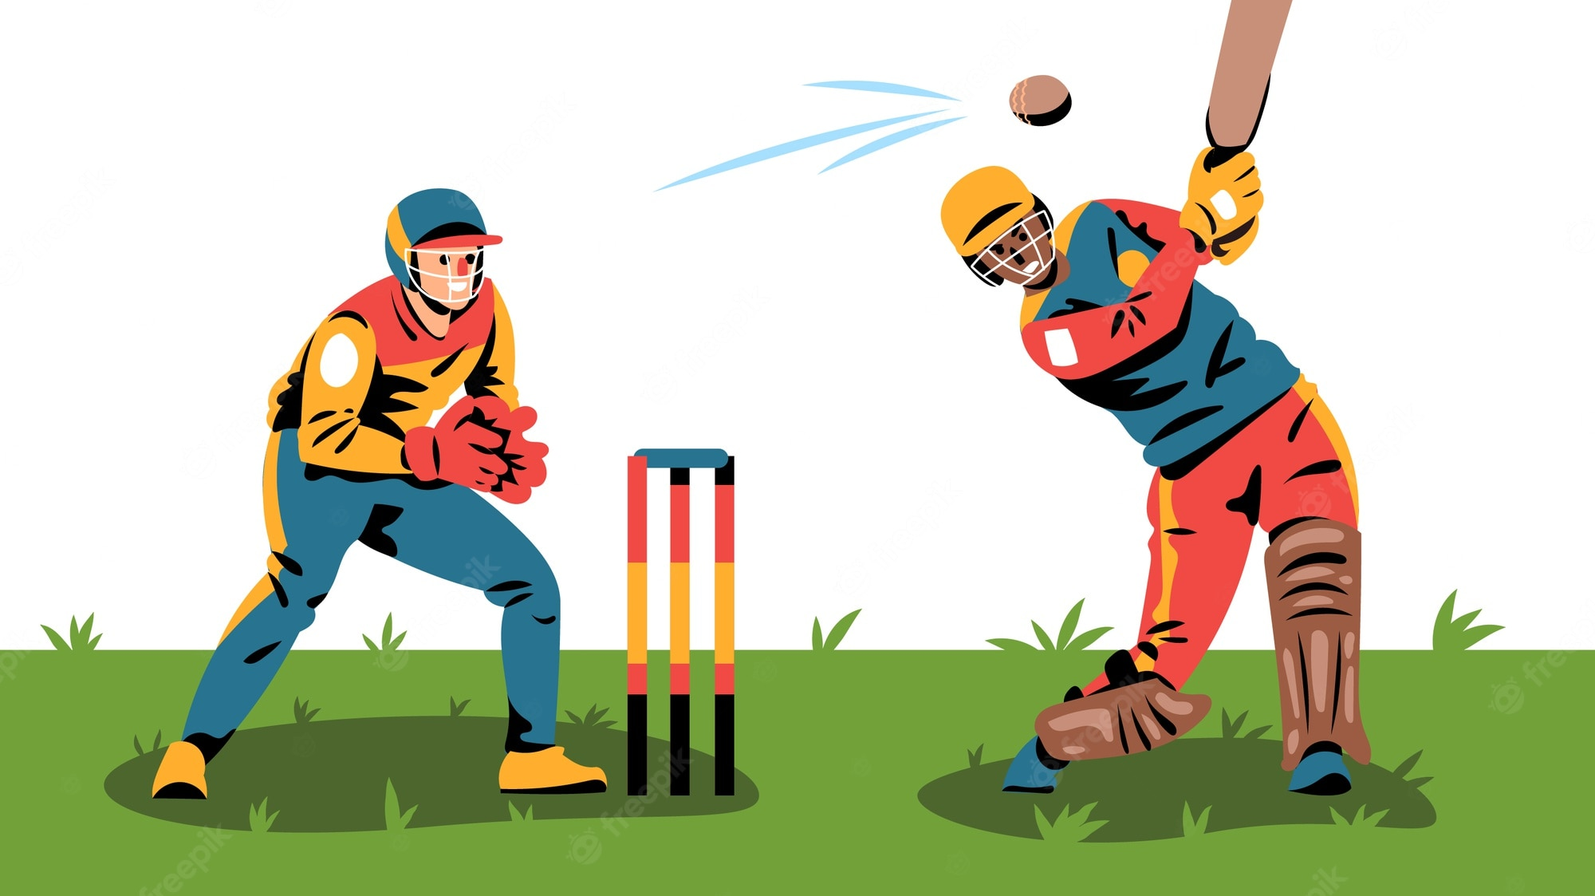
Project Team 4 Cricket League Data Management System
Team Members
Sai Meghana Surapaneni (002929424)
Vamsi Krishna Poluru (002924538)
Jayanth Vakkalagadda (002950342)
Roja Pinnamraju (002925814)
Naga Priya Kumbham (002921442)

Slide 2
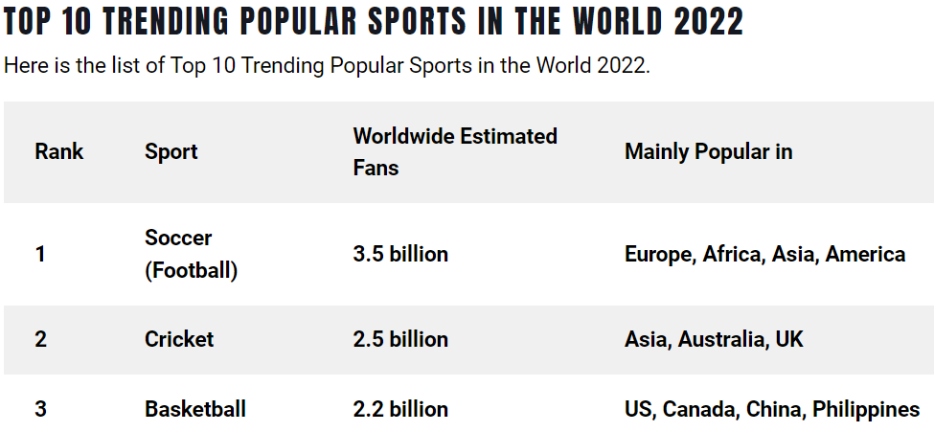
Problem Statement
The purpose of this database is to maintain a major cricket league (Indian Premier League) data for managing the players, teams, staff, and other statistics like schedule, match results, player leaderboard, and points table
This database captures minute details like ball-to-ball score, bowling speed which could enable sports analysts and team coaches to provide strategic tips to the players
The league partners can also leverage this data for updating the scoreboard and other statistics on the league’s website and mobile application

Slide 3
Key Business Rules
Each match will involve two teams
Each match will have only 22 players and 11 from each team
Each match has 2 innings
Each innings should have up to 20 overs
Each innings may have up to 10 wickets
Each team in a match gets a result of win/ lose/ draw
Each venue may have a home team
Each over may have only 6 legal deliveries
Each delivery has a bowler and a batter
Each run type may have 0-6 runs usually
Every team may have multiple staff
Each staff member can be mapped to only one team

Slide 4
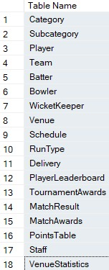

Database Tables

Slide 5
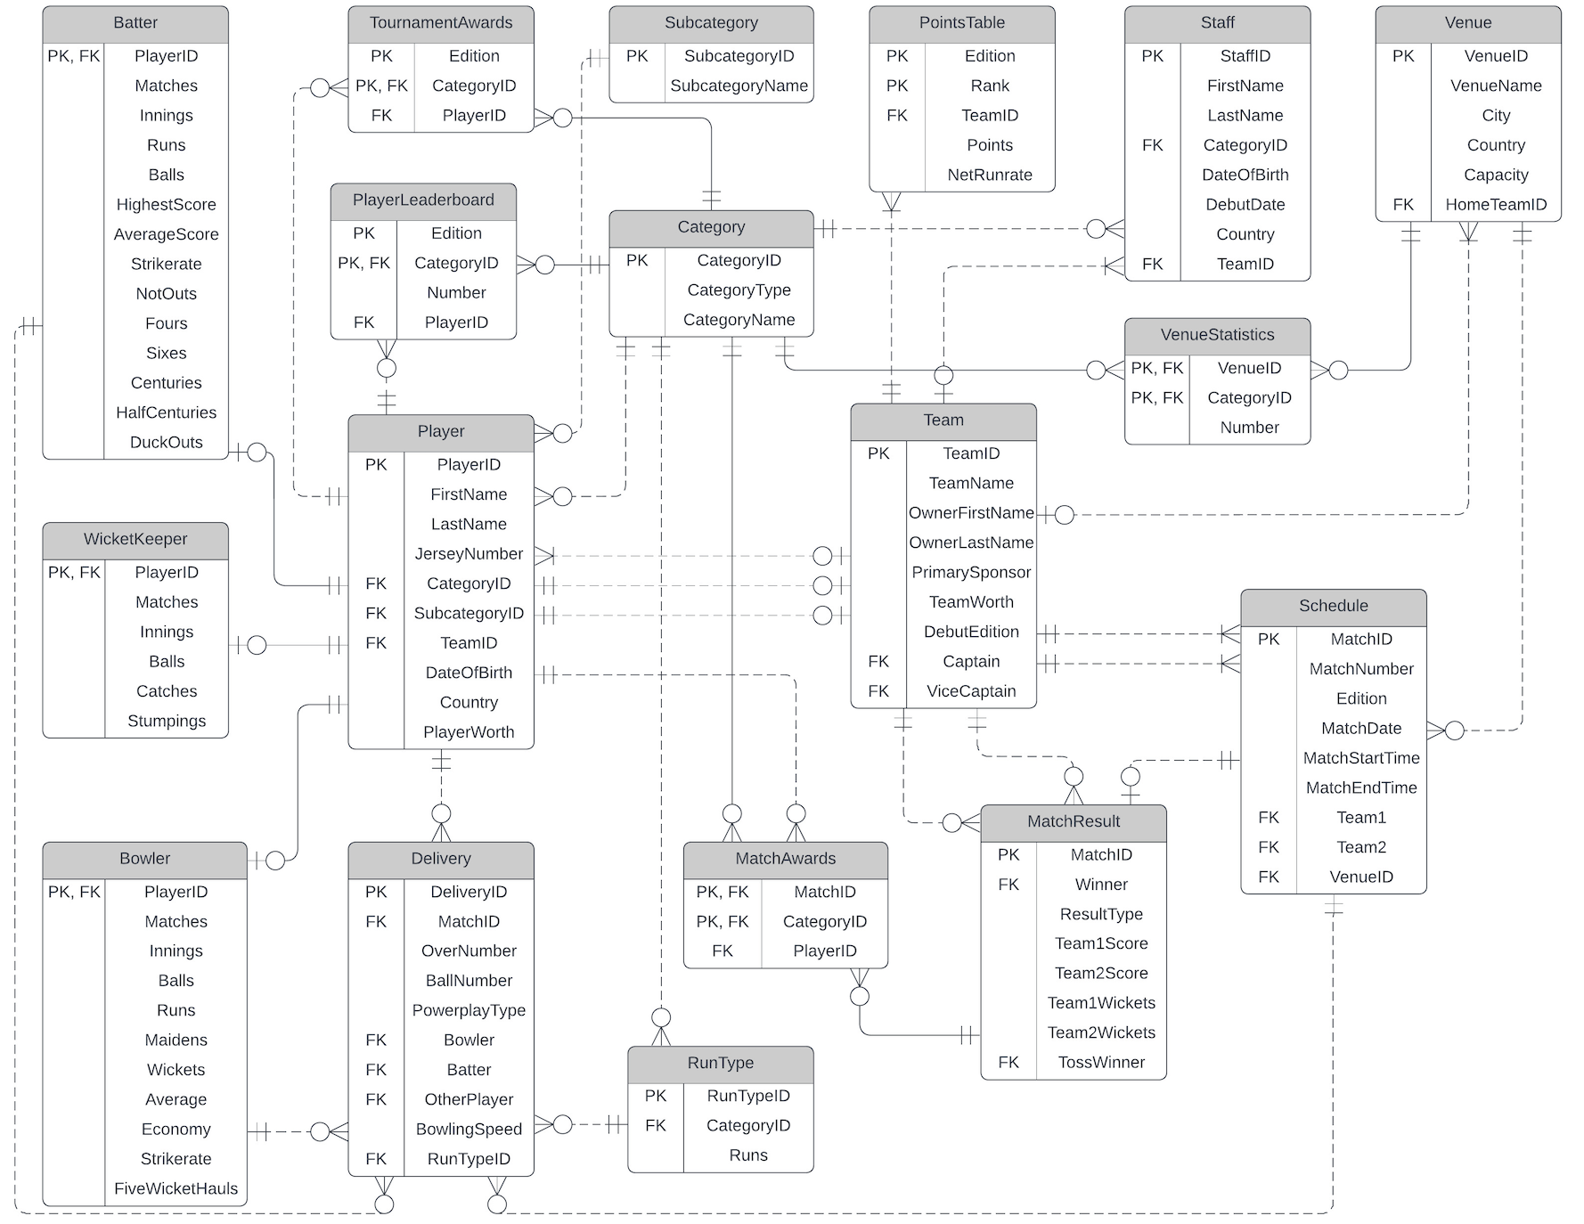
ER Diagram

Slide 6
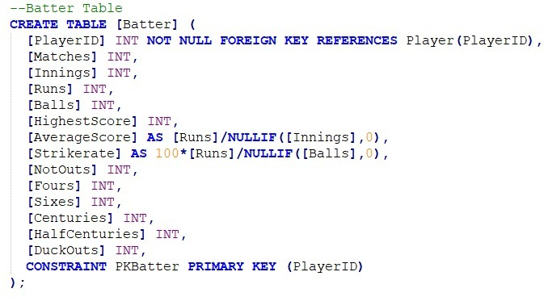
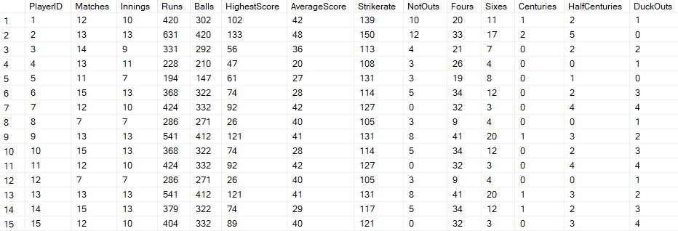
Computed Columns
Batter Table -
Average Score, Strikerate

Slide 7
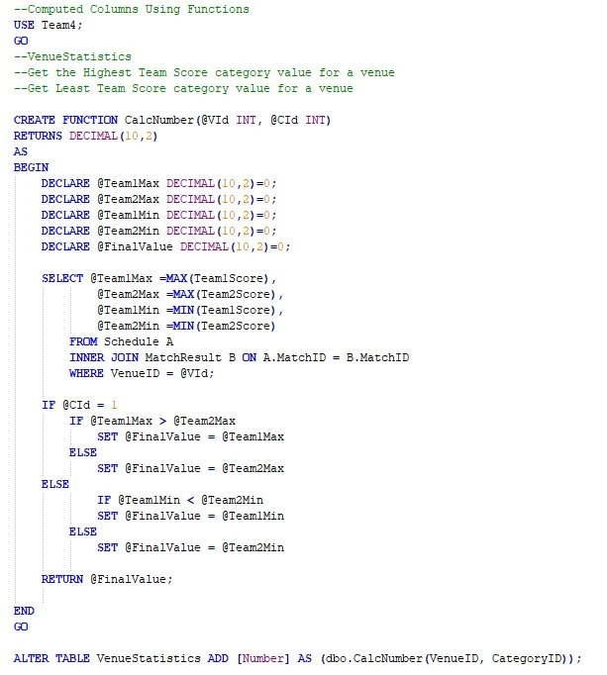
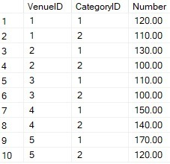
Computed Columns Using Functions
VenueStatistics Table - Number

Slide 8
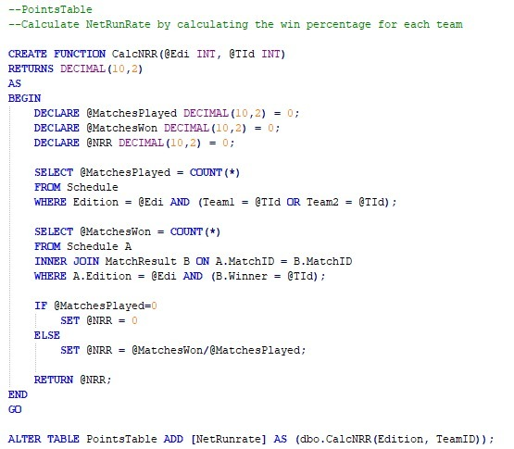
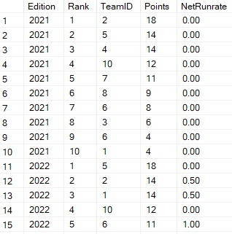
Computed Columns Using Functions
PointsTable - NetRunRate

Slide 9
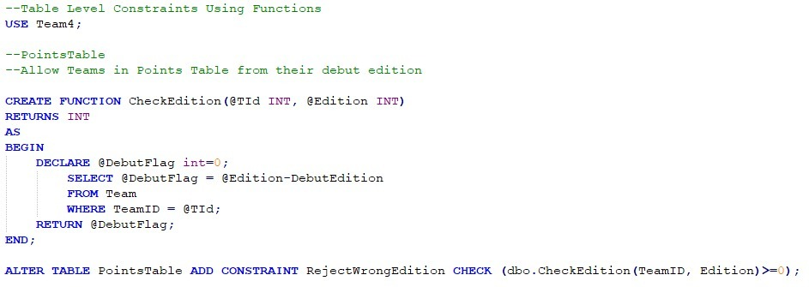
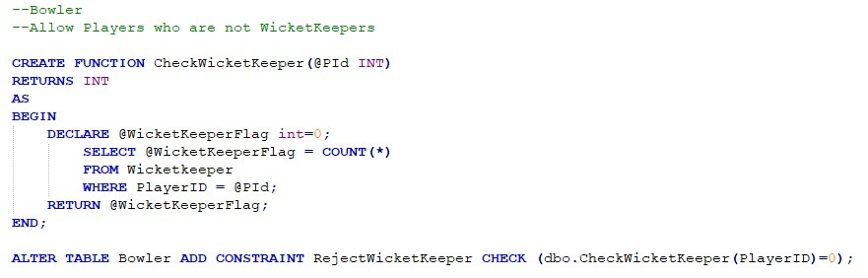
Table-Level
Check Constraints
PointsTable
Bowler Table

Slide 10
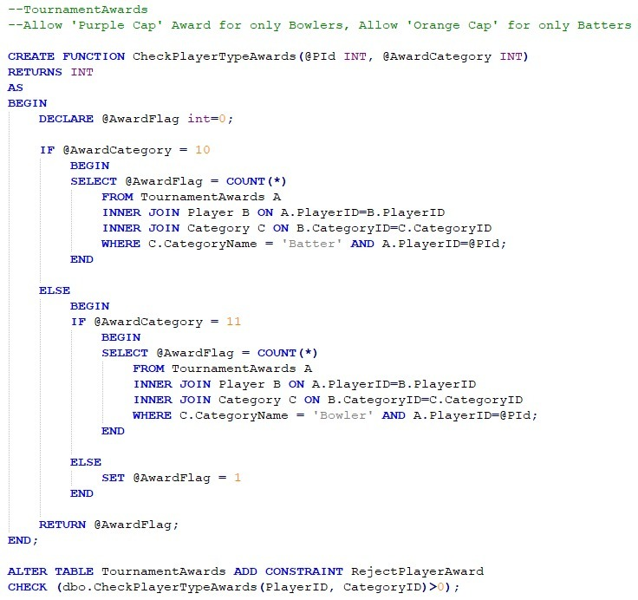
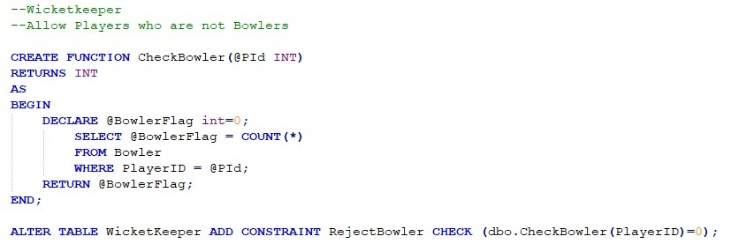
TournamentAwards Table
Table-Level
Check Constraints
Wicketkeeper Table

Slide 11
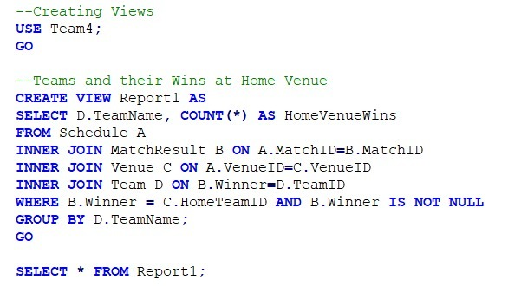
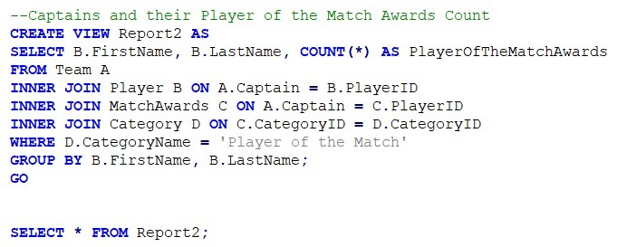
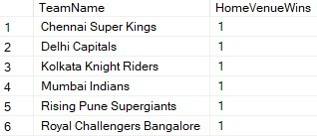

Views
Report2
Report1

Slide 12
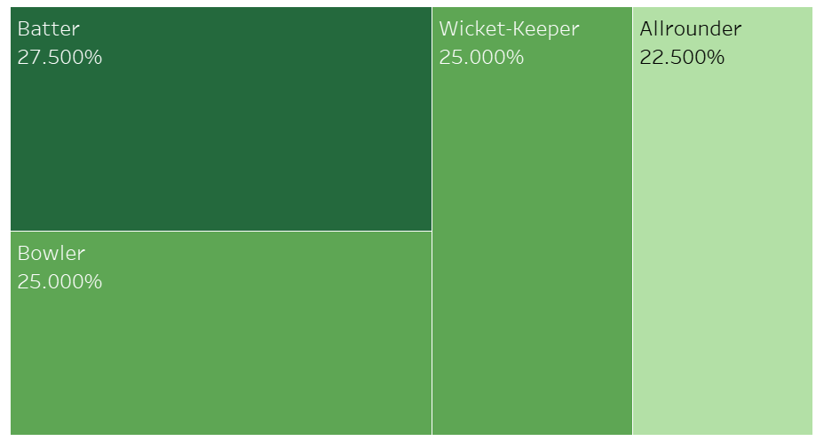
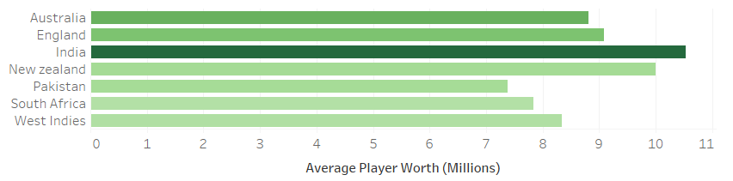
Visualizations
Percentage of different categories of players in the league
Average Player Worth for various Countries

Slide 13
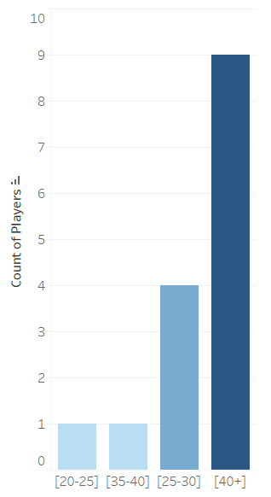
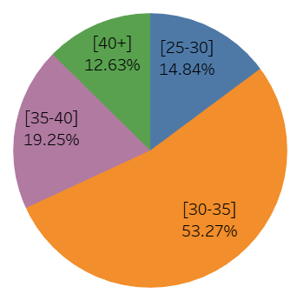
Visualizations
Percentage of players in various Age groups
Batter Average groups

Slide 14
Addressed Problems
Allow maintenance and tracking of data on Players, Teams, Staff, Venue
Provide data on ball-to-ball scores and other details like bowling speed, runs, extra-runs, and wickets
Maintain and track several statistics of players like centuries, half-centuries, five wicket hauls, maiden overs
Help provide history of past and current edition match results, toss results, team scores, points table
Understand statistics like team performances at home venue
Venue Insights like level highest and lowest totals
Provide details on various player level performances in batting and bowling powerplays
Maintain data on various awards distributed to players on match level and edition level

Slide 15


