Slide 1


CAPSTONE PROJECT 2
SENTIMENT ANALYSIS

Slide 2
Problem Statement
The purpose of this Sentiment Analysis is to predict sentiment of the TRS party in GHMC Elections

Slide 3
Data Source
Using the top 500 tweets based on the words 'TRS' and TRS working president 'KTR' from Twitter

Slide 4
SENTIMENT ANALYSIS
Sentiment Analysis is the interpretation and classification of emotions (positive, negative and neutral) within text data using text analysis techniques . Here I have used Natural Language Processing techniques.

Slide 5
Data Preprocessing using Regular Expressions
A RegEx, or Regular Expression, is a sequence of characters that forms a search pattern.
RegEx can be used to check if a string contains the specified search pattern and do some manipulations like substitution,
removal etc.

Slide 6
EDA
EDA implementation:
Finding the 15 most frequent words
Finding maximum and minimum word length in the tweets
Plotting histogram with length of the words
Plotting horizontal bar graph for most common words found in Tweets
Word Cloud

Slide 7
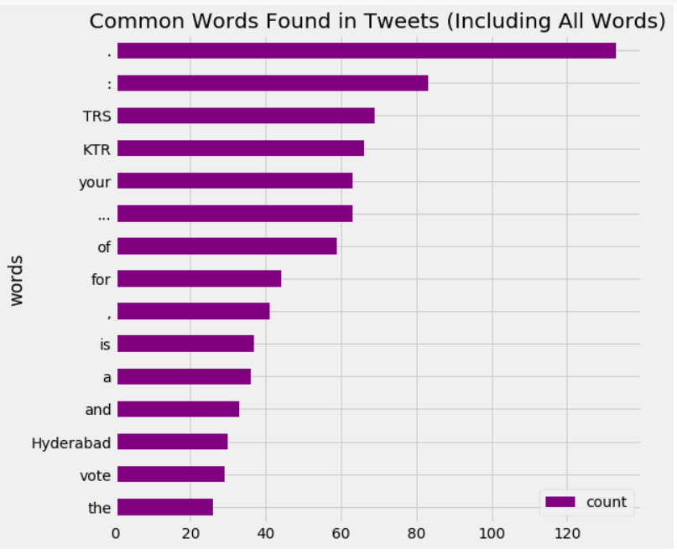
bar graph for most common words found in Tweets
'TRS' party has a largest word count of 74 times and 'KTR' has a second largest count of 72 times

Slide 8
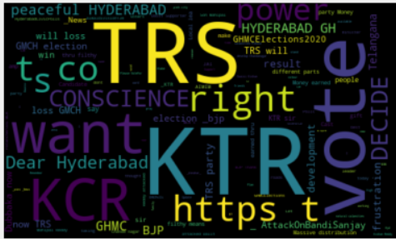
WORD CLOUD Word Cloud is a visualization technique for text data wherein each word is picturized with its importance in the context or its frequency. ‘TRS’ and ‘KTR’ are most significant words

Slide 9
How Text Blob Works
TextBlob is a Python library for processing textual data. It provides a simple API for diving into common natural language processing (NLP) tasks such as part-of-speech tagging, noun phrase extraction, sentiment analysis, classification, translation, and more. Here we used this for sentiment analysis. The sentiment function of textblob returns two properties, polarity, and subjectivity.
Polarity is float which lies in the range of [-1,1] where 1 means positive statement and -1 means a negative statement.
Subjectivity is also a float which lies in the range of [0,1]. In natural language, subjectivity refers to expression of opinions, evaluations, feelings, and speculations

Slide 10
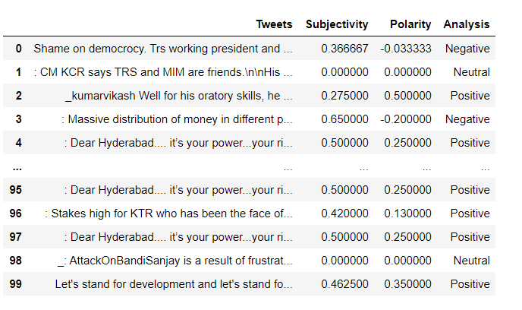
Snap SHOT OF SUBJECTIVITY and POLARITY

Slide 11
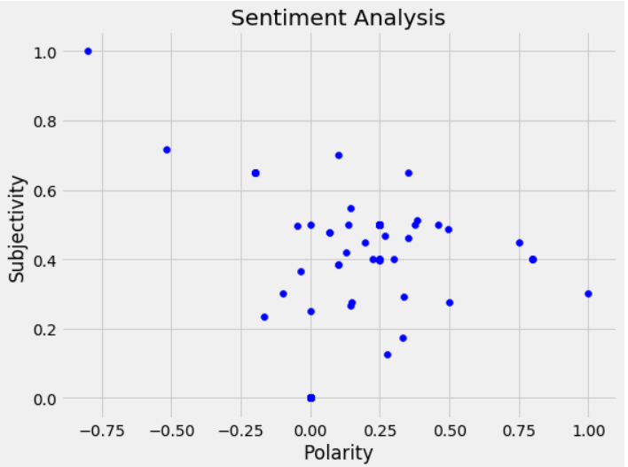
Plot BETWEEN polarity and subjectivity

Slide 12
Derivation from GRAPH
Data points below zero shows the negative polarity which leads to negative sentiment
Data points above zero shows the positive polarity which leads to positive sentiment
Data points on zero shows the neutral sentiment

Slide 13
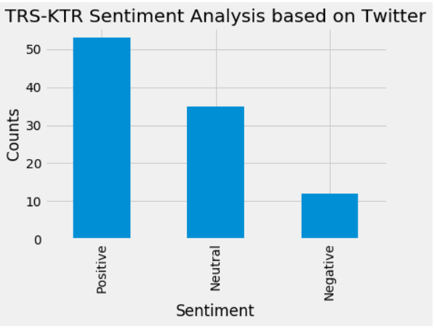
Plotting and visualize the counts

Slide 14
CONCLUSION
This Sentiment Analysis shows that the TRS party for which KTR is the working president has a positive sentiment and has an edge to win the current GHMC elections.
TRS party has a positive sentiment of 55 percent currently
'TRS' party has a largest word count of 74 times and 'KTR' has a second largest count of 72 times as per the top 500 public twitter tweets

Slide 15
FUTURE STEPS
This analysis can be used for any sentiment prediction by taking the most significant words to know the sentiment towards that specific topic for example,
COVID-19 research progress
Sentiment towards a specific movie
Knowing sentiment towards a newly launched product and taking measures to increase sales
Knowing sentiment towards a brand name etc.

Slide 16
Thank you
Thank you

