Slide 1

CAPSTONE PROJECT 1
Graduate Admission

Slide 2
PROBLEM STATEMENT:
Prediction of Chance of Admit for an aspirant for Masters Programs
The parameters included are :
GRE Scores
TOEFL Scores
University Rating
Statement of Purpose and Letter of Recommendation Strength
Undergraduate GPA
Research Experience
Chance of Admit

Slide 3
Data Wrangling
I have taken the data from Kaggle and performed cleaning steps on it. I observed for missing values, inconsistent column names, and for any outliers from the data set named 'df' .
Then I named the cleaned dataset as df_cleaned. Later I have done with the Exploratory Data Analysis along with some visualization to check the relation between all the fields with the "Chance of Admit" column to predict some facts if anything.
Visualizations are GOOD ENOUGH to confirm that the relation with all the fields with "Chance of Admit" is linear or directly proportional.
Finally, I have come up with those records that who has highest chance of admission and have lowest chance of admission

Slide 4
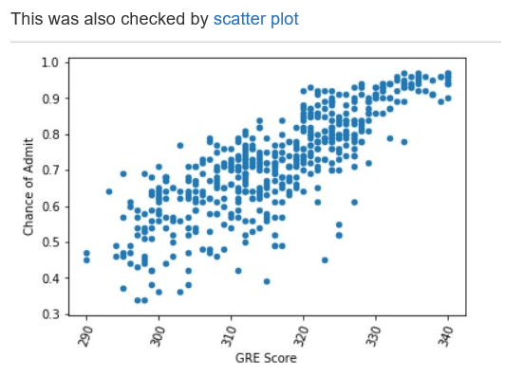
Visualizations : chance of admit vs gre Score : This Relation is linear

Slide 5
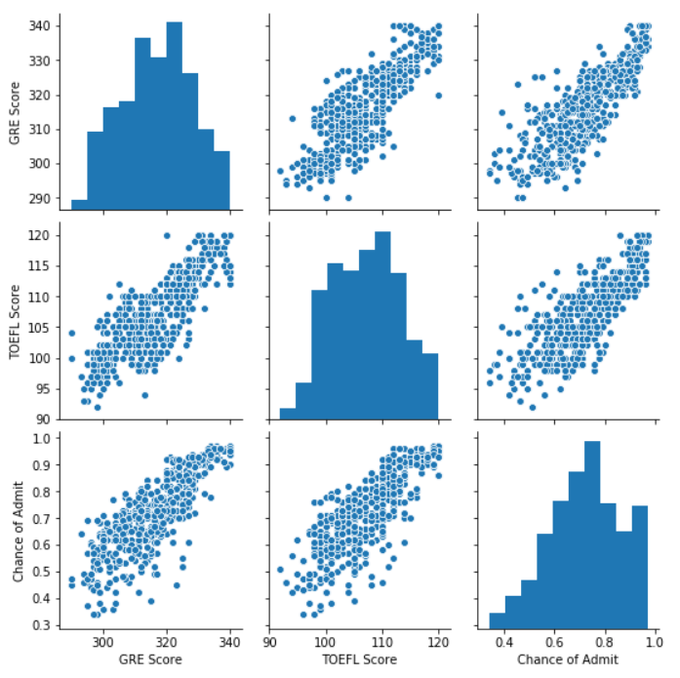
Pair plot

Slide 6
Thank you
Thank you

