Slide 1

CAPSTONE PROJECT 1
Graduate Admission

Slide 2
PROBLEM STATEMENT:
Prediction of Chance of Admit for an aspirant for Masters Programs
The parameters included are :
GRE Scores
TOEFL Scores
University Rating
Statement of Purpose and Letter of Recommendation Strength
Undergraduate GPA
Research Experience
Chance of Admit

Slide 3
Story
This workout clearly highlights the chance of an individual getting admitted to the renowned Universities
This workout is based on several factors such as GRE and TOEFL scores, their graduation GPAs of the individual.
The data has been taken from the Kaggle website. There are multiple factors to be considered of getting more chance to be admitted into top Universities of USA.
This presentation is all about analyzing the past data and preparing a Machine Learning model that best fits and predicts the chance of admission of an individual.

Slide 4
Data Wrangling & EDA ( Data Source – KAGGLE )
The data from Kaggle was made to undergo some cleaning steps. I observed for missing values, inconsistent column names, and for any outliers from the data set
Re-named the column names which have inconsistent names
I have used box plots to find outliers graphically. But no outliers detected I have used z-score technique by taking 3rd standard deviation and found no outliers
EDA was performed to know various relations between variables

Slide 5
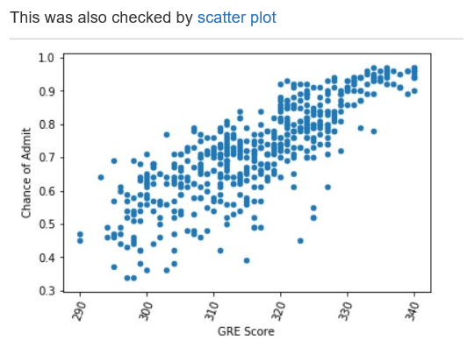
SOME OF THE Visualizations : chance of admit vs gre Score : This Relation is linear

Slide 6
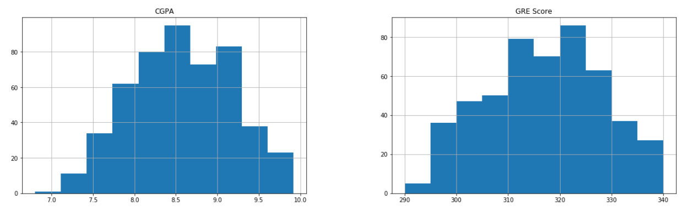
Histograms for continuous variables

Slide 7
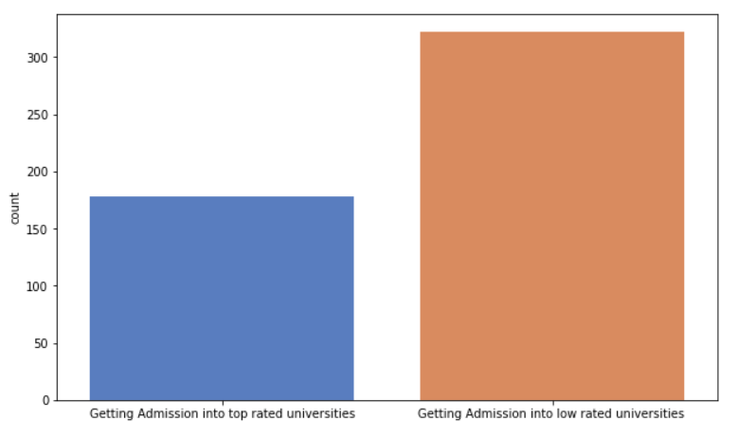
Graph Showing count of number of persons getting into top rated universities

Slide 8
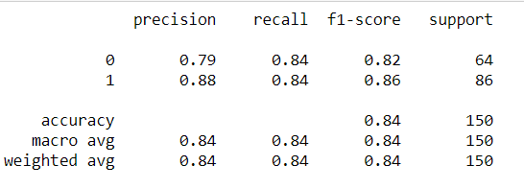
Logistic regression
Classification report
High precision is nothing but low false positive rate, also called as positive predicted value
High recall means actual happened things are Predicted correctly. Recall is called sensitivity or true positive rate
F1score is twice of the ratio of product of precision and recall to sum of precision and recall

Slide 9
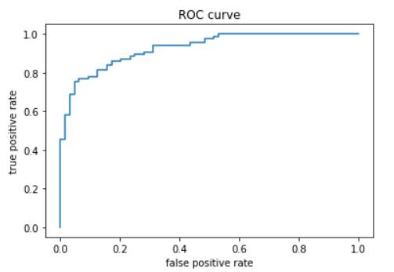
ROC curve
An ROC curve (receiver operating characteristic curve) is a graph showing the performance of a classification model at all classification thresholds. This curve plots two parameters: True Positive Rate. False Positive Rate.

Slide 10

Accuracy and confusion matrix using logistic regression
Accuracy of the model is 84.0%
[1][1] represents the values which are predicted to be false and are actually false.
[1][2] represents the values which are predicted to be true, but are false.
[2][1] represents the values which are predicted to be false, but are true.
[2][2] represents the values which are predicted to be true and are actually true.

Slide 11
Hyper TUNING the model
Hyper tuning done with regularization parameter
Accuracy after hyper tuning is 86.85 %

Slide 12
Tested with alternate model
Model accuracy with Random Forest Classifier
After implementing Random Forest Classifier we got the score of the model as
83.33%

Slide 13
Tested with new data and predicted whether the individual will get the admission
Tested an individual by name Ravi and predicted that he would get the admission in the top rated university

Slide 14
Thank you
Thank you

