Slide 1

CAPSTONE PROJECT 2
REAL-TIME SENTIMENT ANALYSIS

Slide 2
PROBLEM STATEMENT:
Computing sentiment of US-President elections 2020
DATA SOURCE
Twitter Data

Slide 3
Data ANALYSIS & components used
* NLP - Regular Expressions:
* NLP - Text Blob:
* Streaming With Tweepy:

Slide 4
POLARITY
Sentiment Analysis is the process of computationally identifying and categorizing from the piece of text and determine whether the writer's attitude towards a particular topic or the product is either positive or negative or neutral
We calculate the sentiment in many ways, but here we are using a library called TextBlob
In which a property called polarity is used
Polarity is a measurement of sentiment
We calculate the sentiment using TextBlob or Vader. Based on the polarity and subjectivity, we determine whether it is a positive text or negative or neutral. For TextBlob, if the polarity is >0, it is considered positive, <0 -is considered negative and ==0 is considered neutral

Slide 5
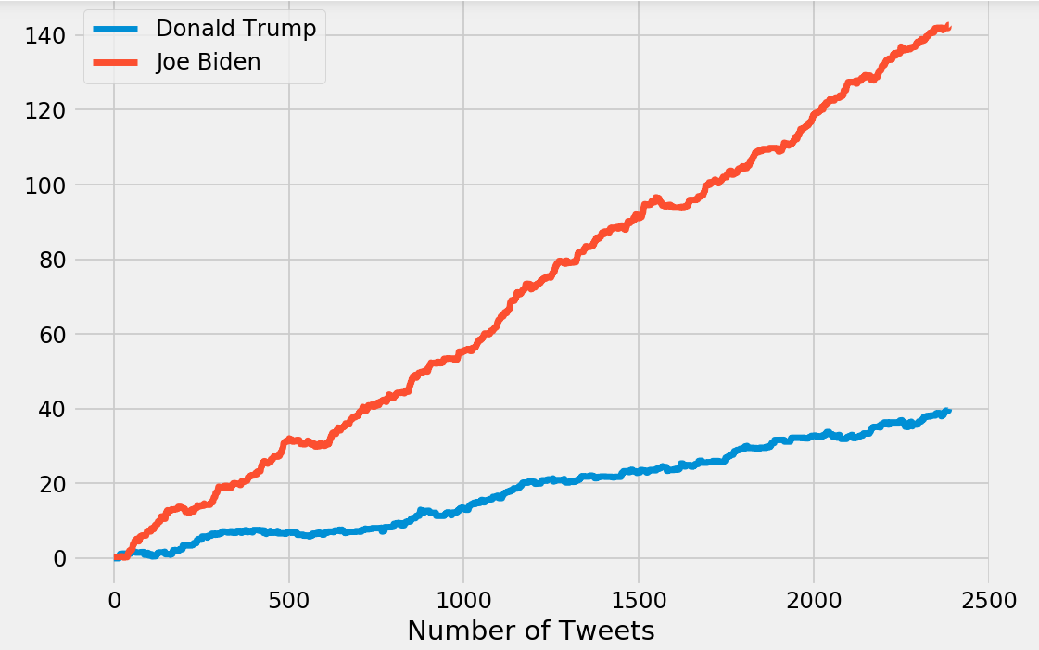
Visualizations : REAL-TIME SENTIMENT COMPARISON BETWEEN DONALD TRUMP AND JOE BIDEN

Slide 6
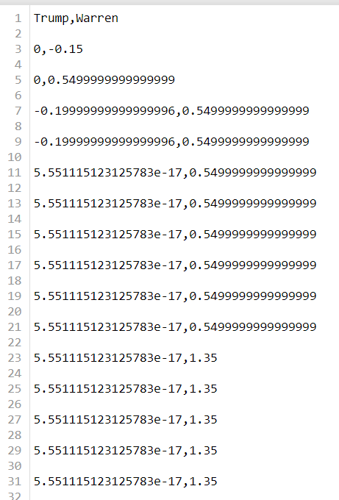
SENTIMENT POLARITY VALUES
SENTIMENT CALCULATION

Slide 7
CONCLUSION
The graph clearly shows that the positive sentiment for Joe Biden is far more than Donald Trump currently.
A week back, both sentiment is very close.
This real time sentiment analysis not only used only for this US elections, we can use for any real time analysis, for example Indian Premier League, Corona Virus, sentiment towards a product, Movies etc.

Slide 8
Thank you
Thank you

