Slide 1
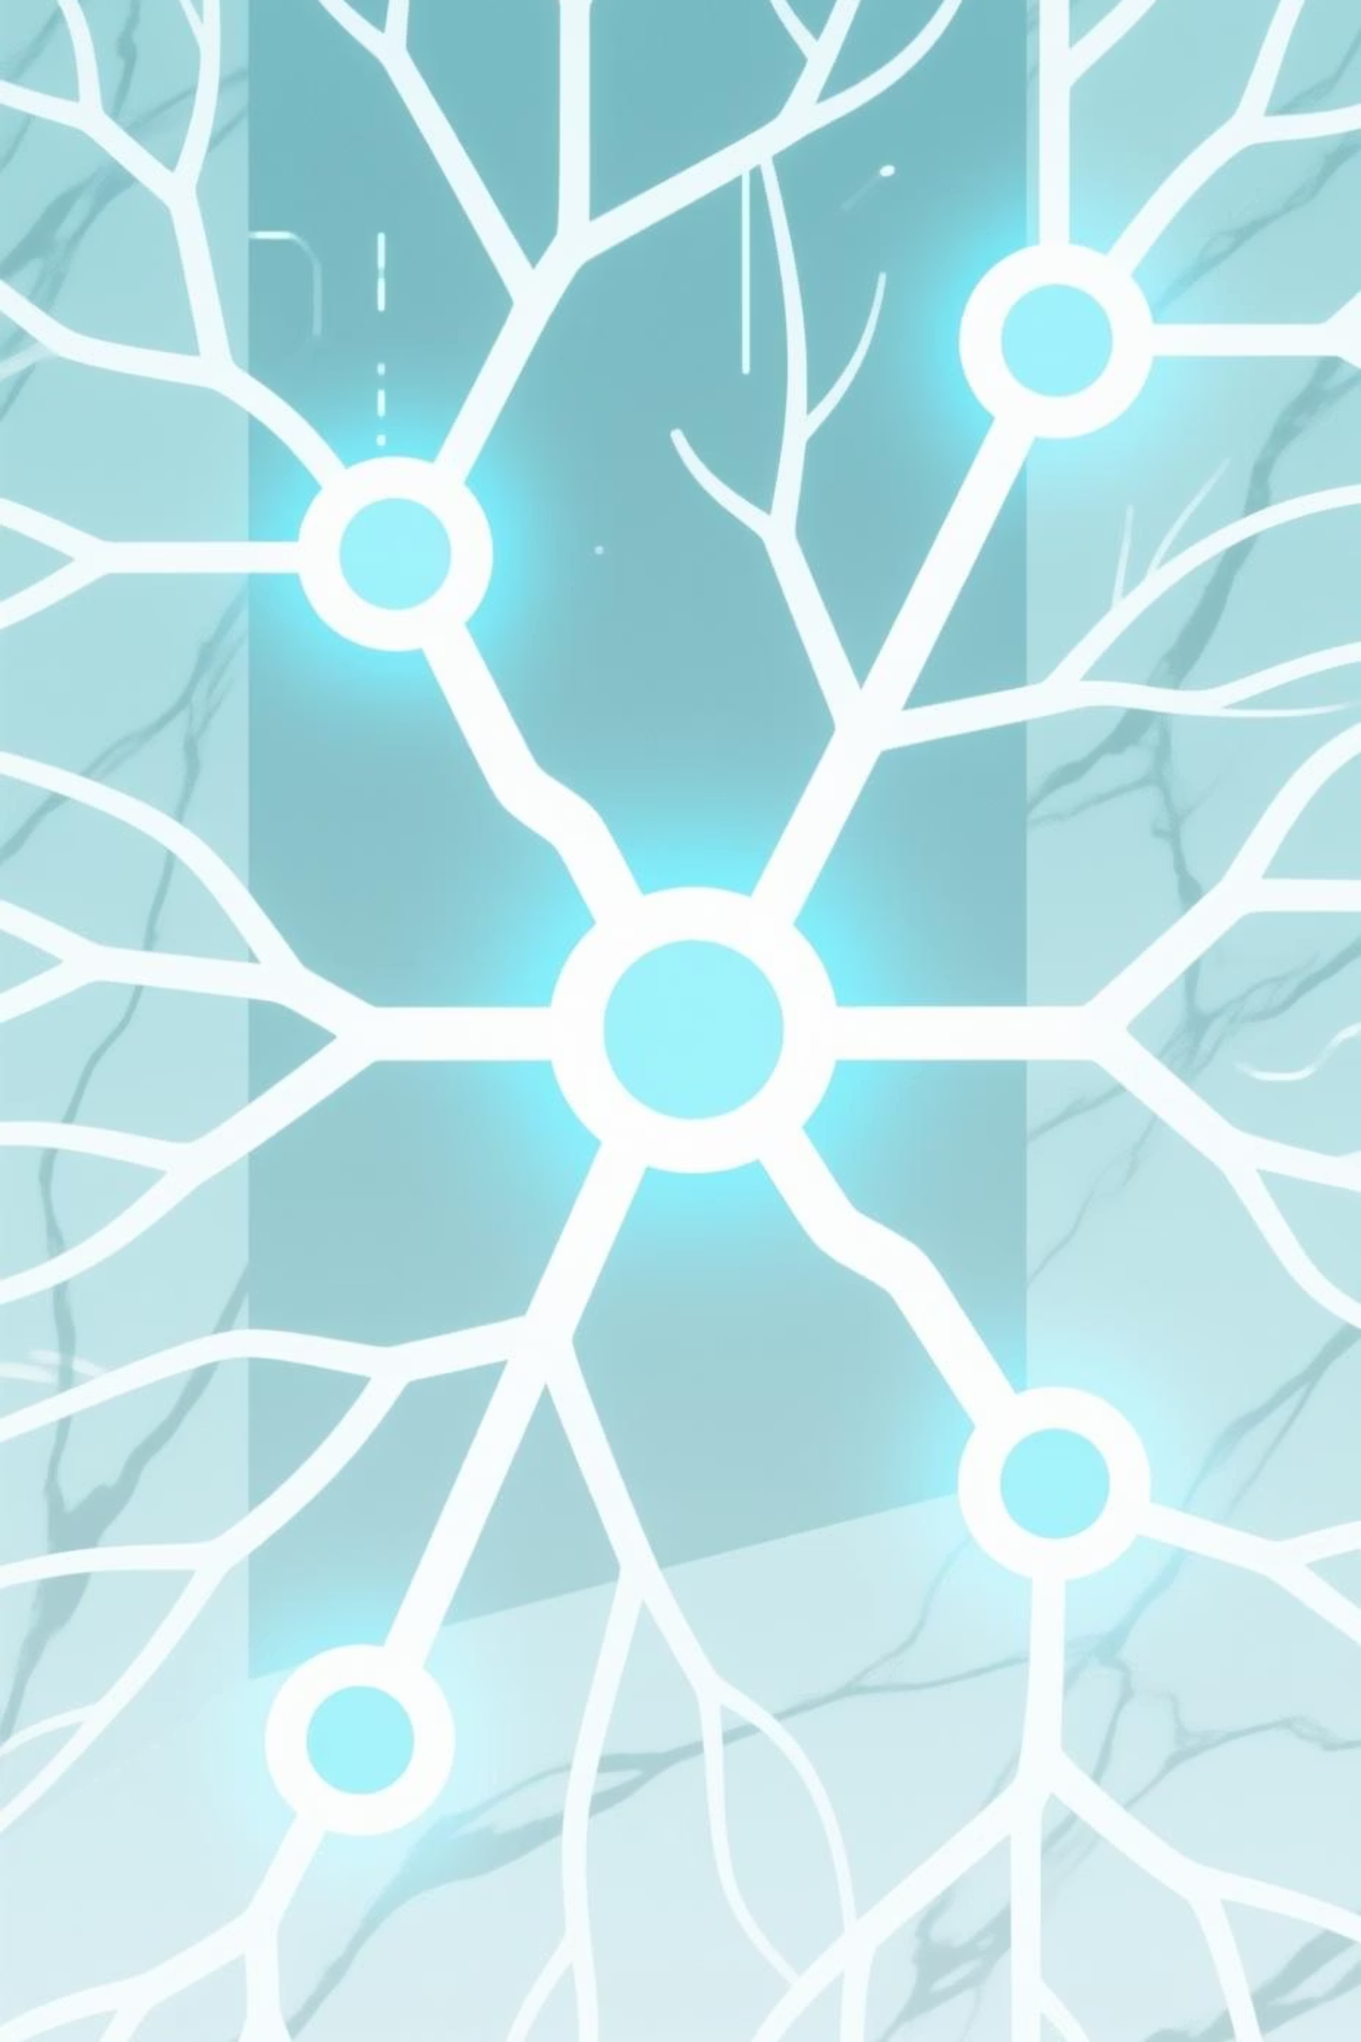
The Memory Agent: SYNAPSE
A sophisticated AI system engineered to solve organizational memory loss—one of the most expensive and frustrating challenges facing modern enterprises. We move beyond simple search to create a dynamic, self-building corporate knowledge repository that transforms how organizations preserve and leverage institutional knowledge.

Slide 2

The Problem: Organizational Memory Loss
The Hidden Cost
Enterprise Impact
Every day, critical business intelligence is lost in scattered emails, forgotten meetings, and disconnected documents. Teams repeatedly solve the same problems, unaware of previous solutions.
Duplicated effort across departments
Lost expertise when employees leave
Repeated mistakes from forgotten failures
Traditional search tools fail because they treat information as isolated fragments rather than interconnected knowledge.
Inefficient resource allocation

Slide 3

The Innovation: Semantic Intelligence
01
02
03
Automated Data Extraction
Advanced Reasoning Engine
Knowledge Graph Construction
Self-hosted n8n automation engine securely extracts data from Google Workspace APIs—Calendar, Docs, and Gmail—creating a continuous feed of organizational activity.
Ollama performs structured entity extraction, converting chaotic meeting notes into precise, queryable data points with defined relationships.
Neo4j powers a dynamic knowledge graph that maps relationships between people, projects, decisions, and outcomes—not just storing documents, but understanding connections.
Example Extraction: Person → Discussed Project → FAILED → Due to Problem (XYZ)

Slide 4




Agentic Power: Predictive Foresight
The Memory Agent doesn't wait for questions—it proactively analyzes graph structures to identify hidden patterns through multi-hop reasoning, delivering timely, high-value insights before problems occur.
Preventive Warnings
Expert Discovery
Detects when new project plans have high similarity scores to previous failures, issuing alerts before resources are wasted.
Automatically maps subject matter expertise based on meeting frequency, problem-solving history, and documented outcomes.
Pattern Recognition
Identifies recurring challenges and successful strategies across departments, enabling cross-functional learning.

Slide 5

Enterprise-Grade Architecture
Technical Stack
Security & Scalability
n8n: Self-hosted automation kernel & Google Workspace
Built with enterprise confidence in mind. Self-hosted n8n kernel guarantees complete data residency and privacy compliance.
Neo4j: Graph database engine
Batch processing logic ensures operational stability and scalability under heavy data loads, while maintaining real-time insight generation.
OLLAMA ( Local AI): Advanced reasoning
React: Interactive visualization
Antigravity IDE: Development environment
The React interface renders a visual knowledge graph, making complex AI reasoning tangible and explorable—allowing decision-makers to see the connections driving predictive insights.

Slide 6

Transform Data Into Foresight
24/7
100%
∞
Continuous Learning
Data Residency
Scalable Growth
Always analyzing, always learning from organizational activity
Complete control over sensitive enterprise information
Knowledge graph expands with your organization
The Memory Agent transforms scattered data into immediate, actionable business foresight—turning organizational memory from a liability into a strategic advantage.

