Slide 1

IIIT Hackathon
10/15/2024 and 10/16/2024

Slide 2
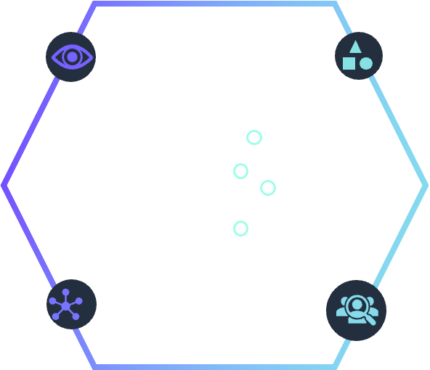
Who is Parabola9?
We are a Generative AI company that builds models based on,
Machine Learning
Deep Learning
Generative AI

Slide 3




Scope
We are interested in
Solution Ideation
Solution Architecture
Code Description
Demo!!

Slide 4
Hackathon Use Cases
VideoGPT Solution
Optical Character Recognition
Notes:
When you want to build GenAI applications that are unique to your business needs, your organization’s data is your differentiator.
When you think about it, every company has access to the same foundational models, but companies that will be successful in building gen AI applications with real business value are those that will do so using their data.
Data is the difference between generic gen AI applications and those that know your business and your customer deeply.
We are seeing very creative generative AI uses including intelligent conversational chatbots, generating programming code from text and summarizing long form narratives such as books and transcripts.
Likewise, we are also seeing a trend of popular application building patterns that AWS customers are using to build gen AI applications.
Transition: Let’s take a look at a few…

Slide 5




Video GPT Solution (1)
Sample Videos
Video Language Models
Video Transcript
Chat with Video
s3://temp-hackathon-2024-us-east-1-054037105643/videogpt/

Slide 6


Optical Character Recognition (2)
Sample Videos
Deep Learning/Gen AI Model
Extracted JSON Data
Chat with Video
s3://temp-hackathon-2024-us-east-1-054037105643/ocr-detection/

Slide 7



Common
Download from/Push to Git
JupyterLab Notebooks
HuggingFace Hub/Model Zoos

Slide 8
Tips for VideoGPT
Use video native models:
https://huggingface.co/Qwen/Qwen2-VL-7B-Instruct
https://huggingface.co/OpenGVLab/InternVL2-8B
Do not process all frames in 1 second – subsample (3-5 frames/second)
Use streamlit for demo!

Slide 9
Tips for OCR Detetion
Images are BIG! Downsize them to 2K, 4K resolution for processing
Use GPUs for accelerated processing
Use popular OCR Frameworks:
Paddle Paddle OCR
https://huggingface.co/jinhybr/OCR-Donut-CORD

Slide 10
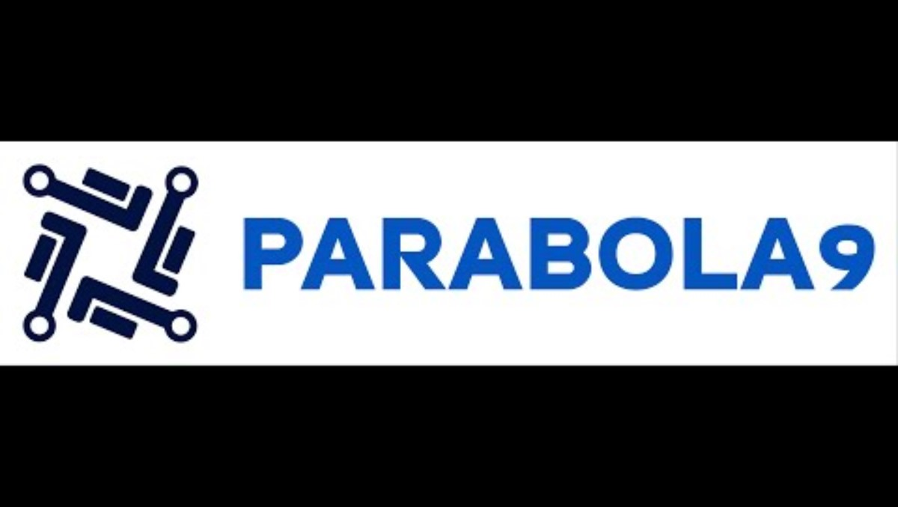
End of Hackathon Demo!

Slide 11
Resources
Use lecturers and us as helpers to troubleshoot problems. Use your own ideas
We want everyone to participate – represent your work!
We love hackers and coders and solution architects alike!

Slide 12
Login to Console
https://054037105643.signin.aws.amazon.com/console
For username and password approach: Vivek and Suren

