Slide 1
CHAT ABUSE PROTECTION – CAPs LOCK
TEAM 2758

Slide 2
PROBLEM STATEMENT
In this day and age, socializing and encountering strangers by means of social media, bonding and sharing interests has become common and in this process user safety is compromised.
Cyberbullying or cyber harassment is a form of bullying or harassment using electronic means which takes place on various platforms.
The most prevalent type of cyberbullying that often goes unnoticed is chat abuse, which is sending hurtful, abusive or threatening messages via messaging platforms and this is the problem we aim to address.

Slide 3
SOLUTION
The purpose of our model is to intervene in cases of cyberbullying i.e harassment or abuse or potential threats via various platforms from anonymous entities, with user consent (choose to protect themselves voluntarily).
The training model flags harassment/ bullying exchanges and prompts the user to report it, on which it is passed to an intermediate human level checking for parameters like genuinity/ validity.
If the user chooses not to report a flag and yet is frequently subjected to the same, the issue is reported by default for precautionary measures.

Slide 4
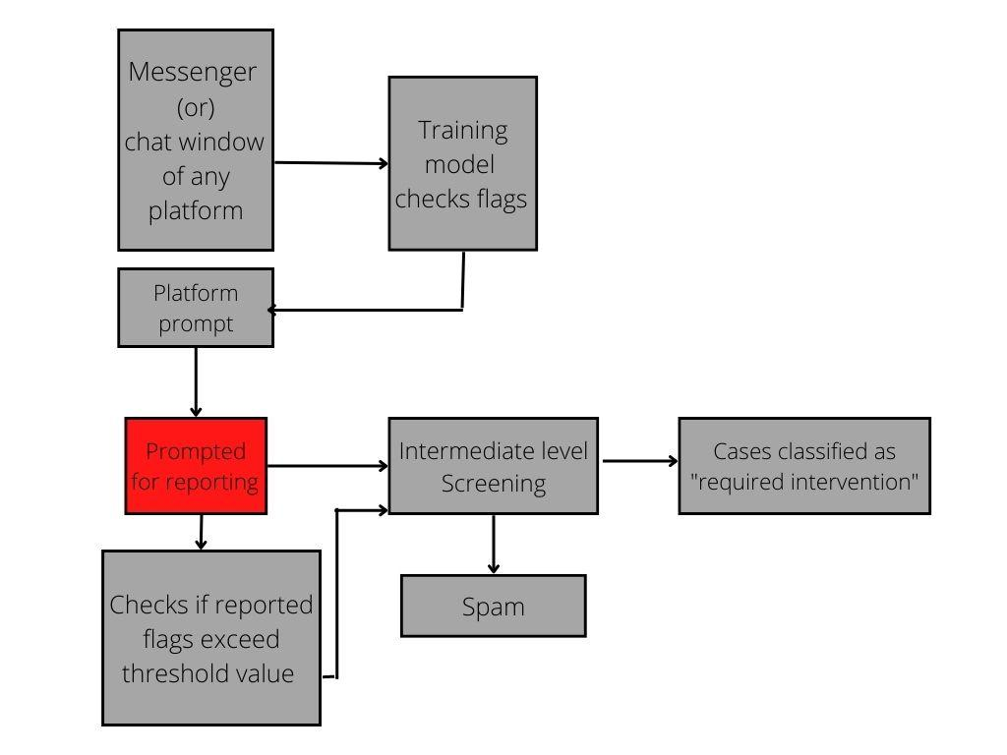
BLUEPRINT

Slide 5
SUSTAINABILITY
The dataset would continuously be updated which would help the model be up to date with the latest slangs, phrases and nuances prevalent today to ensure its relevance to the ever changing trends and scenarios.
Since this software’s next goal is to be converted into a chrome extension, it will ensure that user consent is mandatory from those who prefer a software looking out for them while they are socializing.
As cybersecurity is the need of the hour and its awareness is being increased with each passing day, a lot of online users who are socially active would prefer to safely expand their friend circle online.

Slide 6
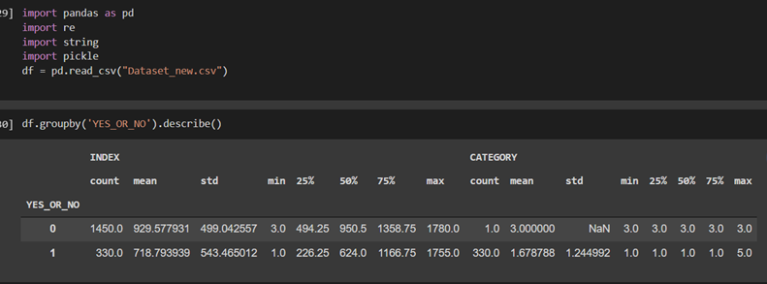
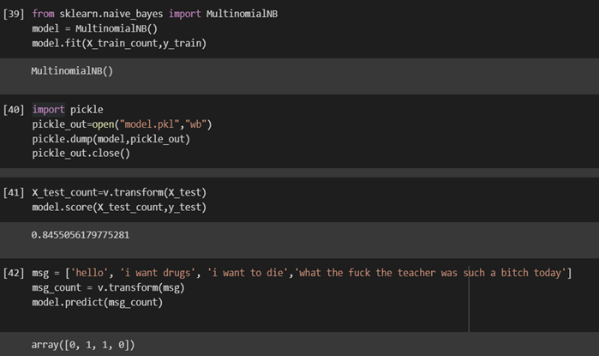
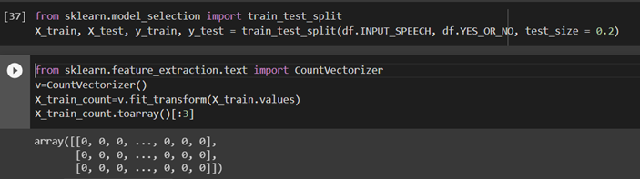
TECHNOLOGIES USED
We have used TensorFlow to create our training model. This model has 85% accuracy in identifying threats, harassment and other forms of cyberbullying.

Slide 7
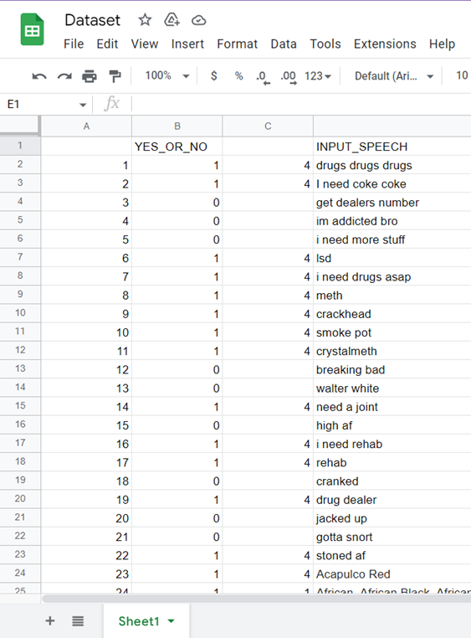
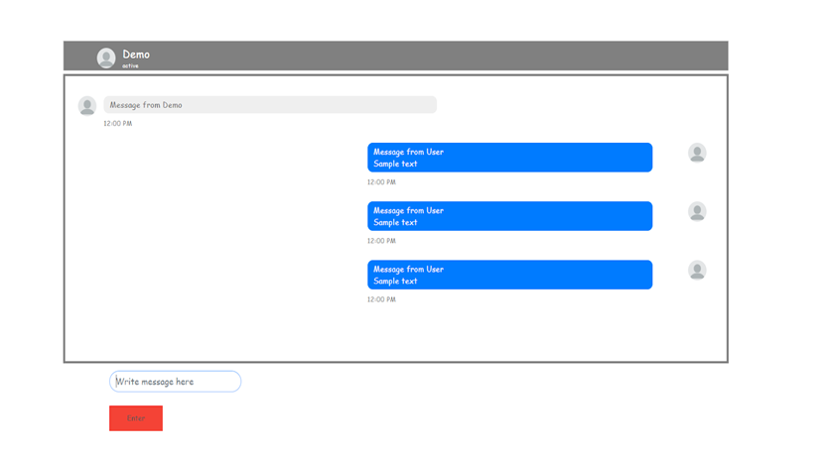
TECHNOLOGIES USED
We have also created a front end messenger application using html, CSS and JavaScript.
The dataset used for the training model
consisting of 1800 entries.

