Slide 1

[Samsung PRISM] Mid Review Report
WIRELESS SENSOR NETWORKS AN23
Team
College Professor(s): Dr. K PANIMOZHI, Dr. SUMA MN
Students:
DHERAJ SK
JAYANTH B
OM BHANDAKAR
PANKAJ SHARMA
Department: COMPUTER SCIENCE, ELECTRONICS AND COMM.
Date: 23 May 2023

Slide 2

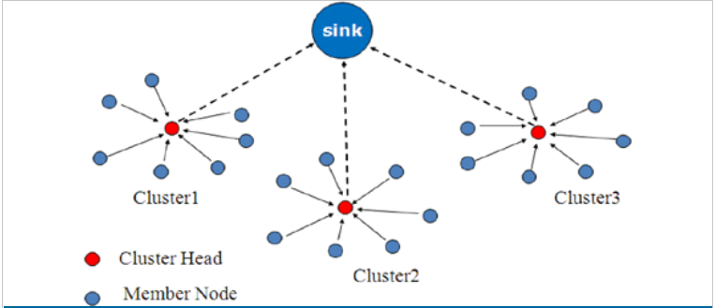
Wireless Sensor Networks
WSN is a network of several sensors usually installed at remote sites .
These networks collect, process and distribute wireless data to the intended database storage centres.
WSNs face many challenges such as network security threats, network architecture, data collection, Power consumptions, deployment and network coverage etc.
If we take case of Data collection , there have been many advancements in recent times with respect to its algorithm.
One such example is Clustering of sensor nodes to collect data and send to required database.
Example of one of clustering method of sensor nodes for Data collection.
Training/ Pre-requisites
Understanding of Wireless communication
Understanding of Wireless Sensor Networks
Tools: C or MATLAB for simulation
Student Learning
experience of WSN and its applications
experience of simulations of WSN
Expectations
Understand the WSNs , its applications, deployment methods in details
Design algorithm for efficient Data collection and distribution in WSN.
Simulation of the algorithm using suitable tool.
Contact us:
Know more:
https://en.wikipedia.org/wiki/Wireless_sensor_network
Dinesh Mahto
dinesh,.mahto@samsung.com
Kick Off
Submit your thoughts
~3 months
Ramp up and jump in!
Algorithm design and validation of efficient Data collection methods in WSN
Identifying designed algorithm gains with respect to existing methods.
~6 months
Algorithm refinement: Design of advanced alternatives for performance and complexity improvement.
Simulation ,result and conclusion.

Slide 3
Proposed Approach / Solution
Concept Diagram :
( Clear detailed schematic / block diagram / flow chart depicting the proposed concept / solution )
Network
Lifetime
Cluster Formation
Optimise Leach
PSO
WSN
Energy Efficient
Cluster Head Selection
Fault Tolerance
Integrated code for PSO and shortest path
Routing Protocols
Dijkstra algorithm
Security

Slide 4
Dataset(s) Analysis / Description
Dataset Capture / Preparation / Generation :
(Discuss the dataset generation process or if downloaded data provide details of what data & from where it was obtained etc… - 2 to 3 bullets only)
No Dataset
Nodes and Energy Values are put randomly
Dataset Understanding / Analysis :
(Provide 2 to 3 bullets about what is your understanding of the data / opinion about the data)
Node Position between 0 and 100
Energy Values between 2 and 5J
Dataset Pre-Processing / Related Challenges (if any) :
(List out the challenges you fore see in data handling wrt problem definition – 2 to 3 bullets only)
No Pre-Processing

Slide 5
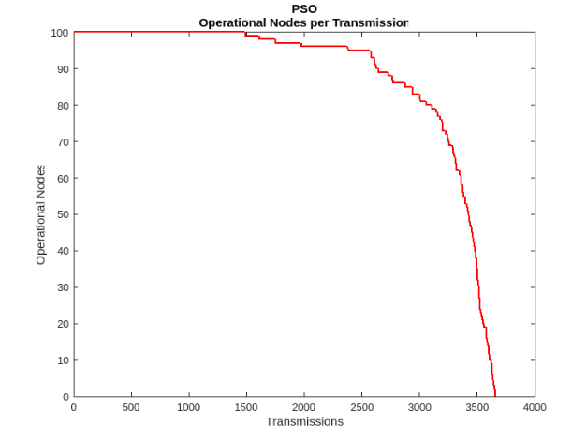
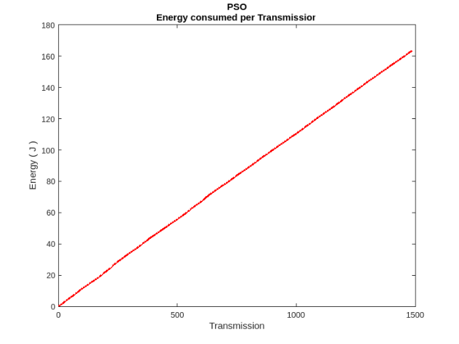
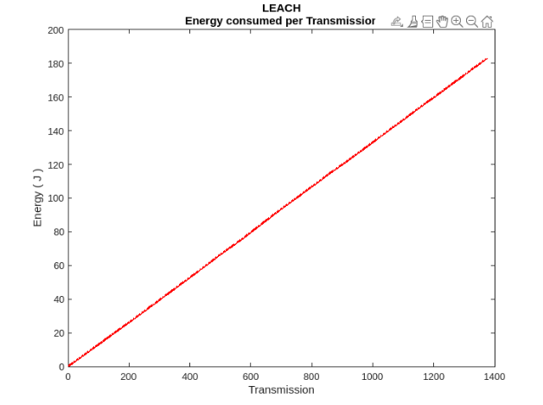
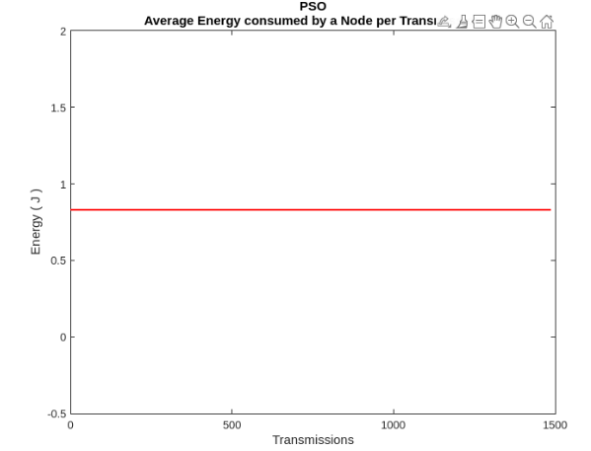
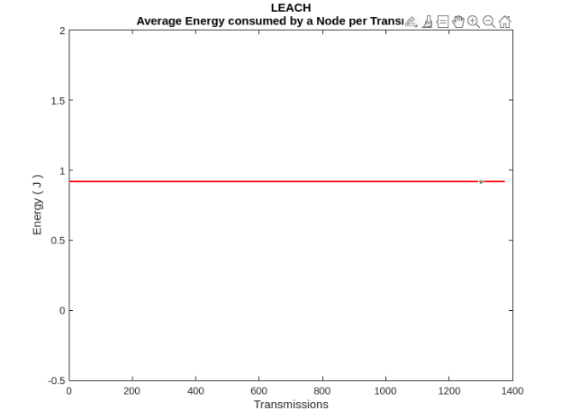
Experimental Results / Simulations / Observations
Results :
(provide numerical data / bar charts / plots / images / videos / tabulated results etc. Use full slide or multiple slides up to max 3 slides to demonstrate the results)

Slide 6
Experimental Results / Simulations / Observations
Major Observations / Conclusions & Challenges :
(provide details about your findings, experimental opinion – Use separate slide if necessary)
Better Energy utilization in PSO compared to Leach.
Higher Operations till all nodes die out.
Lower Energy Consumption per node for an operation.

Slide 7
Further Plan to Complete Project
Final Probable Deliverables :
(Discuss in the form of bullets, what are the next steps to complete the solution, any road blocks / bottlenecks, any support needed from SRIB)
Simulation of WSN with all nodes, energy parameters and constrictions.
PSO algorithm for clustering and CH selection and Shortest Path for Routing.
MATLAB simulation of integrated PSO and routing.
IP Target / Plan :
(Any possibility of papers / patentable ideas / innovative aspects that can lead to patentable ideas)
Can publish a research paper on Achieving High Efficiency in WSN using different protocols and ML based PSO for clustering and Djikstras for Routing.

Slide 8
Further Plan to Complete Project
Completion Plan:
(High level plan to complete the project in next 8 weeks after review, in format below)
Week 1 to 2
Step 1
Step 2
Week 2 to 4
Step 1
Week 5 to 6
Step 1
Step 2
Week 7 to 8
Step 1
Step 2
Step 2
Challenges Anticipated:
Git Upload details:
Up to date committed all changes.

Slide 9
Thank you

