Slide 1
Project on fraud detection system for Fastag transactions
Problem Statement:
This internship project focuses on leveraging machine learning classification techniques to develop an
effective fraud detection system for Fastag transactions. The dataset comprises key features such as
transaction details, vehicle information, geographical location, and transaction amounts. The goal is to
create a robust model that can accurately identify instances of fraudulent activity, ensuring the integrity
and security of Fastag transactions.

Slide 2
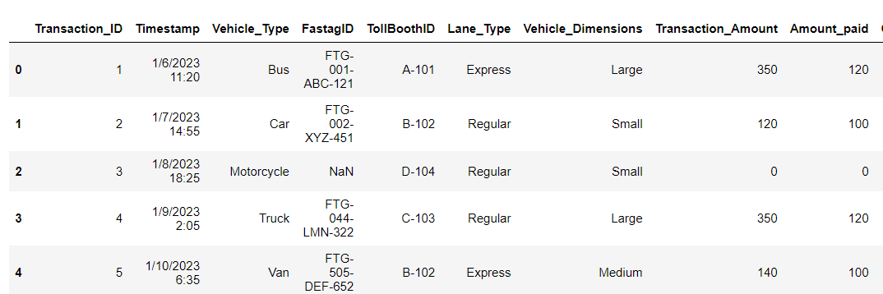
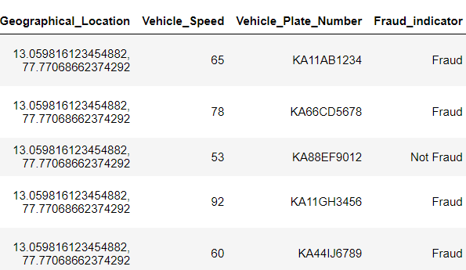
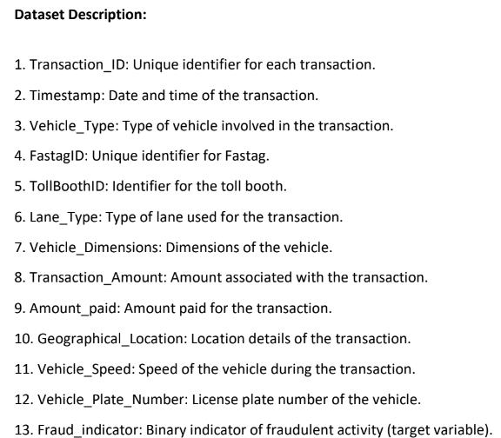
Details about the Dataset :

Slide 3
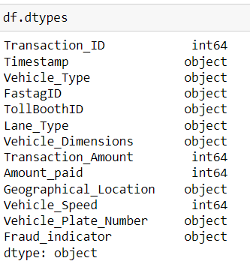
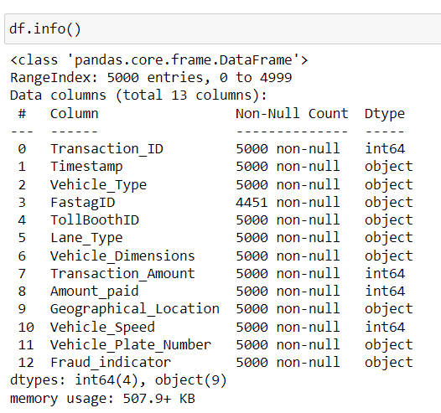
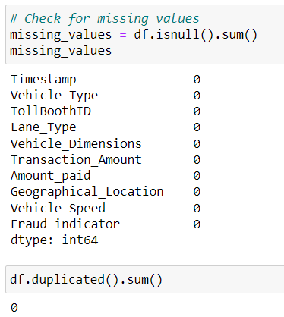
Info and null values and duplicate values:

Slide 4
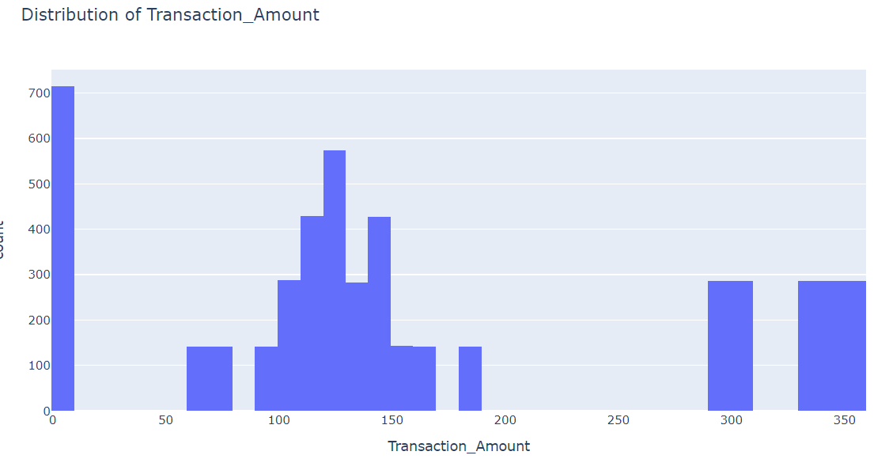
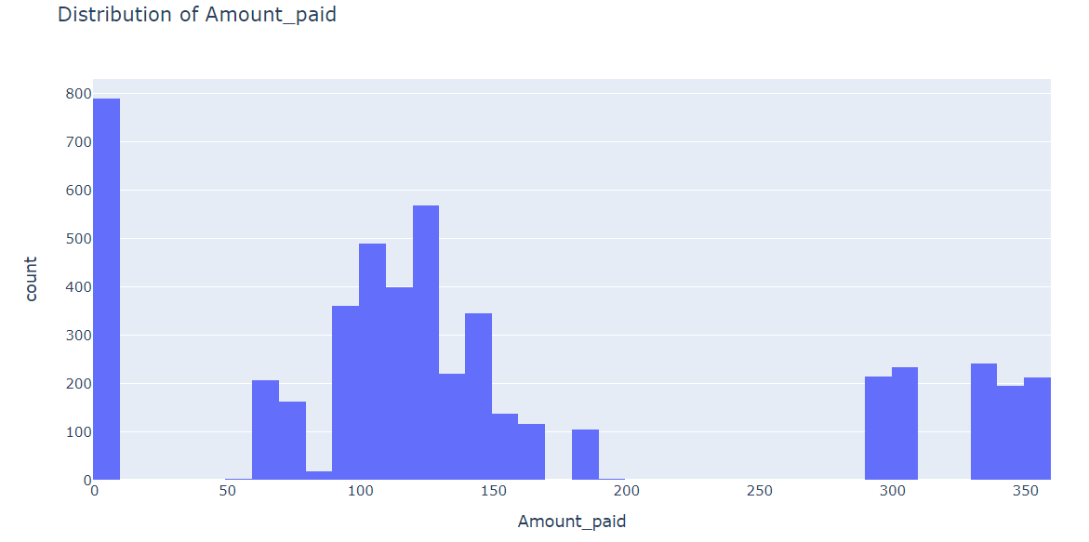
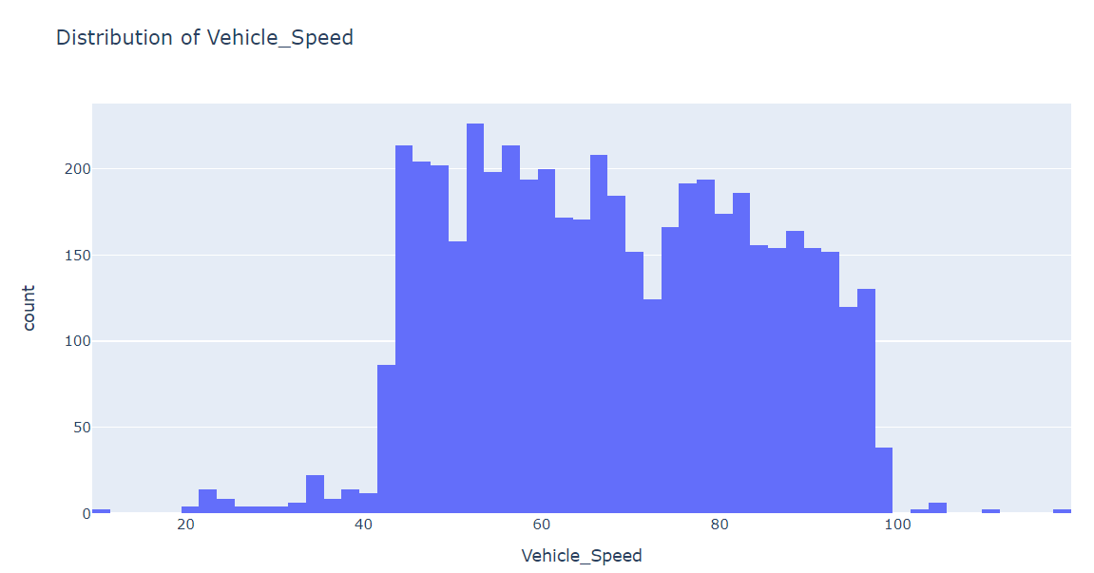
Distribution of Transaction amount, Amount paid and Vehicle speed:
Insights:
Transaction Amounts and Payments: A notable portion of the transactions fall within the 0-9 range for both transaction amounts and payments, indicating a high frequency of low-value transactions in the system.
Average Transaction Value: Most transactions have a consistent value, typically ranging between 100 and 150 for both the transaction amount and the amount paid. This suggests a standardized pricing or fee structure for the majority of transactions.
Vehicle Speeds During Transactions: Vehicles involved in transactions generally maintain speeds between 40 and 100, reflecting a steady flow of traffic through the toll system with minimal variation in vehicle speeds.

Slide 5
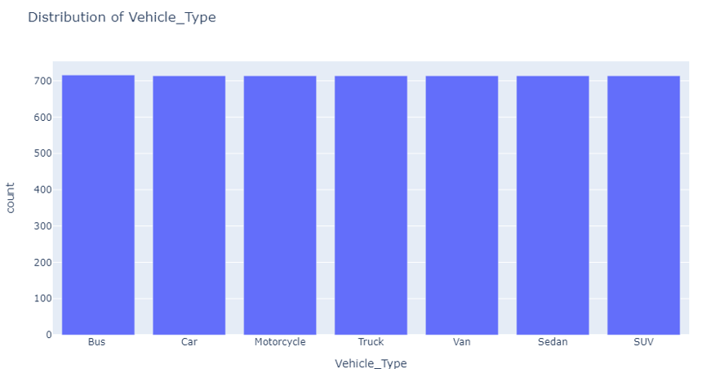
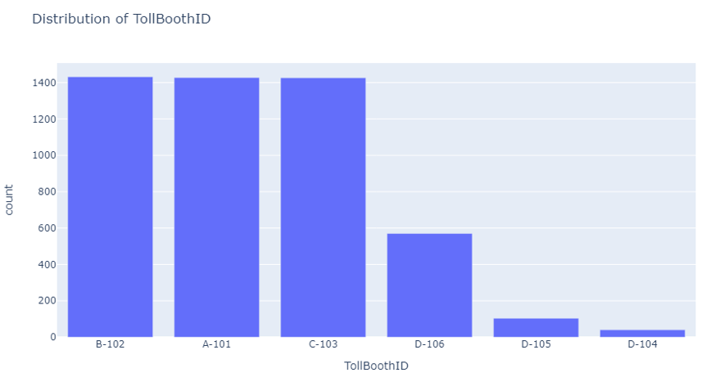
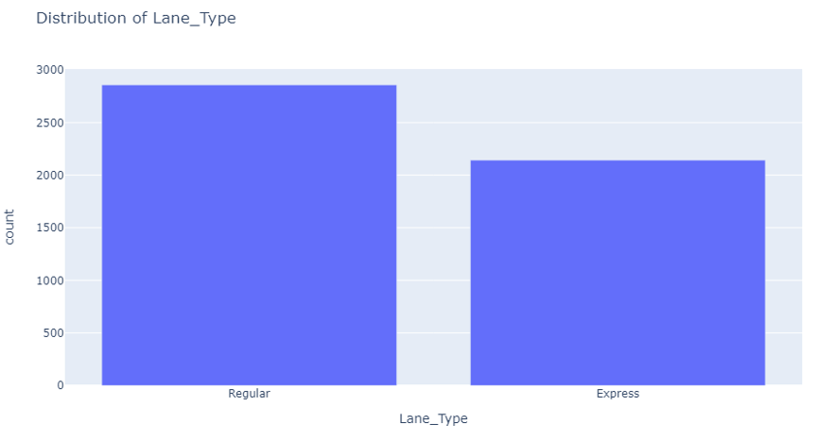
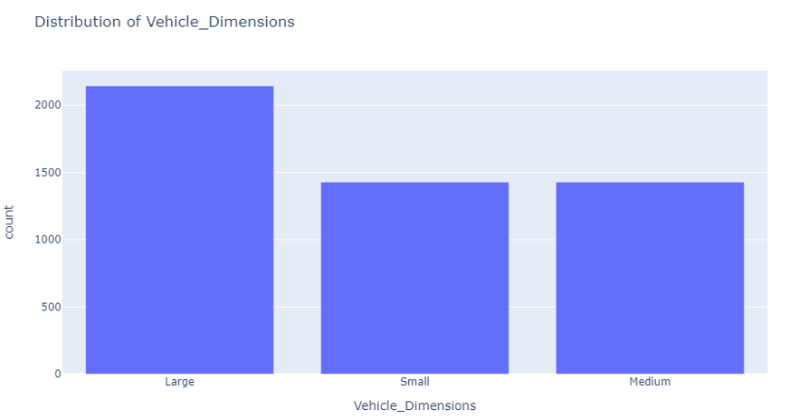
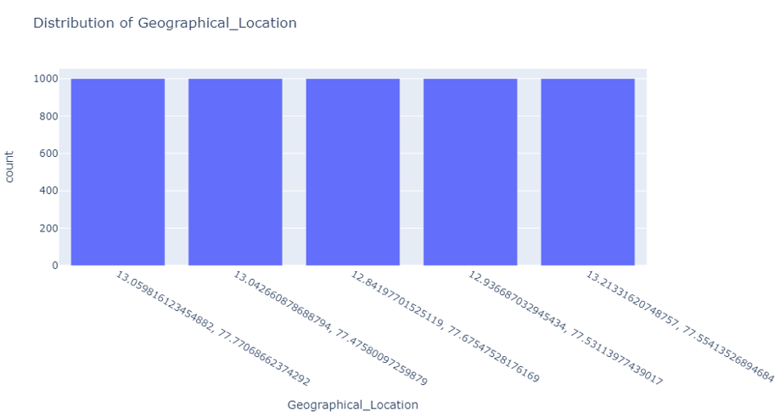
Visualize the distribution of categorical features
Insights:
TVehicle Types in Transactions: The transactions are evenly spread across various vehicle types, with each category contributing approximately 714 transactions. This indicates that the toll system is utilized by a diverse range of vehicles.
TollBooth Activity: TollBoothIDs B-102, A101, and C-103 register the highest transaction counts, marking them as key operational hubs. In contrast, TollBoothID D-104 shows much lower activity, suggesting it may be underutilized or located in a less busy area.
Lane Type Preference: Regular lanes have the highest transaction volume, indicating a strong preference or greater availability of these lanes. This suggests that most vehicles using the toll system are standard-sized and do not need specialized lanes.
Vehicle Dimensions and Transactions: There is a significant trend of larger vehicles being more involved in transactions. This could indicate that the toll system is heavily used by commercial or industrial vehicles, which tend to be larger.
Geographical Spread of Transactions: Transactions are evenly distributed across different geographical locations, showing no significant bias towards any particular area. This uniform distribution suggests a widespread and balanced use of the toll system across the region.

Slide 6
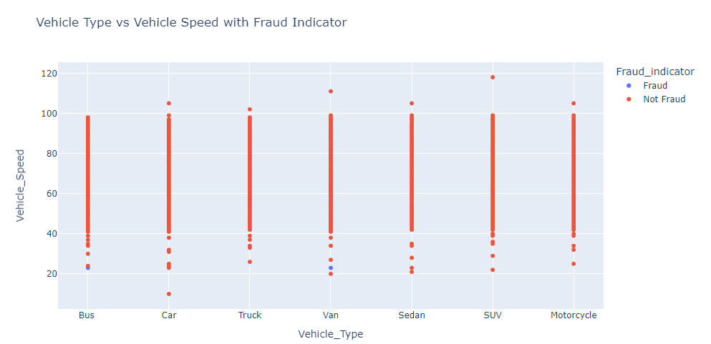
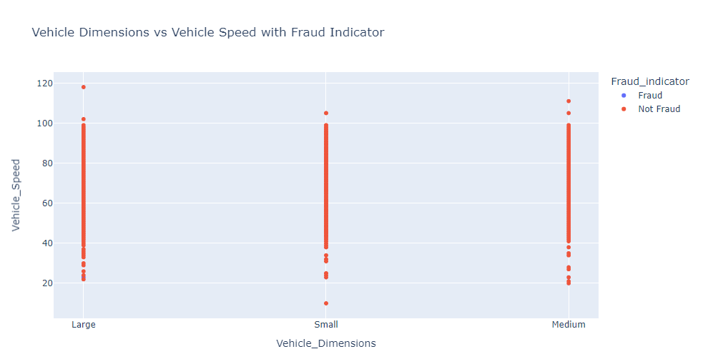
Relationship Between Vehicle Type, Vehicle Dimensions, and Vehicle Speed
Insights:
SUVs and vans are often noted for traveling at higher speeds, which could indicate non-compliance with traffic laws or potential involvement in questionable activities.
Larger vehicles tend to be observed traveling at above-average speeds, highlighting possible safety concerns or irregularities that may need closer scrutiny.

Slide 7
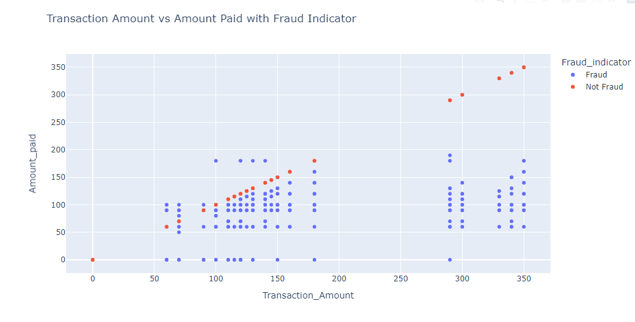
Scatterplot between Transaction amount vs amount paid with Fraud indicator:
Insights:
When the transaction amount matches exactly with the amount paid, there's a noticeable pattern of fraudulent behavior. This precise alignment, which diverges from the typical transaction scenario, may indicate intentional manipulation or exploitation of system weaknesses. Normally, transaction and payment amounts vary due to factors such as fees, discounts, or additional charges, making such exact matches uncommon.

Slide 8
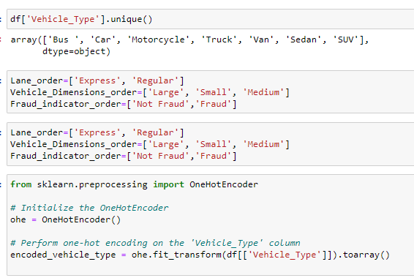
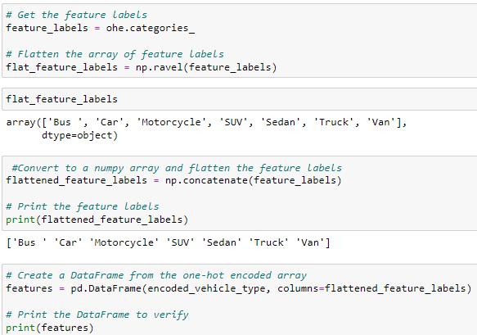
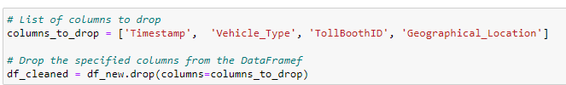
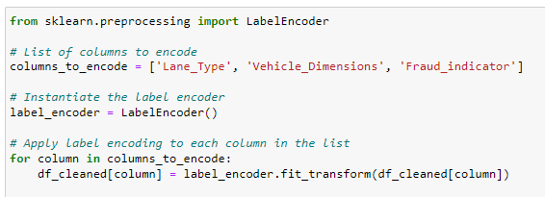
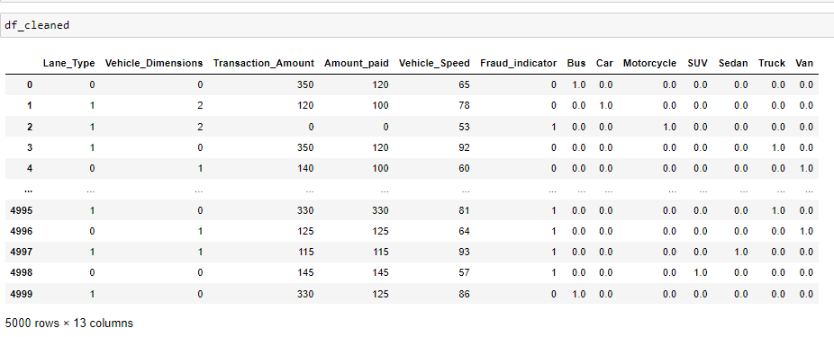
Feature Engineering:

Slide 9
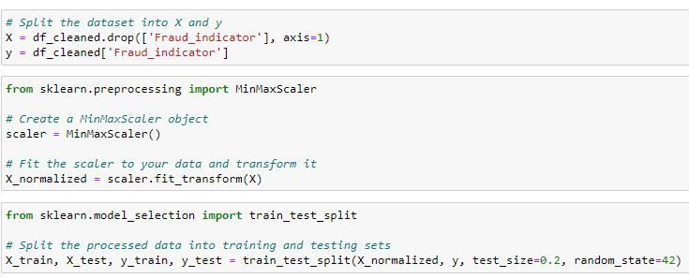
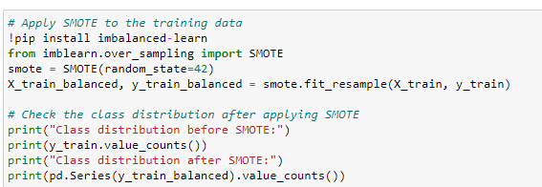
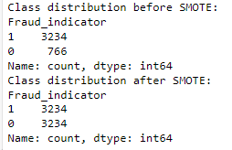
Creating input and output variables:
Balancing the data:

Slide 10
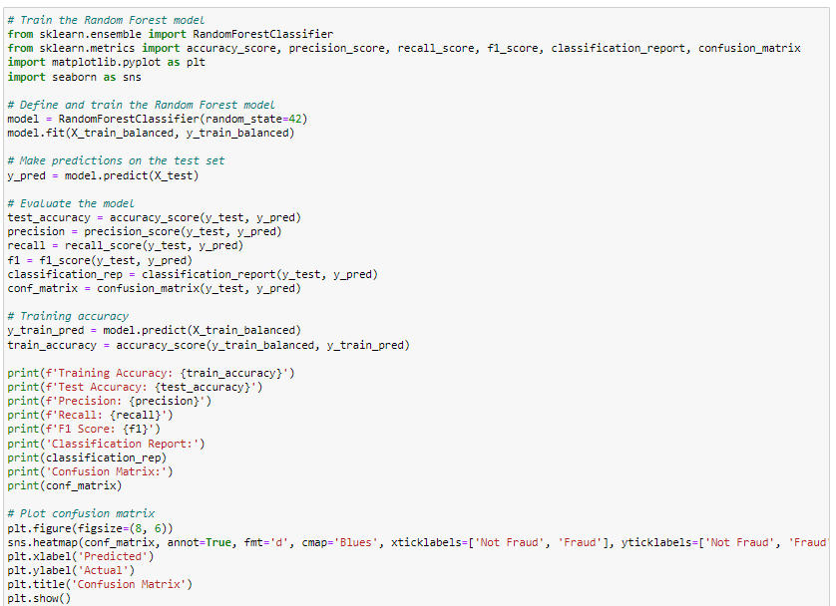
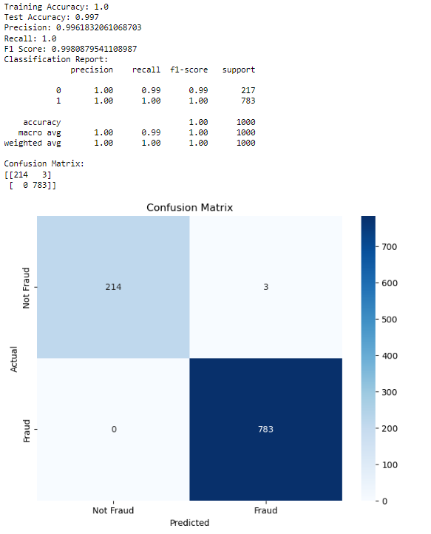
Model Building:
Random forest classifier:

Slide 11
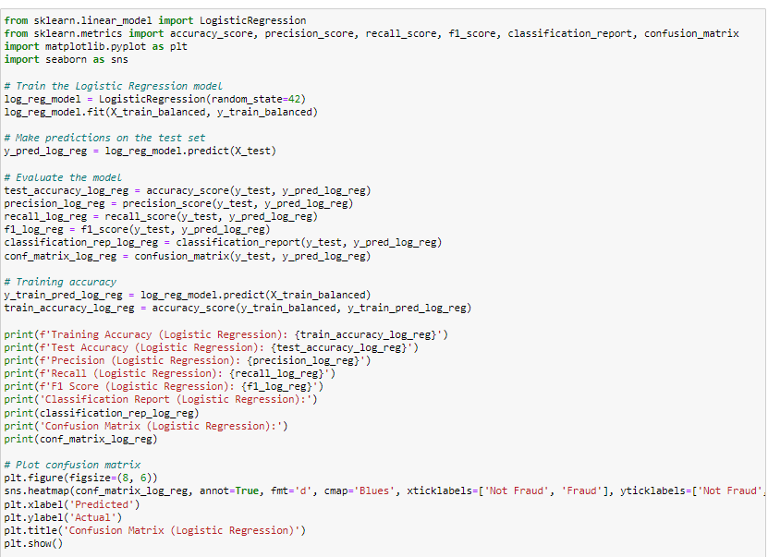
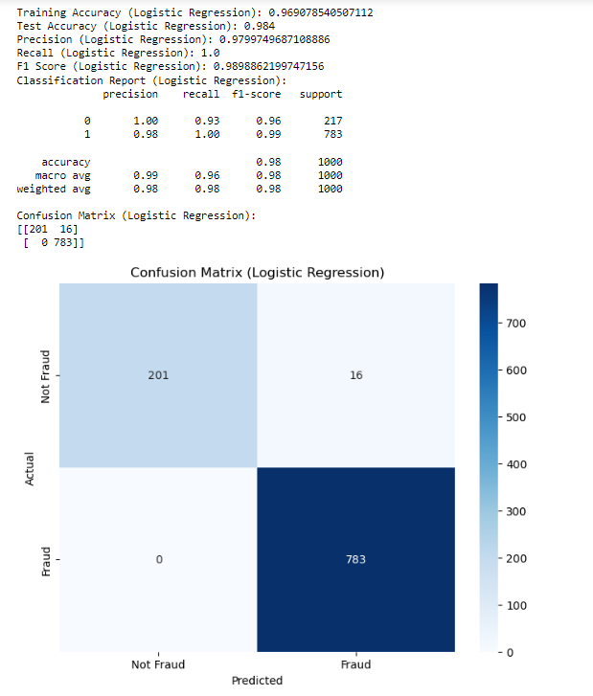
Logistic Regression:

Slide 12
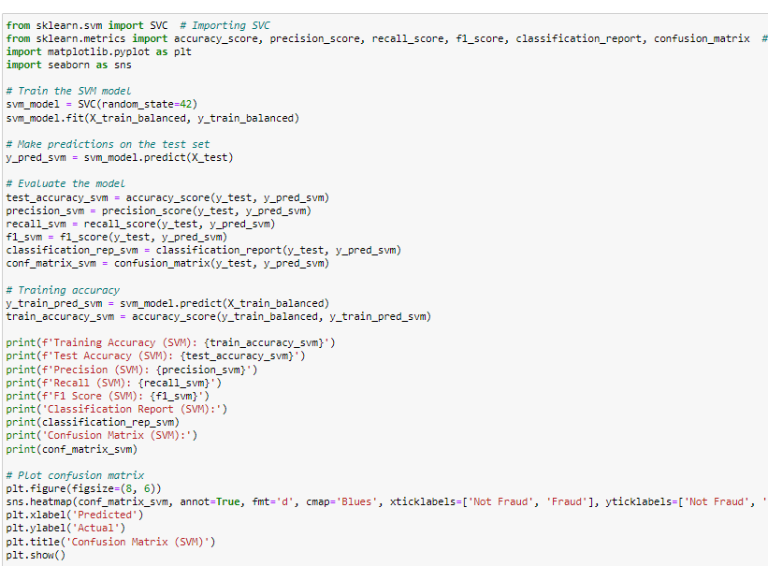
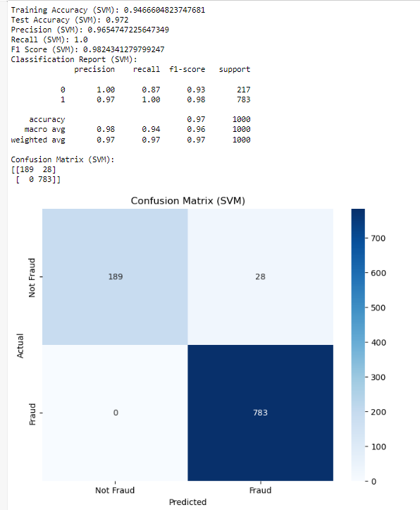
Support Vector classifier:

Slide 13
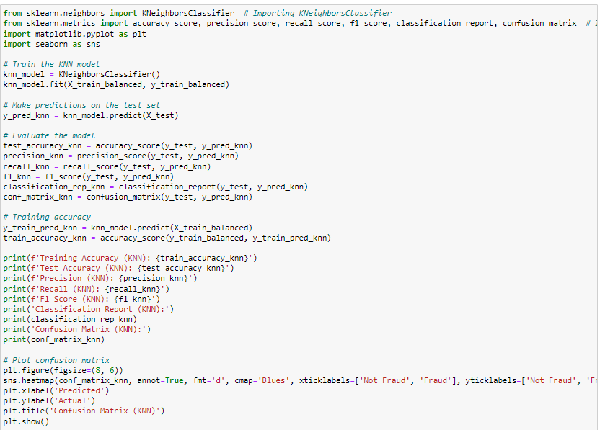
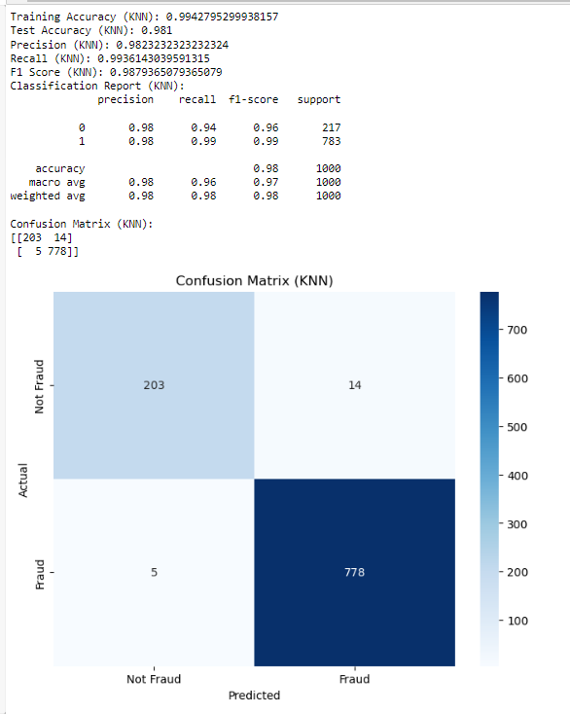
K-Nearest Neighbor classifier:

Slide 14
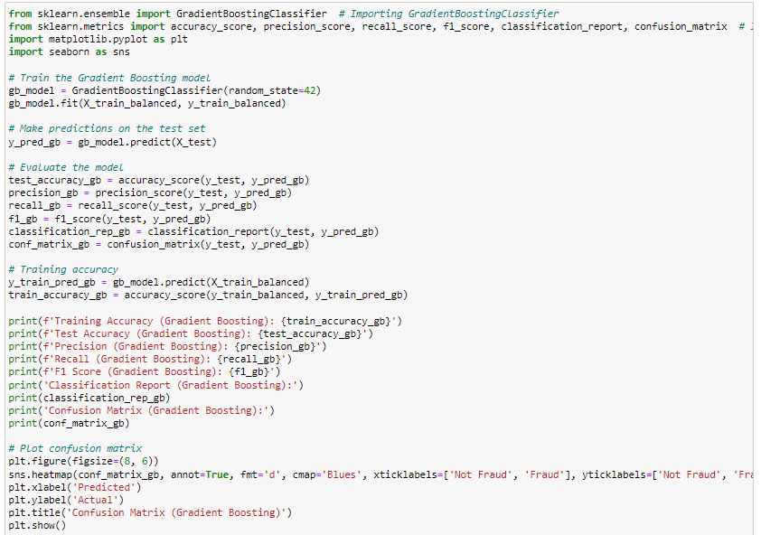
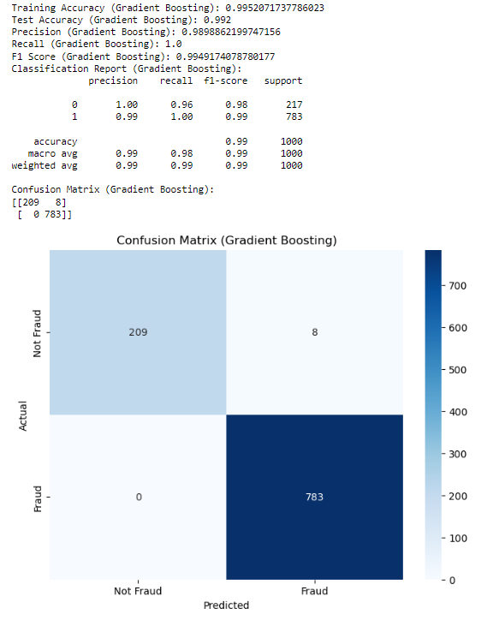
Gradient Boosting classifier:

Slide 15
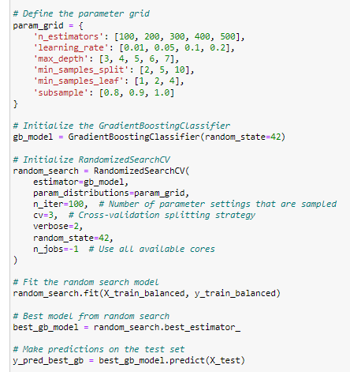
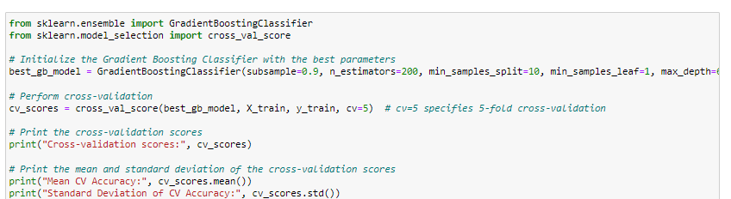

Hyperparameter tuning to get the Best GradientBoosting Classifier Model and Cross-Validation:

Slide 16
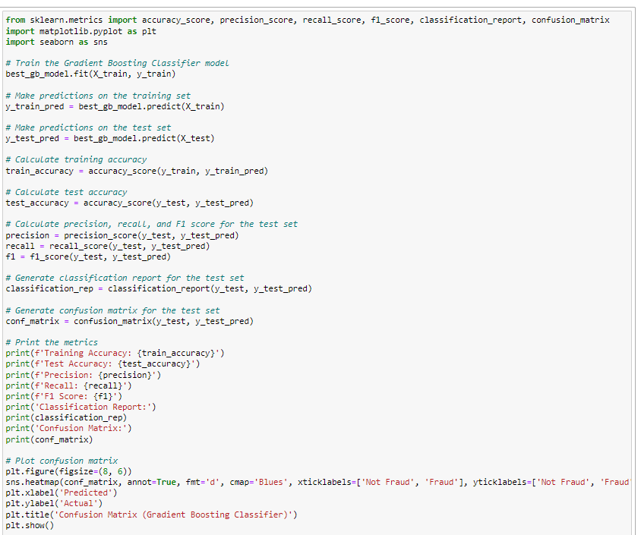
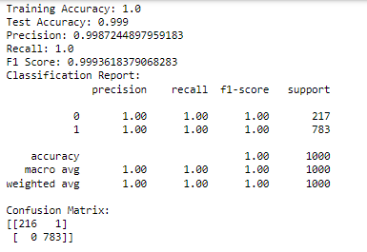
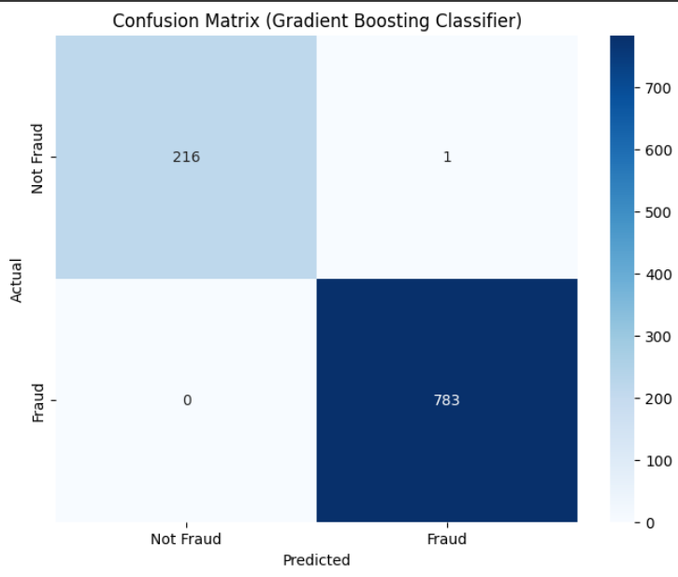
The Best GradientBoosting Classifier:

Slide 17
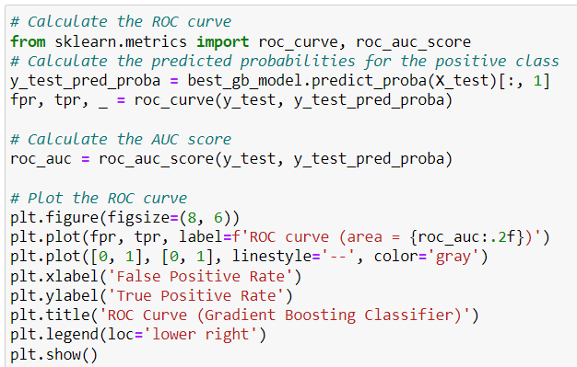
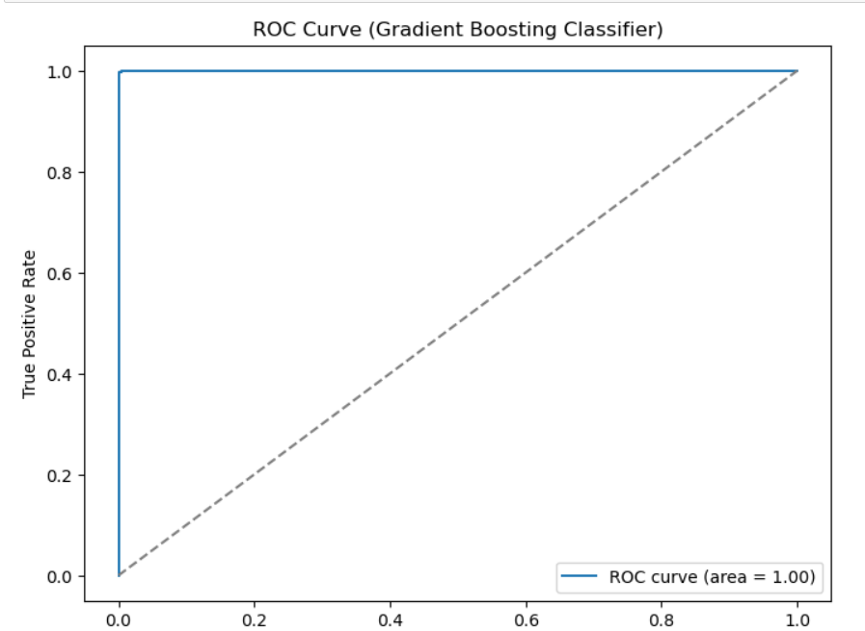
ROC Curve:

Slide 18
THANK YOU

