Slide 1
Project on Salary Predictions of Data Professions
Problem Statement:
Salaries in the field of data professions vary widely based on factors such as experience, job role, and performance. Accurately predicting salaries for data professionals is essential for both job seekers and employees

Slide 2
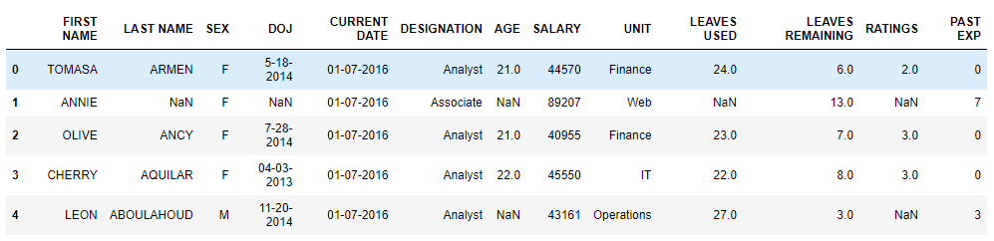
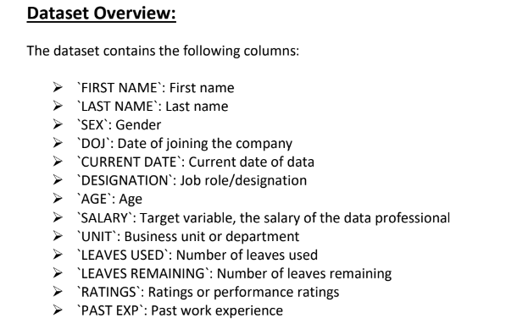
Details about the Dataset :

Slide 3
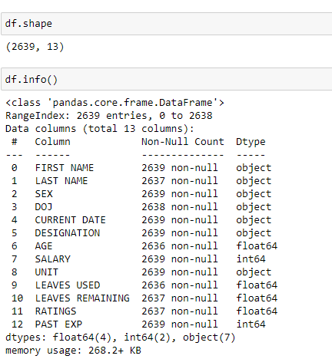
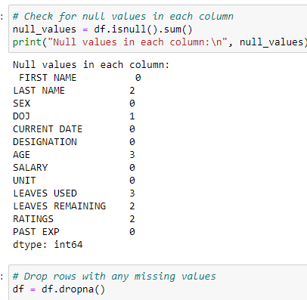
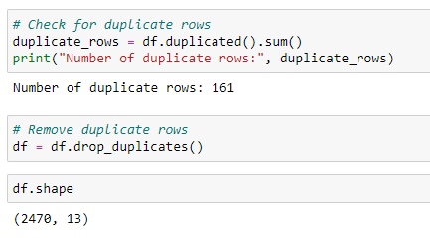
Info and null values and duplicate values:
The dataset contains 2639 rows and 13 columns and it contains 7 object columns 2 integer columns and 4 float columns and it contains some null values which have been dropped and it contains 161 duplicate rows which have been removed and the now the data set has 2470 rows and 13 columns

Slide 4
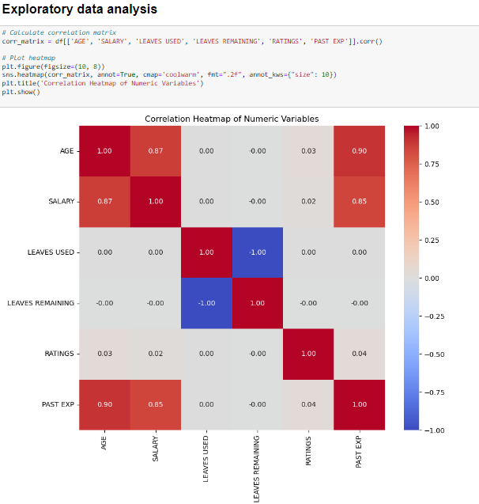
EXPLORATORY DATA ANALYSIS Corelation Matrix
AS you can see the correlation between salary and past experience is high and the correlation between age and salary is also high

Slide 5
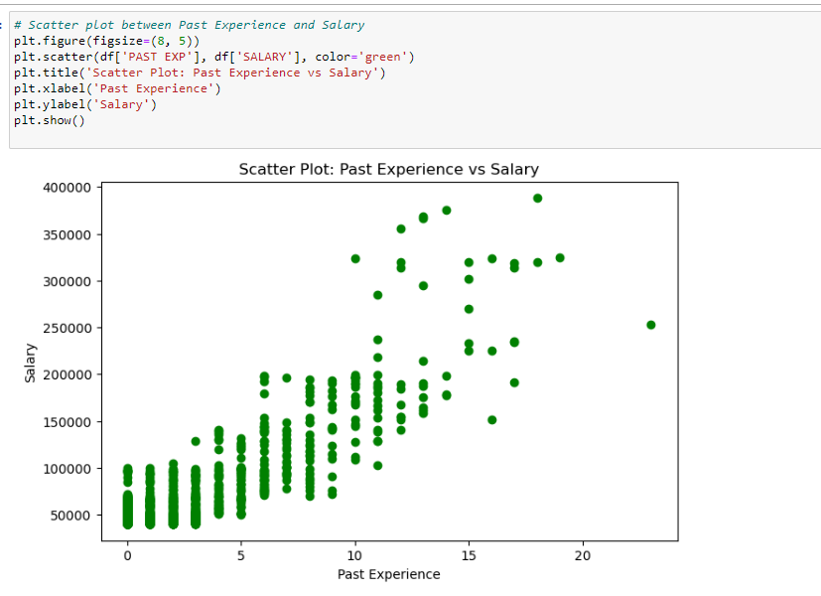
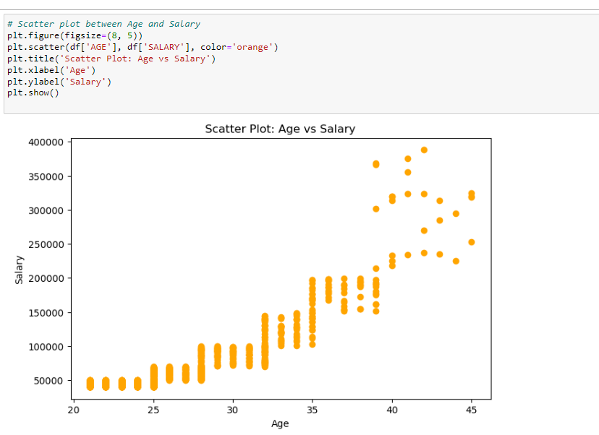
Scatterplot between past experience and salary and age and salary
:-

Slide 6
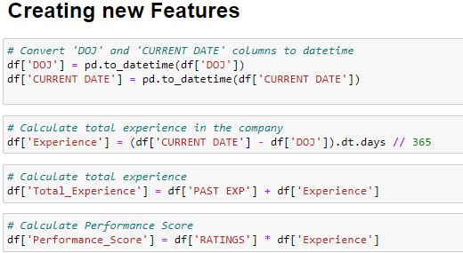
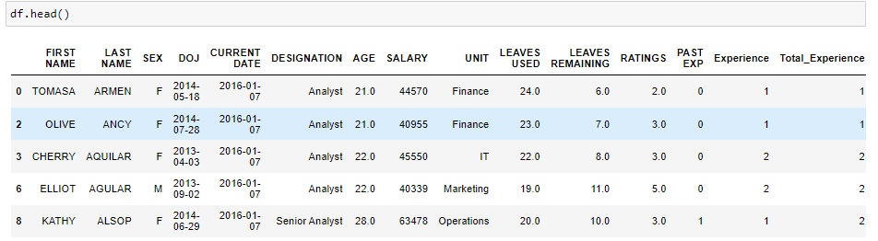
Creating New features
Creating new features
Experience – the experience or tenure in the company which is calculated current date – date of joining in term of years
Total experience – experience + past experience
Performance score – rating * experience

Slide 7
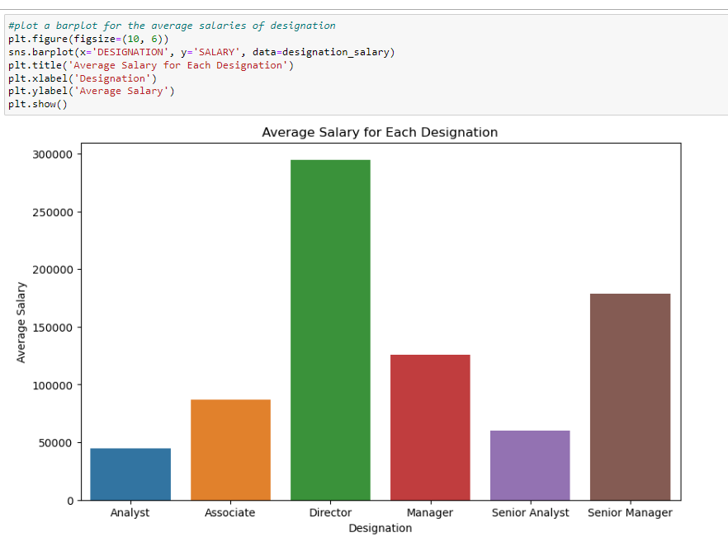
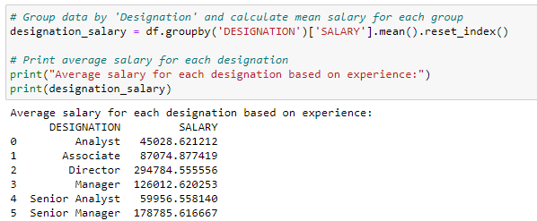
Barplot for Average salary by Designation
This barplot shows the average salaries of the employees by there designation

Slide 8
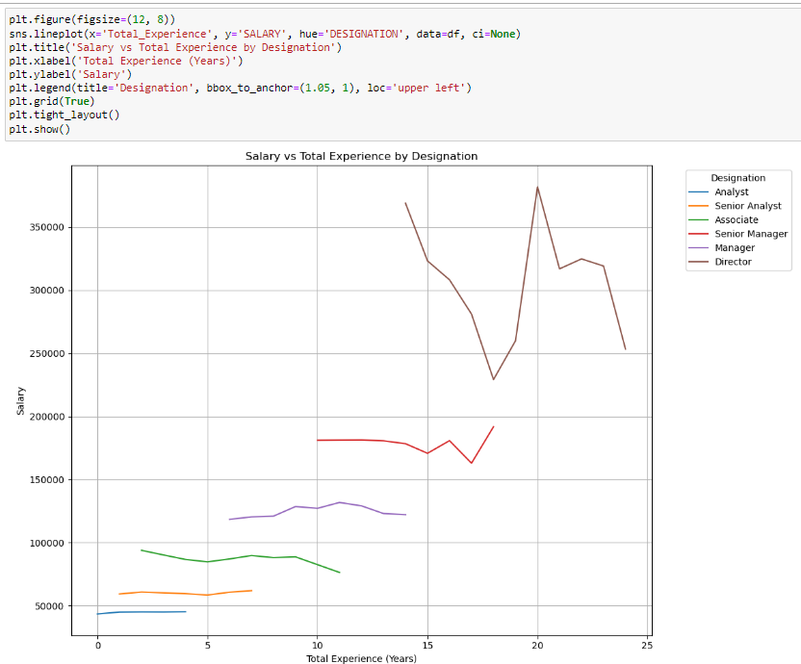
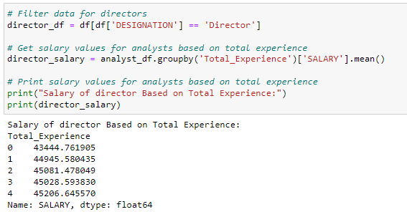
Lineplot for salaries of employees for total experience for all designations:
This line plot shows the salaries of employees based on their work experience for all designations

Slide 9
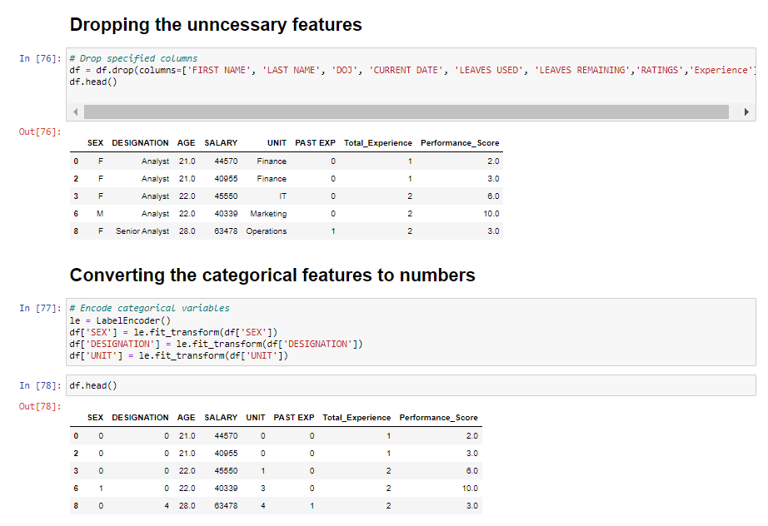
Dropping unnecessary features and converting categorical features to numbers:

Slide 10
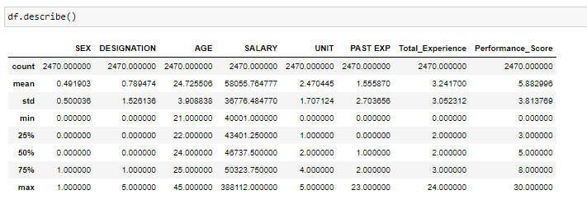
Describe the data:
Insights :
The minimum age in this data set is 21 with zero work experience but his salary is 40000 dollars
There is a employee with 23 years of past experience and his performance score is also the highest at 30 and his salary is the highest amnong all

Slide 11
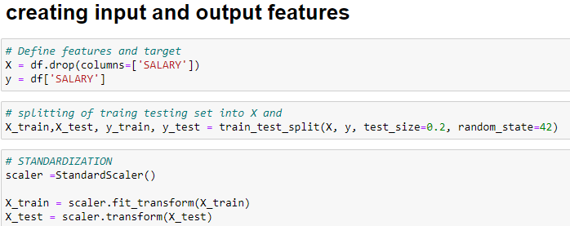
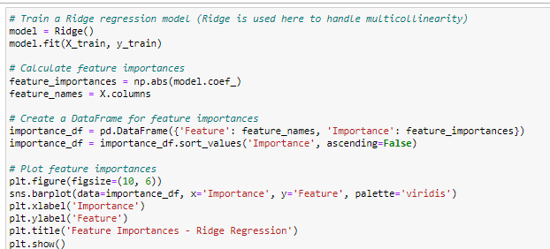
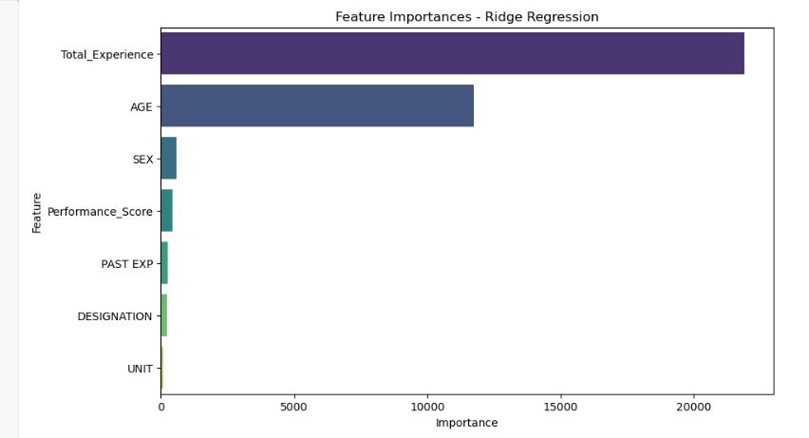

Slide 12
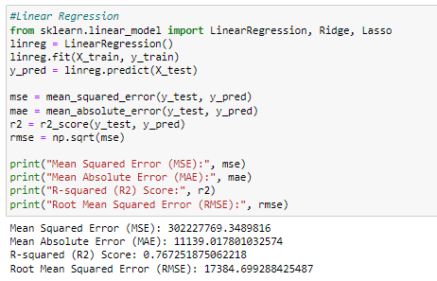
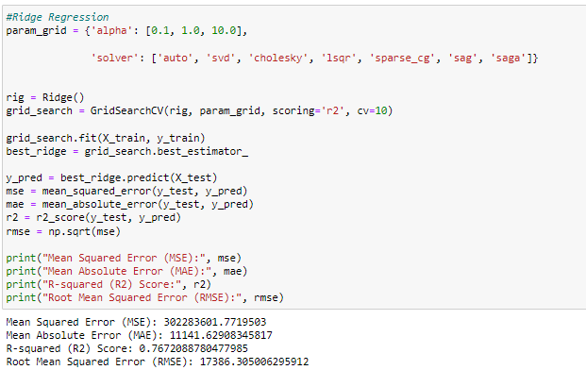
Model Building Linear Regression Model and Ridge Regression model:

Slide 13
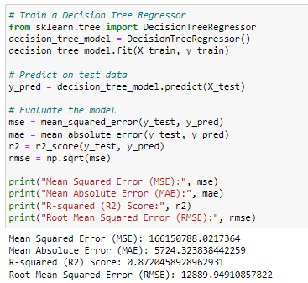
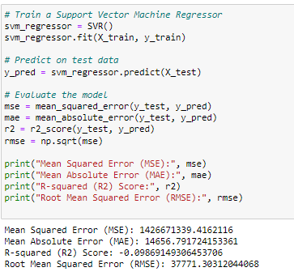
Decision Tree Model and Support Vector machine:

Slide 14
Random Forest Regressor Model:

Slide 15
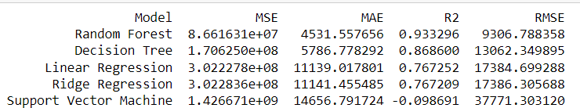
Random forest Regressor model has the lowest root mean square error, lowest mean absolute error and high accuracy so we will select this model for Model deployment.
All Models Performance Metrics Comparison :

Slide 16
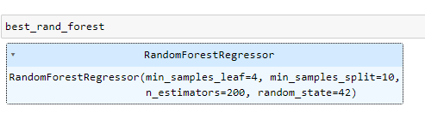
Random forest regressor model with hyper tuning for best results:

Slide 17
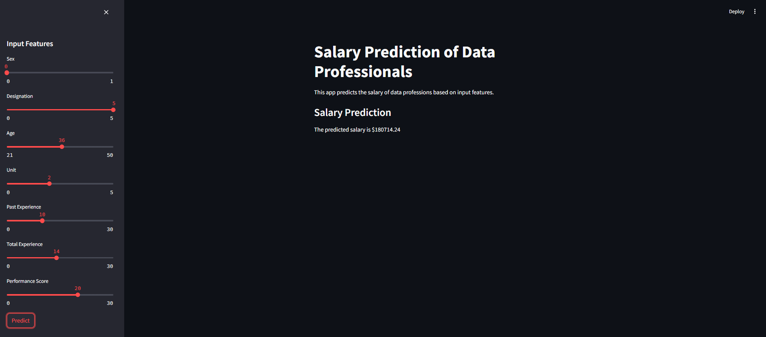
Deployment using Streamlit

Slide 18
THANK YOU

