Slide 1
Title: Sales Performance Dashboard Subtitle: Data Analyst Internship – Task4 Prepared By: Jayanth B

Slide 2
Objective:
• Design an interactive dashboard for business stakeholders • Analyze Sales, Profit, and Growth trends • Provide insights using KPIs and visual analytics

Slide 3
Tools & Dataset
Tools Used: • Power BI • Kaggle Sales Dataset
Dataset Includes: • Revenue • Profit • Orders • Product Category • Country • Date (Year/Month) • Customer Demographics

Slide 4
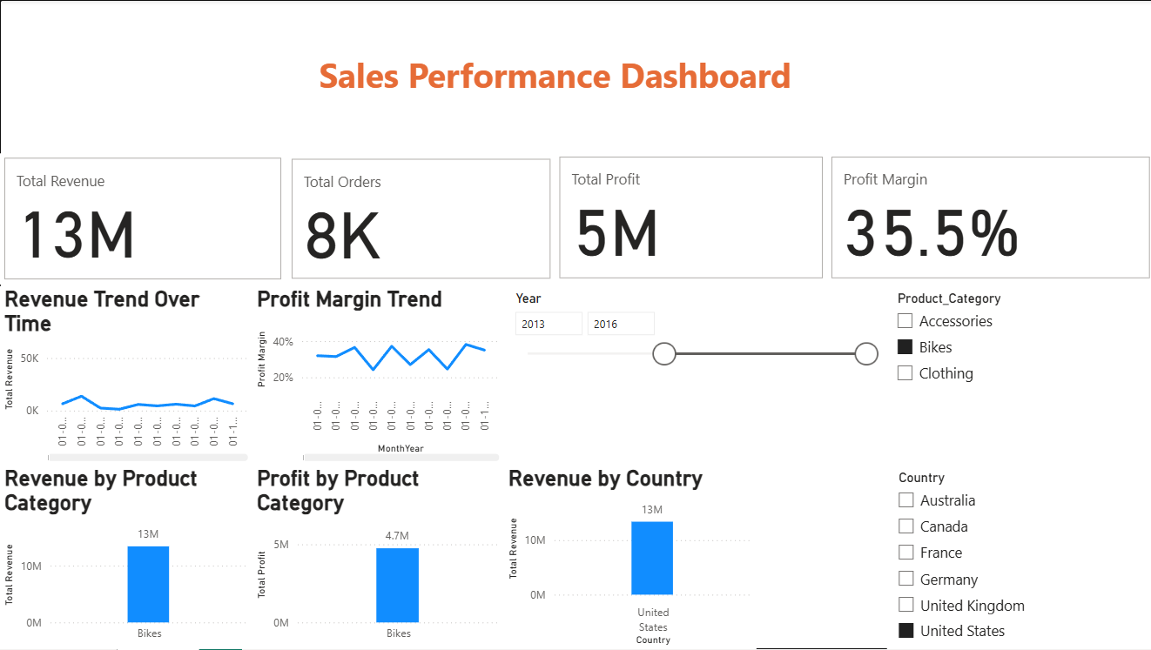
Dashboard Overview • KPI Cards (Revenue, Orders, Profit, Profit Margin) • Revenue Trend Over Time • Profit Margin Trend • Revenue by Category • Revenue by Country • Interactive Slicers

Slide 5
Key Insights:
• Bikes category generates the highest revenue and profit • United States contributes the highest overall revenue • Average profit margin remains around 30–35% • Revenue shows noticeable seasonal variation

Slide 6
Business Recommendations
Focus marketing efforts on high-performing categories (Bikes)
Improve profitability in lower-margin segments (Clothing)
Expand in high-revenue countries
Monitor seasonal trends for demand forecasting

Slide 7
Conclusion
Successfully built an interactive dashboard
Applied time-series analysis
Used KPIs for performance tracking
Enabled business-driven decision making

