Slide 1

Data Engineering

Slide 2
Data Engineering
Finding Data
Data Cleansing
Feature Engineering
Data Splitting
Refers to manipulation — addition, deletion, combination, mutation — of your data set to improve machine learning model training, leading to better performance and greater accuracy
Identify source(s) of data which is relevant to solve the problem, this can be from a business app, public data source, might include synthetic data generation
The process of re-formatting particular attributes and correcting errors in data, such as missing values
Splitting the data into training, validation, and test datasets to be used during the core machine learning stages to produce the ML model
1
2
3
4

Slide 3
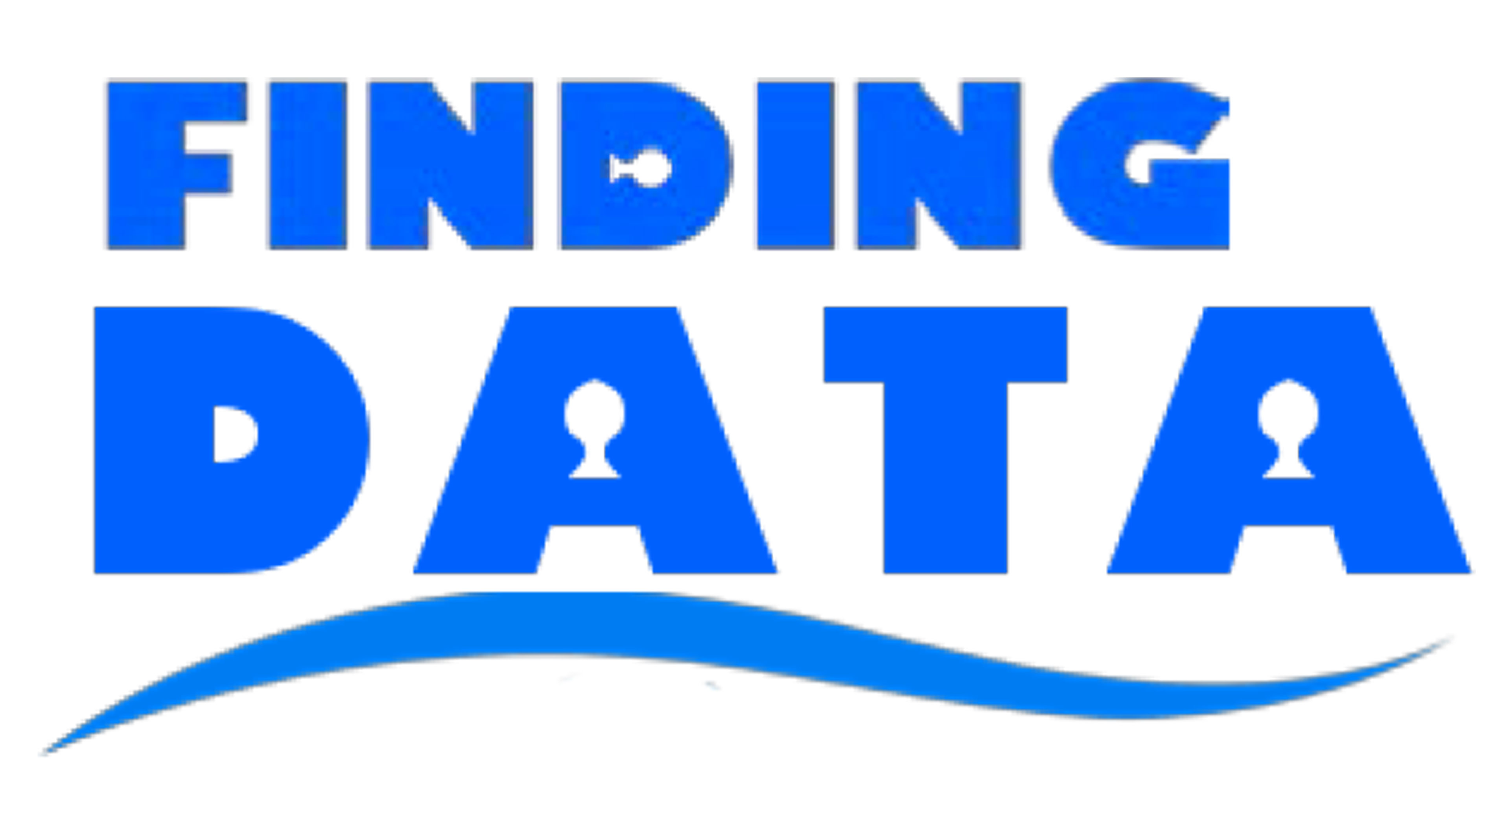

Slide 4

Life of a Data Science Engineer
Data, Data, Data, I don’t like Bad Data…I avoid it…
But bad data likes me…I can’t avoid it

Slide 5
Dataset
A dataset is a collection of data that is organized and formatted in a specific way.
It can consist of variables, observations, and records, and it is used to represent real-world information, such as demographic information, sales data, weather data, and more.
Datasets are used for various purposes, including research, analysis, and modeling, and they play a crucial role in driving insights, making informed decisions, and solving problems.
Finding a right dataset: Key to Successful Projects and Research

Slide 6
Importance of Datasets
Machine Learning: Datasets are crucial for training and testing machine learning algorithms. The quality and size of the dataset can greatly impact the performance and accuracy of the models.
Data Analysis: Datasets are used for exploring and understanding patterns, trends, and relationships in data. This is important for business intelligence, market research, and decision-making.
Research: Datasets are essential for conducting scientific research and studies. Researchers use datasets to collect and analyze data, test hypotheses, and validate findings.
Predictive Modeling: Datasets are used for building predictive models, such as time-series forecasting, customer segmentation, and risk management.
Artificial Intelligence: Datasets are critical for developing and training artificial intelligence algorithms. Large, high-quality datasets are needed to build models that can accurately perform tasks such as image recognition and natural language processing.
Overall, the importance of datasets lies in their ability to provide insights, drive decisions, and solve problems. It is essential to have high-quality, accurate, and relevant datasets to ensure that the results of a project or research are reliable and valuable.

Slide 7
Characteristics of Good Dataset
Relevance: The dataset should be relevant to the problem or project being addressed. It should contain information that is useful and meaningful.
Accuracy: The data in the dataset should be accurate and reliable. This includes accurate measurement, correct data entry, and proper validation.
Completeness: The dataset should be complete and contain all relevant information. This includes having sufficient data points and covering a representative range of scenarios.
Consistency: The data in the dataset should be consistent and formatted in the same way. This makes it easier to work with and analyze.
Accessibility: The dataset should be easily accessible and available in a format that can be used for the desired purpose. This includes being open, free, and easy to download.
Timeliness: The dataset should be up-to-date and reflect current information. This is particularly important for real-time data, such as stock prices or weather reports.
Representativeness: The dataset should be representative of the real-world phenomenon being studied. This means having a good mix of different types of data, such as demographic data and economic data.

Slide 8
Sources
Government Agencies
Non-Profit Organizations
Academic Institutions
Companies
Open Data Initiatives

Slide 9



Finding Data - Government Agencies
Government agencies are a rich source of datasets covering a wide range of topics and domains.
Datasets from government agencies are often free, open, and accessible to the public.
These datasets can provide valuable information for research, analysis, and decision-making.
Reliable and accurate data: Government agencies are responsible for collecting and managing data in a systematic and reliable manner.
Comprehensive coverage: Government agencies often collect data across a wide range of topics and domains, providing a comprehensive view of the data.
Types of Datasets:
Demographic data: Information on population, age, gender, education, and more.
Economic data: Information on GDP, employment, trade, and more.
Environmental data: Information on weather, climate, and natural resources.
Geographic data: Information on locations, maps, and boundaries.
Health data: Information on diseases, mortality, and health outcomes.

Slide 10

Finding Data - Nonprofits
These organizations collect and manage data for a wide range of social, environmental, and economic issues.
Specialized data: Non-profit organizations often collect data in specific areas of interest, providing specialized and relevant information.
Mission-driven data: Non-profit organizations collect data with a specific purpose and mission, ensuring data quality and reliability.
Free and open access: Many non-profit organizations make their datasets available for free and open access, allowing for greater use and dissemination of the data.
Types of Datasets:
Social issues data: Information on poverty, inequality, education, and more.
Environmental data: Information on sustainability, conservation, and climate change.
Health data: Information on access to healthcare, disease prevalence, and health outcomes.
Human rights data: Information on human rights violations, freedom of expression, and more.
Economic data: Information on income, employment, and economic development.

Slide 11

Finding Data - Academic Institutions
Academic institutions are a major source of datasets for research and analysis in various fields of studies.
Cutting-edge data: Academic institutions generate and collect data in the latest fields of research and study, providing access to cutting-edge information.
High-quality data: Academic institutions have high standards for data quality, reliability, and validity, ensuring the accuracy and validity of the data.
Diverse data: Academic institutions collect data from various sources and disciplines, providing a diverse range of data for analysis and study.
Types of Datasets:
Scientific data: Information on biology, chemistry, physics, and more.
Humanities data: Information on history, literature, and culture.
Social science data: Information on sociology, psychology, economics, and more.
Health data: Information on medical research, health outcomes, and more.
Geographical data: Information on geography, maps, and environmental issues.

Slide 12


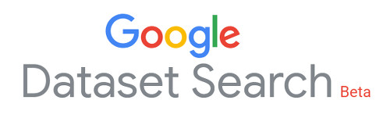
Finding Data - Companies
Companies generate, collect, and manage data in various fields of business and commerce.
Datasets from companies can provide valuable information for market analysis, customer insights, and decision-making.
Real-world data: Companies generate and collect data from real-world transactions and interactions, providing valuable insights into customer behavior and market trends.
Commercial data: Companies have access to commercial data, such as sales and marketing data, providing valuable insights into business performance and market trends.
Types of Datasets:
Sales and marketing data: Information on customer behavior, market trends, and sales performance.
Financial data: Information on company performance, stock prices, and financial trends.
Customer data: Information on customer demographics, preferences, and behavior.
Supply chain data: Information on product sourcing, logistics, and distribution.
Industry data: Information on specific industries, such as retail, technology, and more.

Slide 13

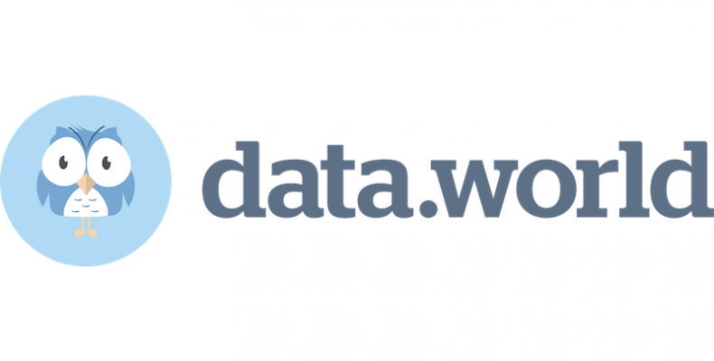
Finding Data - Open Data Initiatives
Open Data Initiative is a global movement towards making data publicly available for free.
The goal of Open Data Initiative is to promote transparency, accountability, and innovation.
Free and accessible data: Open Data Initiative provides free and accessible data to everyone, promoting transparency and accountability.
Diverse data: Open Data Initiative provides access to a wide range of data from various sources and disciplines, promoting innovation and analysis.
Types of Datasets:
Government data: Information on government performance, public services, and more.
Environmental data: Information on climate, weather, and natural resources.
Economic data: Information on the economy, trade, and financial markets.
Transportation data: Information on transportation, traffic, and mobility.
Social data: Information on demographics, health, and social trends.

