Slide 1
Data Injection Attacks on PdM Systems
Link to video presentation: https://github.com/jayanthguduru/FinalProjectPresentation-MLSec

Slide 2
EL-GY-9163: Machine Learning for Cyber-security – Project Presentation Video
Jayanth Guduru – jg7162
Prathyusha kadali – pk2669
Nelanuthula sai goutham – sn3533

Slide 3
Introduction and Goals
Predictive Maintenance System – Solution for predicting faults in a component or a system with machine learning (ML) algorithms.
Learning (DL) algorithms, are known for their vulnerabilities to cyber-attacks.
To date, the majority of the published literature focuses on the accuracy of the IoT and DL enabled PdM systems and often ignores the effect of such attacks.
So the goal of this project is to demonstrate the effect of false data injection attack on a PdM system.

Slide 4
Dataset Description

Slide 5
C-MAPSS Dataset
For this project we are using NASA's turbofan engine degradation simulation dataset C-MAPSS (Commercial Modular Aero-Propulsion System Simulation).
This dataset includes 21 sensor data with different number of operating conditions and fault conditions for 100 engines
There are 4 subsets in the dataset and every subset has training data and test data.
There are 20K total observations in the first subset which we used for demonstrating the results in this presentation.

Slide 6
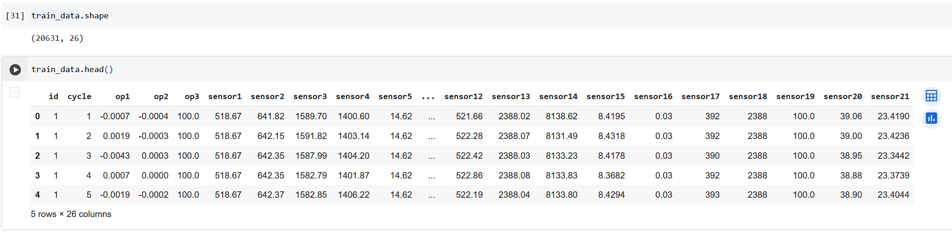
Dataset

Slide 7
Dataset ( cont’d)
These engines are run to failure and the data is captured during different cycles of the engine and the lifetime of the engine represented by Remaining operational cycles(RUL).
There is no RUL data provided for training set. So we count RUL based on cycles in the data Engine. Since this is linear degradation model, the RUL keeps decreasing until failure. So at the first cycle of engine 1, its RUL is 191. After cycle 2, its RUL is 190 and so on. As it fails after 192 cycles, at 192nd cycle, its RUL is 0.
We also have a vector of true Remaining Useful Life (RUL) values for the test data.

Slide 8
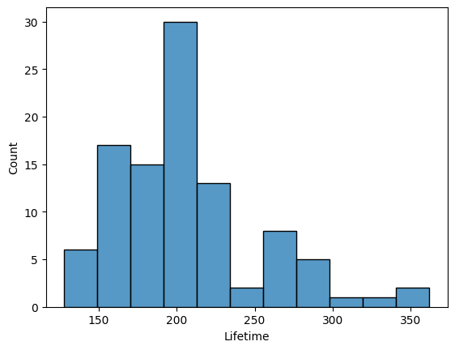
Figure 1: Distribution of lifetime of engines.

Slide 9
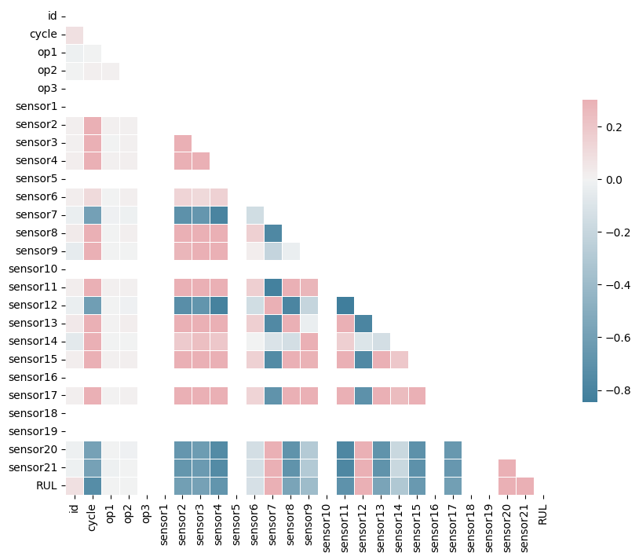
Data Patterns and Feature Selection
Most of the sensors are pairwise correlated with RUL, except for sensors 1, 5, 10,
16, 17, 18

Slide 10
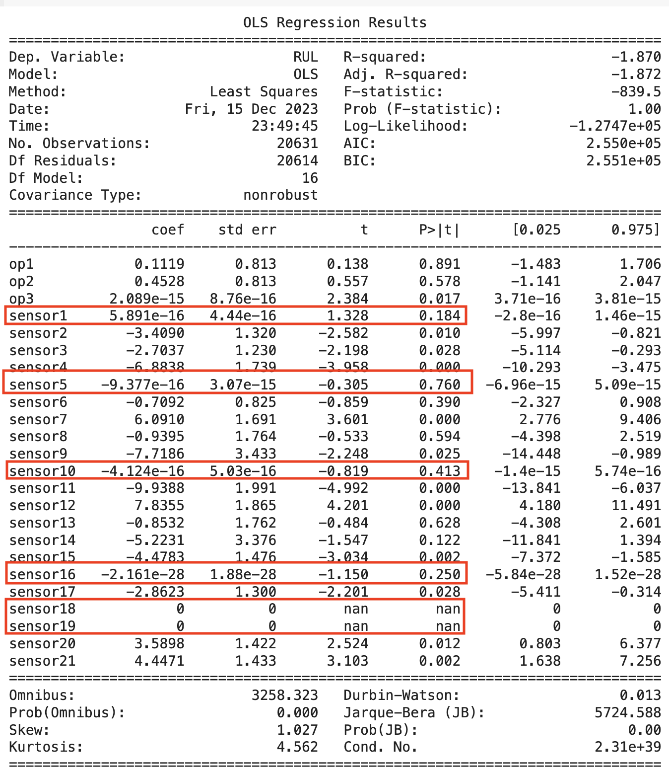
Data Patterns and Feature Selection (cont’d)
Some sensors have no significant
coefficients in a simple OLS
(performed with normalized data)

Slide 11
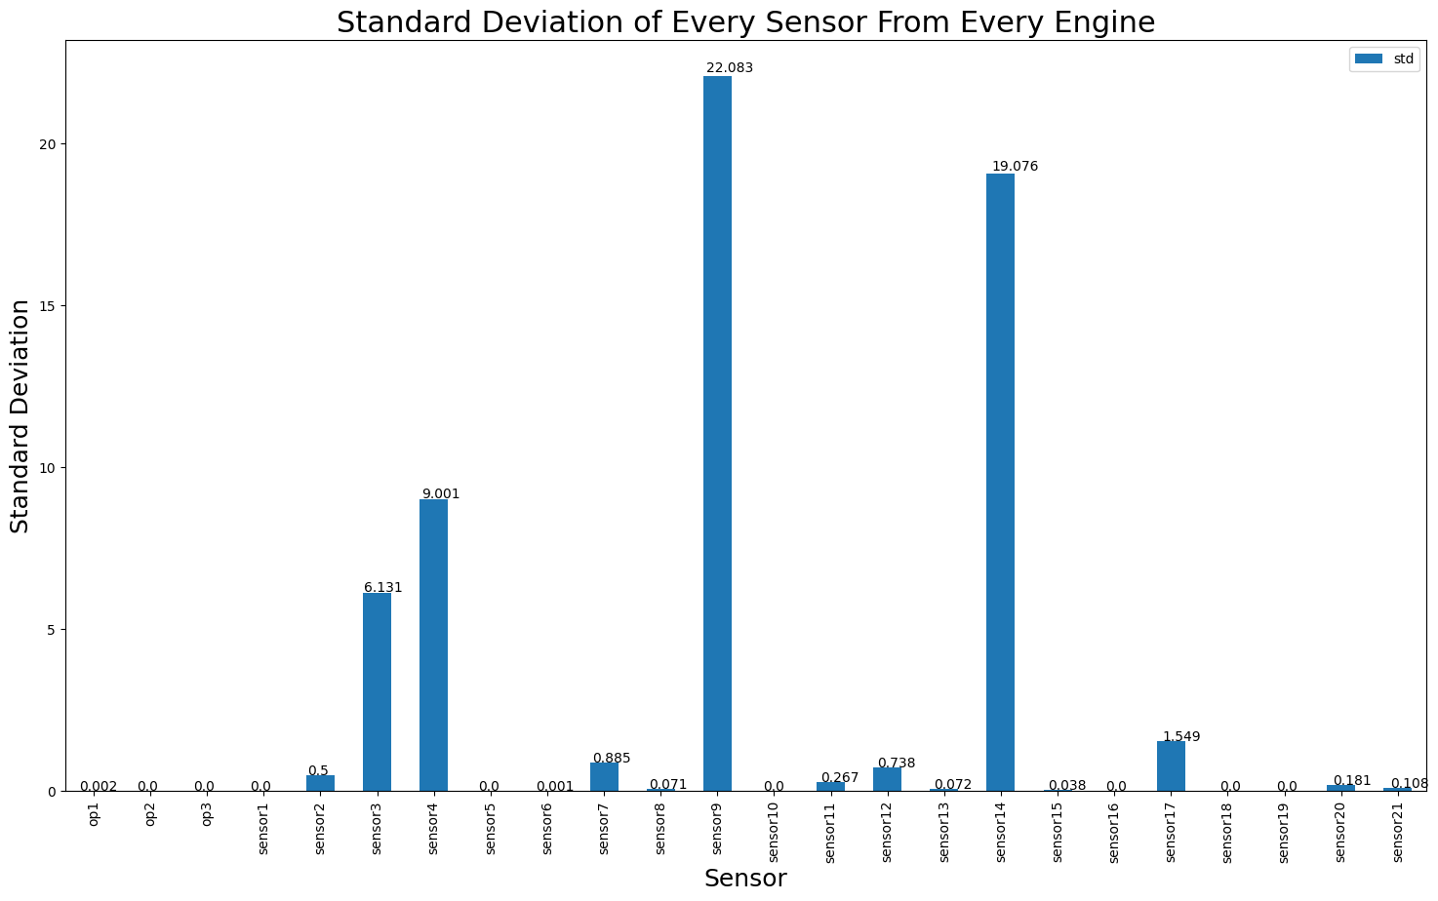
Data Patterns and Feature Selection (cont’d)
Measurements from some sensors are
constant across engines and cycles
(5, 15,10, 16, 18, 19).
Based on observation we dropped these
features

Slide 12
DL Model
Input Variables – Sensor data after feature selection
Target Variable – RUL ( Remaining Useful Life)
Build a model to predict the number of remaining operational cycles(RUL) before failure in the test set.

Slide 13
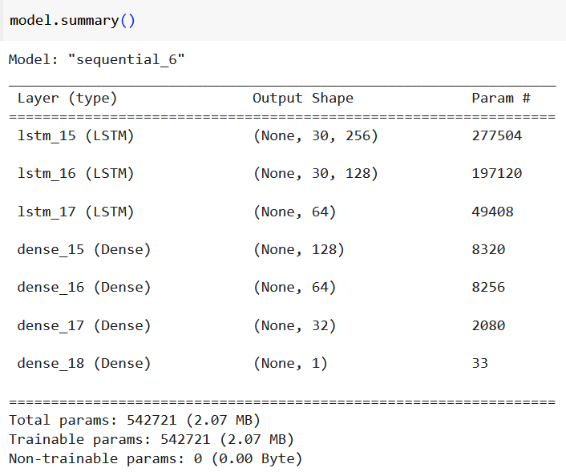
Model Architecture
Deep Learning - Recurrent Neural Network (RNN)
Loss Function Used: RMSE
Optimizer : Adam
Learning rate : 0.001 for first 5 epochs
And From epoch 6 onwards, the learning rate is
updated each epoch according to the formula
lr * tf.math.exp(-0.1).
Activation : TanH and Relu

Slide 14
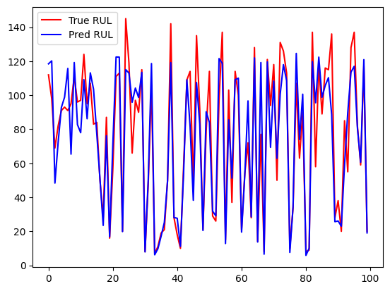
Results
Model performs fairly well with RMSE: 14.31

Slide 15
Attacks
Random FDIA (False Data Injection Attack):
This involves injecting noise at random intervals and magnitudes within a defined range (e.g., 0.01% to 0.05% of the actual sensor reading), which does not follow any discernible pattern and is meant to represent natural variations or random errors in the data.
Biased FDIA:
In a biased FDIA, the noise injection is not random but is introduced with a specific bias, such as consistently adding 0.02% to the sensor readings. This type of attack is designed to skew the data in a particular direction, which could mislead the system into making systematic errors.
Operational Setting Attack:
This attack targets the operational parameters of the system by injecting altered sensor data that could cause the system to operate in an unsafe or inefficient manner. For example, the attack might simulate sensor readings that are consistently within a specific threshold to influence operational settings, like temperature or pressure controls in an industrial system.

Slide 16
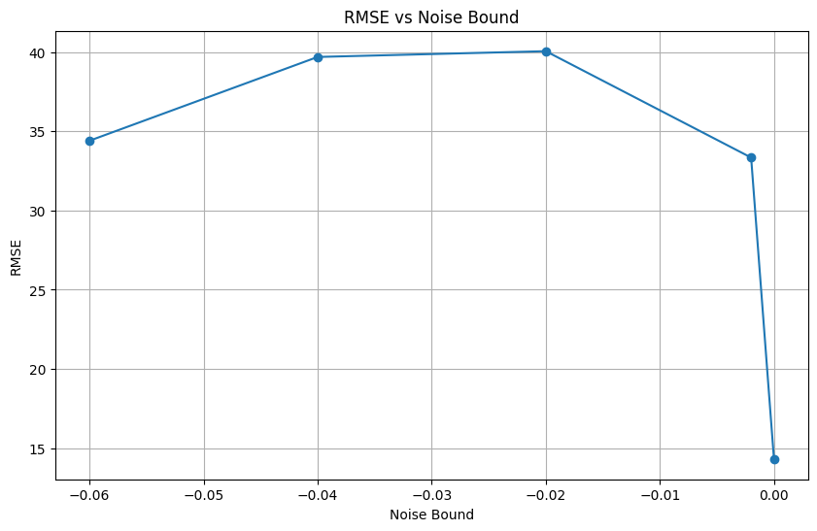
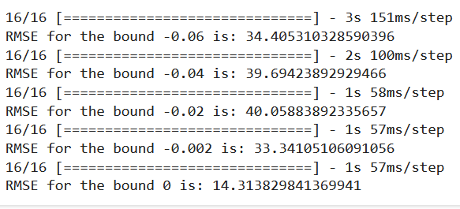
Attacks (cont’d)
To model the FDIA on sensors, we add a vicious vector to the original vector, which modifies the sensor output by a very small margin (0.01% to 0.05%) which we modelled as bound value. We used different bound values of [ -0.06, -0.04, -0.02, -0.002, 0] for biased FDIA. Here, random FDIA means the noise added to the sensor output has a range (0.01% to 0.05%). we are applying a process of injecting noise into a dataset to simulate real-world data inconsistencies. Specifically, we define a range of noise levels (bound) to be added to certain sensor readings in the test dataset.

Slide 17
Benefits of this approach
Robustness Testing
Improved Generalization
Understanding Model Sensitivity
Realistic Evaluation of Predictive Maintenance Models

Slide 18
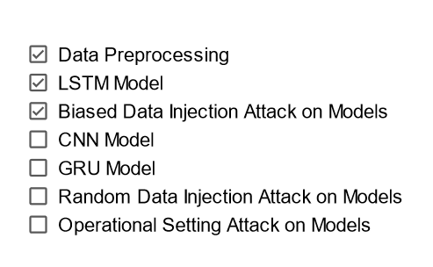
Checklist of Deliverables

Slide 19
Contribution
Jayanth Guduru – Data Preprocessing, LSTM Algorithm and Biased Data Injection Attack
Prathyusha Kadali – CNN Algorithm and Unbiased Data Injection Attack
Nelanuthula sai goutham – GRU Algorithm and Operational setting attack.

