Slide 1
Autism Classification from fMRI
ML MINI-PROJECT · UE24CS352A
Do brain regions that move together tell us more than how much each one swings?
AM123, AM809
Notes:
Introduce the project in one line: we classify autism vs typical control from resting-state fMRI, following a paper that did the same for heavy drinkers. Our question is whether correlation between brain regions works better than the paper's max-min feature. Fill in names, SRNs and the repo link in the footer.

Slide 2

The problem
THE PAPER
OUR VERSION
Heavy drinker vs not
Autism vs typical control
fMRI brain signals, classified with LR, SVMs and deep models
The same pipeline on the public ABIDE dataset
Notes:
The paper classifies heavy drinkers from fMRI, but its data is not public. Our teacher approved using a public fMRI dataset instead, so we apply the same pipeline to autism vs typical control. Our own twist is the feature choice, which comes two slides later.

Slide 3
The data: ABIDE
871
20
2
subjects
scanner sites
brain atlases
resting-state fMRI
different machines
200 and 111 regions
403 autism
468 control
Always guessing "control" scores 53.7%. That is the number to beat.
Notes:
ABIDE is a public autism fMRI dataset. We use 871 subjects from 20 scanning sites, with two ready-made brain atlases (Craddock-200 and Harvard-Oxford). The classes are nearly balanced, so the baseline of always guessing control is 53.7%.

Slide 4

The pipeline
STEP 1
STEP 2
STEP 3
STEP 4
Signals
Features
Models
Testing
A T × N table per person
max-min or correlation
LR and 4 SVM kernels
10-fold cross-validation
Every run is repeated with and without age, sex and site.
Notes:
Each person is a table of time points by brain regions. We turn it into features, either the paper's max-min per region or our correlation between region pairs, then train logistic regression and SVMs with linear, polynomial, RBF and sigmoid kernels. Accuracy comes from 10-fold cross-validation, with a small dev set used to pick the regularisation strength.

Slide 5
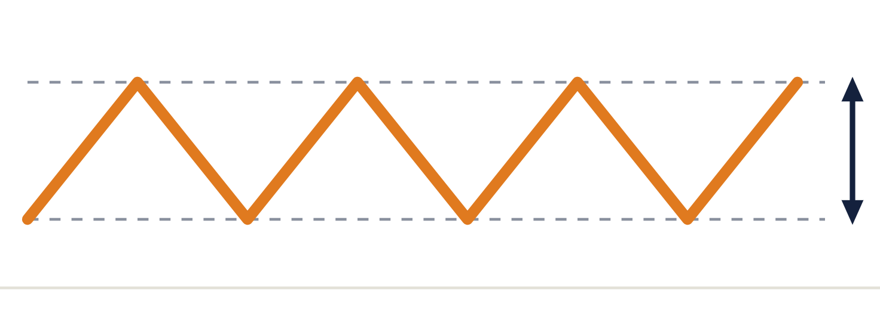
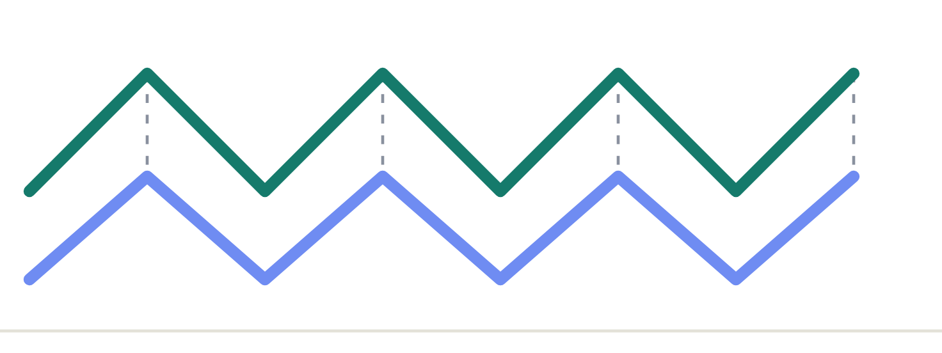
Max-min vs correlation
Max-min (paper)
Correlation (ours)
How much each region swings by itself
Which regions rise and fall together
200 features per person
19,900 features per person
Feature counts shown for the Craddock-200 atlas. Harvard-Oxford gives 111 and 6,105.
Notes:
Max-min only looks at one region at a time: how big its swings are. Correlation looks at pairs of regions: do they rise and fall in step. Two people can have identical max-min values and very different region-to-region coupling, and only correlation can tell them apart. This is our modification of the paper's feature.

Slide 6
Correlation wins
Demographics only
0.530
Max-min, Harvard-Oxford
0.485
Max-min, Craddock-200
0.541
Correlation, Harvard-Oxford
0.650
Correlation, Craddock-200
0.666
Best single result: SVM (poly2) on Craddock-200 correlation, 0.703
10-fold CV accuracy, logistic regression, SVM. Dashed line: always guessing "control" (0.537).
Notes:
Same model, same evaluation, only the features change. Max-min stays at chance on both atlases, while correlation reaches 0.65 to 0.67 with logistic regression. The best single number came from an SVM with a degree-2 polynomial kernel on Craddock-200 correlation features, 0.703. Differences of a few points between kernels are within noise, so do not claim a best kernel.

Slide 7
What did not help
Demographics alone
Max-min features
Age, sex and site give 0.530, no better than the 0.537 baseline
0.47 to 0.54 on both atlases, which is chance level
Sigmoid kernel
Choosing a kernel
Scored the baseline, so it learned nothing
Linear, poly2 and RBF all land at 0.64 to 0.70, with no clear winner
Notes:
Four things that did not matter or did not work. Demographics alone predict nothing here, unlike the paper where age drove the result. Max-min features sit at chance. The sigmoid kernel failed to learn, as it did in the paper. Among the other kernels the gaps are within noise.

Slide 8
Takeaways
1
Correlation features beat max-min by a wide margin
2
Regions that move together carry the signal
3
Caveats: different dataset, small dev set, scanner sites not tested
Notes:
Three points to close on. Correlation features clearly beat the paper's max-min feature. The signal is in how regions move together, not in how much each one swings. And the limits: the dataset differs from the paper's, the dev set used to choose C is small, and we did not test whether the model carries over to a scanner site it has never seen.

Slide 9
Thank you
Notes:
Open for questions. Be ready to explain how a correlation feature is computed, why the scaler sits inside the pipeline, and why the dataset was swapped.

