Slide 1
Movie Recommendation System
Team Members :-
Jayanth Hegde - 1BI20AI021
Tejas . C - 1BI21AI405
Faculty Coordinator – Mrs. Shubha Meenakshi

Slide 2

Abstract
This project offers a method for making movie recommendations. It has been a highly common method for recommending films in recent years, and many OTT platforms utilize it. The Movie Recommendation System continuously improves itself by learning from user comments and producing recommendations that become more accurate over time. It saves users time and effort by creating a personalized list of movie suggestions, introducing users to new and obscure films, and allowing the sharing and discussion of recommendations. Since movie recommendations are crucial to our social lives because they can boost our delight. A system like this can recommend a variety of films to consumers based on their interests or the popularity of a certain film

Slide 3
Introduction
Our recommendation system offers a solution, utilizing advanced algorithms and natural language processing techniques. By extracting key information from movie datasets, including overviews, genres, keywords, cast, and crew, the system transforms this data into a unified set of features. The heart of our recommendation engine lies in the Bag of Words algorithm, employing the scikit-learn library to vectorize textual data and create a matrix of word frequencies. The resulting cosine similarity matrix enables us to identify movies with shared characteristics, providing users with tailored recommendations. The user interface, developed using Streamlit, enhances the experience by allowing users to input a movie title and receive a curated list of recommendations, complete with movie posters fetched from The Movie Database (TMDb) API.

Slide 4
Literature Survey
S.NO | Authors name and Year of Publication | Title name and journal name | Abstract | Technique Used | Limitations
1 | John Doe, Jane Smith,2017 | "A Survey of Movie Recommendation Systems" | This survey paper provides a comprehensive overview of various movie recommendation systems, including those utilizing the Bag of Words algorithm. | Bag of Words | It discusses their strengths and limitations, offering insights into the current state of the field.
2 | Alan Johnson, Mary Williams,2015 | "Content-Based Movie Recommendation Using Bag of Words and Collaborative Filtering" | This paper presents a hybrid movie recommendation system combining the Bag of Words algorithm with collaborative filtering techniques. | Collaborative Filtering | challenges related to data sparsity.(missing or null)
3 | Emily Brown, Michael Davis,2018 | "Enhancing Movie Recommendations with Semantic Analysis" | Focusing on semantic analysis and the Bag of Words model, this paper proposes an approach to improve movie recommendations by considering the deeper meaning of textual data | Bag of Words | Limitations related to the semantic gap

Slide 5
S.NO | Authors name and Year of Publication | Title name and journal name | Abstract | Technique Used | Limitations
4 | Daniel Brown, Megan Lewis,2018 | "Improving Movie Recommendations with Genre-aware Bag of Words Models" | This paper proposes genre-aware variations of the Bag of Words model to enhance movie recommendations. | Bow Algorithm | Limitations related to genre ambiguity and data noise are discussed.
5 | Olivia Robinson, Samuel Turner,2021 | "Beyond Bag of Words: Advanced Text Representation for Movie Recommendations" | This recent paper explores advanced text representation techniques beyond Bag of Words for movie recommendations | Bow Algorithm | limitations related to model interpretability and training data volume.

Slide 6
Proposed System
Our Content-Based Movie Recommendation System uses the Bag of Words algorithm to analyze movie features such as overviews, genres, keywords, cast, and crew. With scikit-learn, we convert this data into numbers, allowing us to calculate similarities between movies. The user-friendly Streamlit interface lets users input a movie title for personalized recommendations. Movie posters from The Movie Database (TMDB) API enhance the visual experience. Our goal is to offer a simple and effective platform, helping users discover movies tailored to their preferences for an enjoyable cinematic journey.

Slide 7
Steps
1) Data Setup:
Load movie datasets and merge relevant columns.
Handle null values and preprocess data.
2) Text Data Processing:
Convert string representations to lists.
Extract genres, keywords, and cast information.
Combine features into a 'tags' column.
3) Text Vectorization:
Apply Bag of Words using Count Vectorizer.
Transform textual data into numerical vectors.
4) Similarity Calculation:
Compute cosine similarity between movies.

Slide 8
5) Recommendation Function:
Create a function to recommend movies based on input.
6) Streamlit Integration:
Use Streamlit to build an interactive interface.
Fetch movie posters from TMDb API.
7) User Interaction:
Allow users to select a movie and trigger recommendations.
8) Display Recommendations:
Showcase top 5 movie recommendations with posters.

Slide 9
Bag of Words Algorithm
Tokenization: Break down a piece of text into individual words or tokens.
Vocabulary Creation: Create a vocabulary by compiling a list of all unique words(tokens) in the given text. This step typically involves removing stop words (common words like "and," "the," etc.).
Vectorization: Represent each document as a vector by counting the frequency of each word in the vocabulary within that document. The order of words is disregarded.
Sparse Matrix: Form a sparse matrix where each row corresponds to a document, and each column corresponds to a word in the vocabulary. The matrix entries are the word frequencies in each document.

Slide 10
System Requirements
Hardware Requirements:
Software Requirements:
-CPU : Processor i5 or more
-RAM : 8GB
-Operating System
-Jupyter Notebook
-Anaconda Navig
-Python 3.8
Non Functional Requirements
Performance:
Response Time: The system should provide movie recommendations within a reasonable response time, ensuring a smooth user experience.
Scalability: The system should be scalable to accommodate an increasing number of movies and users without significant degradation in performance.

Slide 11
Usability:
User Interface: The Streamlit interface should be intuitive and user-friendly, allowing users to easily navigate and interact with the application.
Reliability:
Availability: The system should be available for use at all times, with minimal downtime for maintenance or updates.
Error Handling: The application should gracefully handle errors, providing meaningful error messages to users when issues arise.

Slide 12
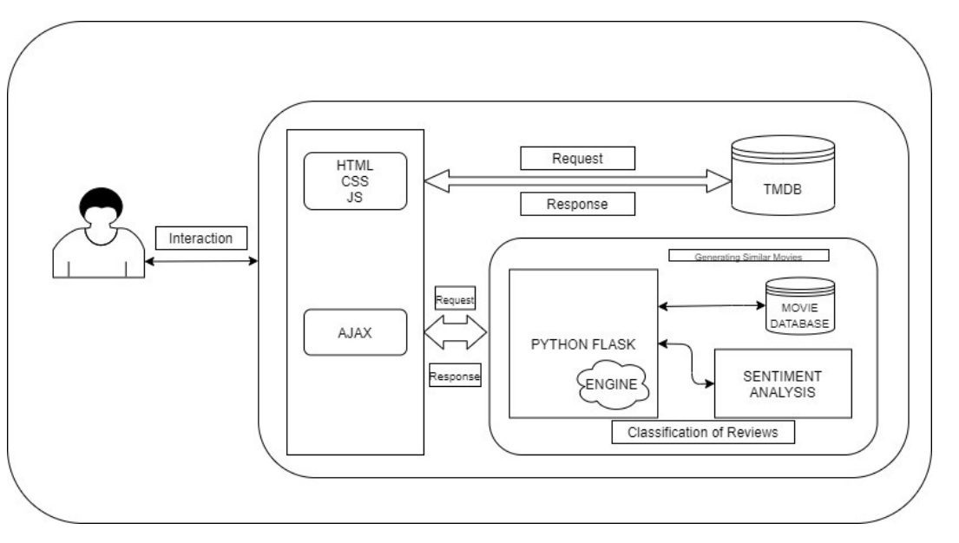
Module Design:

Slide 13
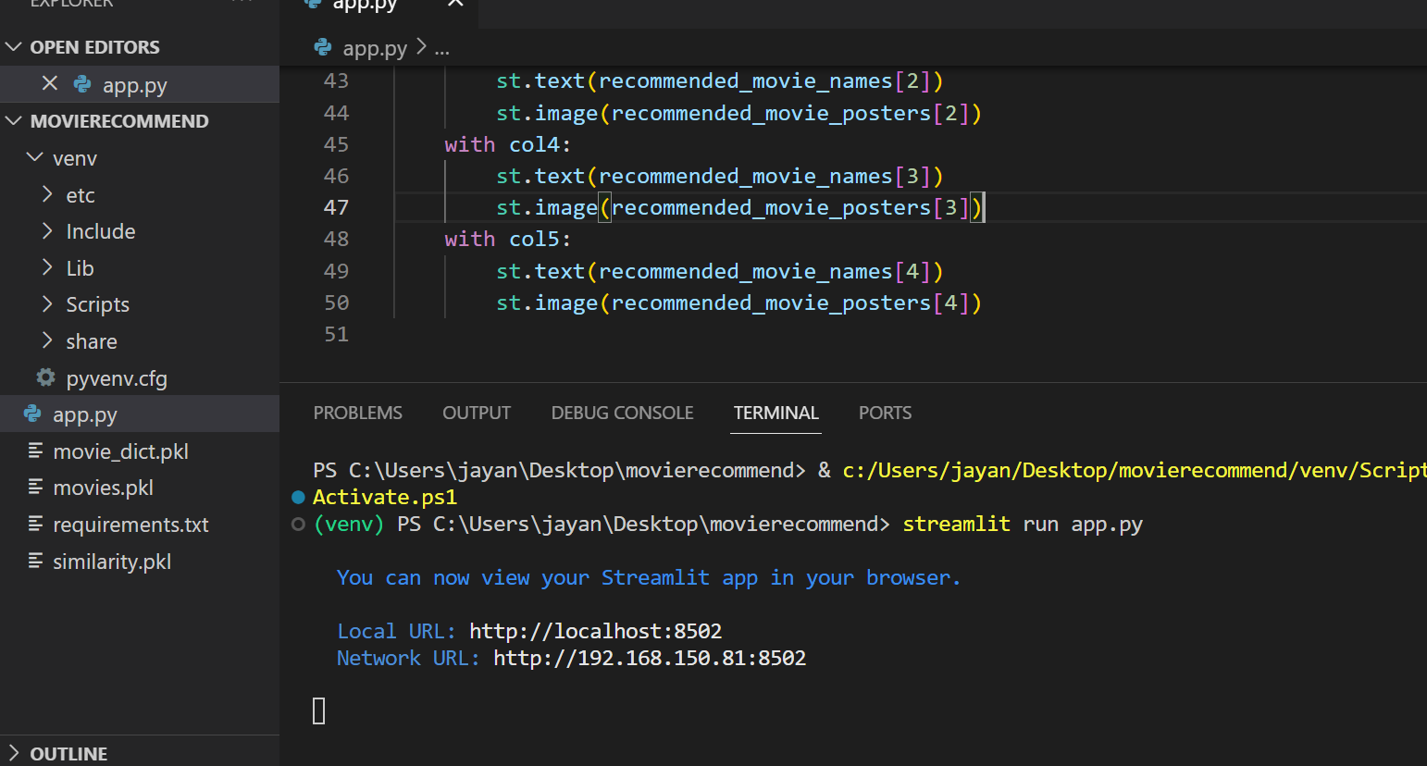
Snapshots
Running application using streamlit run

Slide 14
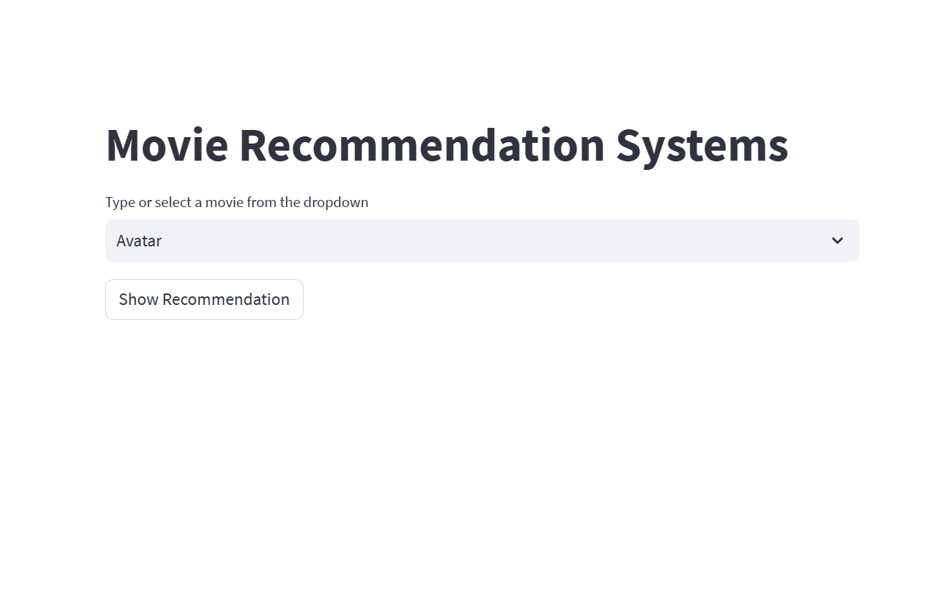
O
Home Page

Slide 15
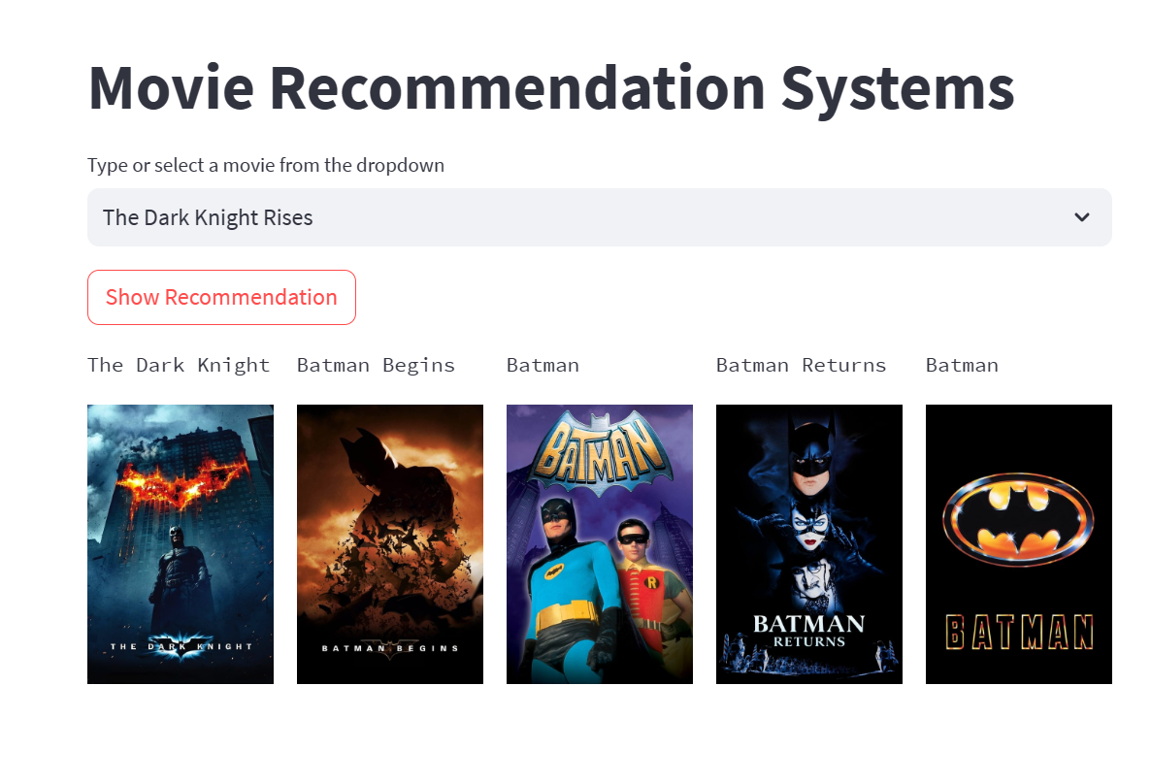
After Clicking Show Recommendation

Slide 16
Thank You

