Slide 1
Regression metrics
Regression metrics in machine learning are used to evaluate the performance of models that predict continuous values (as opposed to classification models, which predict categories). These metrics help determine how well the predicted values match the actual values. Here's a breakdown of the most commonly used regression metrics:

Slide 2
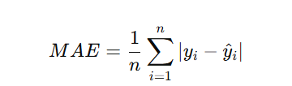
1. Mean Absolute Error (MAE)
What it does: Measures the average of errors in a set of predictions, without considering their direction.

Slide 3
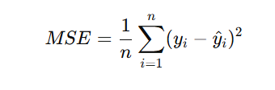
2. Mean Squared Error (MSE)
What it does: Squares the error before averaging, so larger errors are penalized more.

Slide 4
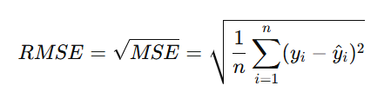
3. Root Mean Squared Error (RMSE)
What it does: Just the square root of MSE, which puts it back in the same units as the original data.

Slide 5
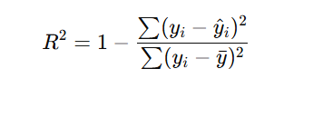
4. R-squared (R²) / Coefficient of Determination
What it does: Indicates how well the model explains the variability of the output.
Range: 0 to 1 (or negative if the model is worse than predicting the mean).
R² = 1: Perfect predictions.
R² = 0: Model does no better than the mean.

Slide 6
Metric | Linear Regression | Decision Tree | Random Forest
MAE | ₹1,279,187.27 | ₹1,296,801.30 | ₹1,255,956.55
MSE | ₹2.89T | ₹3.27T | ₹3.08T
RMSE | ₹1,700,746.57 | ₹1,807,377.51 | ₹1,756,454.36
R² Score | 0.43 | 0.35 | 0.39

