Slide 1

GitHub
Presented by Jayanthinisha R, Lead Software Engineer

Slide 2
Git
Git is a distributed version control system (VCS) for tracking changes in source code during software development.
It’s an open-source tool developers install locally to manage source code.
Git competes with centralized and distributed version control tools such as Subversion, Mercurial, ClearCase and IBM's Rational Team Concert.
It Can be used with or without GitHub.

Slide 3
Key features of Git
Local repository
Branching and merging
Commit history
Reverting changes

Slide 4
GitHub
GitHub is a code hosting platform or web-based Git repository hosting service for version control and collaboration.
It lets you and others work together on projects from anywhere.
It offers all of the distributed revision control and source code management (SCM) functionality of Git.
As well as adding its own features.
We can integrate Git with GitHub.

Slide 5
Key features of GitHub
Remote repository hosting
Collaboration tools
Issue tracking
Pull requests
Code review
Project management

Slide 6

Use Cases
Git
Personal projects
Small-scale collaborations
Open-source contributions
GitHub
Team projects
Large-scale collaborations
Open-source community involvement
Code review and project management

Slide 7
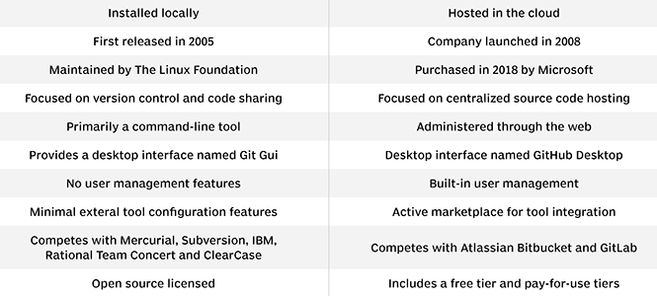
Git Vs GitHub

Slide 8
Important considerations when it comes to using GitHub in an organization are
Scalability
security
interoperability

Slide 9
Scalability
GitHub provides scalability for organizations of all sizes.
It can handle large codebases and accommodate growing teams.
GitHub's infrastructure is designed to handle high traffic and concurrent usage.

Slide 10
Interoperability
GitHub is interoperable with Git, making it compatible with any Git client or tool.
Developers can use their preferred Git workflows and tools with GitHub.
Integration with third-party services and CI/CD platforms enables seamless development pipelines.
APIs and webhooks allow for easy integration with internal systems and processes.

Slide 11
Security
GitHub prioritizes security and implements various measures to protect your code.
Two-factor authentication (2FA) and access controls ensure secure access to repositories.
Private repositories and granular permissions help safeguard sensitive code.
Regular security updates and vulnerability scanning enhance protection.

Slide 12
Conclusion
By considering scalability, security, and interoperability, organizations can determine if GitHub meets their requirements.
GitHub's scalability allows for accommodating growth, robust security measures safeguard code, and interoperability ensures compatibility with existing workflows and tools.
Evaluating these factors will help make an informed decision about utilizing GitHub within the organization.

Slide 13


