Slide 1
MULTI-OBJECTIVE DEEP LEARNING
Jayanth

Slide 2
INTRODUCTION
NLP/Vision challenges have several objectives to be computed simultaneously
Typical approaches are:
Convert all but one into constraint during problem modeling phase
Simplifying the problem consideration losing information and requirements along the way
Multi-output formulation
Formulating each objective function separately and giving weights to combined loss function
Reveals true nature of the problem without over-simplification

Slide 3
ALGORITHM
Decompose the network graph into separate branches
Calculate loss corresponding to each branch end
Do gradient descent w.r.t. calculated loss as weights

Slide 4
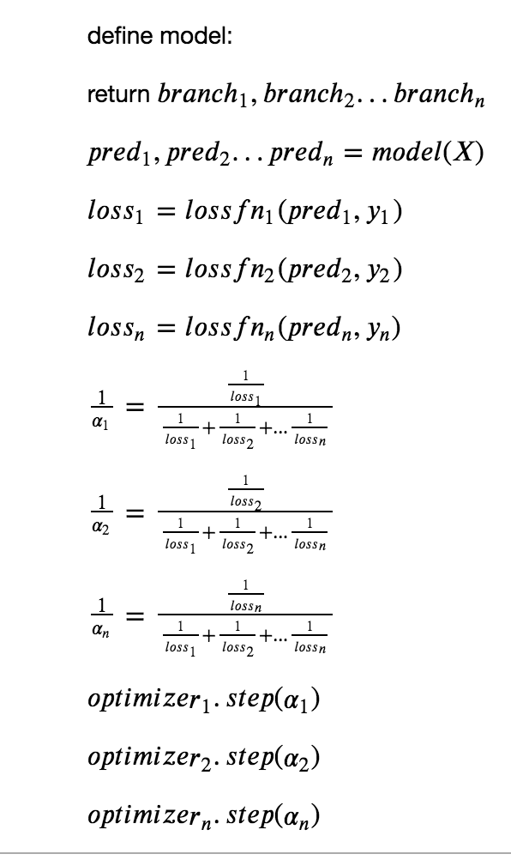
ALGORITHM

Slide 5
VISION DATASET CIFAR100
CIFAR 100 has 2 labels -
Coarse labels are 20 in count
Fine labels are 100 in count.
100 classes containing 600 images each.
500 training images and 100 testing images per class. The 100 “fine” classes in the CIFAR-100 are grouped into 20 “coarse” superclasses.

Slide 6
VISION DATASET EXAMPLE
Superclass | Classes
aquatic mammals | beaver, dolphin, otter, seal, whale
fish | aquarium fish, flatfish, ray, shark, trout

Slide 7
NLP DATASET SEMEVAL
Tweets have two labels:
Binary classification task where the system has to predict whether a tweet is ironic or not.
Multiclass classification task where the system has to predict one out of four labels describing i) verbal irony realized through a polarity contrast, ii) verbal irony without such a polarity contrast (i.e., other verbal irony), iii) descriptions of situational irony, iv) non-irony.

Slide 8
NLP DATASET EXAMPLE
i) verbal irony realized through a polarity contrast,
I really love this year's summer; weeks and weeks of awful weather
ii) verbal irony without such a polarity contrast (i.e., other verbal irony),
Human brains disappear every day. Some of them have never even appeared. http://t.co/Fb0Aq5Frqs |#brain #humanbrain #Sarcasm
iii) descriptions of situational irony,
Most of us didn't focus in the #ADHD lecture. #irony
iv) non-irony.
Please dont fuck with me when I first wake up #not a morning person!

Slide 9
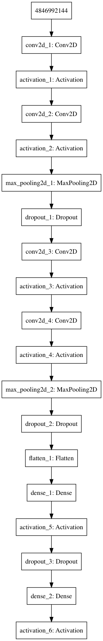
SINGLE NET
Convolution 2D (32, 3, 3) & RELU Activation x 2
Max Pool (2x2) & Dropout (0.25)
Convolution 2D (32, 3, 3) & RELU Activation x 2
Max Pool (2x2) & Dropout (0.25)
FC (512) & RELU & Dropout (0.5)
FC (N) & Softmax [N is 20 for coarse, 100 for fine]

Slide 10
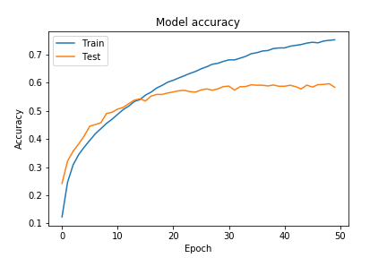
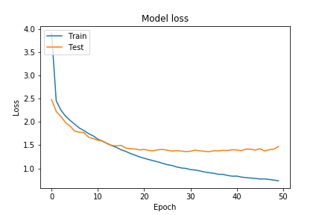
SINGLE NET COARSE RESULTS
Total trainable parameters: 1,255,988
Test loss: 1.469
Test accuracy: 58.34%

Slide 11
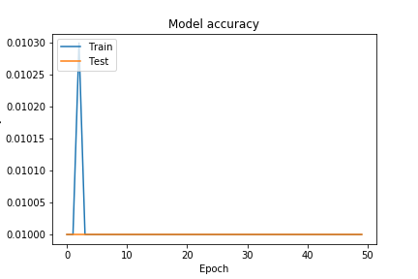
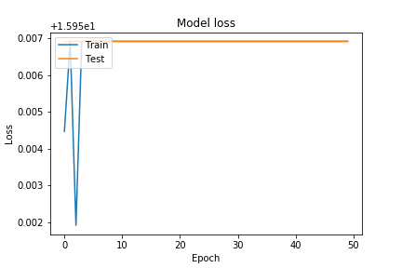
SINGLE NET FINE RESULTS
Total trainable parameters:1,297,028
Test loss: 15.95
Test accuracy: 1%
Average Accuracy for single net models: 28%

Slide 12
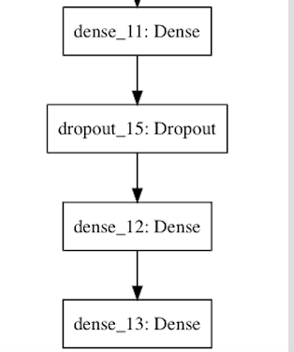
WITHOUT BRANCHING
Convolution 2D (32, 3, 3) & RELU Activation x 2
Max Pool (2x2) & Dropout (0.25)
Convolution 2D (32, 3, 3) & RELU Activation x 2
Max Pool (2x2) & Dropout (0.25)
FC (512) & RELU & Dropout (0.5)
FC (100) & Softmax = Output 1
FC (20) & Softmax = Output 2

Slide 13
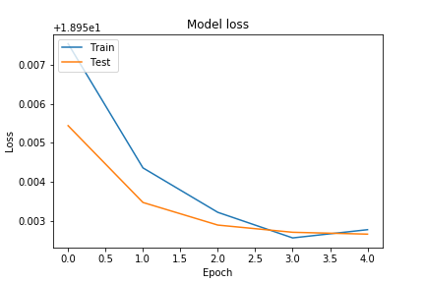
WITHOUT BRANCHING RESULTS
Total Trainable parameters: 1,299,048
Test loss: 18.95
Coarse accuracy: 5%
Fine accuracy: 1%
Average accuracy: 3%
As we can see, the outputs get stagnant at fixed values because we used single neural net without branching, leading to low accuracy.

Slide 14
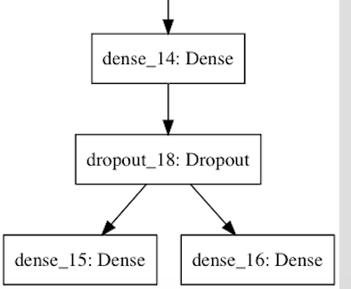
MULTI OUTPUT BRANCHED
Convolution 2D (32, 3, 3) & RELU Activation x 2
Max Pool (2x2) & Dropout (0.25)
Convolution 2D (32, 3, 3) & RELU Activation x 2
Max Pool (2x2) & Dropout (0.25)
FC (512) & RELU & Dropout (0.5)
FC (20) & Softmax = Output 1
FC (100) & Softmax = Output 2

Slide 15
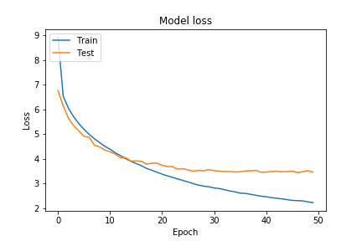
MULTI OUTPUT BRANCHED RESULTS
Total Trainable parameters: 1,307,288
Test loss: 3.465
Coarse accuracy: 59.2%
Fine accuracy: 46.13%
Average accuracy: 52.665%
The average accuracy is 52.66% for coarse and fine label based single multi-output neural net model, which is more than single output models by more than 20%.

Slide 16
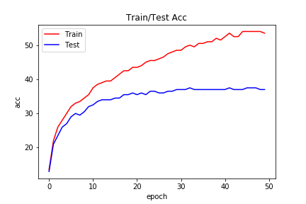
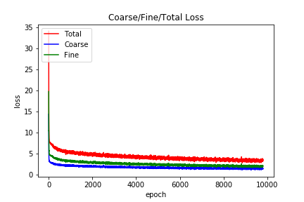
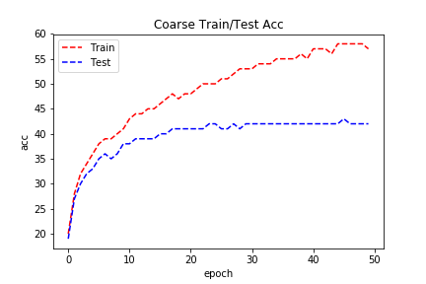
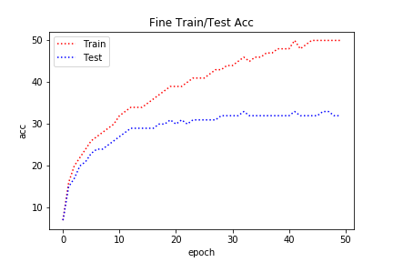
MULTI OUTPUT WEIGHTED BRANCHED
Test loss: 4.21
Coarse accuracy: 42%
Fine accuracy: 32%
Average accuracy: 37%

Slide 17
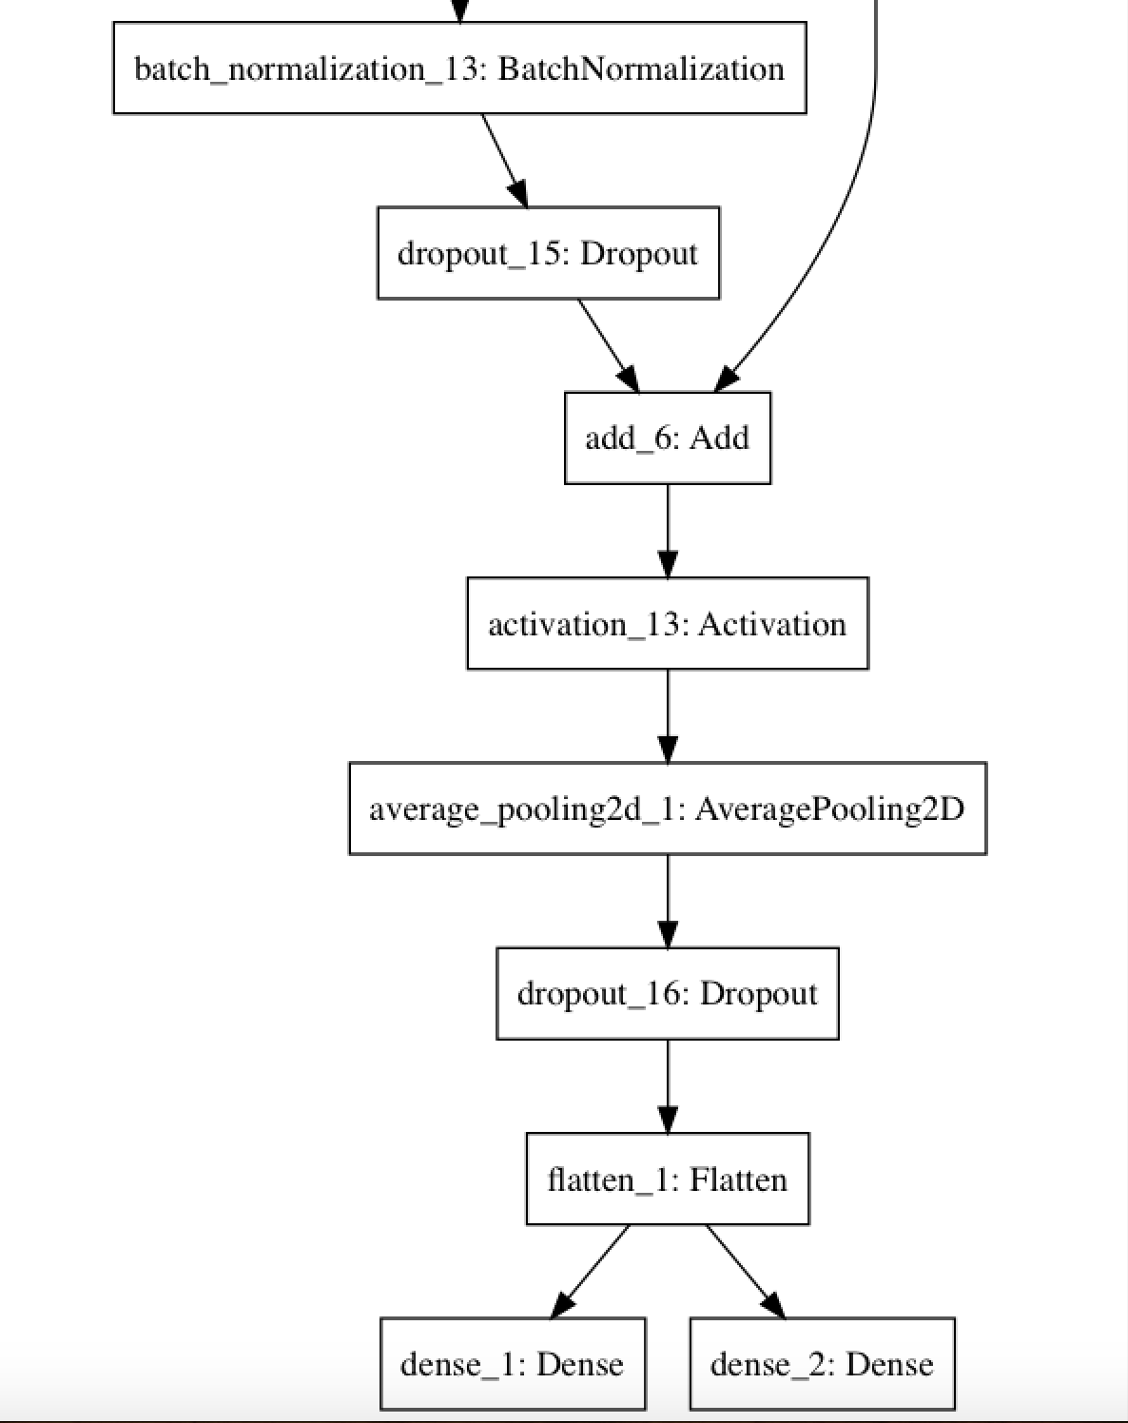
MULTI OUTPUT RESNET
Resnet with depth 32
Branching at last level
5 Resnet layers
Total parameters: 477,368
Trainable parameters: 475,096
Non-trainable parameters: 2,272

Slide 18
MULTI OUTPUT RESNET RESULTS
Test loss: 3.108
Coarse accuracy: 69.19%
Fine accuracy: 53.68%
Average accuracy: 61.435%

Slide 19
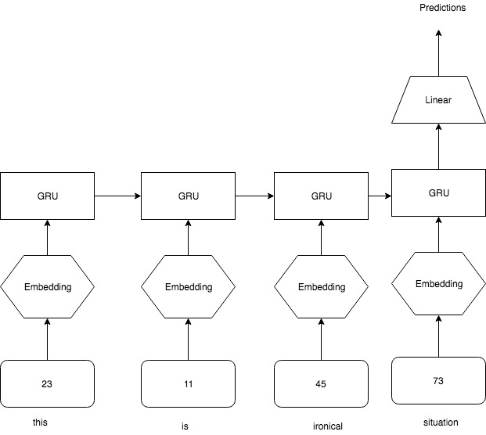
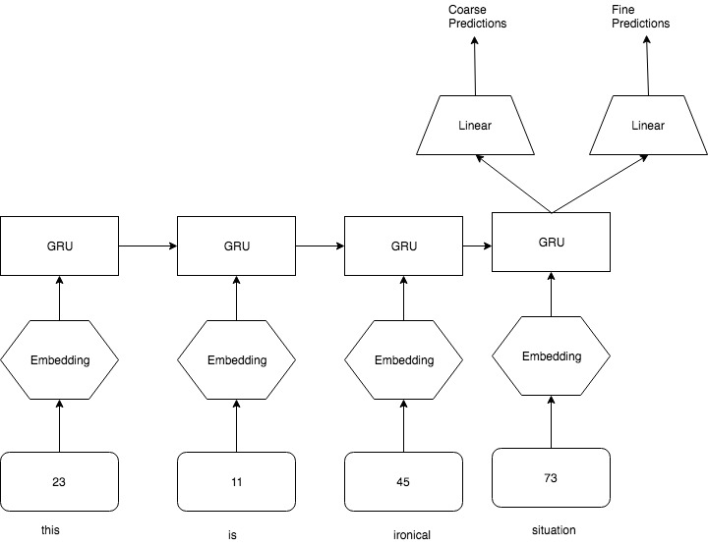
NLP GRU Model

Slide 20
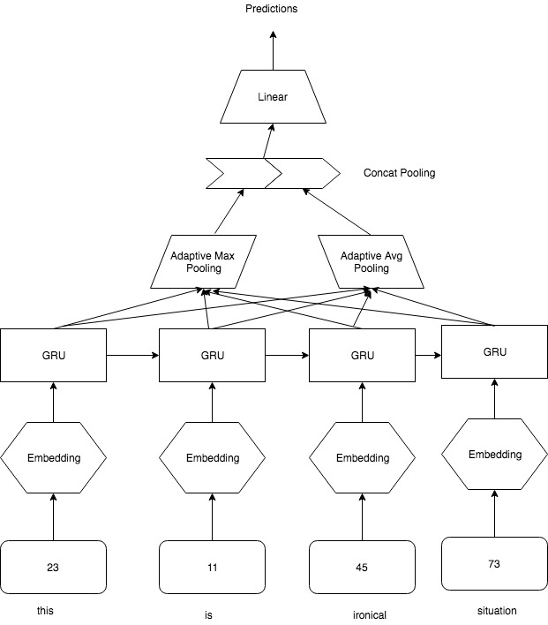
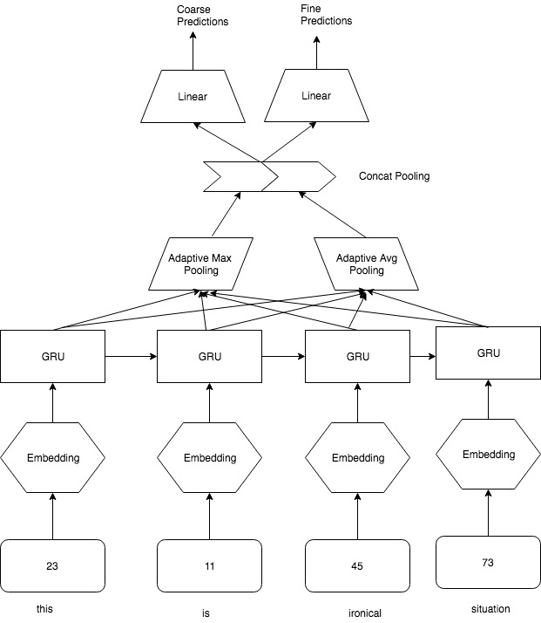
NLP Concat Pooling GRU

Slide 21
SINGLE NET GRU RESULTS
Coarse Test Loss : .7425
Coarse Test Accuracy : 63.28%
Fine Test Loss : 8.9158
Fine Test Accuracy : 53.39%
Average Test Accuracy : 58.33%

Slide 22
SINGLE NET CONCAT POOL GRU RESULTS
Coarse Test Loss : 1.1083
Coarse Test Accuracy : 67.19%
Fine Test Loss : 6.0426
Fine Test Accuracy : 53.39%
Average Test Accuracy : 60.29%

Slide 23
MULTI-OUTPUT
Average GRU Test Loss: 1.55
Average GRU Test Accuracy: 65.62%
Average Concat Pool GRU Test Loss: 1.5366
Average Concat Pool GRU Test Accuracy: 64.58%

Slide 24
MULTI-OUTPUT WEIGHTED
Average GRU Test Loss: 1.52
Average GRU Test Accuracy: 66.28%
Average Concat Pool GRU Test Loss: 1.4834
Average Concat Pool GRU Test Accuracy: 67.06%

Slide 25
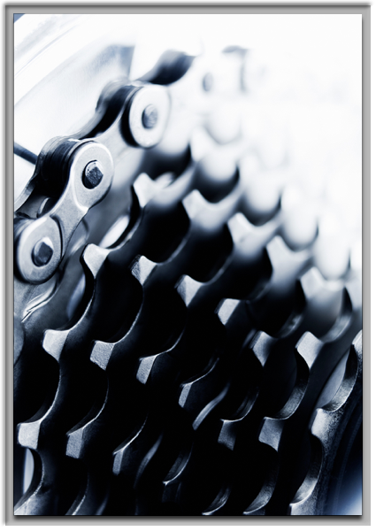
Thank You
Jayanth

