Slide 1
Analyzing Airport Networks of various countries
By:
Jayanth Krishna Yadav, 2016038
Vineet Kumar Rana, 2016115

Slide 2
Introduction & Overview

Slide 3
Introduction & Overview
Air transportation has noticed increasing demand for short & long travelling.
Has significant contribution to economies
We analyze airport network of countries namely, India, USA & Spain to come to some conclusions on its efficiency & structural feedback

Slide 4
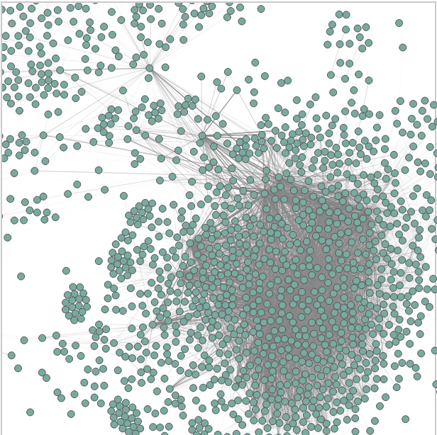
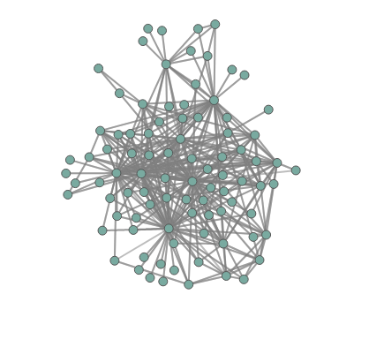
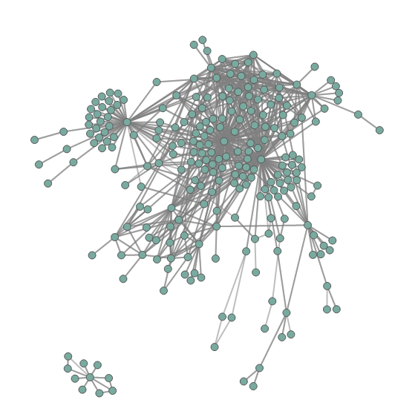
Network visualization
USA India Spain

Slide 5
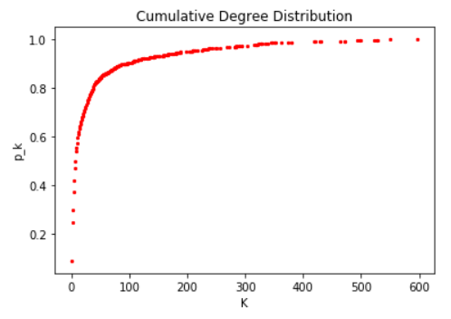
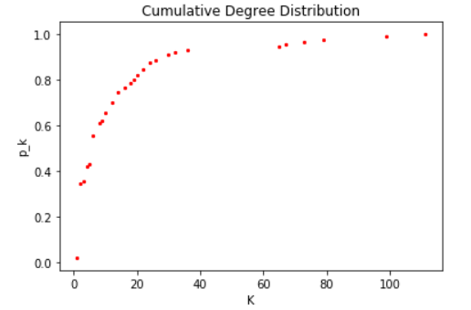
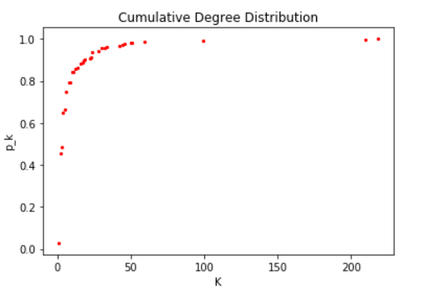
Degree distribution
USA India Spain
Analysis:
USA has highest number of nodes with degree b/w 0-200
India has almost all nodes with degree b/w 0-40
Spain has almost all node with degree b/w 0-70

Slide 6
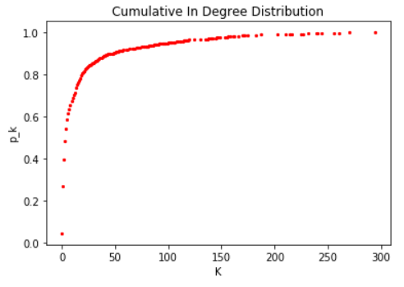
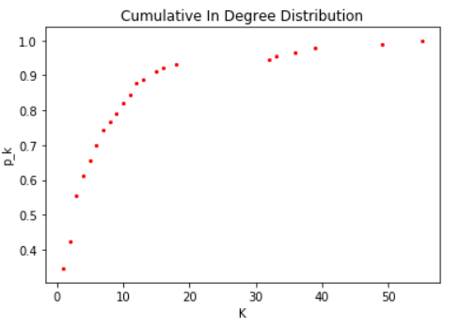
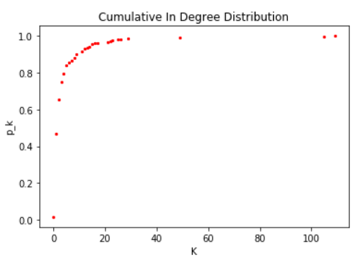
In degree distribution
USA India Spain
Analysis:
Similar trend is observed for all the countries as observed in degree distribution plot analysis

Slide 7
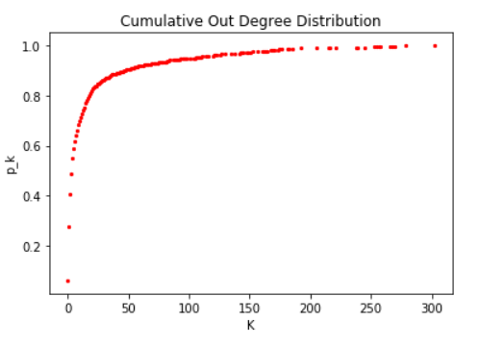
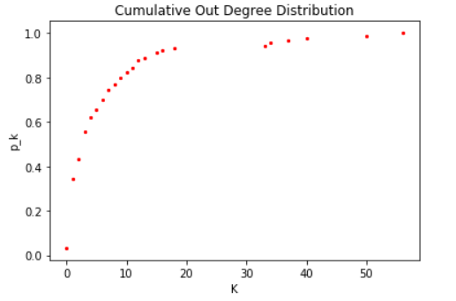
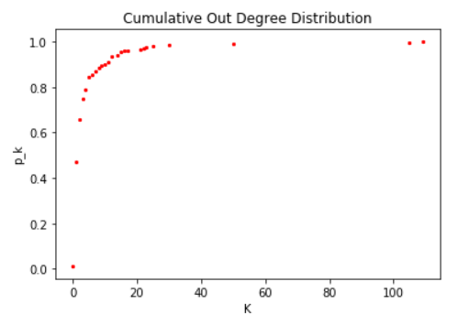
Out degree distribution
USA India Spain
Analysis:
Similar trend is observed for all the countries as observed in degree distribution plot analysis

Slide 8
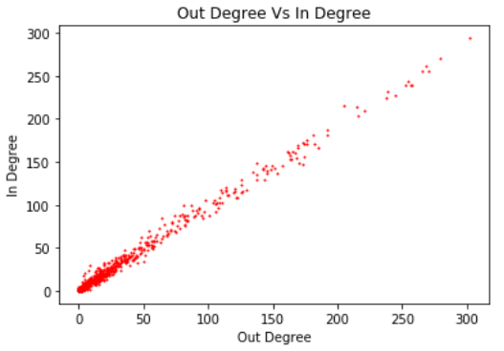
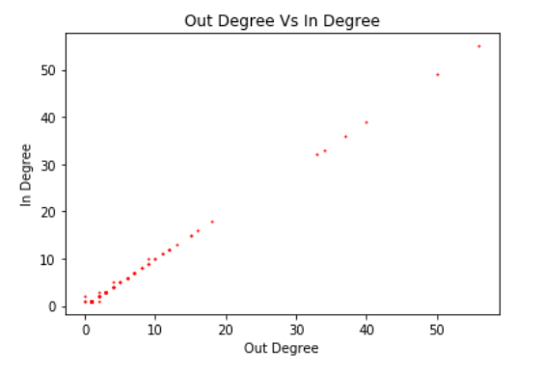
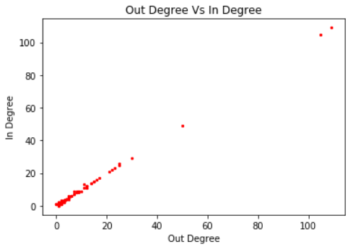
Out Degree vs In degree
USA India Spain
Analysis:
Both the degree distribution tend to grow in the same shape, thus we have a linear relation b/w them.

Slide 9
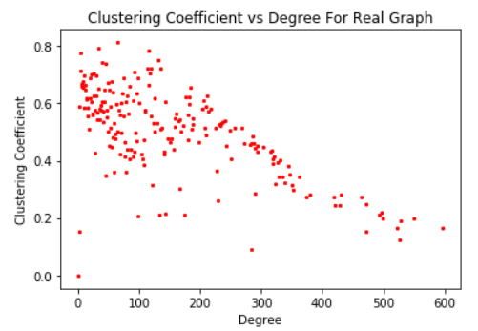
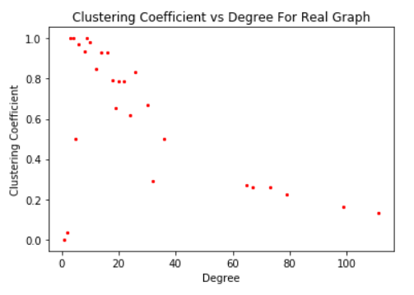
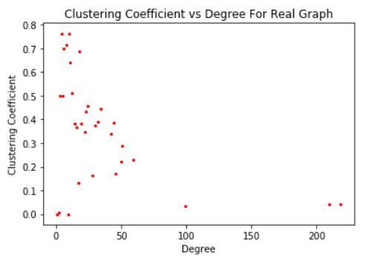
Clustering Coefficient
USA India Spain
Analysis:
***** We averaged the clustering Coefficient for every degree and plotted the graph
USA observes a even spread of clustering coefficient throughout with nodes having degree b/w 1-50 & then it gradually decreases with increasing degree of nodes.
India observes a spread of clustering coefficient b/w 0.5-1.0 with nodes having degree b/w 0-40 and then it gradually decreases with increasing degree of nodes. Thus, Indian AN is more clusterous than that of US.
Spain has a plot similar to that of US but with rare high degree nodes forming clusters.

Slide 10
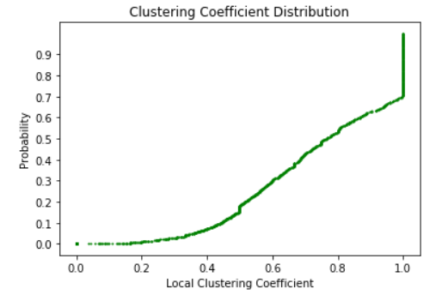
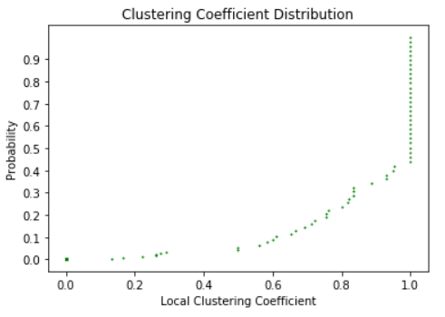
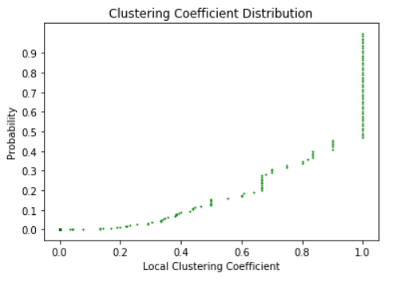
Clustering Coefficient Distribution
USA India Spain

Slide 11
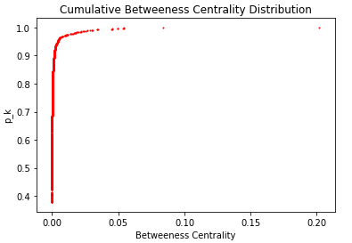
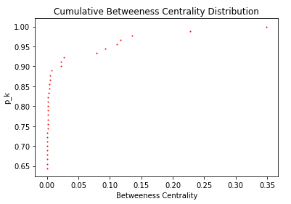
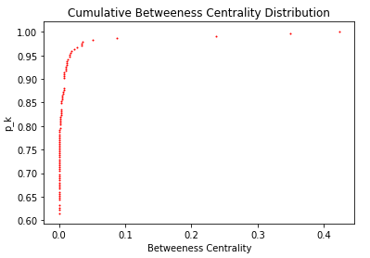
Betweenness Centrality Distribution
USA India Spain
Analysis:
USA has almost no node with high value of betweenness among ~1500 nodes while India has considerably large number of nodes with comparatively large value of betweenness among just ~120 nodes. For Spain, it is close to that of US but has relatively more no. of nodes with comparative betweenness value. Thus, trend suggest: US > Spain > India

Slide 12
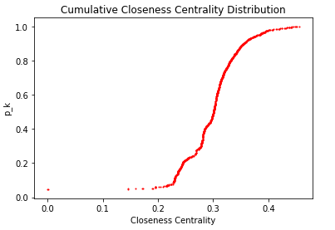
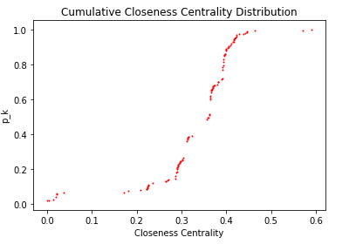
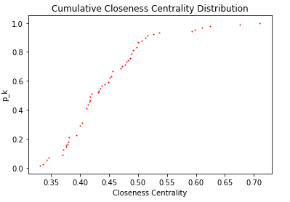
Closeness Centrality Distribution
USA India Spain
Analysis:
India has the highest average value of closeness than Spain, which in turn has a better avg. value of closeness than Spain

Slide 13
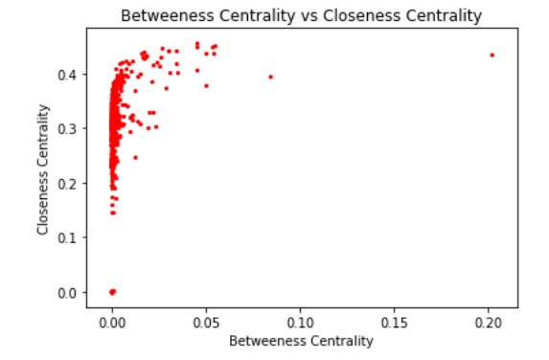
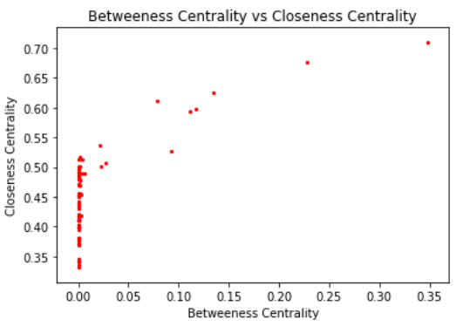
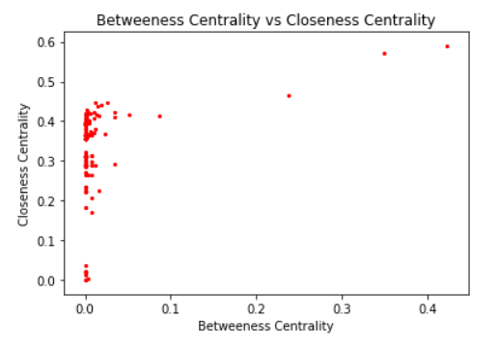
Betweenness vs Closeness Centrality
USA India Spain
Analysis:
There is no proper correlation between Betweenness Centrality vs Closeness Centrality among all the observed networks

Slide 14
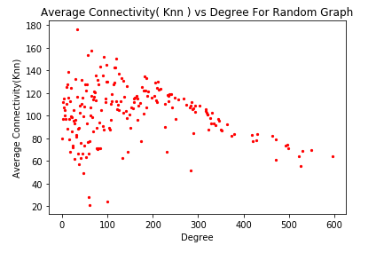
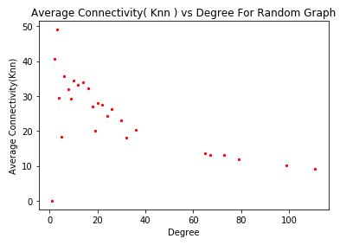
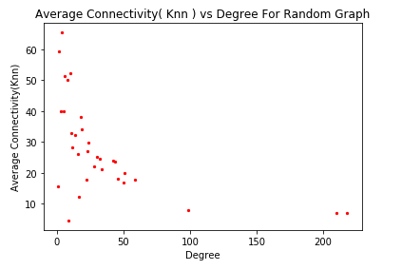
Average connectivity
USA India Spain
Analysis:
The Average connectivity of USA and India is high for smaller degrees and as the degree increases the average connectivity value decreases.
This justifies the disassortative nature of our networks.

Slide 15
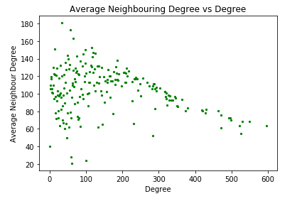
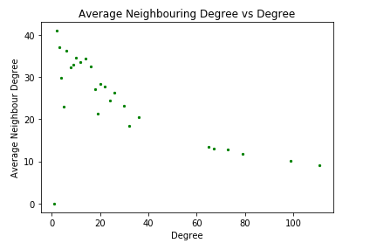
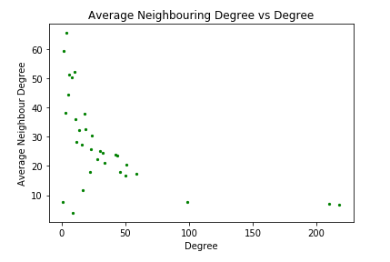
Average neighbouring degree
USA India Spain
Analysis:
This justifies the disassortative nature of our networks.

Slide 16
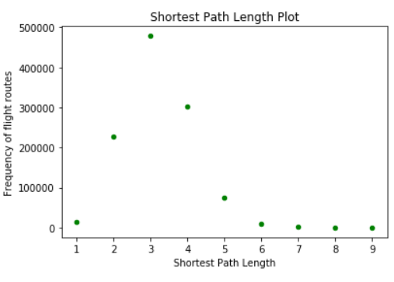
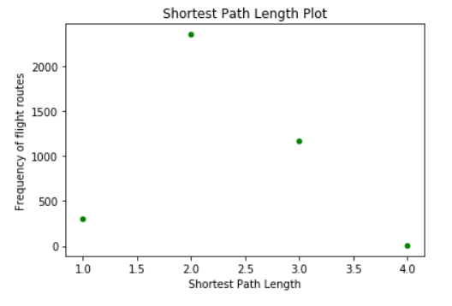
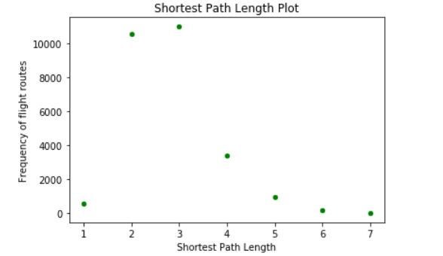
Shortest path length plot
USA India Spain
Analysis:
US has a tip on 3 followed by a tail from 6 onwards.
India has a tip on 2, indicating it has better/quicker way to reach the nodes, comparatively to US but we do have to keep in mind the large size of USA AN.
Spain has a graph similar to USA but larger number of nodes with shortest path length 2

Slide 17
Other parameters
USA India Spain
Number Of Nodes 1574 90 244
Number of Edges 28236 616 1094
Average Degree 35.878 13.689 8.967
Sparsity 0.022 0.153 0.036
Average Clustering coefficient: 0.488. 0.536 0.331
Characteristic path length: 3.914 2.157 3.047
Coefficient of assortativity: -0.122 -0.521 -0.376

Slide 18
Thank You

