Slide 1

Quant Tax Plan Direct-Growth
BY:-MANISH CHOMAL
MCA 3rd SEM
22MCAA38

Slide 2
CONTENT
1.Name of the Scheme
2.Type of the Scheme: Equity / Debt/ Hybrid/ Mid/ Small/ Large/ Sectoral/ Tax
3.Investment objectived.
4.NAV with 1 day change.
5.Returns since inception.
6.Entry/ Exit Loadg.
7.AUM (Fund Size)
8.Lock-in
9.Age
10.Benchmark.
11.Riskometer- Risky/Not Risky
12.Min. Investment: SIP/ Lumpsumm
13.Asset & Portfolio Allocation: Equity and/or Debt

Slide 3

Name of the Scheme
Quant Tax Plan Direct-Growth is a ELSS mutual fund scheme from Quant Mutual Fund. This fund has been in existence for 10 yrs 8 m, having been launched on 01/01/2013. Quant Tax Plan Direct-Growth has ₹4,434 Crores worth of assets under management (AUM) as on 30/06/2023 and is medium-sized fund of its category. The fund has an expense ratio of 0.57%, which is less than what most other Elss funds charge.

Slide 4

Type of the Scheme: Equity / Debt/ Hybrid/ Mid/ Small/ Large/ Sectoral/ Tax
An open ended equity linked saving scheme with a statutory lock in of 3 years and tax benefit. 3 Years from the date of allotment of the respective Units. For Systematic Investment Plan (SIP), the minimum amount is INR 500/- and in multiples of INR 1/- thereafter.

Slide 5

Investment objective
The scheme aims to generate capital appreciation by investing predominantly in equity shares with growth potential. The secondary objective is to give dividend and other income.

Slide 6
NAV(net asset value) with 1 day change
The fund currently has an Asset Under Management(AUM) of ₹6,179 Cr and the Latest NAV as of 01 Sep 2023 is ₹298.21. The Quant Tax Plan Direct Growth is rated Very High risk. Minimum SIP Investment is set to 500. Minimum Lumpsum Investment is 500.

Slide 7

Return since inception
Returns since inception
21.16% p.a.

Slide 8
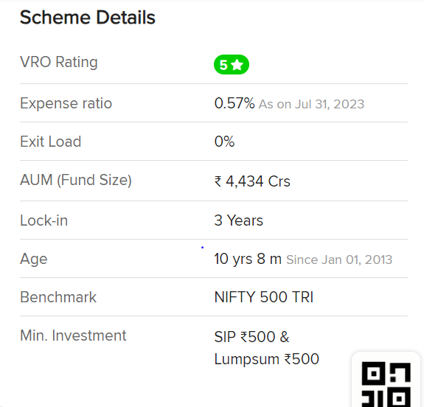
Entry/ Exit Load, AUM (Fund Size) ,Lock-in, Age, Benchmark, Min. Investment: SIP/ Lumpsum

Slide 9
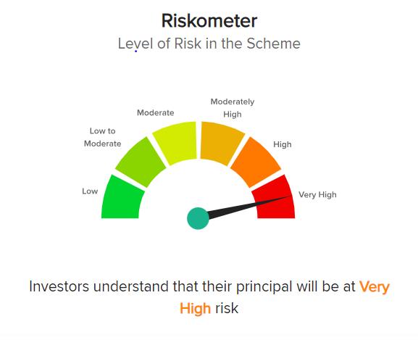
RISKOMETER

Slide 10
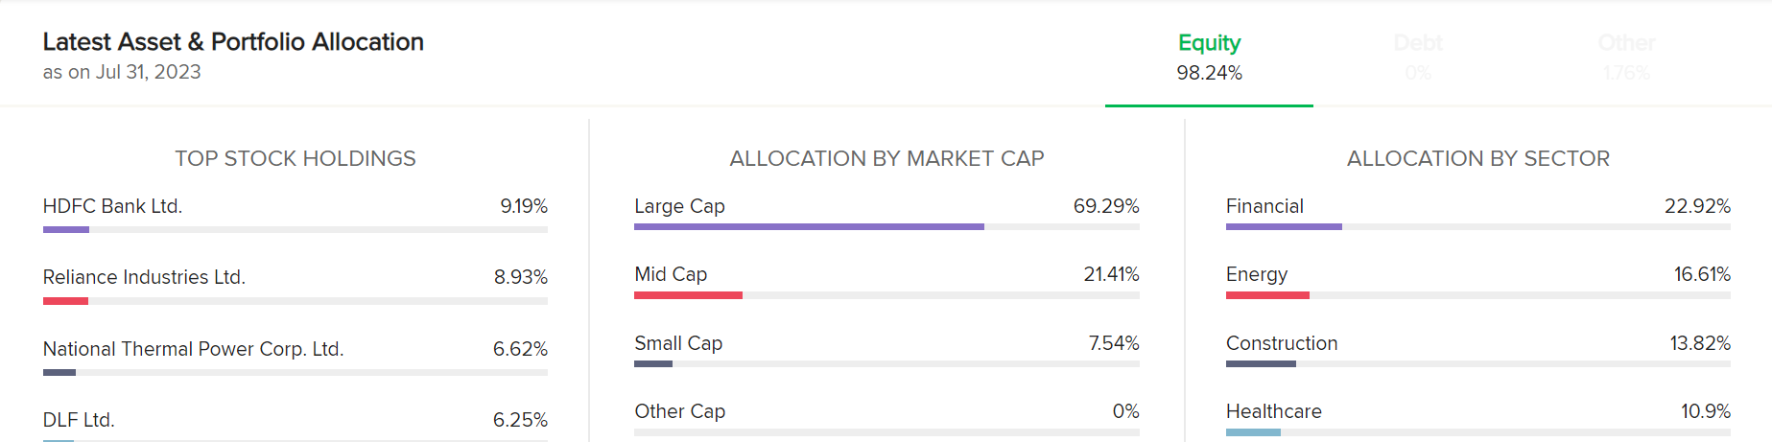
Asset & Portfolio Allocation: Equity and/or Debt

Slide 11
THANK YOU

