Slide 1
Floyd’s Algorithm
All pairs shortest path
Floyd’s Algorithm <number>
Notes:
Algorithms
CS333 / class 22

Slide 2
All pairs shortest path
The problem: find the shortest path between every pair of vertices of a graph
The graph: may contain negative edges but no negative cycles
A representation: a weight matrix where
W(i,j)=0 if i=j.
W(i,j)=∞ if there is no edge between i and j.
W(i,j)=“weight of edge”
Note: we have shown principle of optimality applies to shortest path problems
Floyd’s Algorithm <number>
Notes:
Algorithms
CS333 / class 22

Slide 3
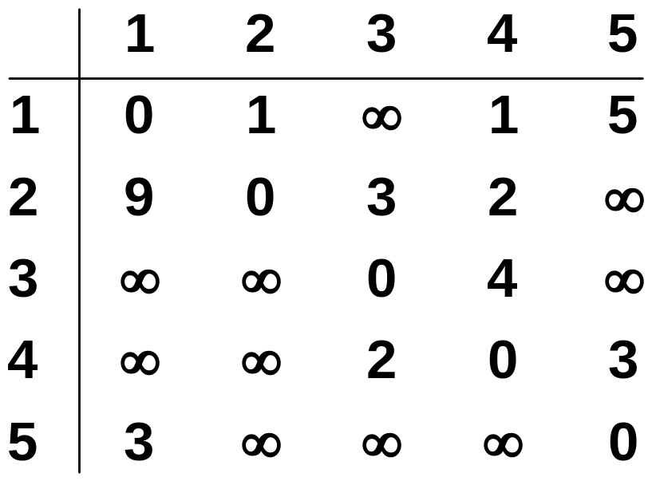
The weight matrix and the graph
1
3
v₁
v₂
9
5
1
2
3
v₅
3
2
v₄
v₃
4
Floyd’s Algorithm <number>
Notes:
Algorithms
CS333 / class 22

Slide 4
The subproblems
How can we define the shortest distance d_{i,j} in terms of “smaller” problems?
One way is to restrict the paths to only include vertices from a restricted subset.
Initially, the subset is empty.
Then, it is incrementally increased until it includes all the vertices.
Floyd’s Algorithm <number>
Notes:
Algorithms
CS333 / class 22

Slide 5
The subproblems
Let D^{(k)}[i,j]=weight of a shortest path from v_{i} to v_{j} using only vertices from {v₁,v₂,…,v_{k}} as intermediate vertices in the path
  D⁽⁰⁾=W
  D^{(n)}=D which is the goal matrix
How do we compute D^{(k)} from D^{(k-1)} ?
Floyd’s Algorithm <number>
Notes:
Algorithms
CS333 / class 22

Slide 6
The Recursive Definition:
Case 1: A shortest path from v_{i} to v_{j} restricted to using only vertices from {v₁,v₂,…,v_{k}} as intermediate vertices does not use v_{k}. Then D^{(k)}[i,j]= D^{(k-1)}[i,j].
Case 2: A shortest path from v_{i} to v_{j} restricted to using only vertices from {v₁,v₂,…,v_{k}} as intermediate vertices does use v_{k}. Then D^{(k)}[i,j]= D^{(k-1)}[i,k]+ D^{(k-1)}[k,j].
Shortest path using intermediate vertices
{V₁, . . . V_{k} }
V_{k}
V_{j}
V_{i}
Shortest Path using intermediate vertices { V_{1, . . .} V_{k -1} }
Floyd’s Algorithm <number>
Notes:
Algorithms
CS333 / class 22

Slide 7
The recursive definition
Since
D^{(k)}[i,j]= D^{(k-1)}[i,j] or
D^{(k)}[i,j]= D^{(k-1)}[i,k]+ D^{(k-1)}[k,j].
We conclude:
D^{(k)}[i,j]= min{ D^{(k-1)}[i,j], D^{(k-1)}[i,k]+ D^{(k-1)}[k,j] }.
Shortest path using intermediate vertices
{V₁, . . . V_{k} }
V_{k}
V_{j}
V_{i}
Shortest Path using intermediate vertices { V_{1, . . .} V_{k -1} }
Floyd’s Algorithm <number>
Notes:
Algorithms
CS333 / class 22

Slide 8
Example
1
2
3
1
0
4
5
W = D⁰ =
1
2
2
0
∞
5
3
∞
-3
0
4
2
3
1
2
3
2
-3
1
0
0
0
P =
2
0
0
0
3
0
0
0
Floyd’s Algorithm <number>
Notes:
Algorithms
CS333 / class 22

Slide 9
k = 1
Vertex 1 can be intermediate node
1
1
2
3
5
D⁰ =
1
0
4
5
4
2
3
2
2
0
∞
2
-3
3
∞
-3
0
1
2
3
1
0
4
5
D¹[2,3] = min( D⁰[2,3], D⁰[2,1]+D⁰[1,3] )
= min (∝, 7)
= 7
D¹[3,2] = min( D⁰[3,2], D⁰[3,1]+D⁰[1,2] )
= min (-3,∝)
= -3
D¹ =
2
2
0
7
3
∞
-3
0
1
2
3
1
0
0
0
P =
2
0
0
1
3
0
0
0
Floyd’s Algorithm <number>
Notes:
Algorithms
CS333 / class 22

Slide 10
k = 2
Vertices 1, 2 can be intermediate
1
2
3
1
5
D¹ =
1
0
4
5
4
2
3
2
2
0
7
2
-3
3
∞
-3
0
1
2
3
1
0
4
5
D²[1,3] = min( D¹[1,3], D¹[1,2]+D¹[2,3] )
= min (5, 4+7)
= 5
D²[3,1] = min( D¹[3,1], D¹[3,2]+D¹[2,1] )
= min (∝, -3+2)
= -1
D² =
2
2
0
7
3
-1
-3
0
1
2
3
1
0
0
0
P =
2
0
0
1
3
2
0
0
Floyd’s Algorithm <number>
Notes:
Algorithms
CS333 / class 22

Slide 11
k = 3
Vertices 1, 2, 3 can be intermediate
1
1
2
3
5
D² =
1
0
4
5
3
4
2
2
2
0
7
2
-3
3
-1
-3
0
1
2
3
1
0
2
5
D³ =
D³[1,2] = min(D²[1,2], D²[1,3]+D²[3,2] )
= min (4, 5+(-3))
= 2
D³[2,1] = min(D²[2,1], D²[2,3]+D²[3,1] )
= min (2, 7+ (-1))
= 2
2
2
0
7
3
-1
-3
0
1
2
3
1
0
3
0
P =
2
0
0
1
3
2
0
0
Floyd’s Algorithm <number>
Notes:
Algorithms
CS333 / class 22

Slide 12
Floyd's Algorithm: Using 2 D matrices
Floyd
1. D ← W // initialize D array to W [ ]
2. P ← 0 // initialize P array to [0]
3. for k ← 1 to n
// Computing D’ from D
4. do for i ← 1 to n
5. do for j ← 1 to n
6. if (D[ i, j ] > D[ i, k ] + D[ k, j ] )
7. then D’[ i, j ] ← D[ i, k ] + D[ k, j ]
8. P[ i, j ] ← k;
9. else D’[ i, j ] ← D[ i, j ]
10. Move D’ to D.
Floyd’s Algorithm <number>
Notes:
Algorithms
CS333 / class 22

Slide 13
Printing intermediate nodes on shortest path from q to r
path(index q, r)
if (P[ q, r ]!=0)
path(q, P[q, r])
println( “v”+ P[q, r])
path(P[q, r], r)
return;
//no intermediate nodes
else return
Before calling path check D[q, r] < ∞, and print node q, after the call to
path print node r
1
2
3
1
0
3
0
P =
2
0
0
1
3
2
0
0
1
5
4
2
3
2
-3
Floyd’s Algorithm <number>
Notes:
Algorithms
CS333 / class 22

Slide 14

Example
Floyd’s Algorithm <number>
Notes:
Algorithms
CS333 / class 22

Slide 15

The final distance matrix and P
The values in parenthesis are the non zero P values.
Floyd’s Algorithm <number>
Notes:
Algorithms
CS333 / class 22

Slide 16

Solve the all-pairs shortest path problem for the digraph shown below
a
2
b
3
7
6
c
d
1

Slide 17
Cost Adjacency matrix
 | a | b | c | d
a | 0 | ∞ | 3 | ∞
b | 2 | 0 | ∞ | ∞
c | ∞ | 7 | 0 | 1
d | 6 | ∞ | ∞ | 0

Slide 18
Step 1
Consider the shortest distance through vertex a. Consider only non zero non infinity values
(b,a) = 2 and (a,c) = 3. So (b,c) = min{(b,c),(b,a)+(a,c)}
= min{∞,2+3} = 5
So (b,c) = 5
2. (d,a)=6 and (a,c) = 3. So (d,c) = min{(d,c),(d,a)+(a,c)}
=min{∞,6+3}
=9
So (d,c) = 9
 | a | b | c | d
a | 0 | ∞ | 3 | ∞
b | 2 | 0 | ∞ | ∞
c | ∞ | 7 | 0 | 1
d | 6 | ∞ | ∞ | 0

Slide 19
Resultant matrix is
 | a | b | c | d
a | 0 | ∞ | 3 | ∞
b | 2 | 0 | 5 | ∞
c | ∞ | 7 | 0 | 1
d | 6 | ∞ | 9 | 0

Slide 20
Step 2
Consider the shortest distance through vertex b.
(c,b)=7 and (b,a)=2. So (c,a)=min{(c,a),(c,b)+(b,a)}
=min{∞,7+2}
=9
So (c,a) = 9
2. (c,b)=7 and (b,c)=5. So (c,c)=min{(c,c),(c,b)+(b,c)}
=min{0,7+5}
=min{0,12)
=0
So, (c,c) =0
 | a | b | c | d
a | 0 | ∞ | 3 | ∞
b | 2 | 0 | 5 | ∞
c | ∞ | 7 | 0 | 1
d | 6 | ∞ | 9 | 0

Slide 21
Resultant matrix is
 | a | b | c | d
a | 0 | ∞ | 3 | ∞
b | 2 | 0 | 5 | ∞
c | 9 | 7 | 0 | 1
d | 6 | ∞ | 9 | 0

Slide 22
Step 3
(a,c)=3 and (c,a)=9. So (a,a)=min{(a,a),(a,c)+(c,a)}
=min{0,3+9}=0
So (a,a) = 0
2. Continue with the rest
 | a | b | c | d
a | 0 | ∞ | 3 | ∞
b | 2 | 0 | 5 | ∞
c | 9 | 7 | 0 | 1
d | 6 | ∞ | 9 | 0

Slide 23
Resultant matrix is
 | a | b | c | D
a | 0 | 10 | 3 | 4
b | 2 | 0 | 5 | 6
c | 9 | 7 | 0 | 1
d | 6 | 16 | 9 | 0

Slide 24
Step 4
 | a | b | c | d
a | 0 | 10 | 3 | 4
b | 2 | 0 | 5 | 6
c | 9 | 7 | 0 | 1
d | 6 | 16 | 9 | 0
Consider the shortest distance through vertex d.
(a,d)=4 and (d,a)=6. So (a,a) = min{(a,a),4+6} = 0
Continue

Slide 25
Resultant matrix is
 | a | b | c | D
a | 0 | 10 | 3 | 4
b | 2 | 0 | 5 | 6
c | 7 | 7 | 0 | 1
d | 6 | 16 | 9 | 0

Slide 26
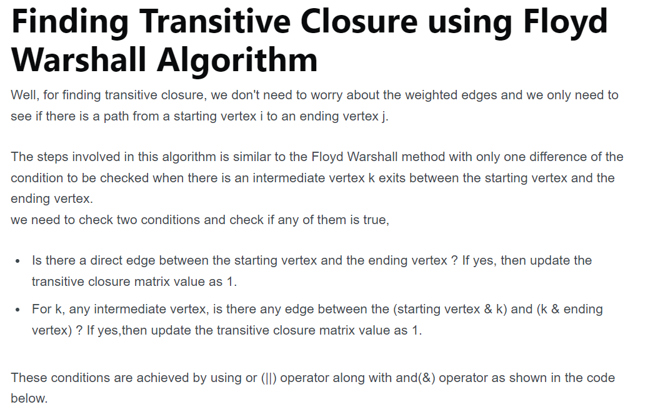

Slide 27
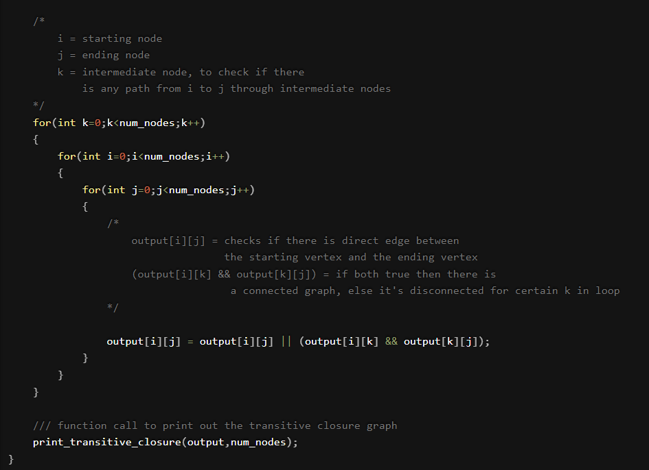

Slide 28
Optimal Binary Search Tree
A set of integers are given in the sorted order and another array freq to frequency count. Our task is to create a binary search tree with those data to find the minimum cost for all searches.

Slide 29
Input:
The key values as node and the frequency.
Keys = {10, 12, 20}
Frequency or Cost = {34, 8, 50}
Output:
The minimum cost is 142.
These are possible BST from the given values.

Slide 30
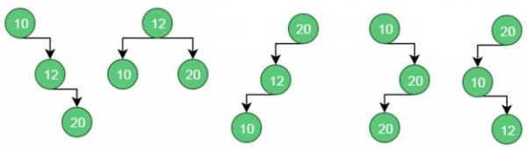


Slide 31
For case 1, the cost is: (34*1) + (8*2) + (50*3) = 200
For case 2, the cost is: (8*1) + (34*2) + (50*2) = 176.
For case 3, the cost is: (50*1) + (8*2) + (34*3) = 168.
For case 4, the cost is: (34*1) + (50*2) + (8*3) = 158.
For case 5, the cost is: (50*1) + (34*2) + (8*3) = 142 (Minimum)
Floyd’s Algorithm <number>

Slide 32
Average Comparisons
1+2+3/3=2
1+2+2/3=
Floyd’s Algorithm <number>

Slide 33
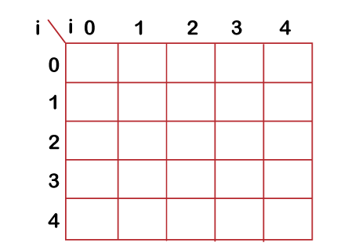
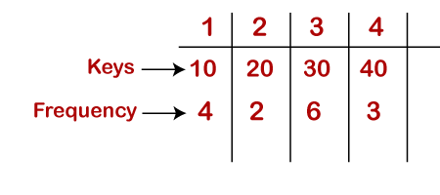
Dynamic Approach
Consider the below table, which contains the keys and frequencies.

Slide 34
First, we will calculate the values where j-i is equal to zero.
When i=0, j=0, then j-i = 0
When i = 1, j=1, then j-i = 0
When i = 2, j=2, then j-i = 0
When i = 3, j=3, then j-i = 0
When i = 4, j=4, then j-i = 0
Therefore, c[0, 0] = 0, c[1 , 1] = 0, c[2,2] = 0, c[3,3] = 0, c[4,4] = 0
Floyd’s Algorithm <number>

Slide 35
Now we will calculate the values where j-i equal to 1.
When j=1, i=0 then j-i = 1
When j=2, i=1 then j-i = 1
When j=3, i=2 then j-i = 1
When j=4, i=3 then j-i = 1
Floyd’s Algorithm <number>

Slide 36
Now to calculate the cost, we will consider only the jth value.
The cost of c[0,1] is 4 (The key is 10, and the cost corresponding to key 10 is 4).
The cost of c[1,2] is 2 (The key is 20, and the cost corresponding to key 20 is 2).
The cost of c[2,3] is 6 (The key is 30, and the cost corresponding to key 30 is 6)
The cost of c[3,4] is 3 (The key is 40, and the cost corresponding to key 40 is 3)
Floyd’s Algorithm <number>

Slide 37
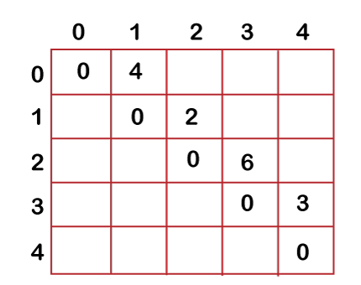
Floyd’s Algorithm <number>

Slide 38
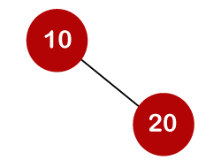
Now we will calculate the values where j-i = 2
When j=2, i=0 then j-i = 2
When j=3, i=1 then j-i = 2
When j=4, i=2 then j-i = 2
When i=0 and j=2, then keys 10 and 20. There are two possible trees that can be made out from these two keys shown below:
In the first binary tree, cost would be: 4*1 + 2*2 = 8
In the second binary tree, cost would be: 4*2 + 2*1 = 10
The minimum cost is 8; therefore, c[0,2] = 8
Floyd’s Algorithm <number>

Slide 39
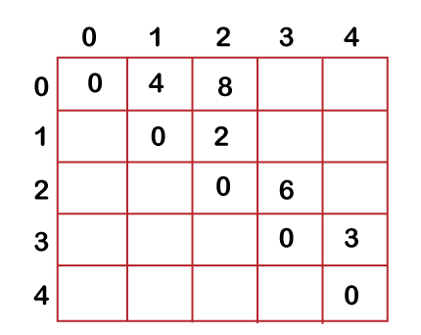
Floyd’s Algorithm <number>

Slide 40
When i=1 and j=3, then keys 20 and 30. There are two possible trees that can be made out from these two keys shown below:
In the first binary tree, cost would be: 1*2 + 2*6 = 14
In the second binary tree, cost would be: 1*6 + 2*2 = 10
The minimum cost is 10; therefore, c[1,3] = 10
When i=1 and j=3, then keys 20 and 30. There are two possible trees that can be made out from these two keys shown below:
In the first binary tree, cost would be: 1*2 + 2*6 = 14
In the second binary tree, cost would be: 1*6 + 2*2 = 10
The minimum cost is 10; therefore, c[1,3] = 10
Floyd’s Algorithm <number>

Slide 41
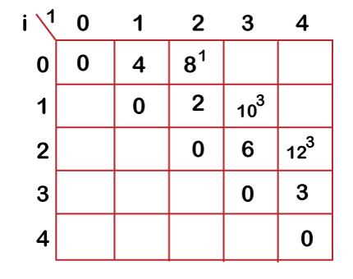
Floyd’s Algorithm <number>

