Slide 1
Unit -4
Algorithm Design Techniques

Slide 2
Divide and Conquer
A divide and conquer algorithm works by recursively breaking down a problem into two or more sub-problems of the same (or related) type (divide), until these become simple enough to be solved directly (conquer).
Divide-and-conquer algorithms work according to the following general plan:
1. A problem is divided into several subproblems of the same type, ideally of about equal size.
2. The subproblems are solved (typically recursively, though sometimes a different algorithm is employed, especially when subproblems become small enough).
3. If necessary, the solutions to the subproblems are combined to get a solution to the original problem.

Slide 3
Divide and conquer methodology can be easily applied on the following problem.
1. Merge sort
2. Quick sort
3. Binary search

Slide 4
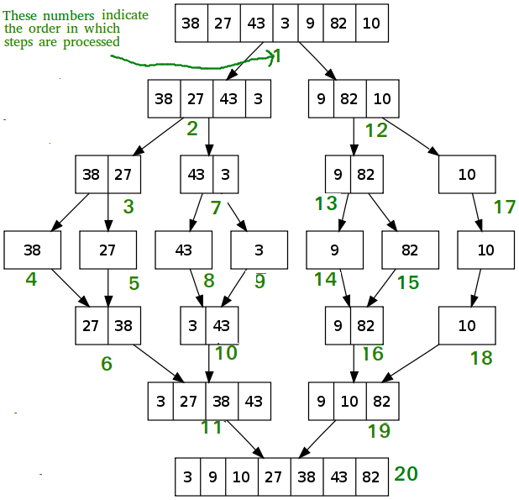
Merge sort

Slide 5
Binary Search
In this algorithm, we want to find whether element x belongs to a set of numbers stored in an array numbers[]. Where l and r represent the left and right index of a sub-array in which searching operation should be performed.
Algorithm: Binary-Search(numbers[], x, l, r)
if l = r then
return l
else
m := ⌊(l + r) / 2⌋
if x ≤ numbers[m] then
return Binary-Search(numbers[], x, l, m)
else
return Binary-Search(numbers[], x, m+1, r)

Slide 6
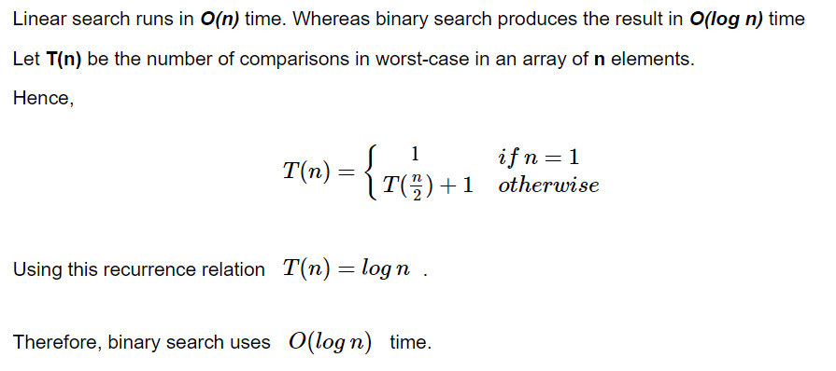
Analysis

Slide 7
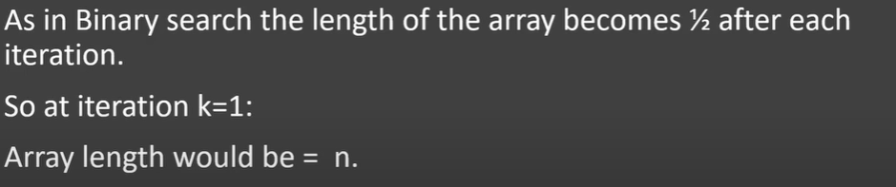
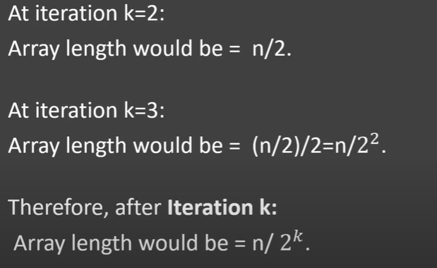
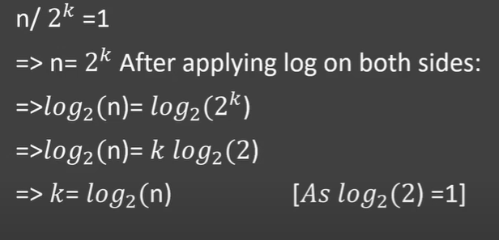
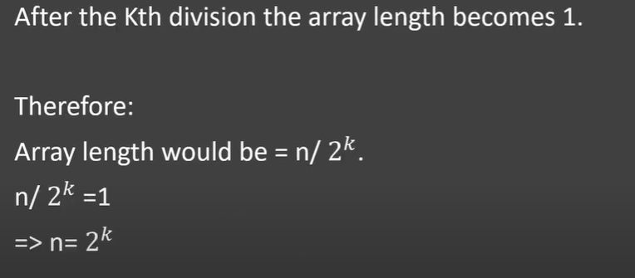

Slide 8
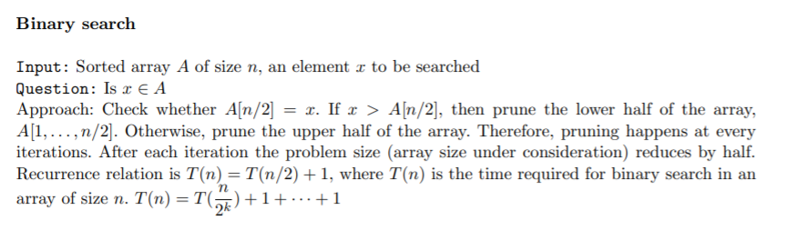

In mathematics, a recurrence relation is an equation that expresses the nth term of a sequence as a function of the k preceding terms, for some fixed k (independent from n), which is called the order of the relation.

Slide 9
Algorithm for Strassen’s matrix multiplication
Algorithm Strassen(n, a, b, d)
begin
If n = threshold then compute
C = a * b is a conventional matrix.
Else
Partition a into four sub matrices a11, a12, a21, a22.
Partition b into four sub matrices b11, b12, b21, b22.
Strassen ( n/2, a11 + a22, b11 + b22, d1)
Strassen ( n/2, a21 + a22, b11, d2)
Strassen ( n/2, a11, b12 – b22, d3)
Strassen ( n/2, a22, b21 – b11, d4)
Strassen ( n/2, a11 + a12, b22, d5)
Strassen (n/2, a21 – a11, b11 + b22, d6)
Strassen (n/2, a12 – a22, b21 + b22, d7)
C = d1+d4-d5+d7 d3+d5
d2+d4 d1+d3-d2-d6
end if
return (C)
end.

Slide 10
D1 = (a11 + a22) (b11 + b22)
D2 = (a21 + a22).b11
D3 = (b12 – b22).a11
D4 = (b21 – b11).a22
D5 = (a11 + a12).b22
D6 = (a21 – a11) . (b11 + b12)
D7 = (a12 – a22) . (b21 + b22)
C11 = D1 + D4 – D5 + D7 C12 = D3 + D5 C21 = D2 + D4 C22 = D1 + D3 – D2 – D6

Slide 11
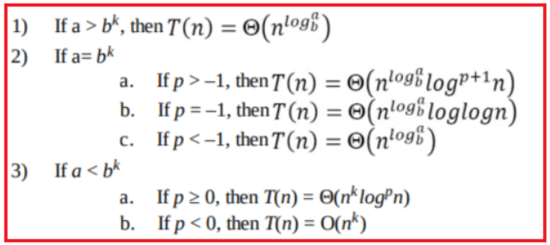
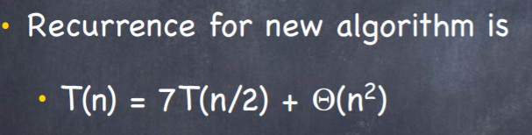
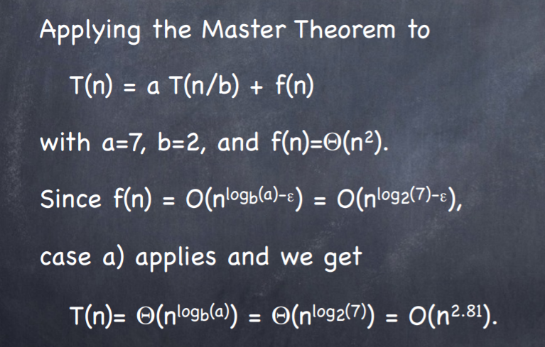

Slide 12
Dynammic Programming
Dynamic Programming requires:
Problem divided into overlapping sub-problems
Sub-problem can be represented by a table
Principle of optimality, recursive relation between smaller and larger problems

Slide 13
Warshall’s Algorithm
ALGORITHM Warshall(A[1..n, 1..n])
//ImplementsWarshall’s algorithm for computing the transitive closure
//Input: The adjacency matrix A of a digraph with n vertices
//Output: The transitive closure of the digraph R(0) ←A
for k←1 to n do
for i ←1 to n do
for j ←1 to n do
R(k)[i, j ]←R(k−1)[i, j ] or (R(k−1)[i, k] and R(k−1)[k, j])
return R(n)
Warshall’s algorithm’s time efficiency is only Θ(n3). Space efficiency is Θ(n2). i.e matrix size.

Slide 14
Optimal Binary Search Tree
Total number of possible Binary Search Trees with n different keys (countBST(n)) = Catalan number Cn = (2n)! / ((n + 1)! * n!)
For n = 0, 1, 2, 3, … values of Catalan numbers are 1, 1, 2, 5, 14, 42, 132, 429, 1430, 4862, …. So are numbers of Binary Search Trees.
Total number of possible Binary Trees with n different keys (countBT(n)) = countBST(n) * n!

Slide 15
Given a sorted array key [0.. n-1] of search keys and an array freq[0.. n-1] of frequency counts, where freq[i] is the number of searches for keys[i].
Construct a binary search tree of all keys such that the total cost of all the searches is as small as possible. Let us first define the cost of a BST.
The cost of a BST node is the level of that node multiplied by its frequency. The level of the root is 1.

Slide 16
Input: keys[] = {10, 12}, freq[] = {34, 50}
There can be following two possible BSTs
10 12
\ /
12 10
I II
Frequency of searches of 10 and 12 are 34 and 50 respectively.
The cost of tree I is 34*1 + 50*2 = 134
The cost of tree II is 50*1 + 34*2 = 118

Slide 17
Input: keys[] = {10, 12, 20}, freq[] = {34, 8, 50}
There can be following possible BSTs
10 12 20 10 20
\ / \ / \ /
12 10 20 12 20 10
\ / / \
20 10 12 12
I II III IV V
Among all possible BSTs, cost of the fifth BST is minimum.
Cost of the fifth BST is 1*50 + 2*34 + 3*8 = 142

