Slide 1
Unit 2

Slide 2
Stack
A stack is a non primitive linear data structure in which addition of new element or deletion of existing element takes place at the same end, known as top of the stack. The stack is also called as Pushdown list.
The operation of insertion of an element into the stack is called Push operation. The operation of removing an element from the stack is called Pop operation.
Data is stored and retrieved in a Last In First Out basis. It is called the LIFO principle. That is the element which is inserted last will be deleted first.
Example – A stack of books

Slide 3
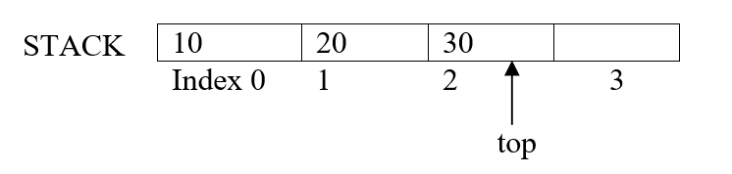
Memory representation of Stack
Stack is represented by a linear array STACK.
A pointer variable TOP, which contains the location of the top element of the stack; the variable MAXSTK which gives the maximum number of elements that can be held by the stack.
The condition TOP= -1 will indicate that the stack is empty.
TOP=2 as the stack has 3 elements and the array index starts from 0.
MAXSTK=4 as the maximum number of elements the stack can store is 4.

Slide 4
Stack Implementation
A stack is a simple linear data structure. It can be implemented in the following ways.
i) Static implementation - Array
ii) Dynamic Implementation – Linked list

Slide 5
Static Implementation using arrays
Static implementation can be achieved by using arrays.
Limitations:
Once a size of the array is declared, it cannot be modified during program execution.
If the reserved memory is more, then the memory will be wasted.
Therefore this method is suitable only when we know exactly the number of elements to be stored..
An array can be declared large enough for the maximum size of the stack. A variable TOP, which specifies the position of the top item of the stack, is maintained. Insertions and deletions are done with the help of this variable.
In executing the procedure PUSH, one must first test whether there is space in the stack for the new item or not.
In executing the procedure POP, one must first test whether there is an element in the stack to be deleted or not.

Slide 6
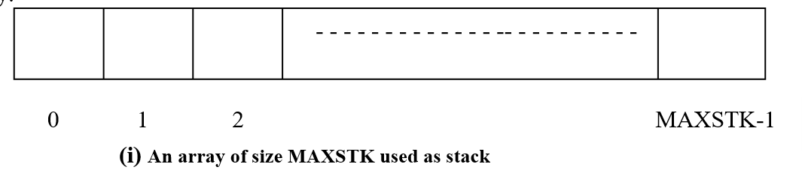

Slide 7
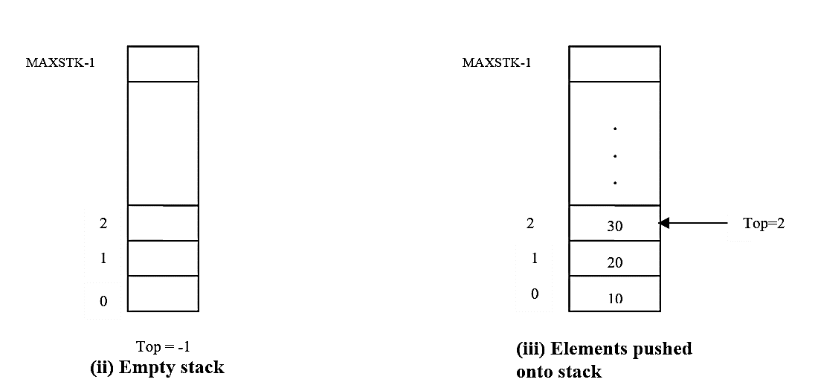

Slide 8
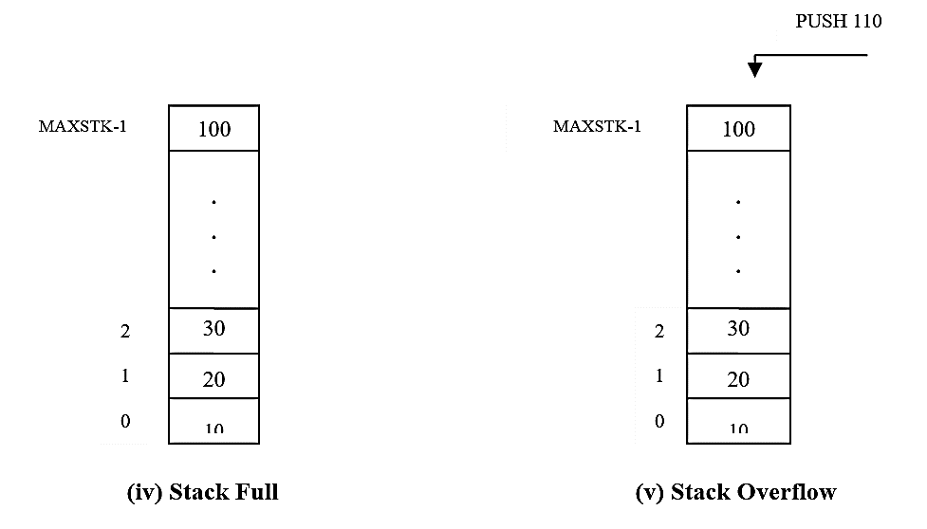

Slide 9
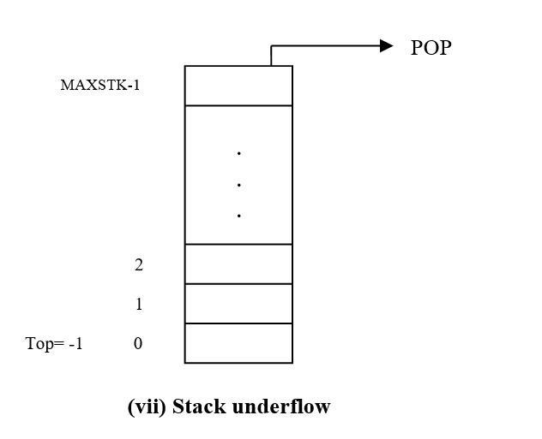
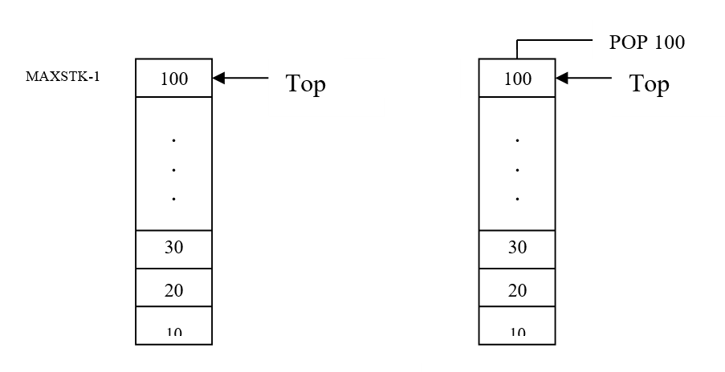

Slide 10
Dynamic implementation
Pointers can be used to create stack. There is no restriction on the number of elements.
It is possible to increase the size of the stack and memory is utilized efficiently with the use of pointers.

Slide 11
Stack operations
Creating a stack
Checking the status of a stack whether it is empty of full
Initializing a stack
Inserting or pushing an element into a stack
Deleting or popping an element from a stack
Accessing the top element
Displaying the elements of stack
Identify the current position of top of stack

Slide 12
1.Creating a stack
void createstack( )
{
printf(“\n Enter the number of elements in the stack:”);
scanf(“%d”,&n);
for(top=0;top<n;top++)
scanf(“%d”,&st[top]);
}

Slide 13
2.Checking the status of a stack whether empty or full
The isempty() operation is used to find whether stack contains any element or not. If stack is empty, which is denoted by top=-1, it returns true. If stack is not empty, it returns false. This function is mainly used to test stack underflow condition.
int isempty( )
{
if(top = = -1)
return 1;
else
return 0;
}
The isfull( ) operation is used to find whether stack contains all elements ie, whether the stack of size MAXSTK is completely filled with elements. If stack is full, it is indicated by top=MAXSTK-1, and it returns true. Otherwise, it returns false. This function is mainly used to test stack overflow condition.
int isfull( )
{
if(top = = MAXSTK-1)
return 1;
else
return 0;
}

Slide 14
3. Initializing a stack
int stack[MAXSTK] = { 0 };

Slide 15
4. Push operation
Insertion is placing an item in the stack and is referred as PUSH operation.
Algorithm for pushing (inserting) an element in stack:
PUSH (S, TOP, X) – This algorithm inserts an element x to the top of the stack which is represented by a vector S containing N elements with a pointer Top denoting the Top element in the stack.
1. [Check for stack overflow]
if Top = MAXSTK-1
then write (‘STACK OVERFLOW’)
2. [Increment Top]
Top ← Top + 1
3. [Insert element]
S[TOP] ← x
4. [Finished ]
Return
When the array is full, i.e. when the stack contains as many elements as the array and if an attempt is made to push yet another element onto the stack. The result of such an attempt is called Overflow.
void push()
{
int item;
if (top == max - 1)
printf("\n Stack is full");
else
{
top++;
printf("\n Enter the item to be inserted: ");
scanf("%d", &item);
stk[top]=item;
printf("\n %d is inserted", item);
}
}

Slide 16
5. Algorithm for poping (deleting) an element from a stack.
Deletion is removing an existing element from the stack and is referred as pop operation.
ALGORITHM POP (S, TOP) – This algorithm removes the top element from the stack which is represented by a vector S and return this element. Top is a pointer to the top element of the stack.
1. [Check for underflow on stack]
if Top = -1
then write (‘STACK UNDER FLOW’)
Exit
2. [Assign top element of stack]
item = S[Top])
3. [Decrement pointer]
Top ← Top - 1
If an attempt is made to pop an item from an empty stack, such an attempt is called Underflow
void pop()
{
int item;
if (top == -1)
printf("\n Stack underflow");
else
{
item = stk[top];
top--;
printf("\n %d is poped", item);
}
}

Slide 17
6. Display operation
Display the contents of the stack from the top till the bottom of the stack.
ALGORITHM FOR DISPLAY( )
1. [Check if stack is empty]
if Top = -1
then write (‘STACK EMPTY”)
Exit
2. [Output the top element of stack]
While (Top ! = -1)
Output S[Top])
3. [Decrement pointer]
Top ← Top - 1
End of while.

Slide 18
7. Accessing the top element
It is to print the top most element.
void stacktop( )
{
if(top = = -1)
printf(“\n stack underflow”);
else
printf(“%d”, st[top]);
}

Slide 19
8. Identifying current position of top of stack
Write a C program to implement stack using array.
void top( )
{
printf(“Top position = %d”, top);
}

Slide 20
Applications of Stacks
The different applications of stacks are,
1. Conversion of expressions
2. Evaluation of expressions
3. Reversal of string
4. Recursion
Arithmetic Expression: It is combination of operands and operators placed in its proper place. An arithmetic expression can be represented in three ways.
1. Infix
2. Prefix (Reverse polish notation)
3. Postfix (Suffix polish notation/polish notation)
(The name polish notation is named after polish logician Jan Lukasiewicz )
Consider the sum of A and B.
The arithmetic expression is written as A+B where A and B are operands, + is the operator.
This particular representation, if the operator is between A and B (operands) is infix notation.
If the operator precedes the two operands, then the notation is prefix notation i.e. +AB
If the operator follows the two operands then the notation is post fix notation. i.e. AB+

Slide 21
Infix to Postfix
Algorithm 1. Scan the infix expression from left to right. 2. If the scanned character is an operand, output it. 3. Else, 1 If the precedence of the scanned operator is greater than the precedence of the operator in the stack(or the stack is empty or the stack contains a ‘(‘ ), push it. 2 Else, Pop all the operators from the stack which are greater than or equal to in precedence than that of the scanned operator. After doing that Push the scanned operator to the stack. (If you encounter parenthesis while popping then stop there and push the scanned operator in the stack.) 4. If the scanned character is an ‘(‘, push it to the stack. 5. If the scanned character is an ‘)’, pop the stack and output it until a ‘(‘ is encountered, and discard both the parenthesis. 6. Repeat steps 2-6 until infix expression is scanned. 7. Print the output 8. Pop and output from the stack until it is not empty.

Slide 22
Trace of the algorithm to convert the infix expression (A*(B-C)) to postfix expression
Sl.no | Symbol (Q) | Postfix (P) | Stack
1 | ( |  | (
2 | A | A | (
3 | * | A | (*
4 | ( | A | (*(
5 | B | AB | (*(
6 | - | AB | (*(-
7 | C | ABC | (*(-
8 | ) | ABC- | (*
9 | ) | ABC-*

Slide 23
Evaluation of postfix expression
Algorithm:
Scan the postfix expression from left to right.
If we encounter an operand, push it on to stack.
If we encounter an operator, pop two operands from the stack. The first operand popped is an operand 2 and second popped is operand 1.
Perform the desired operation on the operands. i.e. operand 1 operator operand 2
Push the result on to the stack.
Repeat the above procedure till the end of input is encountered.

Slide 24
Trace of algorithm to evaluate the postfix expression 6 3 2 – 5 * + 1 ^ 7 +
Symbol | Operand2 N2 | Operand1 N1 | Result (N1 operator N2) | Stack
6 |  |  |  | 6
3 |  |  |  | 6,3
2 |  |  |  | 6 3 2
- | 2 | 3 | 1 | 6 1
5 | 2 | 3 | 1 | 6 1 5
* | 5 | 1 | 5 | 6 5
+ | 5 | 6 | 11 | 11
1 | 5 | 6 | 11 | 11 1
^ | 1 | 11 | 11 | 11
7 | 1 | 11 | 11 | 11 7
+ | 7 | 11 | 18 | 18

Slide 25
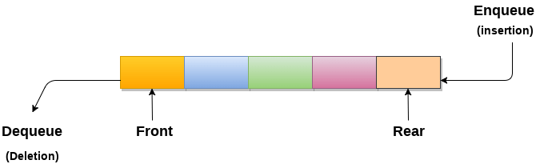
Queue
Queue is an ordered collection of items. These items may be deleted at one end (called the FRONT / HEAD of the queue) and inserted at other end (called the REAR / TAIL of the queue). Also known as FIFO – First In First Out.
Example, to withdraw money at ATM

Slide 26
Applications of Queue
Due to the fact that queue performs actions on first in first out basis which is quite fair for the ordering of actions. There are various applications of queues discussed as below.
Queues are widely used as waiting lists for a single shared resource like printer, disk, CPU.
Queues are used in asynchronous transfer of data (where data is not being transferred at the same rate between two processes) for eg. pipes, file IO, sockets.
Queues are used as buffers in most of the applications like MP3 media player, CD player, etc.
Queue are used to maintain the play list in media players in order to add and remove the songs from the play-list.
Queues are used in operating systems for handling interrupts.

Slide 27
Operations on Queue
a. Inserting an element into queue
b. Deleting an element from queue
c. Checking the status whether queue is empty
d. Checking the status whether queue is full
e. Displaying the elements of queue
The first element inserted into a queue is the first element to be removed. For this reason queue is referred as first-in-first-out (FIFO) list.

Slide 28
Insertion
a) Insertion:
Points to remember when we add an element in the queue:
Check whether the queue has any space to add an element into it.
If the queue has spaces then add the element into the queue by incrementing the REAR pointer.
Example:
Increment the REAR as REAR+1 or REAR++
Queue [Rear] = Item which is used to add an element into the queue.
Note: Rear is the position where the item is to be inserted.
Algorithm
Step 1: IF REAR = MAX - 1 Write OVERFLOW Go to step [END OF IF]
Step 2: IF FRONT = -1 and REAR = -1 SET FRONT = REAR = 0 ELSE SET REAR = REAR + 1 [END OF IF]
Step 3: Set QUEUE[REAR] = NUM
Step 4: EXIT
void qinsert()
{
int item;
if(rear==max-1)
printf("queue is full");
else
{
scanf("%d",&item);
rear++;
queue[rear]=item;
}
getch();
}

Slide 29
Queue Overflow:
Insertion of an element in a queue is possible only if there is room in the array to fit in elements. If the maximum size of the array is reached and if an attempt to insert an element into the queue that is full, is tried, the condition that occurs is called ‘queue overflow’.

Slide 30
Deleting an element from the queue
void qdelete()
{
int item;
if(front==-1 || front > rear))
Printf(“queue is empty”);
Else
{
printf("deleted item is %d",queue[front]);
front++;
}
getch();
}
Points to remember when we remove an element from the queue:
Check whether the queue has any element to be deleted.
If so, delete the element from the queue by incrementing the FRONT pointer.
Example:
Item= queue[rear]
Increment the front using front++
Note: Rear is the position where the item is to be inserted.

Slide 31
Queue Full operation:
A function to check whether queue is full or not returns 1 when the queue is full and returns 0 when the queue is not full. This function is used to check for queue overflow.
A queue is full when REAR reaches the maximum size of the array used for the queue i.e.e REAR=max-1. FRONT = 0 and REAR = n-1 indicates this condition.
int qfull( )
{
if(rear = = max-1)
return 1;
else
return 0;
}
Queue empty operation:
A function to check whether queue is empty or not return 1 when the queue is empty and returns 0 when the queue is ot empty. This function is used to check for queue underflow.
int qempty()
{
if(front=-1 || front>rear)
return 1;
else
return 0;
}
Queue Underflow
Deletion or removal of an element from the queue can be done only if at least one item is there* in the queue. It means that the queue must be non-empty. An attempt to remove an element from an empty queue is called ‘queue underflow’.

Slide 32
Queue display operation:
This operation is used to display all the elements present in a queue. Whenever REAR value becomes equal to the FRONT-1 i.e.REAR = -1 and FRONT = 0 then the queue is empty.
void qdisplay()
{
int item;
int p=front;
if(p==-1|| p>rear)
printf("queue is empty");
else
{
printf("\n queue elements");
while(p<=rear)
{
printf("%d\t",queue[p]);
p++;
}
}
getch();
}

Slide 33
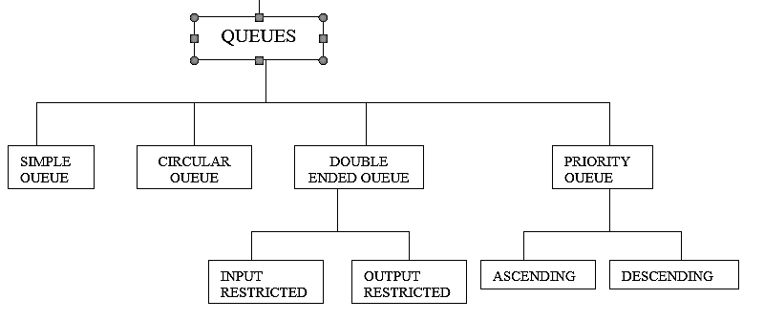
Types of queues

Slide 34
Simple Queue (Linear Queue)
Algorithm for Simple Queue (Linear Queue)
Algorithm of qinsert()
Step 1:if(rear==max-1)
Display"Queue is full");
Step 2:else Input the value to insert(item)
Step 3:rear++;
Step 4 :queue[rear]=item;
End if in step 1
Algorithm of qdelete()
Step 1:if(front==rear+1 || front==-1)
Output “Queue is empty"
Step 2:else
item=queue[front];
Output “Deleted item “
Step 3:front++
End if in step 1
.
Algorithm of qdisplay()
Step 1:p=front;
Step 2:if(p==rear+1|| p=-1)
Display ”Queue is empty"
Step 3:else while(p<=rear)
Step 4:Output queue[p]
Step 5:p++
End if of step1

Slide 35
Disadvantage of Linear Queue
Using array to implement the queue will create a problem when the queue is full – memory space are fixed.
Linear queue have a drawback that once a queue is full, i.e. it has reached the maximum size of the array, even through elements may be deleted from the front/ head , and certain locations are free, we cannot add any more elements as rear/tail would have already reached the last position in the queue. So insertion is not possible and it will indicate the queue overflow condition.
Solution
Create a circular queue.
Circular queue wraps around to the beginning whenever the Head(Front) or the Tail(Rear) reaches the end of the queue.

Slide 36
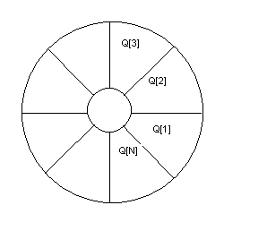
Circular Queue – The method of arranging the queue elements Q[1], Q[2], …….. Q[n] in a circular fashion with Q[1] following Q[n] is called circular Queue

Slide 37
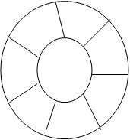
Insertion of element into circular queue:
Initially Front=1;Rear=0;
To insert element into the circular queue, increment REAR
Rear = (Rear+1)%n where n is size of circular queue ie 7
2) Queue[Rear]=item use this statement to insert value.
It is important to check for queue overflow condition before inserting an element.
Figure shows an empty circular queue with maximum size of 7 elements.

Slide 38
During insertion
1) check queue is full or not using the following function
int cqfull()
{
if((front==1&&rear==n)||(front==rear+1))
return 1;
else
return 0;
}
2) Read the value 3) Increment rear → rear=(rear%n)+1;
So rear=(7%7)+1;
Rear= 0+1=1
4) insert the value
queue[rear]=item;
void cqinsertion()
{
int item;
if(cqfull())
printf("\nQueue is full");
else
{
printf("Enter the element:");
scanf("%d",&item);
rear=(rear%n)+1;
queue[rear]=item;
}
}

Slide 39
Deletion of element from circular queue
To delete an element from the queue, front is to be incremented by 1,
item = queue [front]
front=front+1
then print item value

Slide 40
ALGORITHM–CIRCULAR QUEUE
Algorithm cqinsert ()
Step 1: if (front ==(rear+1)%n)
Display "Queue overflow”
Step 2: else input the value to be inserted(item)
Step 3: if (front==-1)
front =rear=0;
otherwise
rear=(rear+1)%n;
End if in step 3
Step 4: cq[rear]=item;
End if in step 1
Algorithm cqdisplay()
Step 1: if((front==-1)&&(rear==-1))
Display "Queue Empty”
Step 2: if(front<=rear)
Repeat step 3 for i=front to rear
Step 3: Display cq[i]
End if of step 2.
Step 4: if(front>rear)
Repeat step 5 for i=front to (n-1)
Step 5: Display cq[i]
Step 6: Repeat step 7 for i=0 to rear
Step 7: Display cq[i]
End if of step 4.

Slide 41
Algorithm cqdelete ()
Step 1: if((front==-1)&&(rear==-1))
Display "Queue underflow
Step 2: else display “cq[front] is deleted”
Step 3: if(front==rear)
front=rear=-1
Step 4: otherwise
front=(front+1)%n;
End of if in step 3.
End of if in step 1.

Slide 42
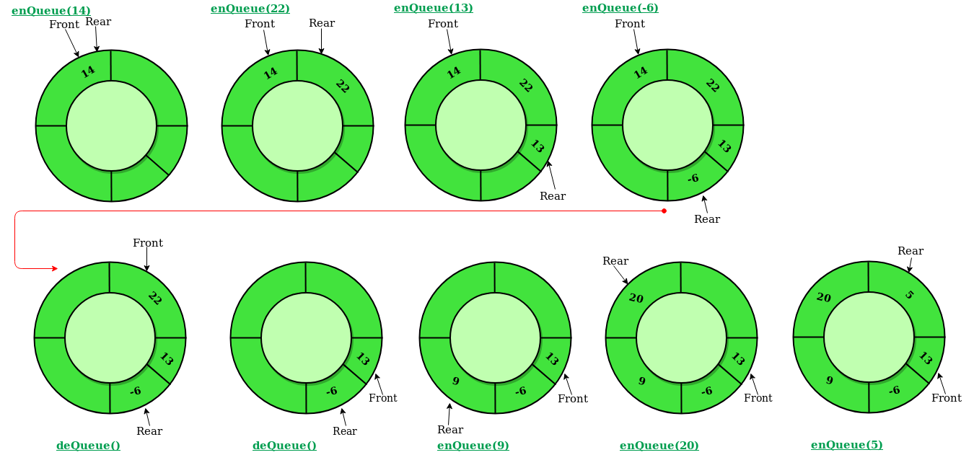

Slide 43
Deque (Double-ended queue)
It is a linear list in which insertions and deletions are made to or from either end of the structure. There are two variations of a deque namely,
1. Input – restricted deque
2. Output – restricted deque
The input – restricted deque allows insertions at only one end.
While an output – restricted deque permits deletions from only at one end.
← Insertion
Deletion ← → Deletion
Input-restricted deque
← Insertion
Insertion ← → Deletion
output-restricted deque.

Slide 44
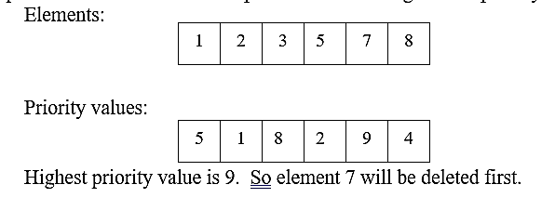
Priority Queues
A Queue in which it is able to insert elements or remove elements from any position on some property (such as priority of the task to be processed) is referred as priority Queue.
An element of higher priority is processed before any element of lower priority.
Two elements with the same priority are processed according to the order in which they were added to the queue.
In priorty queue, every element has been assigned with a priority value called priority. The elements can be inserted or deleted randomly any where in the queue.
Priority queue is a data structure in which prioritized insertion and deletion operations on elements can be performed according to their priority values.

Slide 45
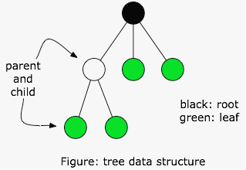
Tree
Definition: A Tree is a data structure that emulates a hierarchical tree structure with a set of linked nodes.
It is a data structure accessed beginning at the root node. Each node is either a leaf or an internal node. An internal node has one or more child nodes and is called the parent of its child nodes. All children of the same node are siblings. Contrary to a physical tree, the root is usually depicted at the top of the structure, and the leaves are depicted at the bottom.

Slide 46
The important properties of tree data structure are-
· There is one and only one path between every pair of vertices in a tree.
· A tree with n vertices has exactly (n-1) edges.
· A graph is a tree if and only if it is minimally connected.
· Any connected graph with n vertices and (n-1) edges is a tree.

Slide 47
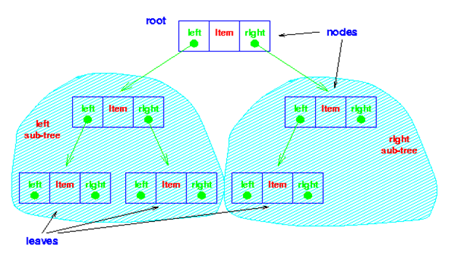
Binary Tree
The simplest form of tree is a binary tree. A binary tree consists of a node (called the root node) and left and right sub-trees. Both the sub-trees are themselves binary trees.

Slide 48
Complete binary tree
-is a strict binary tree with all leaf nodes at the same level. The number of nodes at level ‘n’ is 2 ^{n}
Left Skewed Tree:
A binary tree with only left sub tree is called left skewed tree.
Right Skewed Tree:
A binary tree with only right sub tree is called right skewed tree.

Slide 49
Implementation of Binary Trees
Binary trees are implemented in two ways:
Array implementation of Binary Trees
Linked List implementation of Binary Trees

Slide 50
Traversals of a Binary Tree
There are three ways of traversing a Binary Tree. Displaying the tree contents is known as transversal. The tree can be traversed in inorder, preorder and postorder methods. PREORDER TRAVERSAL:
Process the root R.
Traverse the left sub tree of R in preorder.
Traverse the right sub tree of R in preorder.
INORDER TRAVERSAL:
Traverse the left sub tree of R in inorder.
Process the root R.
Traverse the right sub tree of R in inorder.
POSTORDER TRAVERSAL :
Traverse the left sub tree of R in postorder.
Traverse the right sub tree of R in postorder.
Process the root R.

Slide 51
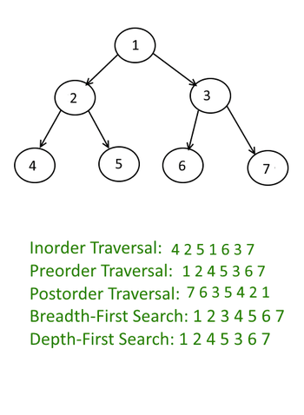

Slide 52
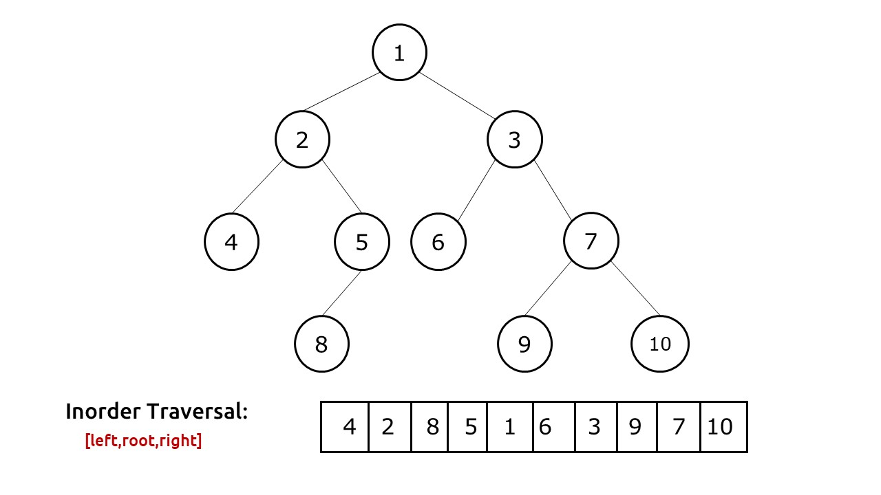

Slide 53
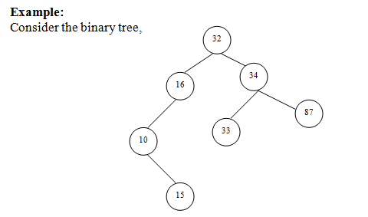

Slide 54
The order in which each node in the tree is traversed is as follows,
INORDER TRAVERSAL:10,15 ,16 ,32 ,33,34,87
PREORDER TRAVERSAL :32 ,16,10,15,34,33,87
POSTORDER TRAVERSAL :15, 10, 16, 33, 87, 34, 32
Adelson-Velsky and Landis
Adelson-Velsky and Landis
Adelson-Velsky and Landis

Slide 55
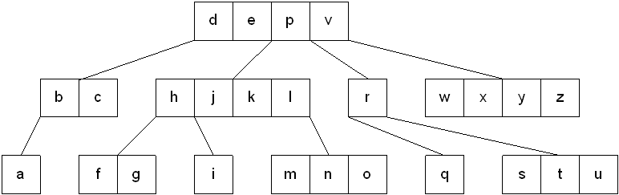
Multi way trees
A multiway tree is a tree that can have more than two children. A multiway tree of order m (or an m-way tree) is one in which a tree can have m children.
As with the other trees that have been studied, the nodes in an m-way tree will be made up of key fields, in this case m-1 key fields, and pointers to children.
multiway tree of order 5

Slide 56
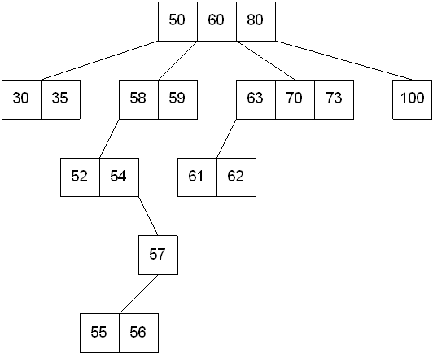
Multi way search Tree
To make the processing of m-way trees easier some type of order will be imposed on the keys within each node, resulting in a multiway search tree of order m ( or an m-way search tree). By definition an m-way search tree is a m-way tree in which:
Each node has m children and m-1 key fields
The keys in each node are in ascending order.
The keys in the first i children are smaller than the ith key
The keys in the last m-i children are larger than the ith key

Slide 57
B Tree
B Tree is a specialized m-way tree that can be widely used for disk access.
A B-Tree of order m can have at most m-1 keys and m children.
One of the main reason of using B tree is its capability to store large number of keys in a single node and large key values by keeping the height of the tree relatively small.

Slide 58
Properties of B-tree
B-Tree of Order m has the following properties...
1. All leaf nodes are at the same level.
2. All non leaf nodes (except the root) have at most m
And at least m/2 children.
3. The number of keys is one less than the number of
children for non leaf nodes and at most m-1 and at
least m/2 for leaf nodes.
4. The root may have as few as 2 children unless the
tree is the root alone.
For example, B-Tree of Order 4 contains a maximum of 3 key values in a node and maximum of 4 children for a node.

Slide 59
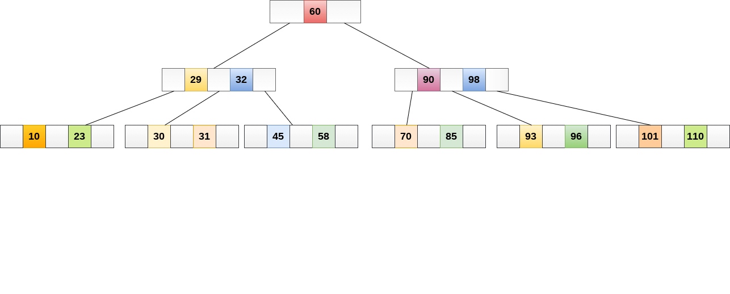
B tree of Order 5

Slide 60
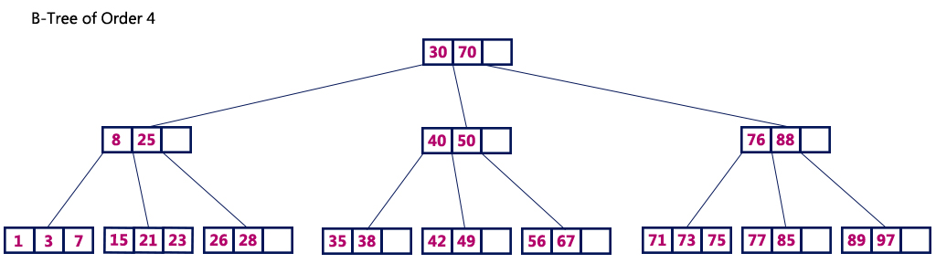

Slide 61
Operations on a B-Tree
The following operations are performed on a B-Tree...
Search
Insertion
Deletion

Slide 62
Search Operation
The search operation in B-Tree is similar to the search operation in Binary Search Tree.
In a Binary search tree, the search process starts from the root node and we make a 2-way decision every time (we go to either left subtree or right subtree).
In B-Tree also search process starts from the root node but here we make an n-way decision every time. Where 'n' is the total number of children the node has.
In a B-Tree, the search operation is performed with O(log n) time complexity. The search operation is performed as follows..

Slide 63
Step 1 - Read the search element from the user.
Step 2 - Compare the search element with first key value of root node in the tree.
Step 3 - If both are matched, then display "Given node is found!!!" and terminate the function
Step 4 - If both are not matched, then check whether search element is smaller or larger than that key value.
Step 5 - If search element is smaller, then continue the search process in left subtree.
Step 6 - If search element is larger, then compare the search element with next key value in the same node and repeate steps 3, 4, 5 and 6 until we find the exact match or until the search element is compared with last key value in the leaf node.
Step 7 - If the last key value in the leaf node is also not matched then display "Element is not found" and terminate the function.

Slide 64
Insert
In a B-Tree, a new element must be added only at the leaf node. That means, the new keyValue is always attached to the leaf node only. The insertion operation is performed as follows...
Step 1 - Check whether tree is Empty.
Step 2 - If tree is Empty, then create a new node with new key value and insert it into the tree as a root node.
Step 3 - If tree is Not Empty, then find the suitable leaf node to which the new key value is added using Binary Search Tree logic.
Step 4 - If that leaf node has empty position, add the new key value to that leaf node in ascending order of key value within the node.
Step 5 - If that leaf node is already full, split that leaf node by sending middle value to its parent node. Repeat the same until the sending value is fixed into a node.
Step 6 - If the spilting is performed at root node then the middle value becomes new root node for the tree and the height of the tree is increased by one.

Slide 65
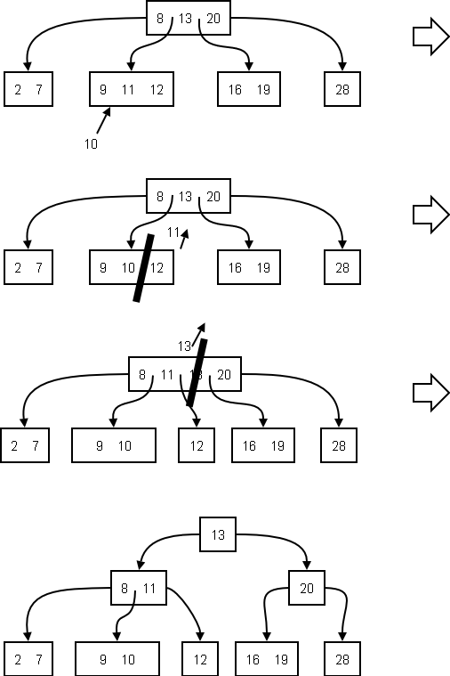

Slide 66
Example
Construct a B-Tree of Order 3 by inserting numbers from 1 to 10.

Slide 67
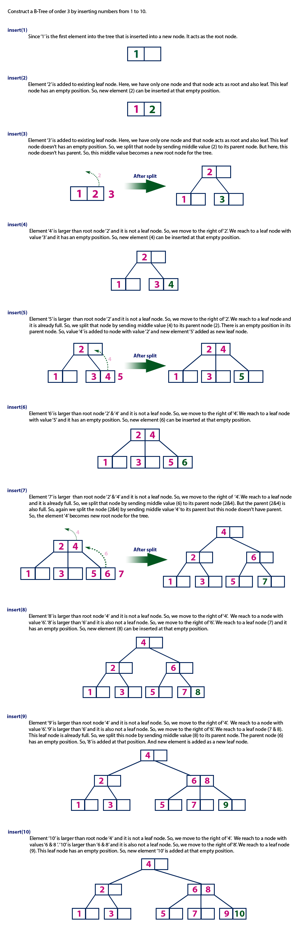

Slide 68
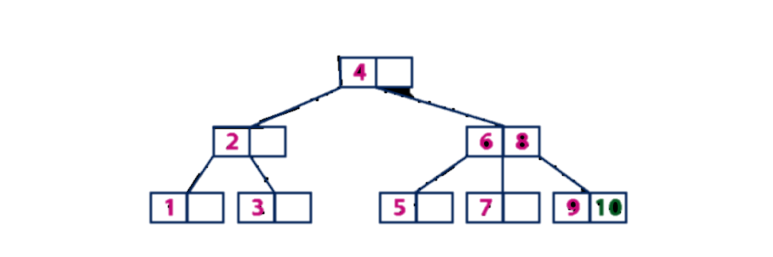

Slide 69
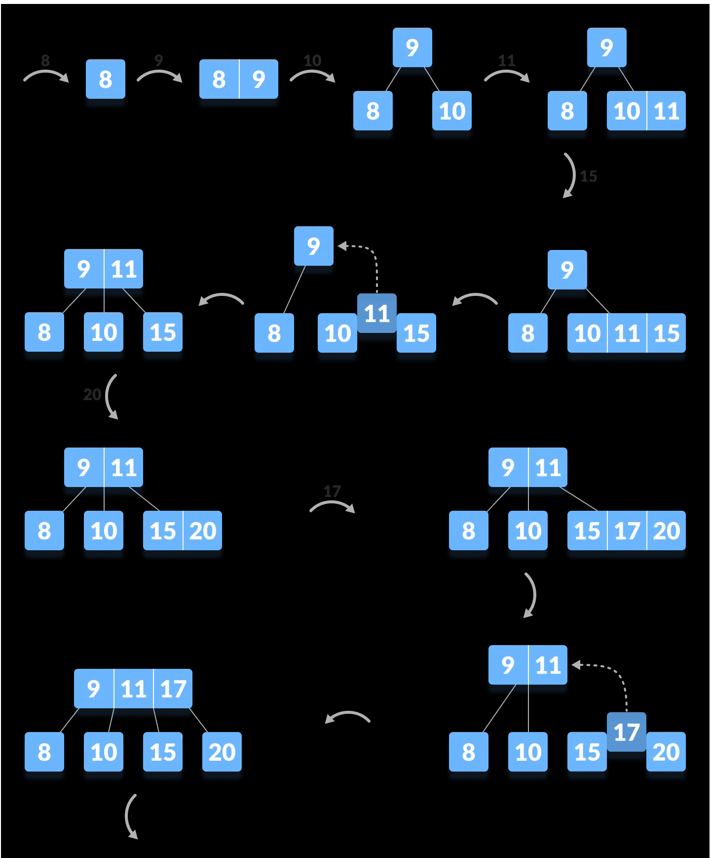
The elements to be inserted are 8, 9, 10, 11, 15, 20, 17. (order of tree is 3)

Slide 70
Deletion Operation
The terms to be understood before studying deletion operation are:
Inorder Predecessor The largest key on the left child of a node is called its inorder predecessor.
Inorder Successor The smallest key on the right child of a node is called its inorder successor.

Slide 71
Case 1: If the target key is in the leaf node
Target is in the leaf node, more than min keys.
Deleting this will not violate the property of B Tree
Target is in leaf node, it has min key nodes
Deleting this will violate the property of B Tree
Target node can borrow key from immediate left node, or immediate right node (sibling)
The sibling will say yes if it has more than minimum number of keys
The key will be borrowed from the parent node, the max value will be transferred to a parent, the max value of the parent node will be transferred to the target node, and remove the target value
Target is in the leaf node, but no siblings have more than min number of keys
Search for key
Merge with siblings and the minimum of parent nodes
Total keys will be now more than min
The target key will be replaced with the minimum of a parent node

Slide 72
Case 2: If the target key is in an internal node
Either choose, in- order predecessor or in-order successor
In case the of in-order predecessor, the maximum key from its left subtree will be selected
In case of in-order successor, the minimum key from its right subtree will be selected
If the target key’s in-order predecessor has more than the min keys, only then it can replace the target key with the max of the in-order predecessor
If the target key’s in-order predecessor does not have more than min keys, look for in-order successor’s minimum key.
If the target key’s in-order predecessor and successor both have less than min keys, then merge the predecessor and successor.

Slide 73
Case 3:If the target key is in a root node
Replace with the maximum element of the in-order predecessor subtree
If, after deletion, the target has less than min keys, then the target node will borrow max value from its sibling via sibling’s parent.
The max value of the parent will be taken by a target, but with the nodes of the max value of the sibling.

Slide 74
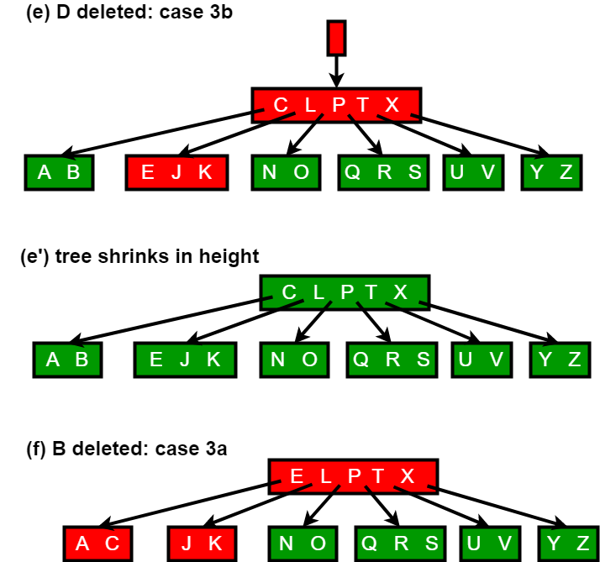

Slide 75
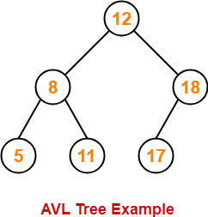
AVL (Adelson-Velsky and Landis)
AVL(Adelson-Velsky and Landis) trees are special kind of binary search trees.
In AVL trees, height of left subtree and right subtree of every node differs by at most one.
AVL trees are also called as self-balancing binary search trees.
Following tree is an example of AVL tree-

Slide 76
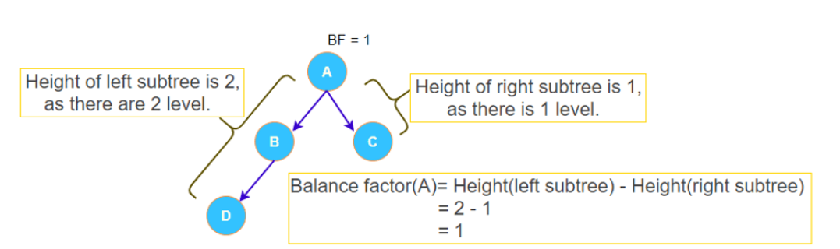
Balance Factor
In AVL tree,
Balance factor is defined for every node.
Balance factor of a node = Height of its left subtree – Height of its right subtree
In AVL tree,
Balance factor of every node is either 0 or 1 or -1.
The value –1 indicates that the right sub-tree contains one extra, i.e., the tree is right heavy.
The value +1 indicates that the left sub-tree contains one extra, i.e., the tree is left heavy.
The value 0 shows that the tree includes equal nodes on each side, i.e., the tree is perfectly balanced.

Slide 77
Why AVL tree
Most of the BST operations (e.g., search, max, min, insert, delete.. etc) take O(h) time where h is the height of the BST.
The cost of these operations may become O(n) for a skewed Binary tree. If we make sure that height of the tree remains O(Logn) after every insertion and deletion, then we can guarantee an upper bound of O(Logn) for all these operations. The height of an AVL tree is always O(Logn) where n is the number of nodes in the tree

Slide 78
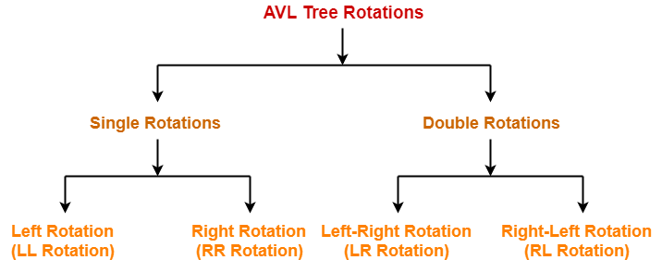
Kinds of Rotations
To make the AVL Tree balance itself, when inserting or deleting a node from the tree, rotations are performed.
We perform the following LL rotation, RR rotation, LR rotation, and RL rotation.
Left – Left Rotation
Right – Right Rotation
Right – Left Rotation
Left – Right Rotation

Slide 79
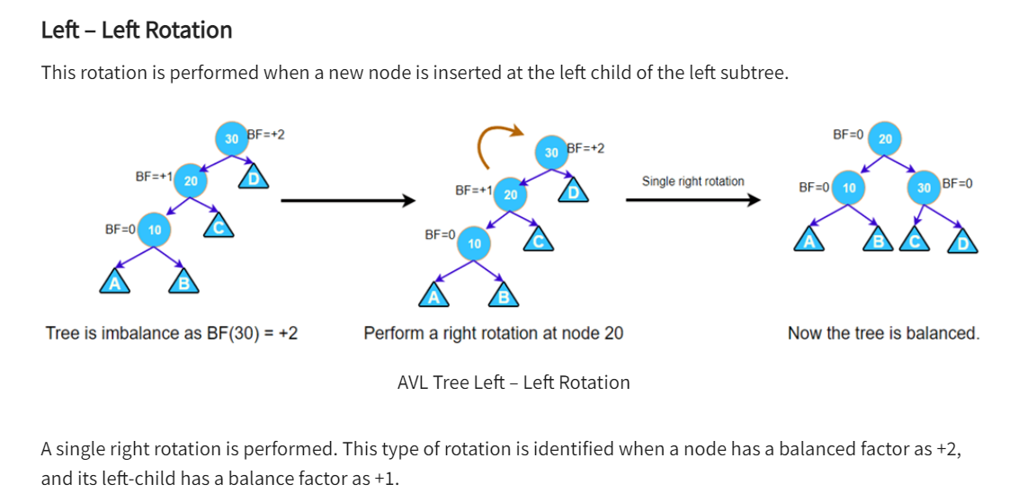
Cases Of Imbalance And Their Balancing Using Rotation Operations
Case 01 (Left Left imbalanced Tree) – Perform right rotation (about root node).

Slide 80
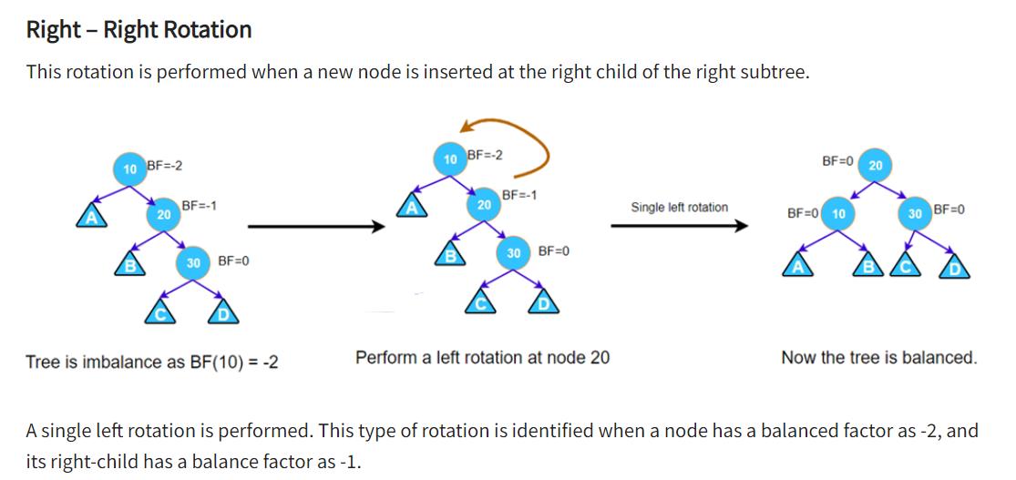
Perform left rotation about root node

Slide 81
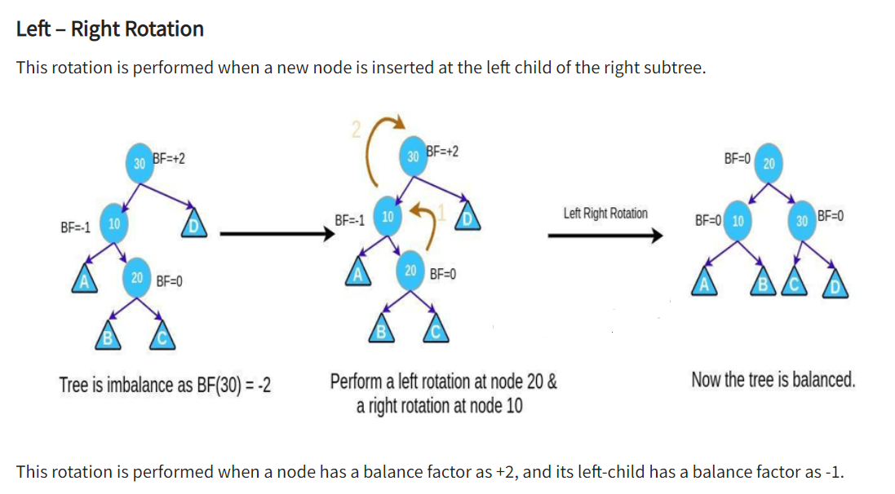
Left rotation about left child of root node.
Right rotation about root node.
Case 03

Slide 82
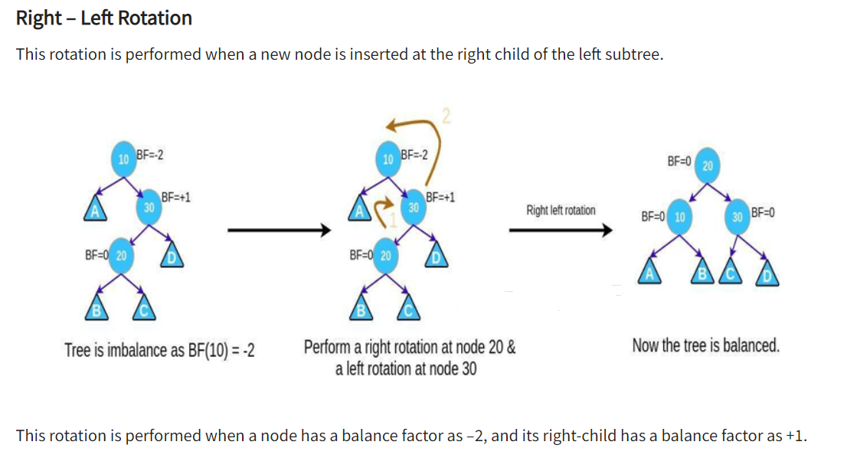
Right rotation about right child of root node.
left rotation about root node.
Case 04

Slide 83
Difference between B –tree and AVL tree
An AVL tree is a self-balancing binary search tree, balanced to maintain O(log n) height.
A B-tree is a balanced tree, but it is not a binary tree. Nodes have more children, which increases per-node search time but decreases the number of nodes the search needs to visit. This makes them good for disk-based trees.

Slide 84
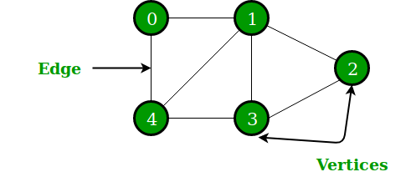
Graph
A Graph is a non-linear data structure consisting of nodes and edges. The nodes are sometimes also referred to as vertices and the edges are lines or arcs that connect any two nodes in the graph. More formally a Graph can be defined as,
A Graph consists of a finite set of vertices(or nodes) and set of Edges which connect a pair of nodes.
In the above Graph, the set of vertices V = {0,1,2,3,4} and the set of edges E = {01, 12, 23, 34, 04, 14, 13}.

Slide 85
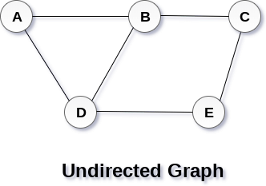
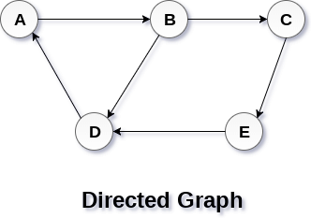
Directed and Undirected Graph

Slide 86
Graph representation
A graph is a data structure that consist a sets of vertices (called nodes) and edges. There are two ways to store Graphs into the computer's memory:
Sequential representation (or, Adjacency matrix representation)
Linked list representation (or, Adjacency list representation)

Slide 87
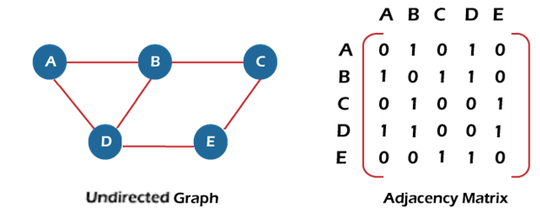
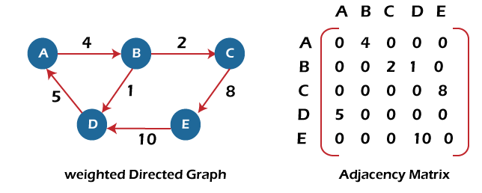


Slide 88
