Slide 1
Algorithm Design techniques

Slide 2
A given problem can be solved in various different approaches and some approaches deliver much more efficient results than others.
Algorithm analysis is a technique used to measure the effectiveness and performance of the algorithms.
It helps to determine the quality of an algorithm based on several parameters such as user-friendliness, maintainability, security, space usage and usage of other resources.

Slide 3
Brute-force or exhaustive search.
Divide and Conquer.
Greedy Algorithms.
Dynamic Programming.
Branch and Bound Algorithm.
Backtracking
Randomized Algorithm.

Slide 4
Branch and bound
Branch and bound is one of the techniques used for problem solving.
It is similar to the backtracking since it also uses the state space tree.
It is used for solving the optimization problems and minimization problems.
If we have given a maximization problem then we can convert it using the Branch and bound technique by simply converting the problem into a maximization problem.

Slide 5
Assignment problem
Let there be N workers and N jobs. Any worker can be assigned to perform any job, incurring some cost that may vary depending on the work-job assignment.
It is required to perform all jobs by assigning exactly one worker to each job and exactly one job to each agent in such a way that the total cost of the assignment is minimized.

Slide 6
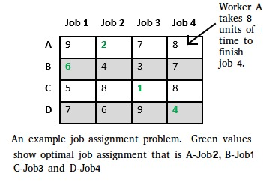

Slide 7
There are two approaches to calculate the cost function:
For each worker, we choose job with minimum cost from list of unassigned jobs (take minimum entry from each row).
For each job, we choose a worker with lowest cost for that job from list of unassigned workers (take minimum entry from each column).

Slide 8
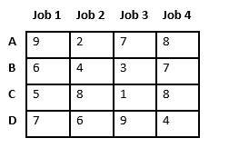
Let’s take below example and try to calculate promising cost when Job 2 is assigned to worker A.

Slide 9
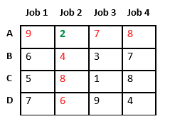
Since Job 2 is assigned to worker A (marked in green), cost becomes 2 and Job 2 and worker A becomes unavailable (marked in red).

Slide 10
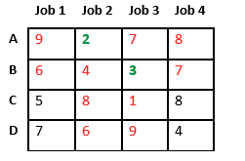
Now we assign job 3 to worker B as it has minimum cost from list of unassigned jobs. Cost becomes 2 + 3 = 5 and Job 3 and worker B also becomes unavailable.

Slide 11
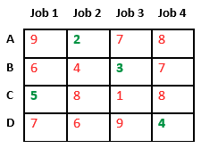
Finally, job 1 gets assigned to worker C as it has minimum cost among unassigned jobs and job 4 gets assigned to worker D as it is only Job left. Total cost becomes 2 + 3 + 5 + 4 = 14.

Slide 12
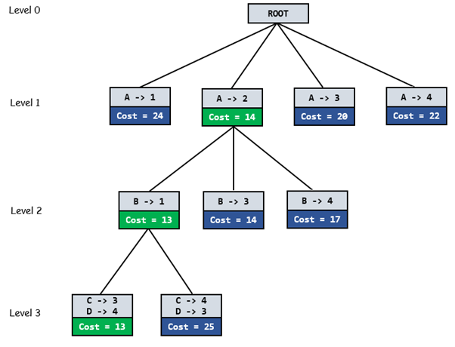

Slide 13
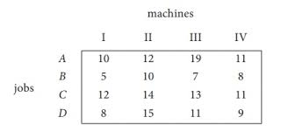
Problem

Slide 14
Limitations of Algorithm power
Some problems cannot be solved by any algorithm. Other problems can be solved algorithmically but not in polynomial time.
And even when a problem can be solved in polynomial time by some algorithms, there are usually lower bounds on their efficiency.
Polynomial time
Exponential time
Polynomial | Non Polynomial / Exponential
Binary Search O(log n) | 0/1 Knapsack O(2^n)
Linear Search O(n) | Travelling salesman
Merge Sort O(n log n) | Sum of subsets
Matrix multiplication O(n3) | Hamiltonian cycle

Slide 15
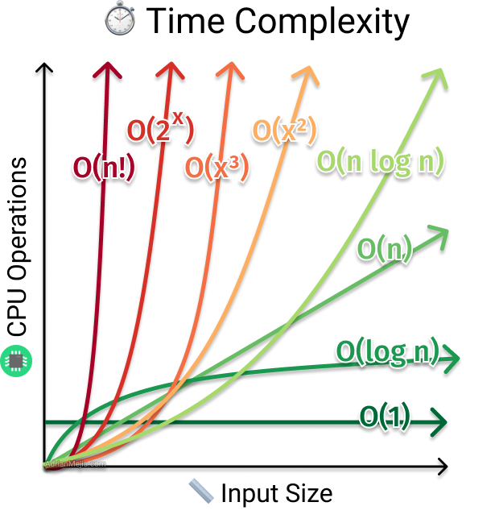

Slide 16
Non polynomial to polynomial
Develop non deterministic algorithm
Relate and solve multiple problems with same input

