Slide 1

UE19CS204 Web Technologies Mini Project
BY –
JAYANTH KUMAR,HARI PRASAD,KEDARNATH

Slide 2
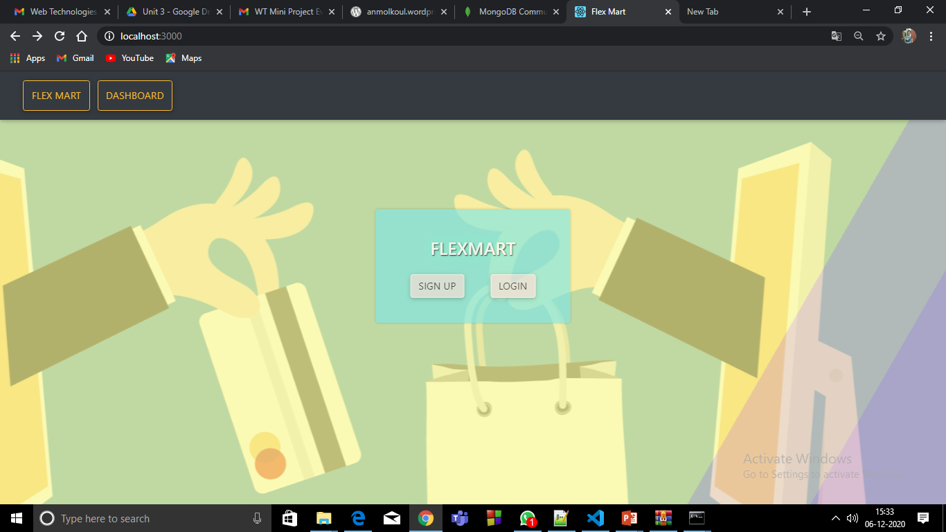
PROJECT TITLE : FLEX MART
SECTION : G
GITHUB Link –
https://github.com/jayanthkumar1/online-shopping-website
NAME | SRN
JAYANTH KUMAR A | PES2UG19CS162
HARI PRASAD H R | PES2UG19CS137
KEDARNATH K BHAT | PES2UG19CS180

Slide 3
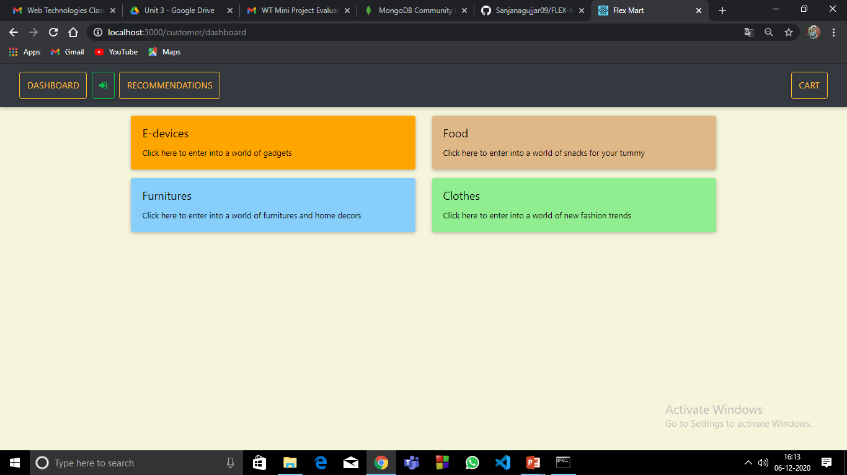
ABSTRACT
E-commerce web app built using MERN stack Project with features like CRUD operations, conditional Rendering of components, search bar and sidebar for filtering.
It uses modal for data display and edit, protected routes with token from backend after authentication ie. login/signup based on user role, display of data relevant to the component and user and much more.

Slide 4





TECHNOLOGIES USED
mongoDB
express js
node js
react js
BlueBird.js
Underscore.js
CSS
firebase

Slide 5
MEMBER CONTRIBUTIONS
JAYANTH :-front end and backend part of cart page,Dashboard and upload product page.
KEDARNATH :- front end and backend part of Login , register , logout
HARI PRASAD:-Styling component , Search bar and filter.

Slide 6
THANK
YOU

