Slide 1
TalentSearch
Find the Right Talent, Faster with TalentSearch

Slide 2
Milestones
Reference Link
1. Planning and Requirements Analysis
2. Design and Development
3. Testing and Debugging
4. Deployment and Project Presentation

Slide 3
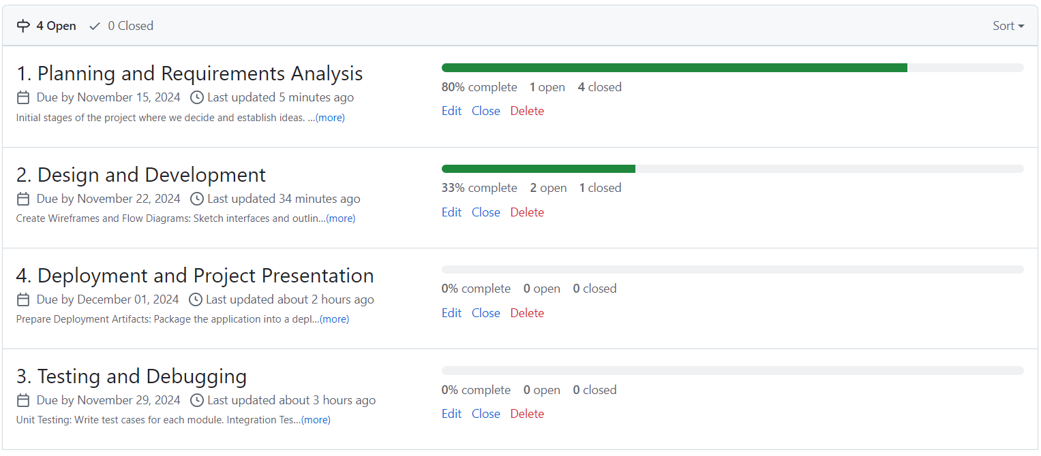
Milestones

Slide 4
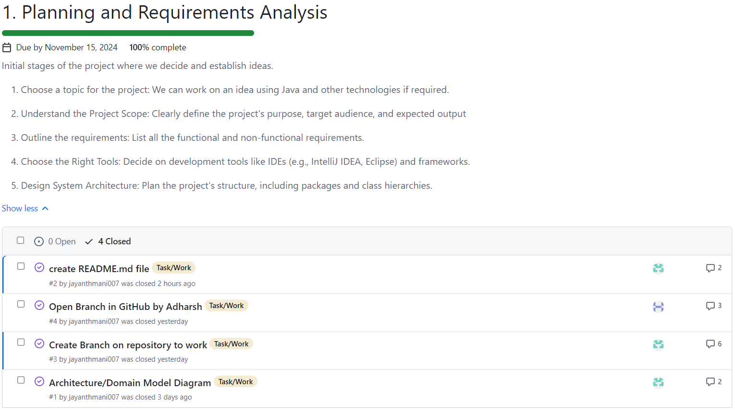

Slide 5
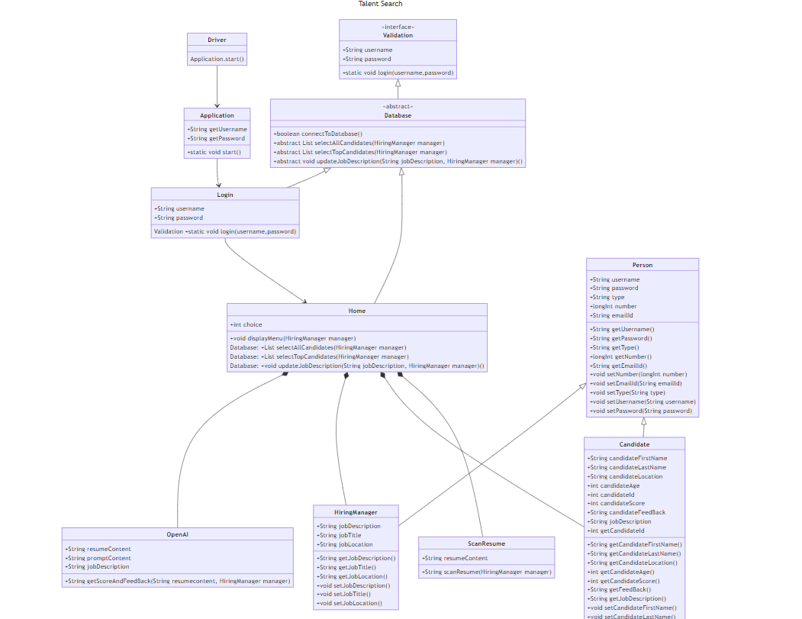
UML Diagram: Class Diagram
Developed using Mermaid Code

Slide 6
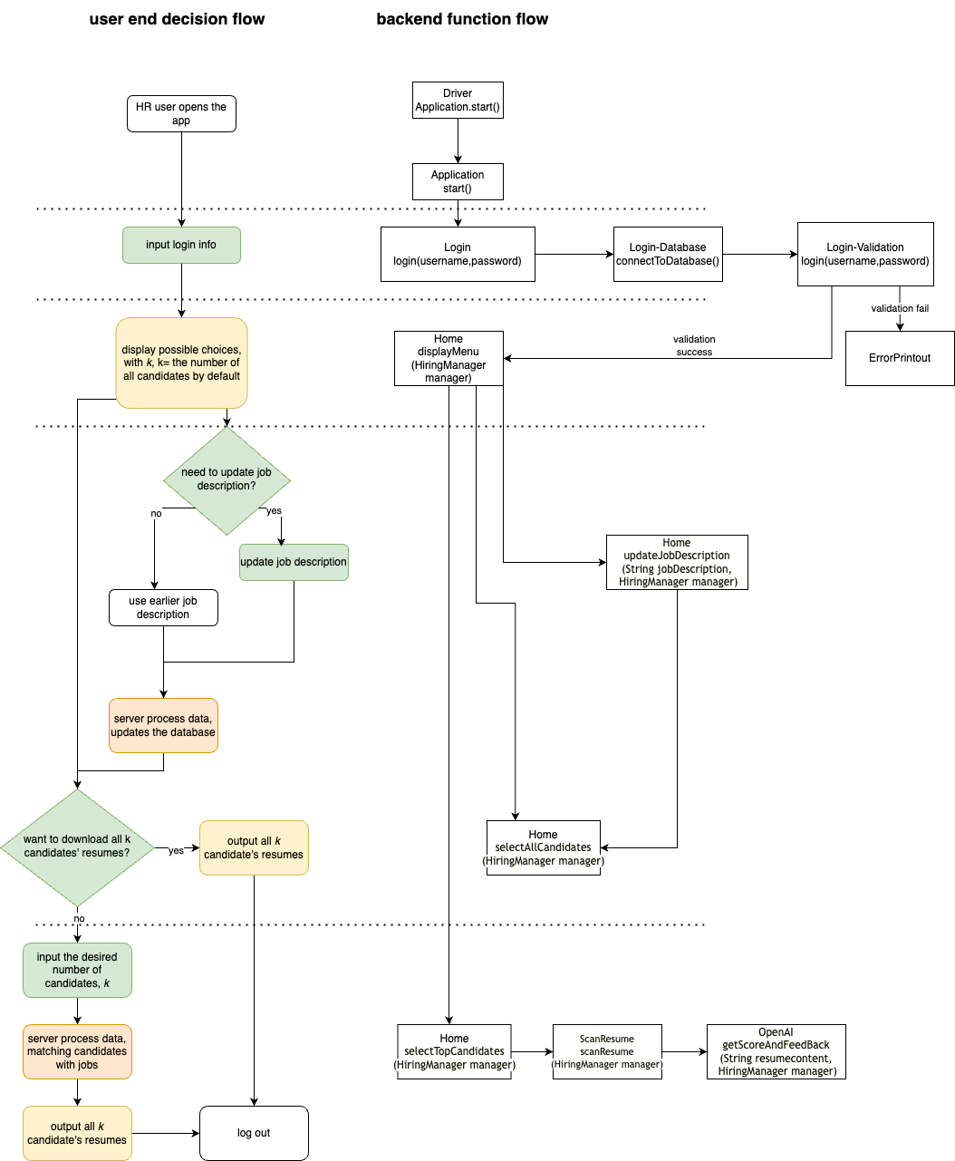
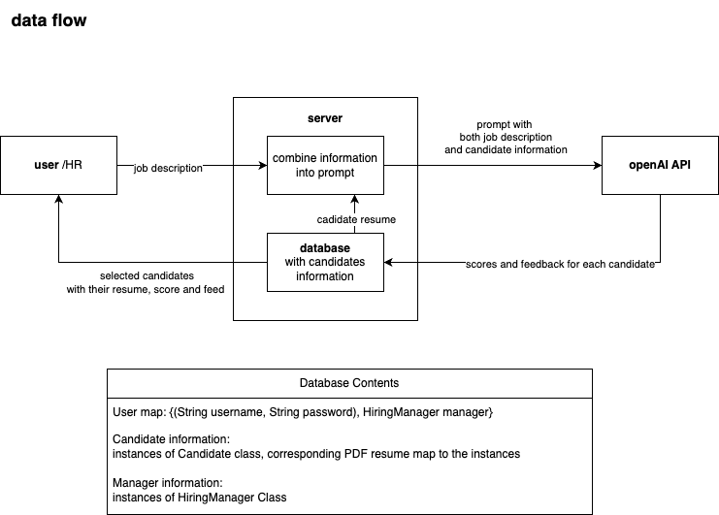
System Design Diagram: Sequence Diagram

