Slide 1
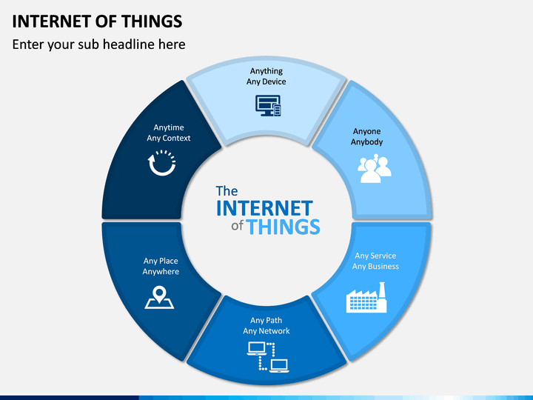
Internet of Things
Session 1 – Basic networking elements and Node MCU ( esp8266)

Slide 2
Difference between (I)nternet and (i)nternet
The internet refers to any interconnection of computer network that can communicate and share files with each other. It may be owened by two or more organizations ( for example google, facebook)
The Internet (big “I”) is the world wide network comprising of all other networks interconnected and communicating on the open Web. The IP addresses and DNS names are organized and issued by organization designated by the host country.

Slide 3
What is IP(public and private) address ?
A Public IP address is an IP address that can be accessed over the Internet. Like postal address used to deliver a postal mail to your home, a public IP address is the globally unique IP address assigned to a computing device.
Private IP address, on the other hand, is used to assign computers within your private space without letting them directly expose to the Internet.

Slide 4
What happens when you type an URL?
DNS Search – searches the browser, OS, ISP cache if the requested URL is not found it performs a DNS query to find the ip address.
Browser enables a TCP connection with server.
Browser sends a HTTP request to the server.
Server handles the request and sends a HTTP response
The browser displays the HTML content.

Slide 5
What is IoT ?
A raw Internet searched explanation :
The Internet of Things (IoT) is a system of interrelated computing devices, mechanical and digital machines, objects, animals or people that are provided with unique identifiers and the ability to transfer data over a network without requiring human-to-human or human-to-computer interaction.

Slide 6
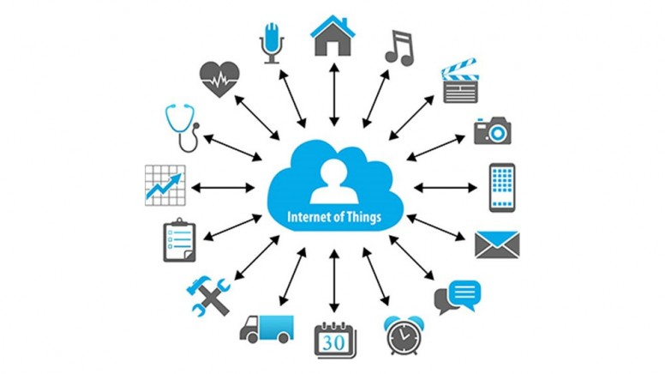
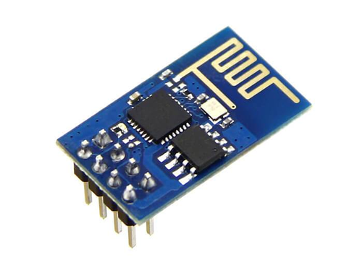
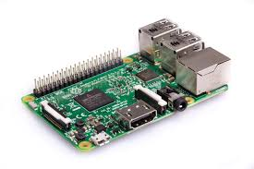
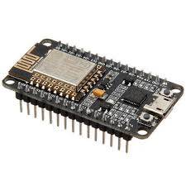
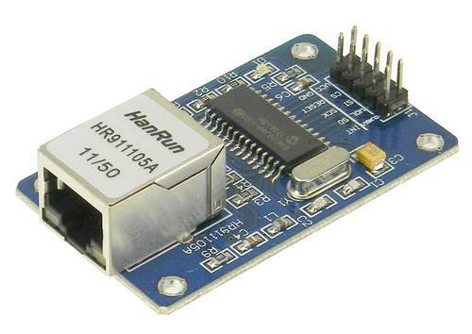
Cloud
IoT device
Gateway

Slide 7
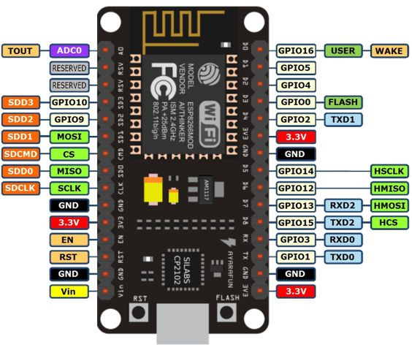
Node MCU pinout
The node MCU pinout is not convectionally numbered like the arduino so use the pinout to program the GPIO pins.

Slide 8
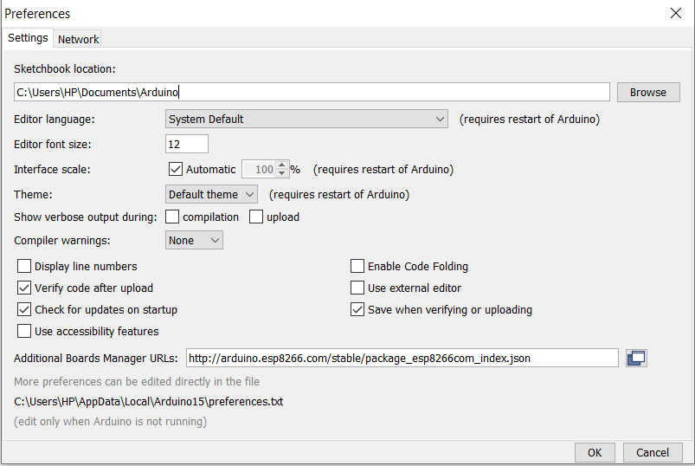
Getting started with Arduino IDE
Download the latest version of Arduino IDE from the official site.
Open the IDE and go to File --> preferences. In additional board manager URL type http://arduino.esp8266.com/stable/package_esp8266com_index.json

Slide 9
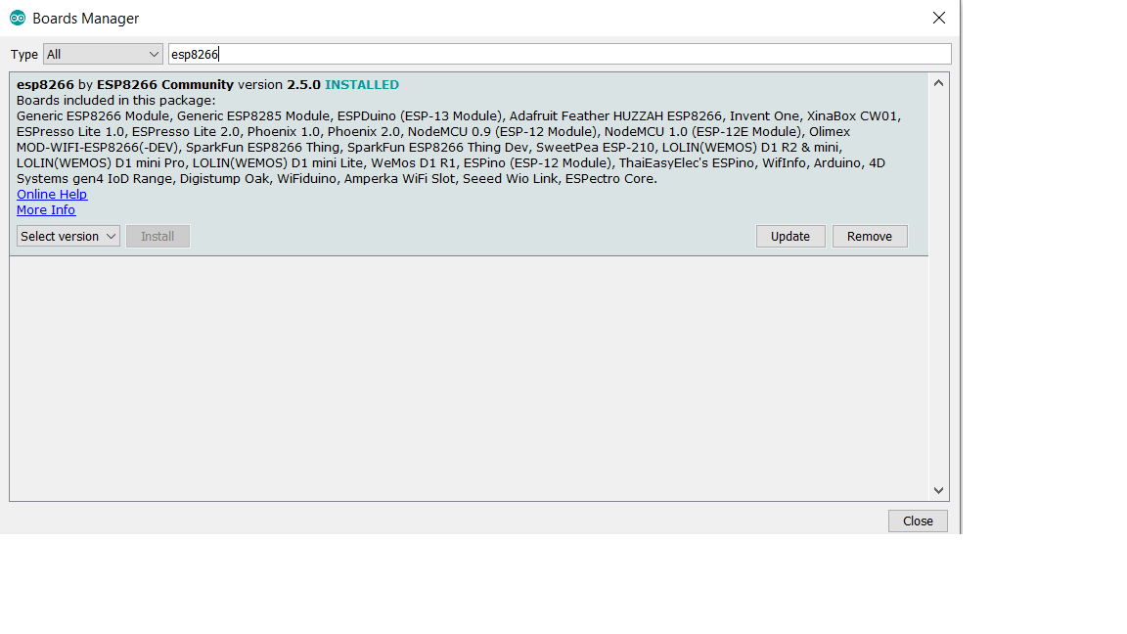
Getting started with Arduino IDE continued..
Open the IDE and go to Tools --> Board --> Board Manager
Search esp8266 and install the latest version available.

Slide 10
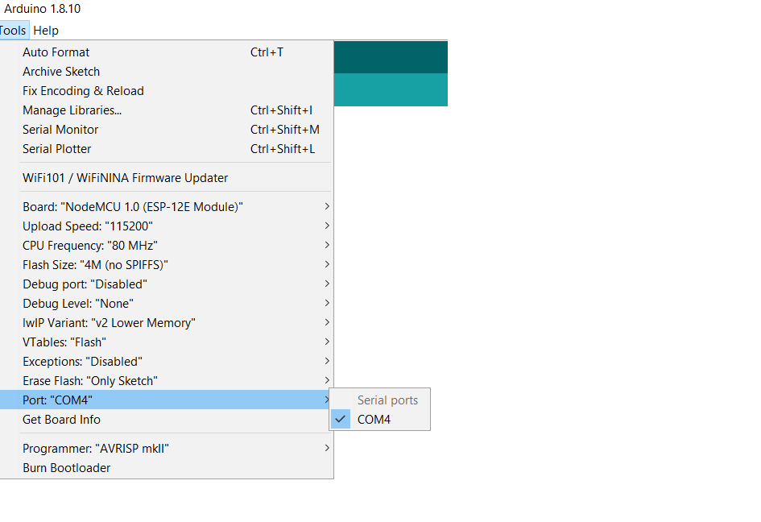
Continued..
After the procedure you should be able to select the com port from tools.
If the port is not visible then you will have to update your com port from Device manager. Search for Device manager on your device : Device Manager --> Com port --> update driver

Slide 11
TUNIOT
TUNIOT provides an easier way to code in the Arduino IDE (http://www.easycoding.tn/tuniot/demos/code/ )
You only need to know the logic.
Disconnect from other networks
Start new connection
Provide the network credentials
Start loop
Wait for connection

Slide 12
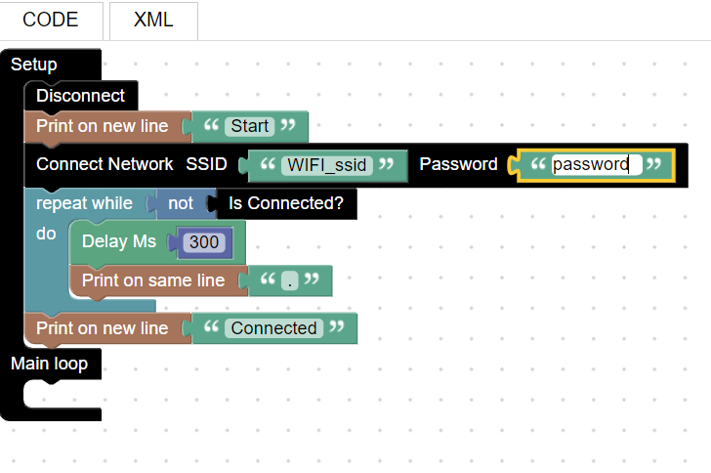
TUNIOT continued..

Slide 13
Continued..
Get the code corresponding to the blocks and paste it in the Arduino IDE.
Select the corresponding board and com port
Upload the code
Open the Serial monitor

Slide 14
THANK YOU

